Slide 1
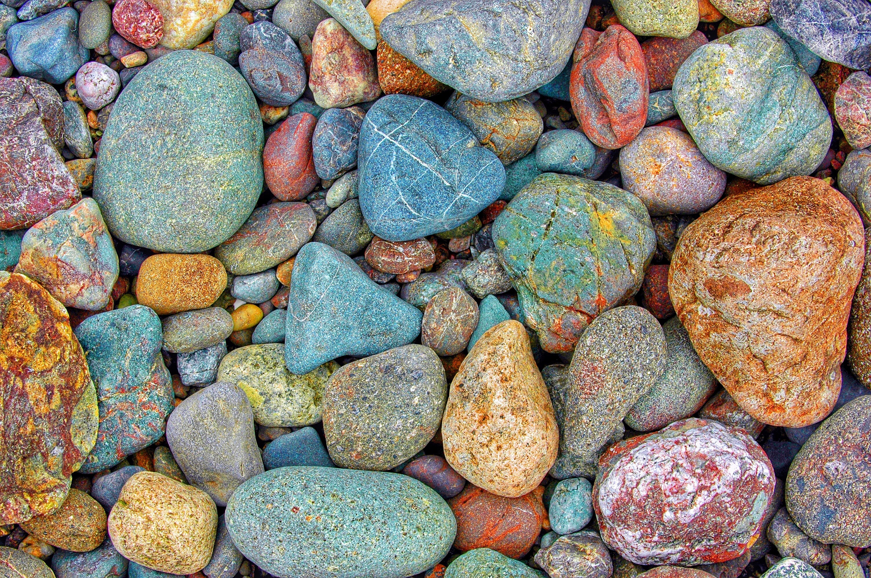

GALE PRESENTS: NATIONAL GEOGRAPHIC KIDS
Rocks and Minerals Escape Room

Slide 2
TABLE OF CONTENTS
1 | Cover
2 | Table of Contents
3-4 | Escape Room Instructions and Arrangements
5 | Resource Access
6 | Printing Suggestions for Activities
7 | Answer Sheet
8 | Teacher Answer Key
9-13 | Individual Task Answer Keys
14-15 | Description Cards for Stations or Folders
16 | Task 1 Directions: What is a Rock? What is a Mineral?
17 | Task 1 Mystery Picture - Questions
18 | Task 1 Mystery Picture – Coloring Sheet
19 | Task 2 Directions: The Rock Cycle
20 | Task 2 Matching Activity
21 | Task 3 Directions: Rocks as Resources
22 | Task 3 Fill-In-The-Blank Questions
23 | Task 4 Directions: Cool Things about Rocks & Minerals
24 | Task 4 Tarsia Puzzle
25 | Task 5 Directions: Calling All Rockhounds!
26-29 | Task 5 Matching Activity

Slide 3
GENERAL INSTRUCTIONS
BEFORE
Print and organize all necessary activity materials (see Printing Suggestions). Some stations consist of cut-and-sort activities. You can choose to have students cut these as they progress and then sort or, you can have them cut and placed in envelopes or folders before they begin.
Tasks can be set up as stations or as completion tasks where groups remain in one location. In either setup, it is important to have materials prepared that equal the number of groups. Having a folder/envelope for each task is best practice.
Gale resources should be accessed through the Gale Presents: National Geographic Kids resource. (See Resource Access page).
DURING
Walk around the room and assist groups when necessary. Each time a group finishes a task, check their code to approve them to go onto the next one.
AFTER
Review reading material with students. This activity works well as an introduction to a topic, or as a culminating activity at the end of a unit. Students can reflect about what they learned during the activity with reflection writing or use what they learned as a starting point for a deeper research project.
TASK-SPECIFIC INSTRUCTIONS
TASK 1:
Instructions: Students will read the assigned section of the “Absolute Expert: Rocks and Minerals” (pg. 19-20) eBook via Gale Presents: National Geographic Kids. As they read, they will answer the accompanying multiple-choice questions. Using the color key, students will then color the blank mystery picture document, eventually revealing a volcano, which is their code for Task 1. See the answer key on pg.10 for what the finished picture will look like if colors/answers are correct.
Arrangements: If students are working in groups, have them divide labor among themselves, or provide each team member with their own coloring sheet. See Resource Access for best practices on sharing Gale content with students.

Slide 4
TASK 2:
Instructions: Students will read the assigned section of the Gale Presents: National Geographic Kids eBook “Everything Rocks & Minerals” on the rock cycle (pg. 23). They will then match each portion of the rock cycle illustrated to its correct description, using the image from the eBook as a guide. I recommend using a ruler for straight lines on the matching assignment. The letters that do not have a line through them at the end reveal the code, which is lava. Straight lines are essential. See pg. 11for an answer key.
Arrangements: This is a single answer sheet, so one sheet per group is recommended with students working together and assigning roles. For this one, it is recommended that one student use the ruler to match correct options to ensure lines are straight. See Resource Access for best practices on sharing Gale content with students.
TASK 3:
Instructions: Students will read the assigned section of the Gale Presents: National Geographic Kids eBook “Everything Rocks & Minerals” (pg. 15). They will fill in the blanks of the accompanying questions. When they put these answers on their answer sheet, the shaded letters will reveal the code word cores. See pg. 12 for an answer key.
Arrangements: There are two question sheets per page to save on copies. One answer sheet should be given to each group. See Resource Access for best practices on sharing Gale content with students.
TASK 4:
Instructions: Students will read the assigned section of the Gale Presents: National Geographic Kids magazine article “35 Cool Things About Rocks and Minerals”. Students will then complete the Tarsia puzzle by connecting the sides of each triangle to their corresponding question. They will end with a hexagon shape. Their code is a famous Neil Armstrong quote, which will be visible once you complete the puzzle. See pg. 13 for an answer key.
Arrangements: The activity for this is a cut-and-sort activity. You can have students cut them and then sort or have them precut and stored in an envelope or bag. See Resource Access to determine how you want to share reading materials with your students.
TASK 5:
Instructions: Students will read the assigned section of the Gale Presents: National Geographic Kids eBook “Ultimate Explorer Field Guide: Rocks & Minerals” (pg. 146). Using the images from the page, students will complete the matching acvitity and record their answers on the group answer sheet. At the end, there will be 7 letters that are shaded. Students will unscramble these letters for their final code which is mineral. See pg. 14 for an answer key.
Arrangements: The activity for this is a cut-and-sort activity. You can have students cut them and then sort or have them precut and stored in an envelope or bag. See Resource Access to determine how you want to share reading materials with your students.

Slide 5





RESOURCE ACCESS
The best way to have students access task articles it to have them visit Gale Presents: National Geographic Kids and then open the links for each task using the links below.
Task 1: What is a Rock? What is a Mineral? | https://link.gale.com/apps/doc/UGRBLX909146455/NGMK?&sid=bookmark-NGMK&xid=91d132f6&pg=19
Task 2: The Rock Cycle | https://link.gale.com/apps/doc/JDBDNT273642099/NGMK?&sid=bookmark-NGMK&xid=6ce1ce10&pg=23
Task 3: Rocks as Resources | https://link.gale.com/apps/doc/JDBDNT273642099/NGMK?&sid=bookmark-NGMK&xid=6ce1ce10&pg=15
Task 4: Cool Things about Rocks & Minerals | https://link.gale.com/apps/doc/GSGBVM852551519/NGMK?&sid=bookmark-NGMK&xid=1252d0b1
Task 5: Rock Matching | https://link.gale.com/apps/doc/LOLNSR487130022/NGMK?&sid=bookmark-NGMK&xid=cc2f30d7&pg=146
TASK1 | TASK 2 | TASK 3
TASK 4 | TASK 5 | Tip: You can also use these QR codes for students to scan!

Slide 6
PRINTING SUGGESTIONS
Page 7 | Answer Sheet
Pages 8-14 | Teacher Answer Key(s)
Pages 15-17 | Description Cards for Stations or Folders (optional)
Page 16 | Task 1 Direction Cards (2 per page)
Page 17 | Task 1 Questions
Page 18 | Task 1 Coloring Sheet
Page 19 | Task 2 Direction Cards (2 per page)
Page 20 | Task 2 Matching Activity
Page 21 | Task 3 Direction Cards (2 per page)
Page 22 | Task 3 Fill-In-The-Blank Questions (2 per page)
Page 23 | Task 4 Direction Cards (2 per page)
Page 24 | Task 4 Tarsia Puzzle (cut-and-sort)
Page 25 | Task 5 Direction Cards (2 per page)
Pages 26-29 | Task 5 Matching Activity (cut-and-sort)
Notes:
Some documents are 2-per page to decrease the number of needed copies. Once cut-and-sort activities are printed and cut out, it is recommended to keep them in an envelope or bag for each group. Consider laminating for future use.
It is recommended that you make 1 copy per student of the coloring sheet (page 18).

Slide 7



ANSWER
SHEET
Gale Presents: National Geographic Kids
Rocks and Minerals Escape Room
Group Members:
TASK 1
TASK 2
TASK 3
1.
2.
3.
4.
5.
CODE
TASK 4
SECRET QUOTE: “__________________________________________
___________________________________________________________”.
-___________________________________
TASK 5
1 | 2 | 3 | 4 | 5 | 6 | 7 | 8 | 9 | 10 | 11 | 12
13 | 14 | 15 | 16 | 17 | 18 | 19 | 20 | 21 | 22 | 23 | 24
UNSCRAMBLED WORD: ___ ___ ___ ___ ___ ___ ___

Slide 8

ANSWER
KEY
Gale Presents: National Geographic Kids
Rocks and Minerals Escape Room
Group Members:
TASK 1 | V | O | L | C | A | N | O
TASK 2
TASK 3
1. | C | H | I | N | A
2. | G | O | L | D
3. | P | E | R | U
4. | S | T | E | E | L
5. | D | I | A | M | O | N | D | S
L
A
V
A
CODE | C | O | R | E | S
TASK 4
Secret Quote:
“Geologists have a saying – rocks remember”.
-Neil Armstrong
TASK 5
I | U | J | K | E | Q | X | B | L | T | D | V
1 | 2 | 3 | 4 | 5 | 6 | 7 | 8 | 9 | 10 | 11 | 12
R | G | O | H | A | C | N | W | S | F | P | M
13 | 14 | 15 | 16 | 17 | 18 | 19 | 20 | 21 | 22 | 23 | 24
UNSCRAMBLED WORD: _M_ _I_ _N_ _E_ _R_ _A_ _L_

Slide 9
TASK 1 – ANSWER KEY
1. What are minerals primarily made of?
A) Molecules
B) Atoms
C) Cells
2. How are sedimentary rocks formed?
D) By the cooling of magma and lava
E) By the pressure of sediment layers
F) By the erosion and sedimentation of existing rocks
3. What determines the appearance of a mineral?
G) Its size
H) Its elemental composition and crystal arrangement
I) Its color
4. How do intrusive igneous rocks cool?
A) They cool quickly on Earth's surface.
B) They cool rapidly during volcanic eruptions.
C) They cool slowly underground.
5. What is the difference between a mineral and a rock?
D) Rocks are made of minerals, while minerals are not made of rocks.
E) Minerals are made of rocks, while rocks are not made of minerals.
F) Minerals are alive, while rocks are not.
6. How are minerals formed?
G) By cooling lava or evaporating ocean water
H) By living organisms
I) By heating and pressurizing rocks
7. What is an example of an intrusive igneous rock?
A) Granite
B) Basalt
C) Marble
8. What is a rock?
D) A liquid substance
E) A solid, natural substance made of one or more minerals
F) A living organism
9. How is metamorphic rock formed?
G) By the cooling of magma and lava
H) By the pressure of sediment layers
I) By the rearrangement of elements under high heat and pressure
KEY
A DARK RED | D LIGHT RED | G BROWN
B YELLOW | E GREY | H GREEN
C ORANGE | F BLACK | I BLUE

Slide 10
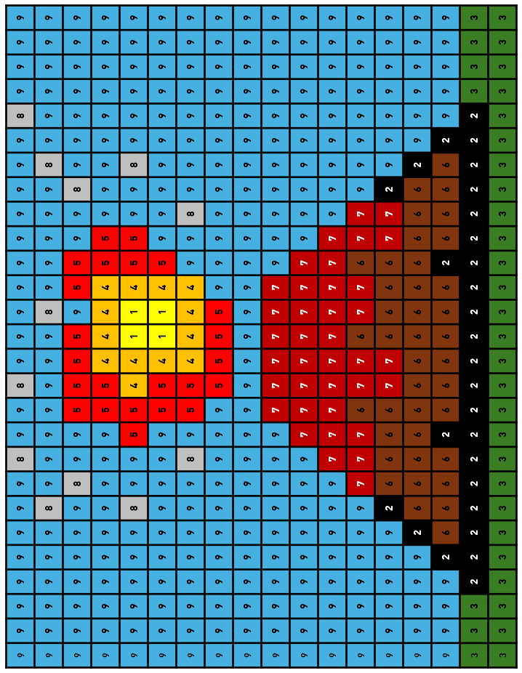
TASK 1 – ANSWER KEY
CODE: VOLCANO

Slide 11
TASK 2 – ANSWER KEY
Volcano | · |  | · | Rocks from the surface get buried and pushed back into the Earth where they are heated and squeezed. The minerals slowly change to form metamorphic rocks.
Tectonic Action | · |  | · | Wind, rain, and ice break down rocks to form sediment. The sediment is carried downhill and deposited in lakes or the ocean.
Erosion And Deposition | · |  | · | Mineral-rich water evaporates, causing crystals of sedimentary rocks to grow.
Lithification | · |  | · | Underground heat causes minerals to melt to form magma. Some of this magma moves to the surface to form lava, and some cools in place to form new plutonic igneous rocks.
Magma | · |  | · | New igneous rocks form from cold lava flowing out of volcanoes at the Earth's surface.
Evaporation | · |  | · | Loose sediment gets compacted and cemented together to form new sedimentary rocks.
C
L
R
A
S
D
H
V
E
A
CODE: LAVA
Notes:
The letters without a line through them after all questions are answered correctly reveals the code “lava”.

Slide 12
_____China______ is the country that produces both the most salt and the most coal.
______Gold______ is used for decorative items, jewelry, and electronic components.
______Peru______ is the country that produces the most silver.
Iron ore is used to make ______steel______, one of the most important construction materials.
The only rock that the United States is not a top 10 producer of on this page is ______diamonds_____.
TASK 3 – ANSWER KEY
Notes:
On the answer sheet, there will be shaded letters in each answer revealing a secret code word, which is “cores”.

Slide 13
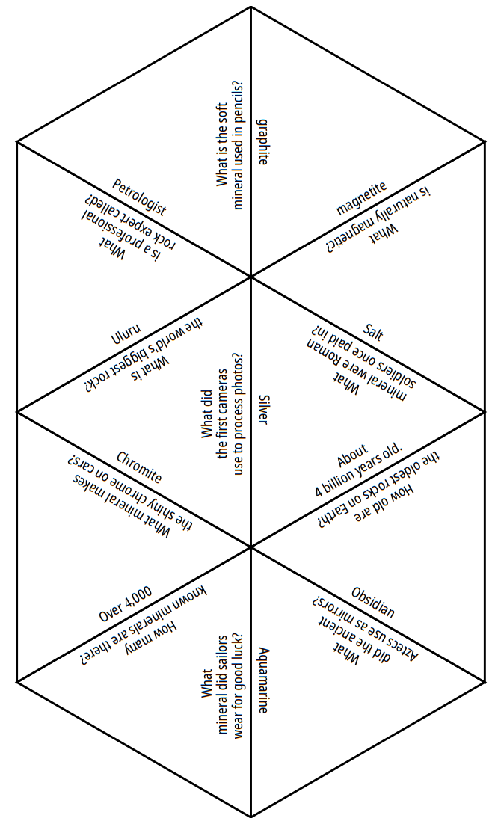
TASK 4 – ANSWER KEY
SECRET PHRASE : Geologists have a saying – rocks remember.
– Neil Armstrong
-
saying
rocks
a
remember.
have
-Neil Armstrong
Geologists
Notes:
When the questions and answers are match accordingly, students will end with a hexagon shape. The words on the outer perimeter reveal the secret quote.

Slide 14
TASK 5 – ANSWER KEY
1 | I – Basalt | 13 | R – Obsidian
2 | U - Granite | 14 | G – Schist
3 | J - Gneiss | 15 | O – Quartzite
4 | K – Rhyolite | 16 | H – Sandstone
5 | E - Granite pegmatite | 17 | A - Rock salt
6 | Q – Amphibolite | 18 | C – Conglomerate
7 | X – Andesite | 19 | N – Coal
8 | B – Slate | 20 | W – Coquina
9 | L – Marble | 21 | S – Shale
10 | T – Scoria | 22 | F – Chert
11 | D – Phyllite | 23 | P – Limestone
12 | V - Soapstone | 24 | M - Rock gypsum
UNSCRAMBLED WORD: MINERAL
Notes:
The shaded letters will be unscrambled to reveal the final code, “mineral”.

Slide 15

TASK 1
TASK 1
Use the Task 1 resources to complete your task and crack the code! Be sure to record answers on our group answer sheet.
Use the Task 1 resources to complete your task and crack the code! Be sure to record answers on our group answer sheet.
WHAT IS A ROCK?
WHAT IS A MINERAL?
WHAT IS A ROCK?
WHAT IS A MINERAL?
TASK 2
TASK 2
Use the Task 2 resources to complete your task and crack the code! Be sure to record answers on our group answer sheet.
Use the Task 2 resources to complete your task and crack the code! Be sure to record answers on our group answer sheet.
THE ROCK CYCLE
THE ROCK CYCLE
Notes:
These task cards can be printed and placed on the folder or envelope you use for each task. For example, print task cards equal to the number of class groups. Attach the task cards to folders, which inside would have the activities and necessary supplies for each task.

Slide 16

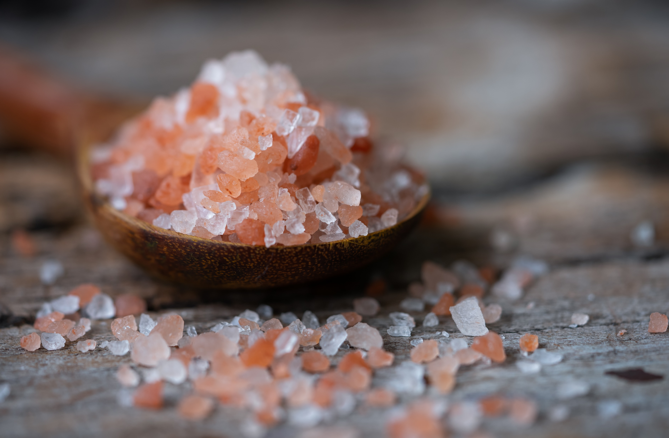
TASK 3
TASK 3
Use the Task 3 resources to complete your task and crack the code! Be sure to record answers on our group answer sheet.
Use the Task 3 resources to complete your task and crack the code! Be sure to record answers on our group answer sheet.
ROCKS AS RESOURCES
ROCKS AS RESOURCES
TASK 4
TASK 4
Use the Task 4 resources to complete your task and crack the code! Be sure to record answers on our group answer sheet.
COOL THINGS ABOUT ROCKS & MINERALS
Use the Task 4 resources to complete your task and crack the code! Be sure to record answers on our group answer sheet.
COOL THINGS ABOUT ROCKS & MINERALS
Notes:
These task cards can be printed and placed on the folder or envelope you use for each task. For example, print task cards equal to the number of class groups. Attach the task cards to folders, which inside would have the activities and necessary supplies for each task.

Slide 17

TASK 5
TASK 5
Use the Task 3 resources to complete your task and crack the code! Be sure to record answers on our group answer sheet.
Use the Task 3 resources to complete your task and crack the code! Be sure to record answers on our group answer sheet.
CALLING ALL ROCKHOUNDS!
CALLING ALL ROCKHOUNDS!
Notes:
These task cards can be printed and placed on the folder or envelope you use for each task. For example, print task cards equal to the number of class groups. Attach the task cards to folders, which inside would have the activities and necessary supplies for each task.

Slide 18
TASK 1
WHAT IS A ROCK?
WHAT IS A MINERAL?
Rocks are pieces of hard minerals. Rocks come from nature. Rocks are all over the world. They are part of Earth’s surface.
Nature makes new rocks all the time. Old rocks break down over time, too.
Rocks are useful. People use rocks in many ways.
Directions: Read the assigned section of the Gale Presents: National Geographic Kids eBook “Absolute Expert: Rocks and Minerals”. Answer the multiple-choice questions based on the text. After answering the questions, use the key to color the picture. Show the picture to your teacher to approve. Your code is the name of what is being shown in the picture.
- - - - - - - - - - - - - - - - - - - - - - - - - - - - - - - - - - - - - - - - - - - - - - - - - - - - - - -
TASK 1
WHAT IS A ROCK?
WHAT IS A MINERAL?
Rocks are pieces of hard minerals. Rocks come from nature. Rocks are all over the world. They are part of Earth’s surface.
Nature makes new rocks all the time. Old rocks break down over time, too.
Rocks are useful. People use rocks in many ways.
Directions: Read the assigned section of the Gale Presents: National Geographic Kids eBook “Absolute Expert: Rocks and Minerals”. Answer the multiple-choice questions based on the text. After answering the questions, use the key to color the picture. Show the picture to your teacher to approve. Your code is the name of what is being shown in the picture.
Notes:
2 per page to save on copies

Slide 19
Answer the following questions based on the text “Absolute Expert: Rocks and Minerals”. After answering the questions, use the key to color the picture.
1. What are minerals primarily made of?
A) Molecules
B) Atoms
C) Cells
2. How are sedimentary rocks formed?
D) By the cooling of magma and lava
E) By the pressure of sediment layers
F) By the erosion and sedimentation of existing rocks
3. What determines the appearance of a mineral?
G) Its size
H) Its elemental composition and crystal arrangement
I) Its color
4. How do intrusive igneous rocks cool?
A) They cool quickly on Earth's surface.
B) They cool rapidly during volcanic eruptions.
C) They cool slowly underground.
5. What is the difference between a mineral and a rock?
D) Rocks are made of minerals, while minerals are not made of rocks.
E) Minerals are made of rocks, while rocks are not made of minerals.
F) Minerals are alive, while rocks are not.
6. How are minerals formed?
G) By cooling lava or evaporating ocean water
H) By living organisms
I) By heating and pressurizing rocks
7. What is an example of an intrusive igneous rock?
A) Granite
B) Basalt
C) Marble
8. What is a rock?
D) A liquid substance
E) A solid, natural substance made of one or more minerals
F) A living organism
9. How is metamorphic rock formed?
G) By the cooling of magma and lava
H) By the pressure of sediment layers
I) By the rearrangement of elements under high heat and pressure
KEY
A DARK RED | D LIGHT RED | G BROWN
B YELLOW | E GREY | H GREEN
C ORANGE | F BLACK | I BLUE
Notes:
Use the key to correctly color the image. For example, if the answer to question 1 is B, then I would color all the number 1s on the image black.

Slide 20

Notes:
Use the key to correctly color the image. For example, if the answer to question 1 is B, then I would color all the number 1s on the image black.
It is recommended that you have a coloring sheet for every student in the group.

Slide 21
TASK 2
THE ROCK CYCLE
Rocks do not seem to do anything. They just stay in one place. They never seem to move.
But rocks are always changing. They change very slowly. People cannot usually see it happen.
The ways rocks change is called the rock cycle. The rock cycle can change single rocks.
Directions: Read the assigned section of the Gale Presents: National Geographic Kids eBook “Everything Rocks & Minerals” on the rock cycle. Correctly match each part of the rock cycle with its description by drawing a line to connect them. At the end, the letters with no line through them will reveal your code.
Tip – use a ruler to get extra straight lines!
- - - - - - - - - - - - - - - - - - - - - - - - - - - - - - - - - - - - - - - - - - - - - - - - - - - - - - -
TASK 2
THE ROCK CYCLE
Rocks do not seem to do anything. They just stay in one place. They never seem to move.
But rocks are always changing. They change very slowly. People cannot usually see it happen.
The ways rocks change is called the rock cycle. The rock cycle can change single rocks.
Directions: Read the assigned section of the Gale Presents: National Geographic Kids eBook “Everything Rocks & Minerals” on the rock cycle. Correctly match each part of the rock cycle with its description by drawing a line to connect them . At the end, the letters with no line through them will reveal your code.
Tip – use a ruler to get extra straight lines!

Slide 22
Correctly match each part of the rock cycle with its description by drawing a line to connect them. At the end, the letters with no line through them will reveal your code. Tip – use a ruler to get extra straight lines!
Volcano | · |  | · | Rocks from the surface get buried and pushed back into the Earth where they are heated and squeezed. The minerals slowly change to form metamorphic rocks.
Tectonic Action | · |  | · | Wind, rain, and ice break down rocks to form sediment. The sediment is carried downhill and deposited in lakes or the ocean.
Erosion And Deposition | · |  | · | Mineral-rich water evaporates, causing crystals of sedimentary rocks to grow.
Lithification | · |  | · | Underground heat causes minerals to melt to form magma. Some of this magma moves to the surface to form lava, and some cools in place to form new plutonic igneous rocks.
Magma | · |  | · | New igneous rocks form from cold lava flowing out of volcanoes at the Earth's surface.
Evaporation | · |  | · | Loose sediment gets compacted and cemented together to form new sedimentary rocks.
C
L
R
A
S
D
H
V
E
A
Notes:
Students will match the correct answer to its corresponding question. Use a ruler to ensure straight lines. At the end, when all questions are answered correctly, the secret code will be revealed via the letters with no line through them. The code is “lava”.

Slide 23
TASK 3
ROCKS AS RESOURCES
When people think of natural resources, rocks are not usually at the top of the list, but rocks are surprisingly important resources.
Most of the metals we use come from mineral ores. Iron, copper, aluminum, nickel, lead, and zinc are all mine from the rocks in the ground.
Most of the energy we use also comes from rocks. Fossil fuels such as coal, oil, and natural gas are used to heat homes; power cars, plans, and trains; and generate electricity.
Directions: Read the assigned section of the Gale Presents: National Geographic Kids eBook “Everything Rocks & Minerals”. Answer the questions by filling in the blank with the correct answer. Once entered on your answer sheet, the shaded boxes will reveal your code word.
- - - - - - - - - - - - - - - - - - - - - - - - - - - - - - - - - - - - - - - - - - - - - - - - - - - - - - -
TASK 3
ROCKS AS RESOURCES
When people think of natural resources, rocks are not usually at the top of the list, but rocks are surprisingly important resources.
Most of the metals we use come from mineral ores. Iron, copper, aluminum, nickel, lead, and zinc are all mine from the rocks in the ground.
Most of the energy we use also comes from rocks. Fossil fuels such as coal, oil, and natural gas are used to heat homes; power cars, plans, and trains; and generate electricity.
Directions: Read the assigned section of the Gale Presents: National Geographic Kids eBook “Everything Rocks & Minerals”. Answer the questions by filling in the blank with the correct answer. Once entered on your answer sheet, the shaded boxes will reveal your code word.

Slide 24
_____________ is the country that produces both the most salt and the most coal.
_____________ is used for decorative items, jewelry, and electronic components.
_____________ is the country that produces the most silver.
Iron ore is used to make _____________, one of the most important construction materials.
The only rock that the United States is not a top 10 producer of on this page is _____________.
- - - - - - - - - - - - - - - - - - - - - - - - - - - - - - - - - - - - - - - - - - - - - - - - - - - - - - -
_____________ is the country that produces both the most salt and the most coal.
_____________ is used for decorative items, jewelry, and electronic components.
_____________ is the country that produces the most silver.
Iron ore is used to make _____________, one of the most important construction materials.
The only rock that the United States is not a top 10 producer of on this page is _____________.
Notes:
Students will record their one-word answers into the Task 23section of their answer key.
The shaded boxes will reveal their code, which they will record. The code is “cores”

Slide 25
TASK 4
COOL THINGS ABOUT
ROCKS & MINERALS
Why are these geological wonders so fascinating?
From their diverse formations and stunning colors to their historical significance, rocks and minerals hold countless surprises!
Directions: Read the assigned section of the Gale Presents: National Geographic Kids magazine article “35 Cool Things About Rocks and Minerals”. Match each question to its correct answer. Your end shape will be a hexagon. The outer perimeter will reveal a secret message quote!
- - - - - - - - - - - - - - - - - - - - - - - - - - - - - - - - - - - - - - - - - - - - - - - - - - - - - - -
TASK 4
COOL THINGS ABOUT
ROCKS & MINERALS
Why are these geological wonders so fascinating?
From their diverse formations and stunning colors to their historical significance, rocks and minerals hold countless surprises!
Directions: Read the assigned section of the Gale Presents: National Geographic Kids magazine article “35 Cool Things About Rocks and Minerals”. Match each question to its correct answer. Your end shape will be a hexagon. The outer perimeter will reveal a secret message quote!

Slide 26

rocks
-
What is the world’s biggest rock?
What is a professional rock expert called?
What is the soft mineral used in pencils?
Uluru
graphite
Petrologist
Chromite
saying
What did the first cameras use to process photos?
Magnetite
What is naturally magnetic?
Salt
What mineral were Roman soldiers once paid in?
What mineral makes the shiny chrome on cars?
a
Over 4,000
Silver
remember.
About 4 billion years old.
How many known minerals are there?
How old are the oldest rocks on Earth?
have
-Neil Armstrong
Obsidian
What mineral did sailors wear for good luck?
What did the ancient Aztecs use as mirrors?
Aquamarine
Geologists
Notes:
When the questions and answers are match accordingly, students will end with a hexagon shape. The words on the outer perimeter reveal the secret quote.

Slide 27
TASK 5
CALLING ALL ROCKHOUNDS!
Rocks are all around you, whether you're in your backyard or on a family vacation to a national park.
These profiles will help you quickly identify some key rocks. See if you can find them again on your next rock-hunting adventure.
Directions: Read the assigned section of the Gale Presents: National Geographic Kids eBook “Ultimate Explorer Field Guide: Rocks & Minerals”. Match each question rock to its correct name. Unscramble the letters in the shaded boxes on your answer sheet to get your final code and escape!
- - - - - - - - - - - - - - - - - - - - - - - - - - - - - - - - - - - - - - - - - - - - - - - - - - - - - - -
TASK 5
CALLING ALL ROCKHOUNDS!
Rocks are all around you, whether you're in your backyard or on a family vacation to a national park.
These profiles will help you quickly identify some key rocks. See if you can find them again on your next rock-hunting adventure.
Directions: Read the assigned section of the Gale Presents: National Geographic Kids eBook “Ultimate Explorer Field Guide: Rocks & Minerals”. Match each question rock to its correct name. Unscramble the letters in the shaded boxes on your answer sheet to get your final code and escape!

Slide 28
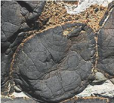
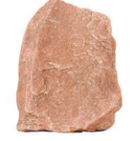
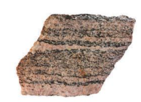
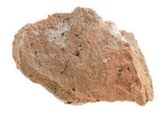
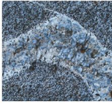
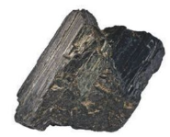
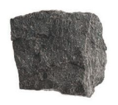
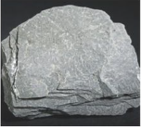

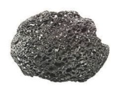
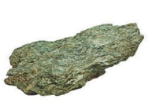
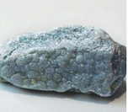
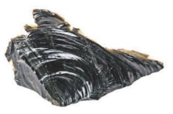
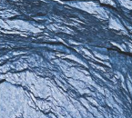
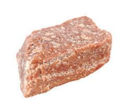
1 | 2 | 3
4 | 5 | 6
7 | 8 | 9
10 | 11 | 12
13 | 14 | 15

Slide 29
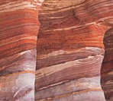
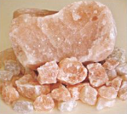
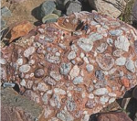
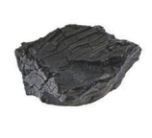
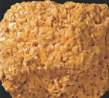
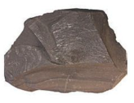
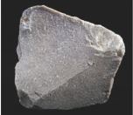
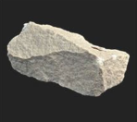
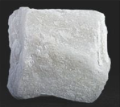
16 | 17 | 18
19 | 20 | 21
22 | 23 | 24
A | B | C
D | E | F
ROCK SALT
SLATE
CONGLOMERATE
PHYLLITE
GRANITE
PEGMATITE
CHERT

Slide 30
G | H | I
J | K | L
M | N | O
P | Q | R
S | T | U
SCHIST
SANDSTONE
BASALT
GNEISS
RHYOLITE
MARBLE
ROCK
GYPSUM
COAL
QUARTZITE
LIMESTONE
APMHIBOLITE
OBSIDIAN
SHALE
SCORIA
GRANITE

Slide 31
V | W | X
SOAPSTONE
COQUINA
ANDESITE

