Slide 1
Gale Interactive: Chemistry

Slide 2
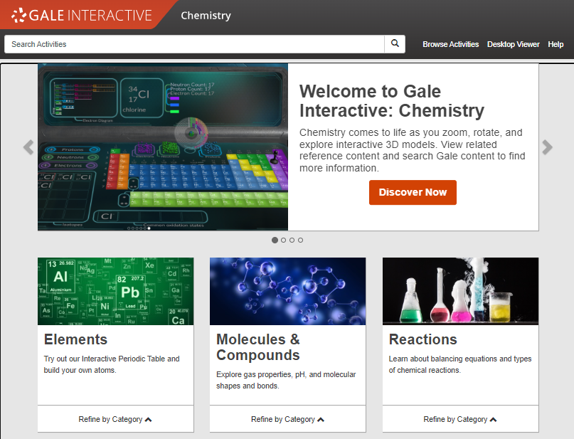
GALE INTERACTIVE: CHEMISTRY
INTERACTIVE MODELS FOR HIGH SCHOOL AND BEYOND
Over 100 models that explore different concepts within Chemistry like elements, molecules, compounds, reactions, & more!
SUPPLEMENTAL CONTENT
Reference materials support a deeper understanding of the topics.
SHARE THE INFORMATION
Send activities to patrons, or link in your social media accounts.
Notes:
Gale Interactive: Chemistry gives middle and high schoolers the power to see science beyond static text. With over 100 interactive activities, learners are inspired to achieve the ultimate outcome—discovery.
Guided interactive lessons match course objectives and provide students with a flexible and robust learning experience paired with supplemental written content from other resources such as Gale In Context: Science and Gale OneFile.
Extend the reach of your resources. Integrated G Suite for Education and Microsoft Office 365 tools enable users to easily share, save, and download content— including highlights and notes.

Slide 3
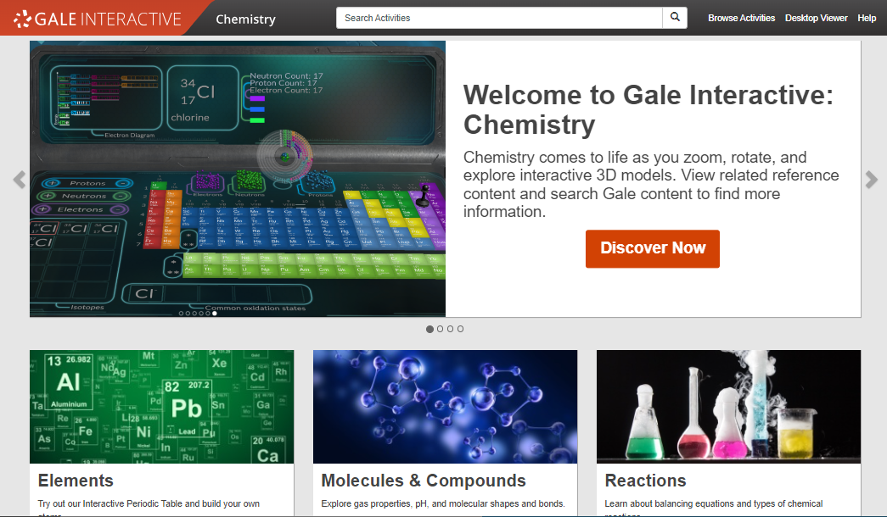
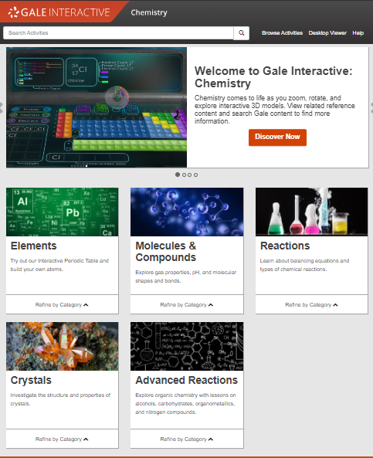
ACCESS ANYWHERE
Anytime
Anywhere
Any Device
Without Ads or Paywalls
WWW.LIBRARYRESOURCESURL.EDU
Notes:
Customize the library access URL on this slide before presenting.
All of the content in Gale Interactive: Human Anatomy can be accessed by you and your learners 24/7 on any device, no matter where you are. Your entire class can look at the same interactive at once without problems, and there are no limits to the amount of content you can access.
Additionally, Gale Interactive: Human Anatomy is an ad-free environment that provides full-text access without paywalls.

Slide 4
INTEGRATE INTO YOUR LMS
Notes:
The next few slides cover discovery within Canvas. If you are utilizing this LMS unhide these slides, if not you can keep them hidden during your presentation. Remember: integrating into your LMS means your users will automatically authenticate into Gale Interactive: Chemistry when selected.

Slide 5
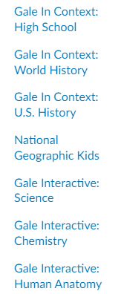
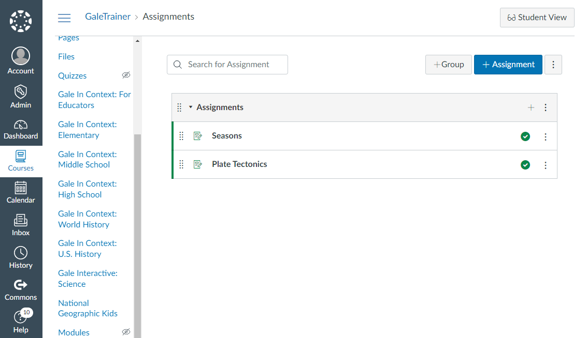
CANVAS
ACCESS THROUGH COURSE HOME
Your integrated Gale resources will appear in the tool bar on the left.
Notes:
To select a resource added to a course users will need to select the course and choose the correct resource from those added to the left side tool bar.

Slide 6
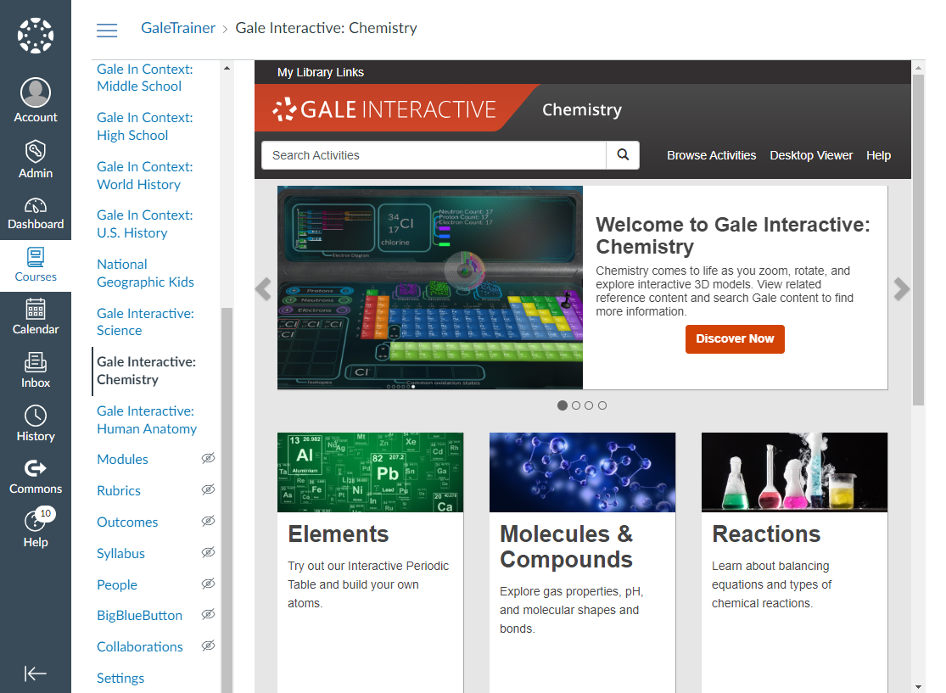
CANVAS
ACCESS THROUGH COURSE HOME
Your integrated Gale resources will appear in the tool bar on the left.
Selecting a resource will open it within the Canvas interface.
Notes:
To select a resource added to a course users will need to select the course and choose the correct resource from those added to the left side tool bar.
Selecting the Gale Interactive: Chemistry option will launch them straight into the resource, while keeping them in the Canvas interface.

Slide 7
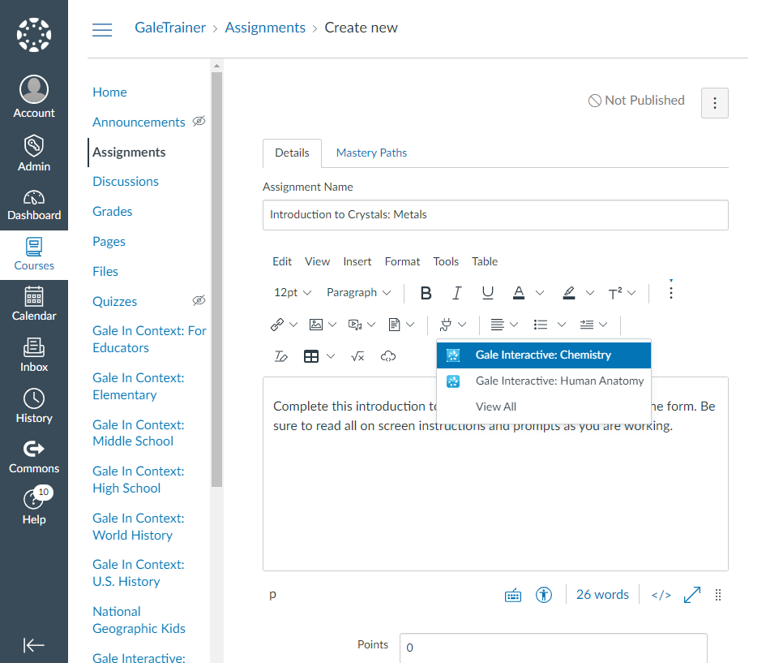
CANVAS
ACCESS THROUGH MATERIALS
When creating or editing a material, select the Apps drop down in the Details section and choose your resource.
Notes:
To access resources while creating or editing a material (like an assignment or discussion post) teachers will select the Apps option at the top of the Details dialogue box. The drop down will have Gale Interactive: Chemistry listed.

Slide 8
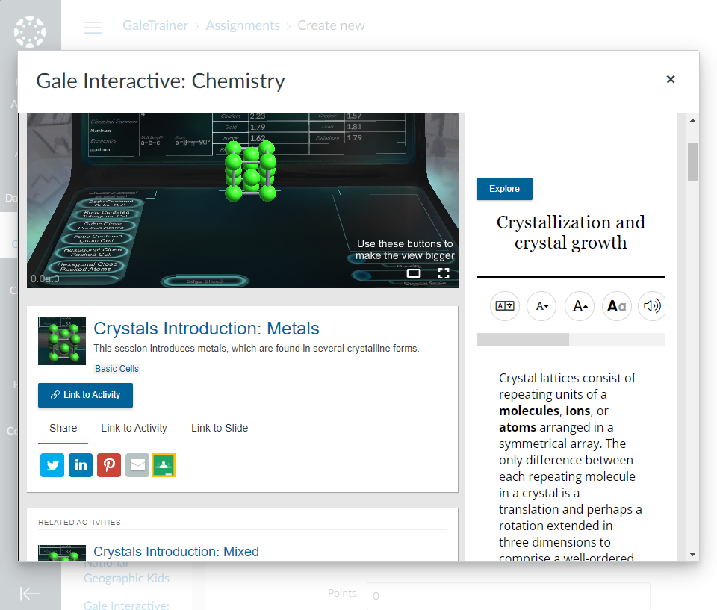
CANVAS
ACCESS THROUGH MATERIALS
When creating or editing a material, select the Apps drop down in the Details section and choose your resource.
The resource will open within Canvas. Utilize the Link to Activity button to add content to your material.
Notes:
Gale Interactive: Chemistry users can Link to Activity. Selecting Link to Activity will enter a URL into the material that others will be able to select.

Slide 9
DISCOVER PREMIUM SCIENCE ACTIVITIES & CONTENT

Slide 10
Search or Browse
Explore Content
Share Activities
Notes:
It’s easy to access all the premium content within Gale Interactive: Chemistry by browsing or searching for topics of interest, exploring content organized by topic, and then clicking individual result titles to view and use activities, reference content, and more.

Slide 11
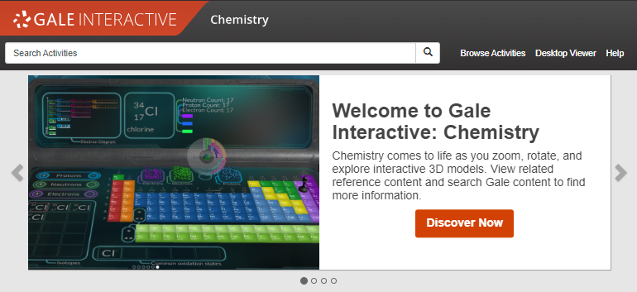
SEARCH
Enter simple search terms to see related activities
Notes:
To perform a basic search, just enter key terms related to topics of interest in the search box on the homepage or at the top of every page throughout Gale Interactive: Chemistry.

Slide 12
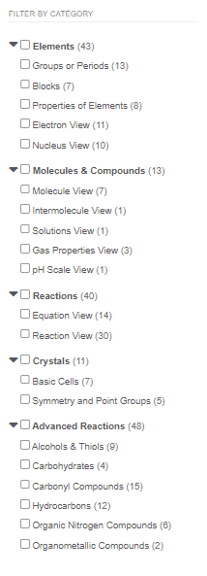
BROWSE
Browse all activities organized by topic
Notes:
In addition to searching, Gale Interactive: Chemistry is designed to make it easy to browse for activities of interest. Simply click the Browse Activities option in the upper right corner of the homepage and on many other pages throughout Gale Interactive: Chemistry to access a list of all Categories for which there are interactive activities. Simply click the arrow next to a Category to see the specific topics within and how many activities are related to each.

Slide 13
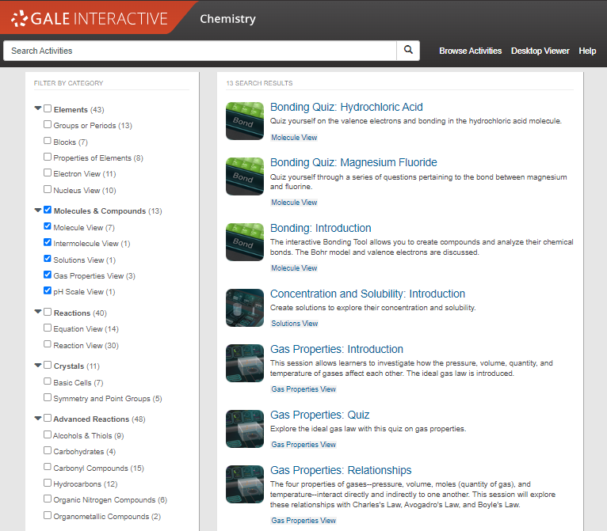
BROWSE
Browse all activities organized by Category
Browse by Category
Select one of the main categories to browse all available content related.
Notes:
You can browse activities by larger categories like the System or Region. Simply check the box next to a category and it will automatically select all Topics within.

Slide 14
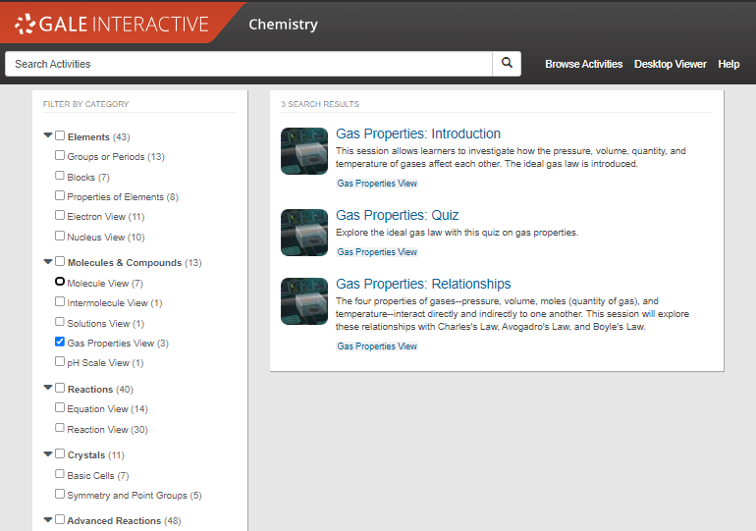
BROWSE
Browse all activities organized by topic
Browse by Category
Select one of the main categories to browse all available content related.
Browse by Topic
Narrow results by selecting a more specific topic within a category.
Notes:
You can also narrow your browsing by selecting one or more topics at a time. There is no limit to how many topics can be selected at once and they also can come from different categories.

Slide 15
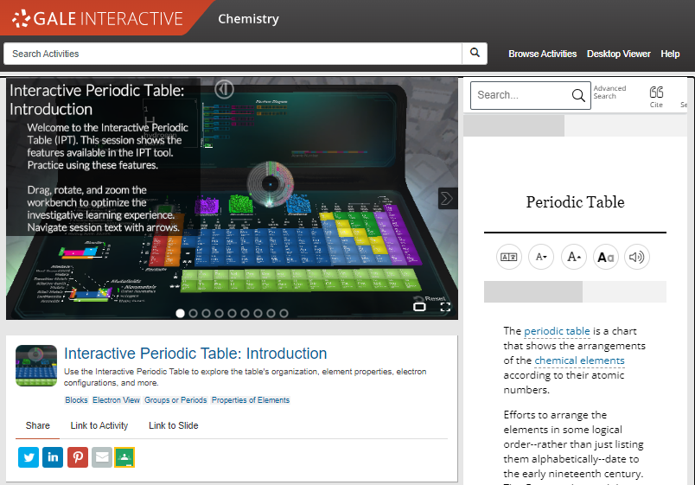
EXPLORE CONTENT
Getting Started
Select the “Start Activity” button to begin an activity and be given instructions on how to interact with the lab or simulation.
Notes:
All instructions on how to interact with a lab or simulation will be given after selecting the “start activity” button. If you are ever unsure what an activity is asking you to complete, look in the on-screen text box that appears in the top left corner.

Slide 16
EXPLORE CONTENT
Help is Always Available
Select the “Help” tool to open on screen prompts that will walk you through how to navigate any interactive simulation.
Options to View
Display options can be changed from Default View to a Theatre View and Full Screen option.
Notes:
There are three different options to view an activity. Every activity will open in “Default View” as seen here but you can enlarge this to two other options. “Theatre View” spreads the activity screen across the width of the screen and pushes all other content underneath. “Full Screen” gives you a more immersive experience and you cannot access other content until you exit it.

Slide 17
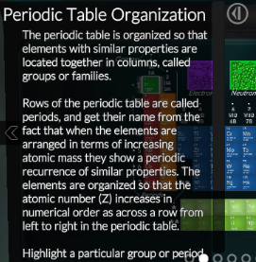
EXPLORE CONTENT
Help is Always Available
Select the “Help” tool to open on screen prompts that will walk you through how to navigate any interactive simulation.
Options to View
Display options can be changed from Default View to a Theatre View and Full Screen option.
Navigate Through Slides
Minimize on slide content to better view an activity by clicking the arrow at the top right of it. Click through sides using side arrows.
Notes:
Most activities in Gale Interactive: Chemistry are set-up as slides you will progress through with on screen content that pairs with it. To minimize the on-screen content and view an activity more clearly, simply click the arrow located at the top right of it and it will collapse. To move to another slide, you can click the arrows on the left and right or you can hop to a slide by using one of the circles at the bottom.

Slide 18
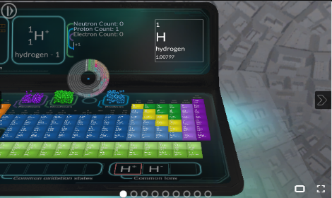
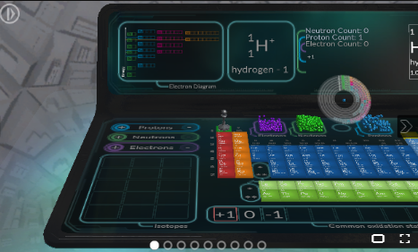
EXPLORE CONTENT – ACTIVITY NAVIGATION
Move lab tables by left clicking and dragging them to desired position.
Notes:
There are several ways you can manipulate an activity, simply by using your mouse. First, you can move an entire lab table around the screen by left clicking and dragging.

Slide 19
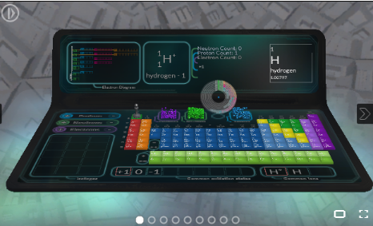
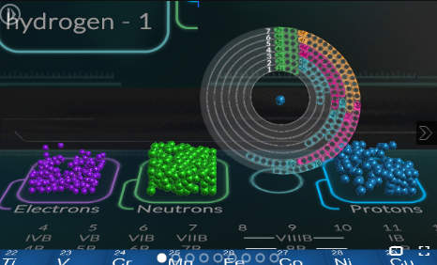
EXPLORE CONTENT – ACTIVITY NAVIGATION
Scroll up to zoom in closer & improve your view. Scroll down to zoom back out.
Notes:
Improve your view by scrolling up to zoom in. Scroll down to zoom back out.

Slide 20
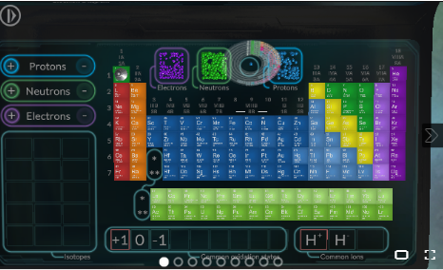
EXPLORE CONTENT – ACTIVITY NAVIGATION
Right click and drag your mouse to change the angle of your view.
Notes:
Right click and move your mouse to change the angle of your view.

Slide 21
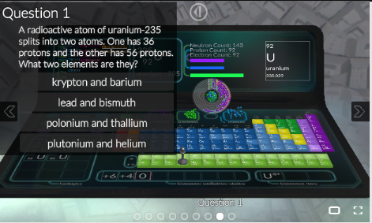
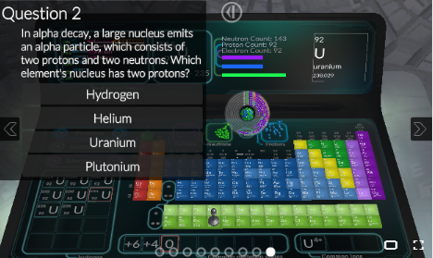
EXPLORE CONTENT
Check for Understanding
At the end of an activity you may find several “Quiz” questions that will assess concepts covered in the interactive.
These questions may be multiple choice, true/false, or even ask you to interact with the lab table to answer.
Notes:
Some interactive activities come with quiz questions to answer at the end to check for understanding. These questions allow multiple attempts and do not record scores, allowing users a low-stakes way to check for understanding and evaluate if they are ready to move on.

Slide 22
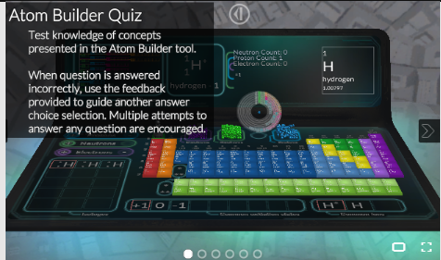
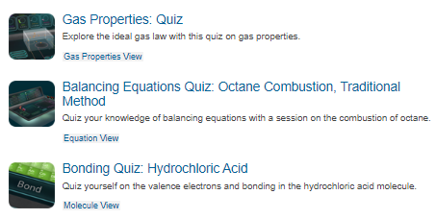
EXPLORE CONTENT
Check for Understanding
At the end of an activity you may find several “Quiz” questions that will assess concepts covered in the interactive.
These questions may be multiple choice, true/false, or even ask you to interact with the lab table to answer.
Quiz Activities
You may also find complete activities that are dedicated to quizzing knowledge. Search “quiz” in the basic search bar to see what is available.
Notes:
You can also find activities that are solely dedicated to checking for understanding by searching the term “quiz” in basic search. These quiz activities typically have an activity counterpart users can complete first to prepare.

Slide 23
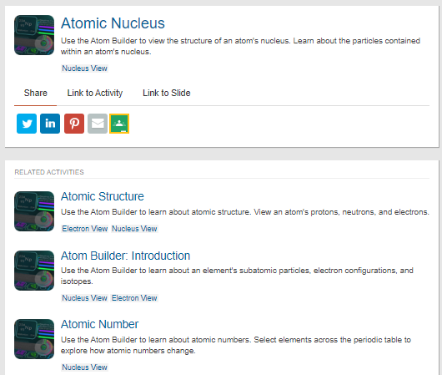
EXPLORE CONTENT
Find Related Activities
Scroll down on an activity page to view recommended activities that address similar concepts or interests.
Quickly preview these activities with description given to the right and standards listed underneath each.
Notes:
Under every activity are related activities you can use to continue learning. This may address the topic or just be of a similar interest.

Slide 24
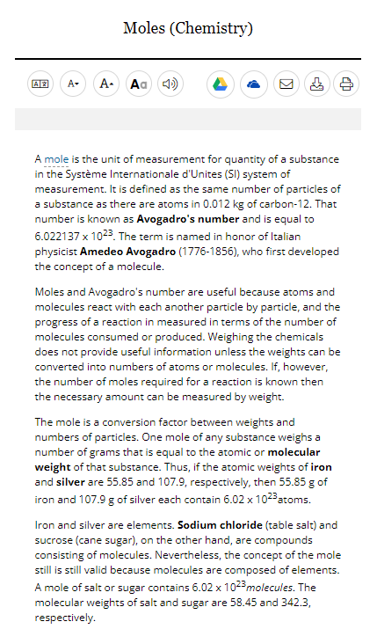
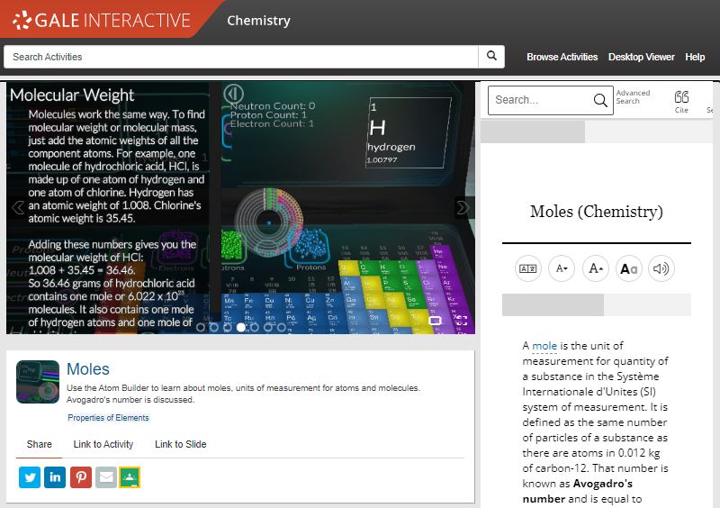
EXPLORE CONTENT
Supplemental Text
In addition to the on-slide content, each slide is paired with a specific piece of reference content. This content changes based on the focus of the current slide and reinforces the concepts being taught.
Notes:
In addition to the content given in an activity, you will also have reference content available that is intentionally paired with every slide. The reference content displayed changes to match each individual slide’s topic and is meant to allow for a deeper connection to the activity.

Slide 25
SUPPORT ACCESSIBLE LEARNING
TRANSLATE
Machine translate articles– 50+ languages
FONT SIZE
Increase or reduce as needed
TEXT MANIPULATION
Edit the font style, color, and spacing
LISTEN
Hear text read aloud, and download as an MP3
Notes:
All reference content available has several accessibility features users can utilize. Translation is offered for over 50 languages, font size can be increased or decreased, display settings can be changed to different fonts and spacing and listen to the article with settings to highlight words and sentences being read, change the speed, and enhance the visibility.

Slide 26
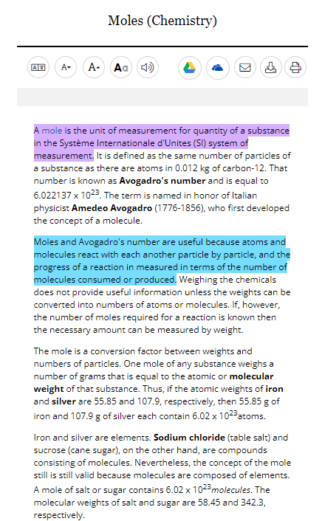
ENCOURAGE ANALYSIS
STEP 1
SELECT TEXT
Click and drag mouse on computer;
Tap on tablet or mobile device
ADD HIGHLIGHTS AND NOTES
Choose color and type annotations in pop-up menu
STEP 2
EXPORT
Add as many notes as desired Download, Print, or Send to… Email, Google Drive or OneDrive before closing
STEP 3
Notes:
Finally, be sure to take the highlighted item with you before you close the resource by downloading, printing, or sending the item to Google Drive or Microsoft OneDrive. This will provide a copy of the result including any highlights and notes you made within the document.
Note that you can also access the Highlights and Notes menu option in the upper right-hand corner of the resource to access all the highlights and notes you’ve made within a given session. This allows you to easily jump to articles and edit highlights and notes, or to download, print, or send a full list of all your highlights and notes to Google Drive or Microsoft OneDrive. Again, if you plan to use this tool, be sure to download, print, or Send to… before exiting the resource.

Slide 27
SHARE ACTIVITIES
Social Media, Email, & Google
Share activities directly to your social media accounts, email, or create and assignment in Google Classroom using the appropriate icon.
Notes:
Share an interactive directly to social media, email, or your Google Classroom with the embedded icons. Selecting any will open log-in prompts to access your account and share whatever activity you are on.

Slide 28
SHARE ACTIVITIES
Social Media, Email, & Google
Share activities directly to your social media accounts, email, or create and assignment in Google Classroom using the appropriate icon.
Get a Link
Generate a shareable link to an activity or even a specific slide.
Notes:
You also have the option to generate a shareable link that can bring someone to the beginning of the activity or to a specific slide of your choice. To link to a slide, make sure you are on the slide you want to bring users to when you generate it.

Slide 29
?
…
Notes:
Use this slide as a visual prompt for final questions and/or discussions

Slide 30
WHAT’S NEXT?
EXPLORE GALE INTERACTIVE: CHEMISTRY
SHARE WITH STUDENTS
CONTACT THE LIBRARY!
Notes:
Wrap up– ask teachers to visit the resource, share articles with students, and contact the library for support

Slide 31
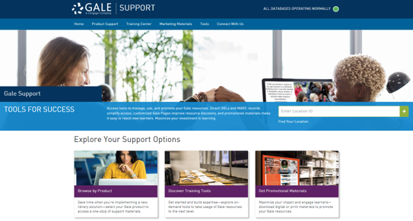
Connect FOR MORE IDEAS
ENTER LIBRARIAN NAME
emailaddress@school.edu
LIBRARY WEBSITE
www.librarysite.edu
SUPPORT.GALE.COM/TRAINING
Lesson plans, tutorials, scavenger hunts, and more
Notes:
Customize this concluding slide with your contact and site/access information.

