Slide 1
GALE IN CONTEXT: FOR EDUCATORS
Notes:
Use this slide to introduce yourself and the presentation.
Notes throughout this presentation provide instruction around areas to customize for your specific audience, as well as speaker notes to make the process of presenting easier. Feel free to hide slides and select what content to feature if you are given shorter speaking times, or if you’re able to take attendees live into Gale In Context: For Educators.

Slide 2
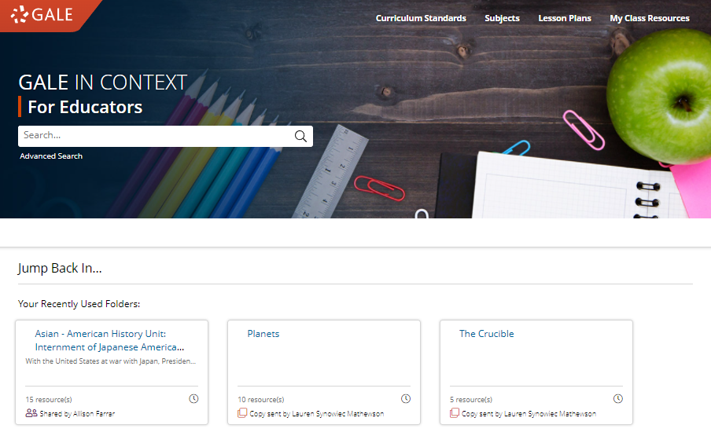
GALE IN CONTEXT: FOR EDUCATORS
Discover Premium Resources
Full lesson plans, trusted reference, top periodicals, engaging multimedia content, and scholarly works
Support Curriculum Standards
Frequently-studied topics from grades K-12 in core content areas
Enhance Teaching and Learning
Folder development, instructor notes and annotations, Google Classroom and LMS integrations
Notes:
Gale In Context: For Educators provides content aligned with national and state curriculum standards in Social Studies, Science, ELA, SEL, and DEI, allowing teachers to easily discover and utilize valuable student-facing information.​
Teachers will find a vast array of resources including full lesson plans, reference works, multimedia information, primary sources, biographies, scholarly works, and more. This content will support all aspects of the classroom and learning including bell ringers, projects, in-class activities, and topic reviews.

Slide 3
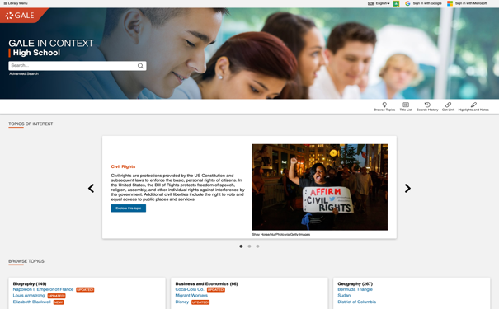
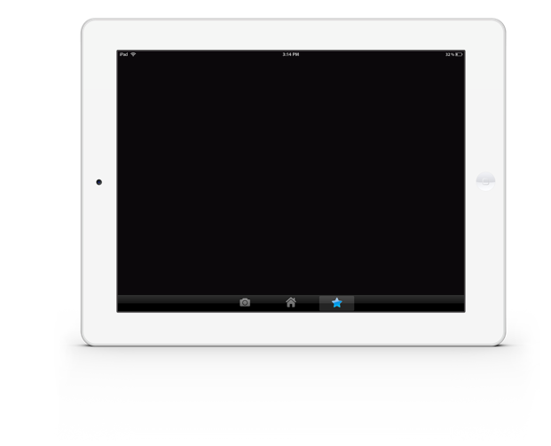
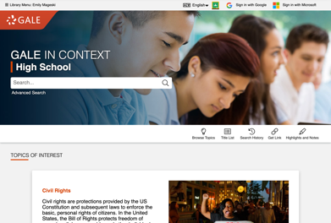
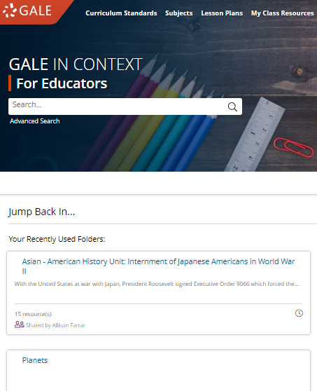
ACCESS
Anytime
Anywhere
Any Device
Without Ads or Paywalls
WWW.LIBRARYRESOURCESURL.EDU
Notes:
All the content in Gale In Context: For Educators can be accessed 24/7 on any device, no matter where you are. Your entire learning community can look at the same article at once without problems, and there are no limits to the amount of content you can access and save.
Additionally, Gale In Context: For Educators is an ad-free environment that provides full-text access without paywalls.
Customize the library access URL on this slide before presenting.

Slide 4
INTEGRATE INTO YOUR LMS
Notes:
The next few slides cover discovery within Schoology and Canvas. If you are utilizing one of these LMS unhide these slides, if not you can keep them hidden during your presentation. Remember: integrating into your LMS means your users will automatically authenticate into Gale In Context: For Educators when selected.

Slide 5
SCHOOLOGY
ACCESS THROUGH COURSE HOME
Your integrated Gale resources will appear in the tool bar on the left.
Notes:
To select a resource added to a course users will need to select the course and choose the correct resource from those added to the left side tool bar.

Slide 6
SCHOOLOGY
ACCESS THROUGH COURSE HOME
Your integrated Gale resources will appear in the tool bar on the left.
Selecting a resource will open it within the Schoology interface.
Notes:
To select a resource added to a course users will need to select the course and choose the correct resource from those added to the left side tool bar.
Selecting the Gale In Context: For Educators option will launch them straight into the resource, while keeping them in the Schoology interface.

Slide 7
SCHOOLOGY
ACCESS THROUGH MATERIALS
When creating or editing a material, select the Insert Content drop down in the Description section and choose your resource.
Notes:
To access resources while creating or editing a material (like an assignment or discussion post) teachers will select the Insert Content option at the top of the description dialogue box. The drop down will have Gale In Context: For Educators listed.

Slide 8
SCHOOLOGY
ACCESS THROUGH MATERIALS
When creating or editing a material, select the Insert Content drop down in the Description section and choose your resource.
The resource will open within Schoology. Utilize the Link to Document or Embed Document buttons to add content to your material.
Notes:
Selecting the Insert Content option pulls forward the Gale In Context: For Educators interface while continuing to keep the user within Schoology.
While in Gale In Context: For Educators users can choose either Link to Document or Embed Document. Selecting Link to Document will enter a URL into the material that others will be able to select. Embed Document creates an iframe in which the native Gale In Context: For Educators platform is available.

Slide 9
CANVAS
ACCESS THROUGH COURSE HOME
Your integrated Gale resources will appear in the tool bar on the left.
Notes:
To select a resource added to a course users will need to select the course and choose the correct resource from those added to the left side tool bar.

Slide 10
CANVAS
ACCESS THROUGH COURSE HOME
Your integrated Gale resources will appear in the tool bar on the left.
Selecting a resource will open it within the Canvas interface.
Notes:
To select a resource added to a course users will need to select the course and choose the correct resource from those added to the left side tool bar.
Selecting the Gale In Context: For Educators option will launch them straight into the resource, while keeping them in the Schoology interface.

Slide 11
CANVAS
ACCESS THROUGH MATERIALS
When creating or editing a material, select the Apps drop down in the Details section and choose your resource.
Notes:
To access resources while creating or editing a material (like an assignment or discussion post) teachers will select the Apps option at the top of the Details dialogue box. The drop down will have Gale In Context: For Educators listed.

Slide 12
CANVAS
ACCESS THROUGH MATERIALS
When creating or editing a material, select the Apps drop down in the Details section and choose your resource.
The resource will open within Canvas. Utilize the Link to Document or Embed Document buttons to add content to your material.
Notes:
To access resources while creating or editing a material (like an assignment or discussion post) teachers will select the Apps option at the top of the Details dialogue box. The drop down will have Gale In Context: For Educators listed.

Slide 13
DISCOVER PREMIUM RESOURCES

Slide 14
SEARCH OR BROWSE
EXPLORE CONTENT
VIEW AND SHARE RESULTS
Notes:
It’s easy to access all the premium resources within Gale In Context: For Educators by browsing or searching for areas of study, exploring content organized by curriculum standard or subject, and then clicking individual result titles to view, edit, and save documents, videos and more.

Slide 15
SEARCH
Enter simple search terms
Notes:
To perform a basic search, just enter key terms related to topics of interest in the search box on the homepage or at the top of every page throughout Gale In Context: For Educators.

Slide 16
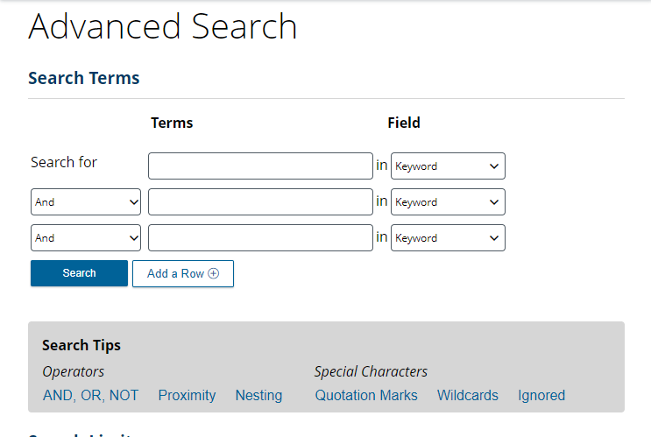
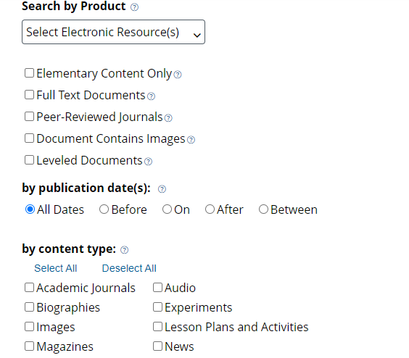
SEARCH
Enter simple search terms
Or, customize multiple fields and limiters
Notes:
You can also run a more targeted or customized search by clicking the Advanced Search option beneath or to the side of the basic search box. Advanced Search provides the option to select specific search fields (For example, Publication title if you’re looking for articles specifically from The New York Times, or content written by a particular author) and combine these fields/terms in various ways (for instance using NOT if you want articles about one subject, but are NOT interested in any articles that also focus on a related subject that is not relevant to what you are teaching). If you scroll down the page, you can also include search options to limit results by document type, date, content level, and more.

Slide 17
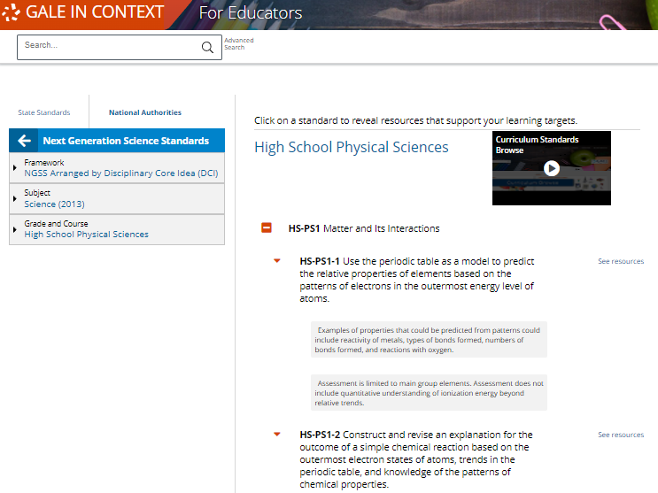
BROWSE CURRICULUM STANDARDS
BROWSE STANDARDS by state or national authority
Notes:
In addition to searching, Gale In Context: For Educators is designed to make it easy for you to browse for topics of interest through curriculum standards. Simply click the Curriculum Standards option in the upper right corner of the homepage to access state and national standards.

Slide 18
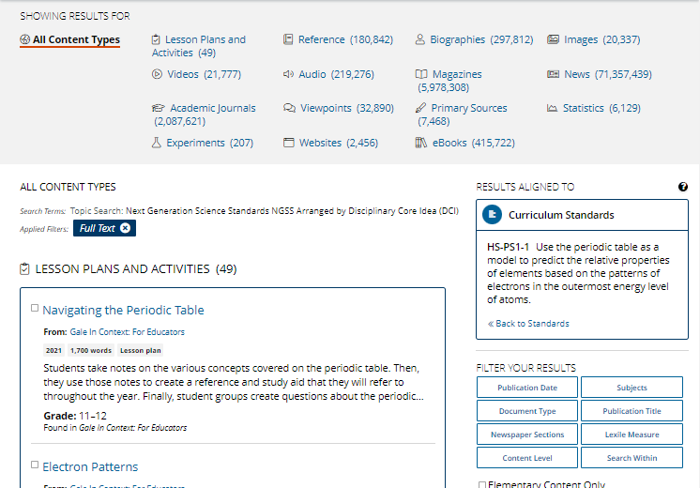
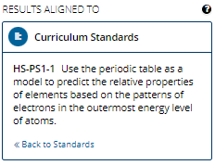
BROWSE CURRICULUM STANDARDS
BROWSE STANDARDS by state or national authority
Connect to curated results
Notes:
When you click the see resources button next to your standard, you’ll be able to access a curated page of information that contains a list of available content types, filters, and a “Results Aligned To” tile. Simply click the header for a content type to view all results of that format, and click the title of an individual result to view that specific lesson plan, article, video, etc.

Slide 19
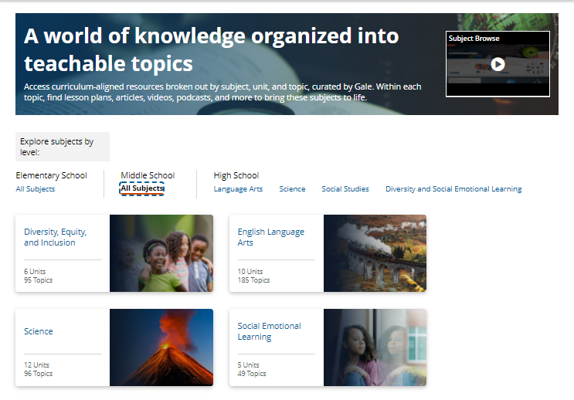
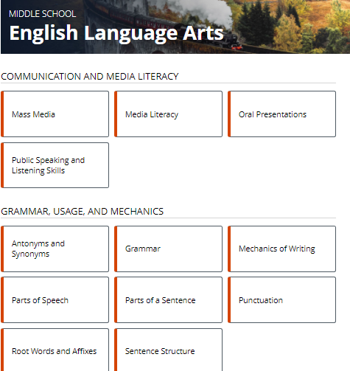
BROWSE SUBJECTS
BROWSE SUBJECTS by grade and topic
Notes:
Gale In Context: For Educators also allows you to browse content by subject. Simply select the Subjects button at the top right of the homepage. When you click you will be launched into a topic tree that allows you to select grade level and subject.

Slide 20
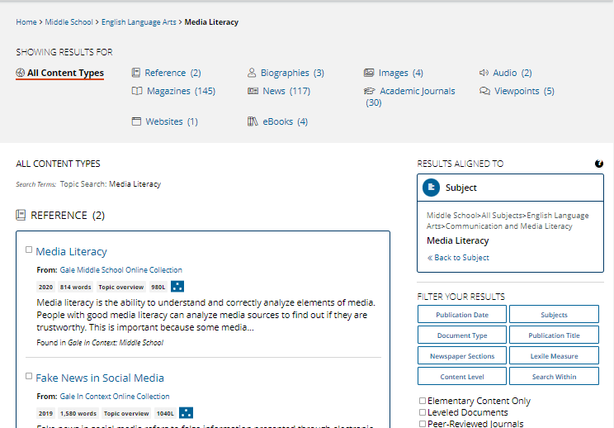
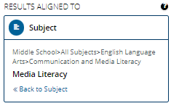
BROWSE SUBJECTS
BROWSE SUBJECTS by grade and topic
Connect to all content types
Notes:
Once you select your topic and access the content, all types will be listed and available for you. In addition, you can refine your browsing using the filters on the right-hand side of the page. The “Results Aligned To” tile tells you what subject your results are for.

Slide 21
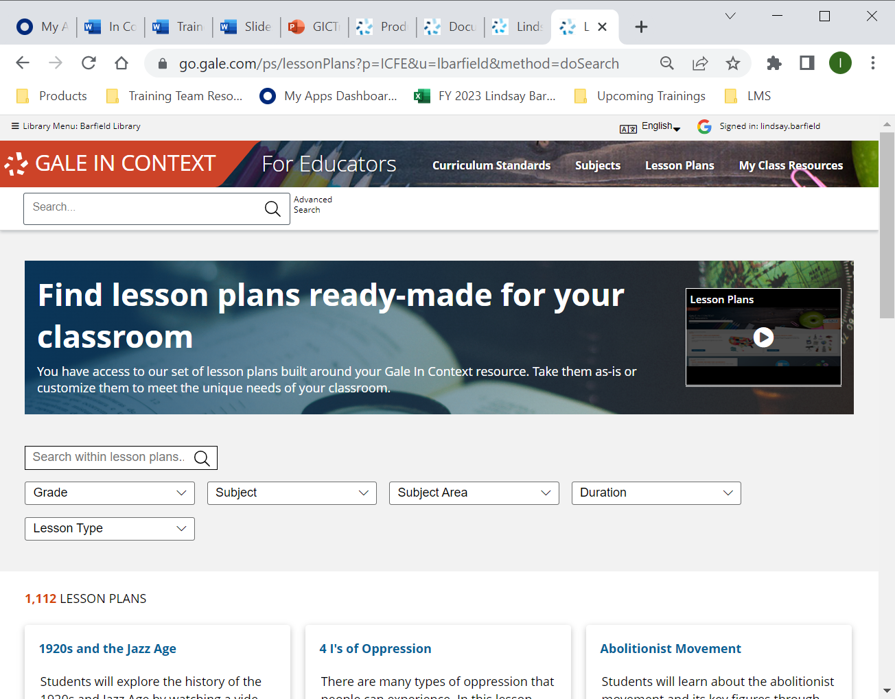
EXPLORE LESSON PLANS
BROWSE LESSON PLANS by grade and subject
Notes:
Gale In Context: For Educators also supports browsing and searching for Lesson Plans directly. Select the Lesson Plans button at the top right of the homepage. When you click you will be launched into the lesson plan browse where you can explore the different lesson plans unique to Gale In Context: For Educators.

Slide 22
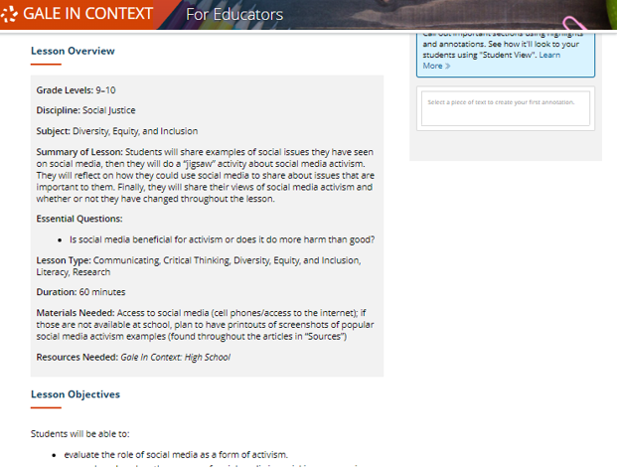
EXPLORE LESSON PLANS
BROWSE LESSON PLANS by grade and subject
DISCOVER fully developed lesson plans
Notes:
Launching a lesson plan allows teachers to easily find and align resources to their classrooms.

Slide 23
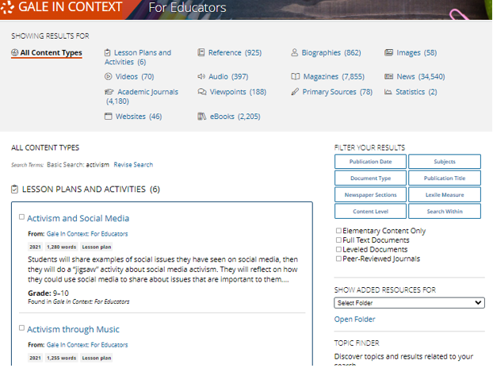
EXPLORE AND FILTER RESULTS
Examine Content Types
Click to focus on results within a format of interest
Notes:
Once you run a search, or browse through one of the previously mentioned workflows, you’ll find options to further pinpoint results of interest. At the top of the page, you can click to view results of specific types (reference articles, videos, lesson plans, etc.) depending on what’s available for your search.

Slide 24
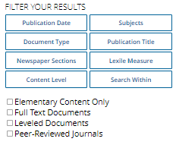
EXPLORE AND FILTER RESULTS
Examine Content Types
Click to focus on results within a format of interest
Narrow Results
Limit by Publication Date, Subjects, Elementary Content, Leveled, Peer Reviewed, etc.
Notes:
In the Filter Your Results portion on the right-hand side of the results, you’ll find options to limit your search results further based on publication date, subjects, content level, etc. Simply click one of the filtering options, check the box next to specific filters of interest, and then click to Apply the filter.

Slide 25
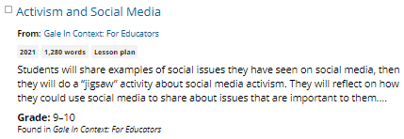
EXPLORE AND FILTER RESULTS
Examine Content Types
Click to focus on results within a format of interest
Narrow Results
Limit by Publication Date, Subjects, Elementary Content, Leveled, Peer Reviewed, etc.
View Individual Resources
Access items of interest
Notes:
When you find an item that you’d like to view, simply click the title of the result to access the document, video, image, etc. From there, you’ll find an array of tools that you can use to incorporate the content into your lessons and assignments. We’ll cover these tools and strategies a bit later.

Slide 26
EXPLORE CONTENT
REFERENCE
LESSON PLANS
VIDEOS AUDIO IMAGES
PRIMARY SOURCES, BIOGRAPHIES, NEWSPAPERS, AND MORE
Notes:
Depending on the topic you search or browse, you will find a wide variety of content types.

Slide 27
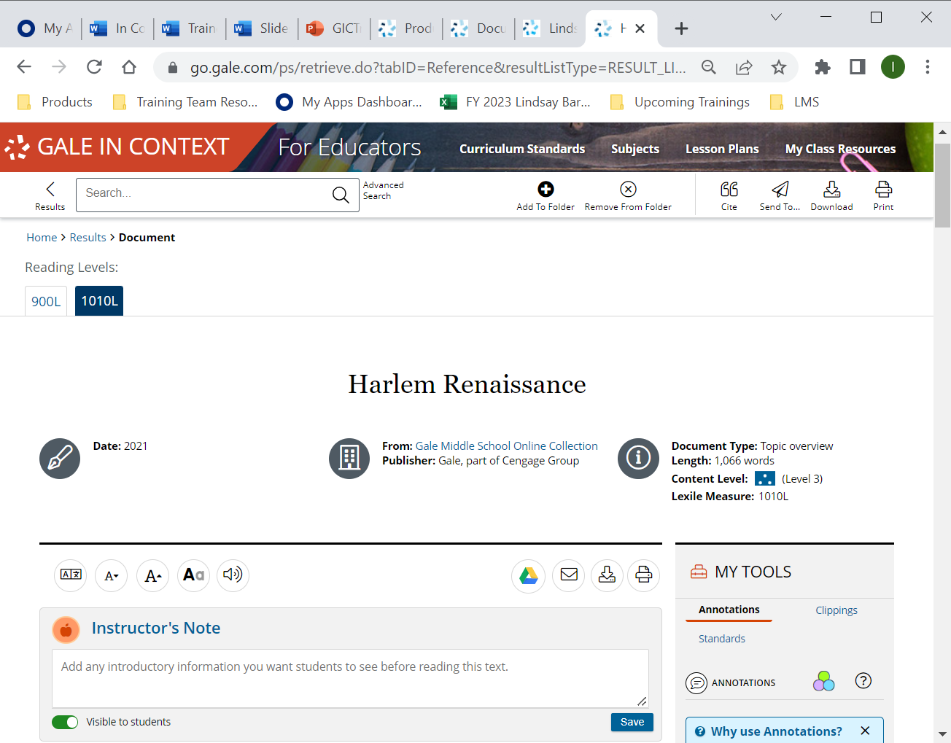
May provide alternate levels or critical thinking questions
REFERENCE
Introduce new or complicated subjects
Develop background knowledge
Assist in research topic selection
Notes:
Some reference entries are leveled (meaning you can choose to view a simplified or more complex version) as shown in the pop-out on the right of the screen. This reference example also includes Fast Facts. You’ll find these in many of the Gale reference entries. They can be used to support assignments or discussions.

Slide 28
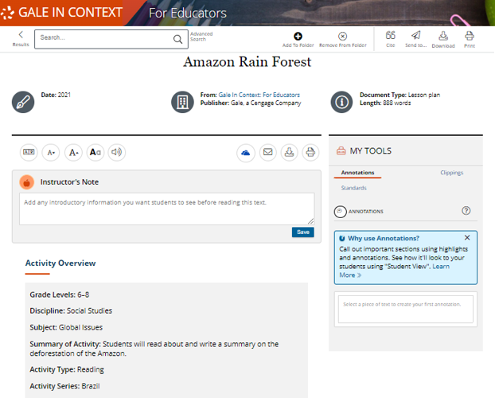
Fully developed for your class
LESSON PLANS
Includes activity overview, learning objective, and sequence
Utilizes Gale content
Different lesson types include critical thinking, project based, SEL, DEI, and more
Notes:
Lesson Plans are fully developed and organized for easy implementation. They include options for differentiation and alternative databases, and correlated standards.

Slide 29
VIDEO
Engage learners and spark discussion
IMAGES
Inspire thinking and enhance projects
AUDIO
Vary teaching and learning format
Notes:
Additionally, multimedia content within Gale In Context resources support learner preferences and can be used to enhance projects or break up instruction.

Slide 30
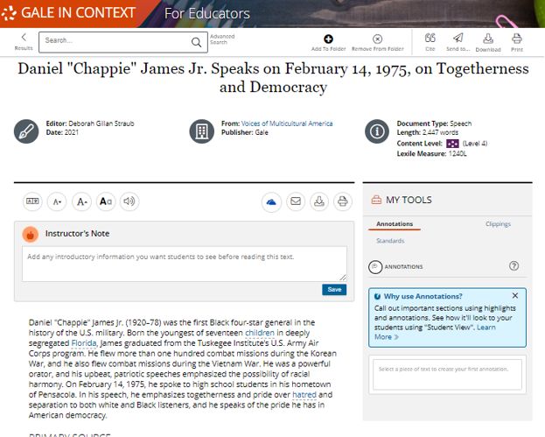
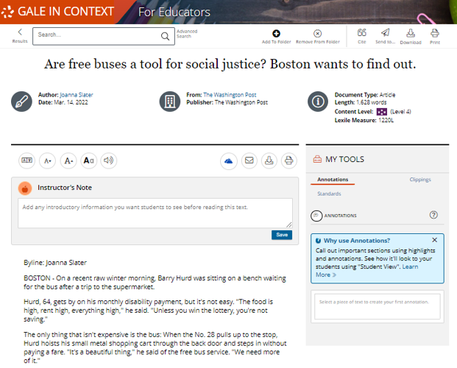
AND MORE!
Encourage critical thinking and research
PRIMARY SOURCES
NEWSPAPERS
Notes:
Additional materials including primary sources, newspapers, biographies, scientific simulations, statistics, and more allow you to build engaging lessons.

Slide 31
SUPPORT DEVELOPING AND ADVANCED READERS
LOWER ELEMENTARY
Up to 500L
UPPER ELEMENTARY
501L – 850L
MIDDLE SCHOOL
851L – 1100L
HIGH SCHOOL
1101L – 1300L
UNDERGRADUATE AND UP
1301L +
Notes:
Plus, the content is leveled, so if you support developing readers, or advanced students, you can find content targeted to their needs! These content levels can be viewed on search and browse results pages.

Slide 32
SUPPORT DEVELOPING AND ADVANCED READERS
LOWER ELEMENTARY
Up to 500L
UPPER ELEMENTARY
501L – 850L
MIDDLE SCHOOL
851L – 1100L
HIGH SCHOOL
1101L – 1300L
UNDERGRADUATE AND UP
1301L +
Notes:
And can also be used to sort or filter search and browse results so that you can pinpoint results that are well suited for your learners.

Slide 33
ENHANCE AND TARGET INSTRUCTION
Notes:
Gale In Context: For Educators can not only be accessed anywhere 24/7 on any device with no limits but can also provide helpful tools to build your classroom materials and lessons to support learning and the development of research skills.

Slide 34
GIVE DIRECTION
Instructor’s Note
Give your students instructions within the article
HIGHLIGHT KEY POINTS
Annotate and Clippings
Direct students to important pieces within the text, and collaborate with colleagues
ORGANIZE MATERIALS
Individual and Shared Folders
Folders allow for easy collaboration and organization
SEND TO STUDENTS
Get Student Link, Send to Drive and Google Classroom
Sharing tools to get content into the hands of students
Notes:
These tools allow you to access, edit, and share content with students and colleagues. In addition, shared folders allow for simple collaboration and lesson development. Note: to edit any piece of content it must be added to a folder (we will discuss this later when we explore folder development).

Slide 35
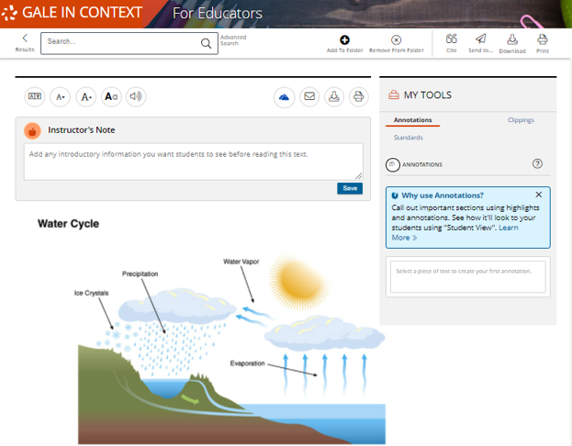
GIVE DIRECTION
INSTRUCTOR’S NOTE
Provide student instructions
Ask thought provoking questions
Give context to a resource
Notes:
Instructor’s Notes allow you to type information onto a resource for students. Any notes will appear at the top of the student view of the resource.

Slide 36
GIVE DIRECTION
INSTRUCTOR’S NOTE
Provide student instructions
Ask thought provoking questions
Give context to a resource
Notes:
Instructor’s Notes allow you to type information onto a resource for students. Any notes will appear at the top of the student view of the resource. The second image provides a look at the student view of an instructor note.

Slide 37
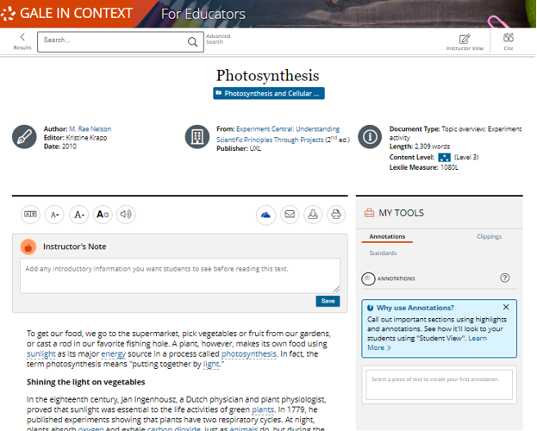
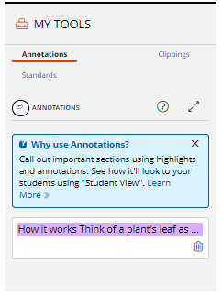
HIGHLIGHT KEY POINTS
ANNOTATE
Highlight words, sentences, paragraphs or sections
Ask questions, give specific instructions, or provide clarification
Notes:
Annotation allows you to highlight a specific portion of the text and add a note. This can be used to provide clarification to a specific portion of the text or ask critical thinking questions. Annotations can also be used to mark up the text to show your colleagues.

Slide 38
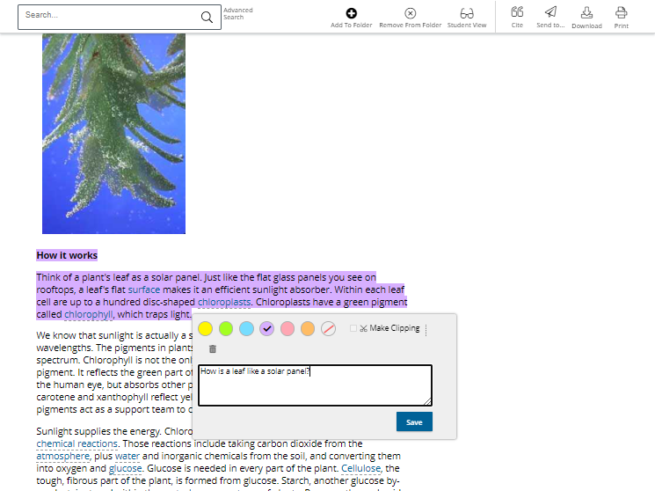
HIGHLIGHT KEY POINTS
ANNOTATE
Highlight words, sentences, paragraphs or sections
Ask questions, give specific instructions, or provide clarification
Notes:
Annotation lets you highlight a specific portion of the text and add a note. This can be used to provide clarification to a specific portion of the text or ask critical thinking questions. Annotations can also be used to mark up the text to show colleagues.
This image shows how the tool looks when being utilized by educators. You can choose highlight color and add their notes.

Slide 39
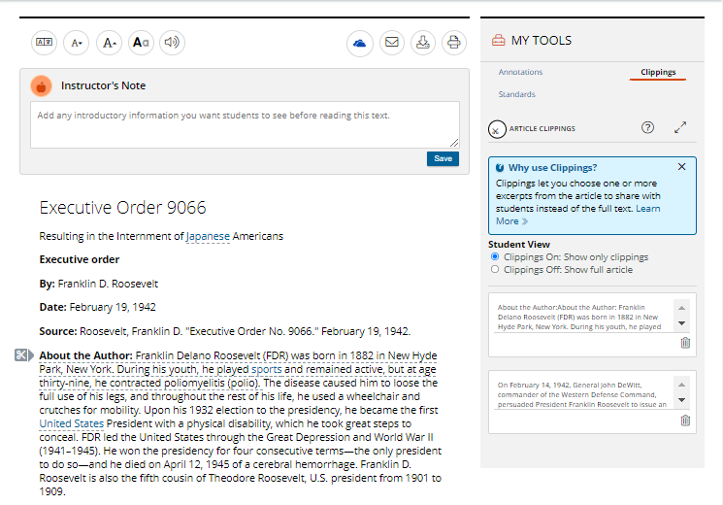
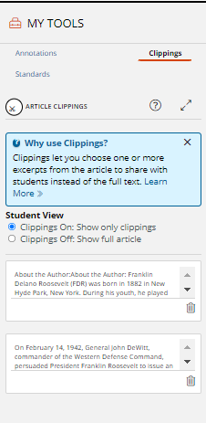
HIGHLIGHT KEY POINTS
CLIPPINGS
“Cut” a piece of the text for students to read
Students will only see the Clipping
Notes:
Clippings are helpful for sharing one piece of content, as opposed to the full article. You can make as many clippings as you want and turn them on and off for easy access.

Slide 40
HIGHLIGHT KEY POINTS
CLIPPINGS
“Cut” a piece of the text for students to read
Students will only see the Clipping
Notes:
When a clipping is made you will see a pair of scissors and an underline of the text included in the clip.

Slide 41
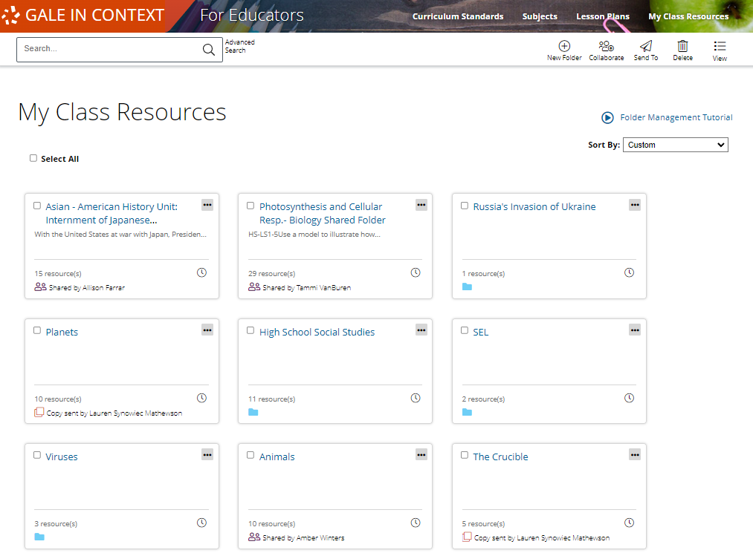
ORGANIZE MATERIALS
FOLDERS
Save resources for yourself, or to share with students and colleagues
Add tags and arrange resource order for complete customization
Hide or show materials for students
Share copies or collaborate within one folder
Notes:
Folders hold and organize all your content in one place. You can create as many folders as you like and can name and provide descriptions for each. Within folders, you can create tags to organize and label different resource types. You can also decide what information students can see within a folder by easily turning on an off the “Visible to Students” option.
Folders can also be shared with colleagues, you can send either a copy of your folder, or send a collaborative folder.
Let’s dive deeper into the functionality of folders.

Slide 42
ORGANIZE MATERIALS
FOLDERS
Found under the My Class Resources option in the top right of the header.
Notes:
To access your Folders, you will click into My Class Resources found in the top right corner of the banner.

Slide 43
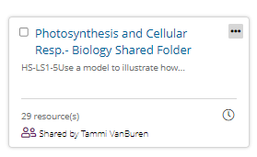
ORGANIZE MATERIALS
FOLDERS
Each tile in this image is an individual folder
Folders on this page show the title, description, number or resources added, and if the information has been shared.
Notes:
While on the My Class Resources page every tile is a folder you have created. You can click and drag the folders to organize them in any order you want.
Each tile shows the basic information about the folder.

Slide 44
ORGANIZE MATERIALS
FOLDERS
Folders can also be nested inside other folders by using the “move to” feature.
Notes:
While on the My Class Resources page every tile is a folder you have created. You can click and drag the folders to organize them in any order you want.
Each tile shows the basic information about the folder.

Slide 45
ORGANIZE MATERIALS
FOLDERS
You can share folders from this page by selecting the folder and choosing collaborate
Notes:
To share folders with your colleagues you will select which folder(s) you want to share by using the check box in the top left corner. Then, select the Collaborate tool found in the tool bar.

Slide 46
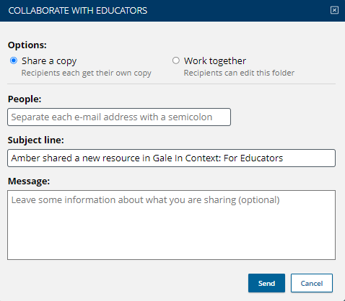
ORGANIZE MATERIALS
FOLDERS
You can share folders from this page by selecting the folder and choosing collaborate
One you select collaborate you can choose to share a copy or work together
Notes:
Once you select the Collaborate tool you can choose to either Share a Copy or Work Together. Sharing a copy will provide your colleagues with their own version of the folder you created. They can’t edit your version of the folder, and you can’t edit theirs.
Choosing Work Together sends a collaborative folder in which everyone can make edits. In other words, if you change something they’ll see it, and if they change something you’ll see it.

Slide 47
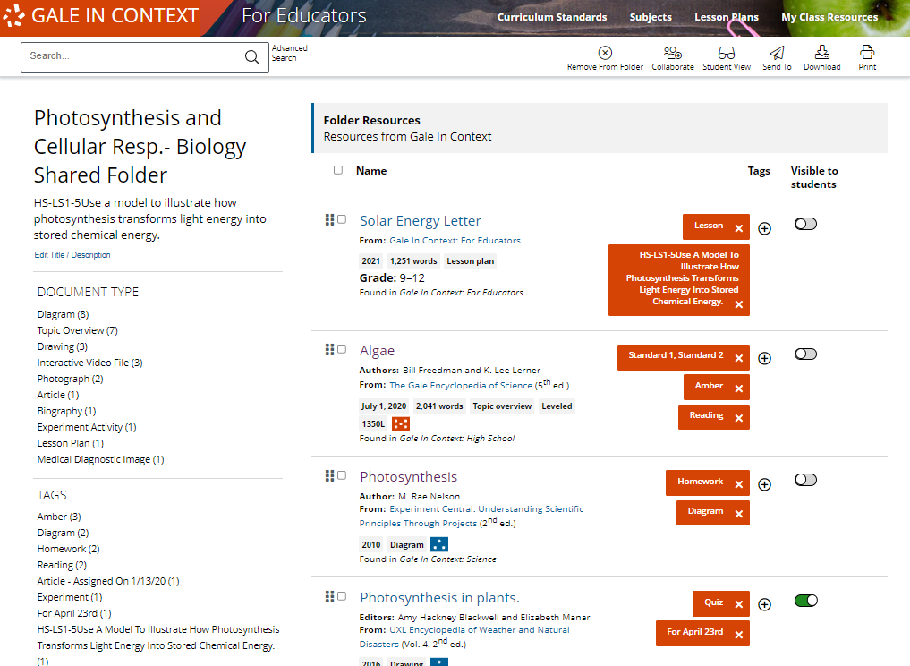
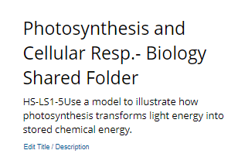
ORGANIZE MATERIALS
FOLDERS
Inside your folders you can:
Edit the title and description
Notes:
To edit the title and description of your folder your can select Edit Title/Description on the top left of the folder page.

Slide 48
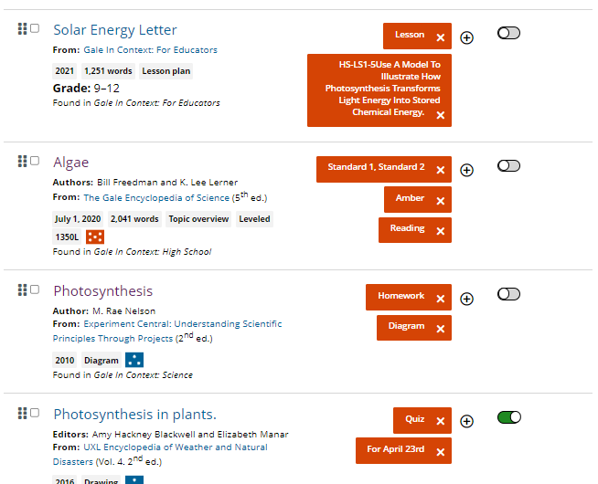
ORGANIZE MATERIALS
FOLDERS
Inside your folders you can:
Edit the title and description
Organize the order of your resources
Notes:
You can click and drag on your resources to organize them in whichever way works best for you. You may want to organize based on date they will be used, unit, or type of material.

Slide 49
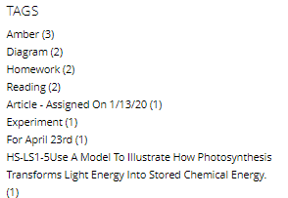
ORGANIZE MATERIALS
FOLDERS
Inside your folders you can:
Edit the title and description
Organize the order of your resources
Add tags to label your resources
Notes:
Tagging your resources can help with large folder organization. Gale provides a few pre-created tags, but you can also create your own to fine-tune your folder.

Slide 50
ORGANIZE MATERIALS
FOLDERS
Inside your folders you can:
Edit the title and description
Organize the order of your resources
Add tags to label your resources
Choose what students can see
Notes:
If you are planning on sharing your folder with students, you can choose what they see using the Visible to Students option. Lesson Plans will never be visible to students, meaning you can share a folder with them without having to toggle the Lesson Plans off.

Slide 51
ORGANIZE MATERIALS
FOLDERS
Inside your folders you can:
Edit the title and description
Organize the order of your resources
Add tags to label your resources
Choose what students can see
Add subfolders, external links, and documents
Notes:
Finally, you can add nested folders, external links, and files by using the “add” feature. This allows you add resources from outside of Gale but still have the ability to organize, tag, and choose when it will be visible to students.

Slide 52
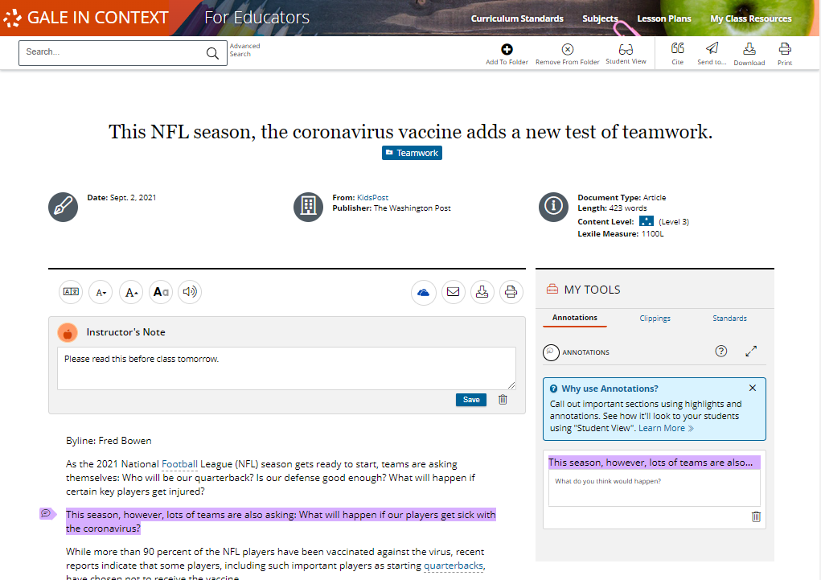
SEND TO STUDENTS
STUDENT VIEW
To access Student View, select the icon in the tool bar at the top of an article (or within a folder)
Notes:
Each resource found within Gale In Context: For Educators (except for lesson plans) have a special student view in which students can see the content and notes you added, but not the educator tools you use.
To access the student view and see what students see, select the Student View icon at the top of the page.

Slide 53
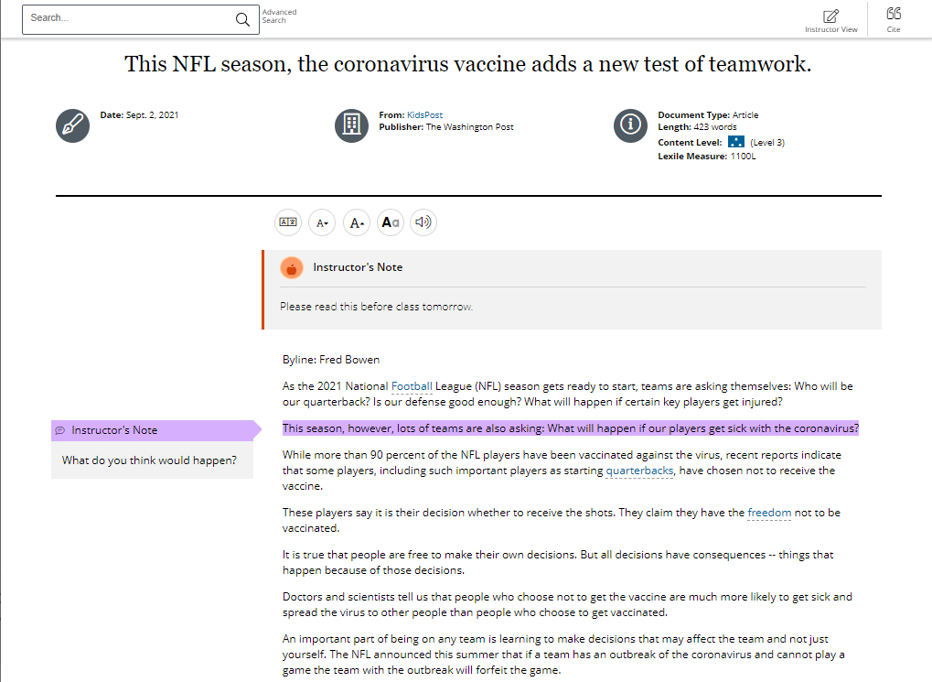
SEND TO STUDENTS
STUDENT VIEW
Students see a version of the resource that doesn’t include educator’s tools
They will see Instructor’s Notes at the beginning of the page, and any Annotations made
Notes:
Any annotations or instructor’s notes you add will be visible for students.

Slide 54
SEND TO STUDENTS
STUDENT VIEW
To get back to the Instructor View, select the icon in the tool bar on the top right of the screen.
Notes:
When you are ready to get back to the version of the resource that allows you to make edits, select the Instructor View icon in the tool bar at the top of the page.

Slide 55
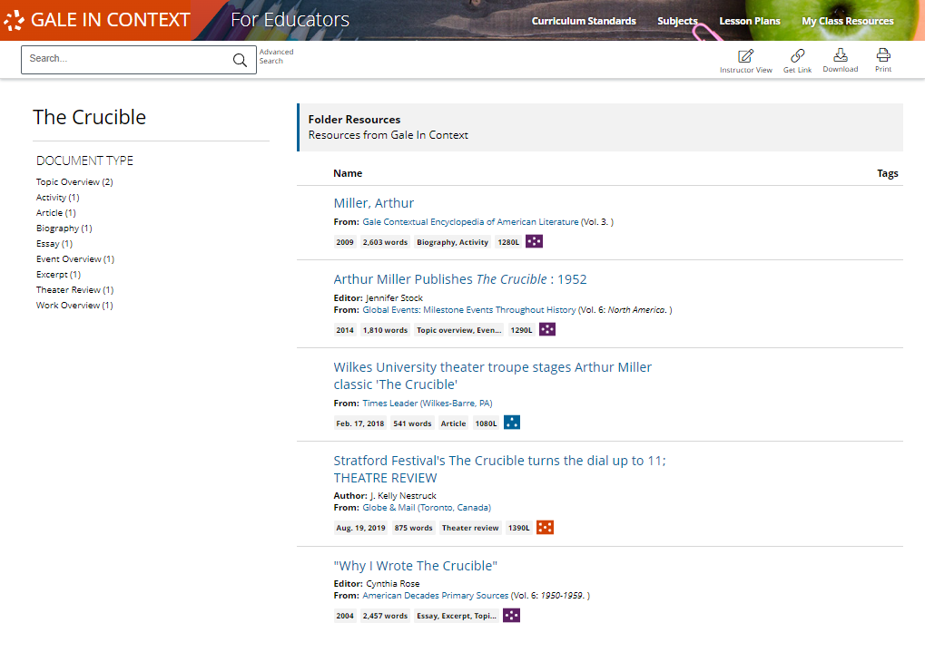
SEND TO STUDENTS
STUDENT VIEW
Student View works the same way in folders. Selecting Student View will let you see how student will experience the folders you created for them.
Notes:
Selecting Student View within a folder will show which resources you have toggled on for students, as well as the tag you created.

Slide 56
SEND TO STUDENTS
SENDING TOOLS
Selecting Send To at the top of the page will allow you to choose what method you would like to use:
Notes:
Selecting the Send To option at the top of the page allows you to utilize tools to get the information (either one resource or a full folder) to students.

Slide 57
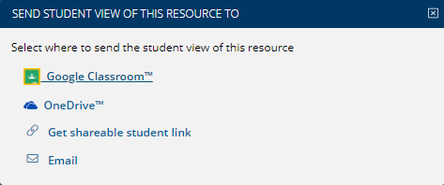
SEND TO STUDENTS
SENDING TOOLS
Selecting Send To at the top of the page will allow you to choose what method you would like to use:
Google Classroom
OneDrive
Google Drive
Shareable Link
Email
Notes:
Using the Send To tool you can send either a single document or a full folder to students through Google Classroom, Google/Microsoft Drives, Persistent Shareable Link, or Email.

Slide 58
?
…
Notes:
Use this slide as a visual prompt for final questions and/or discussions

Slide 59
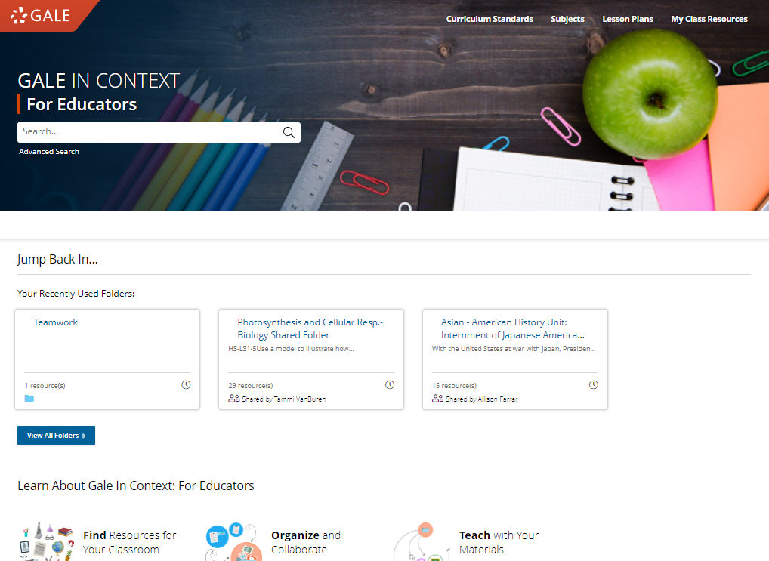
WHAT’S NEXT?
EXPLORE GALE IN CONTEXT: FOR EDUCATORS
SHARE WITH COLLEAGUES
SHARE WITH STUDENTS
Notes:
Wrap up– ask teachers to visit the resource and share information with colleagues and students.

Slide 60
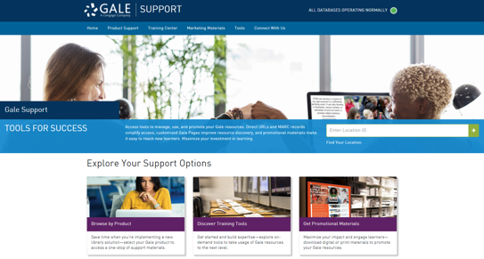
Connect FOR MORE IDEAS
ENTER LIBRARIAN NAME
emailaddress@school.edu
LIBRARY WEBSITE
www.librarysite.edu
SUPPORT.GALE.COM/TRAINING
Notes:
Customize this concluding slide with your contact and site/access information.

