Slide 1
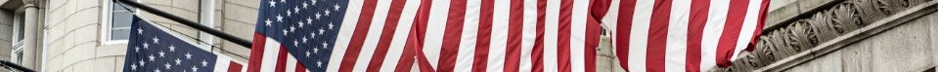
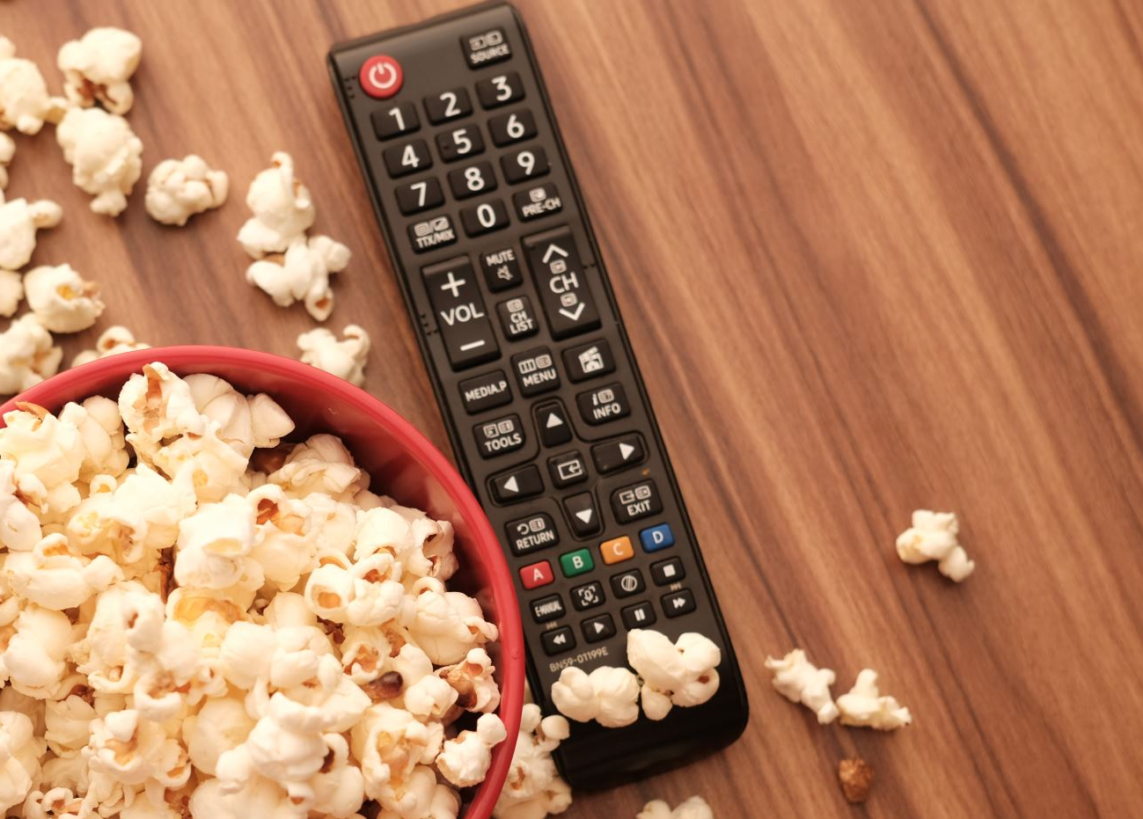
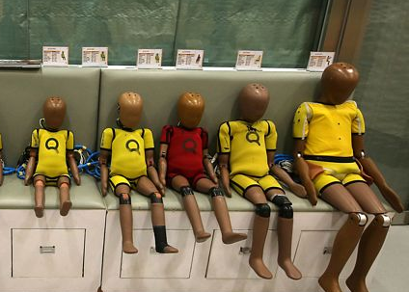







Gale In Context: High School
Inventors Choice Board
Directions: Choose three inventions from the options below. Click on the invention to be taken to the corresponding questions. Use Gale In Context: High School to research and find the answers to your questions. Be sure to cite your sources!

Slide 2

Directions: Using Gale In Context: High School, conduct searches for both the inventor and invention to research and answer the questions below.
Click the Gale logo to go back to the main page.
The TV Remote
Robert Adler
What was Robert Adler’s background in? How did Robert Adler come up with the idea for the TV remote control?
Source:
What were the main features and functionalities of the original TV remote control?
Source:
How did the invention of the TV remote control impact the television industry and the way people interacted with their TVs?
Source:
What other contributions did Adler make to the field of technology or other areas of interest?
Source:
What challenges or obstacles did Adler face during the development or implementation of his invention?
Source:

Slide 3
Directions: Using Gale In Context: High School, conduct searches for both the inventor and invention to research and answer the questions below.
Click the Gale logo to go back to the main page.
Crash Test Dummy
Samuel Anderson
What was Samuel Anderson's background and experience in the field of crash testing or automotive safety?
Source:
What was Samuel Anderson's background and experience in the field of crash testing or automotive safety?
Source:
What were the key features and design elements of the original Crash Test Dummy?
Source:
How did the invention of the Crash Test Dummy revolutionize automotive safety testing and contribute to saving lives? Did Anderson make any other contributions to automobile safety?
Source:
What challenges or obstacles did Anderson face during the development or implementation of his invention?
Source:

Slide 4
Directions: Using Gale In Context: High School, conduct searches for both the inventor and invention to research and answer the questions below.
Click the Gale logo to go back to the main page.
Video Games
Ralph Baer
What was Ralph Baer's background and how did he become interested in the field of video games?
Source:
What were the key contributions and inventions made by Ralph Baer in the development of video games?
Source:
How did Ralph Baer's invention of the Magnavox Odyssey, the first home video game console, impact the gaming industry?
Source:
What were some of the challenges or obstacles Ralph Baer faced during the development and commercialization of his inventions?
Source:
How did Ralph Baer's work and inventions influence the future of video games and interactive entertainment?
Source:

Slide 5
Directions: Using Gale In Context: High School, conduct searches for both the inventor and invention to research and answer the questions below.
Click the Gale logo to go back to the main page.
Various fruits and berries
Luther Burbank
What were Luther Burbank's main areas of focus and contributions as an inventor?
Source:
How did Luther Burbank approach the process of inventing and developing new plant varieties?
Source:
What were some of Luther Burbank's most notable plant inventions and how did they impact agriculture and horticulture?
Source:
What were some of the challenges or obstacles Luther Burbank faced during his career as an inventor?
Source:
How did Luther Burbank's work in plant breeding and invention contribute to advancements in agriculture and the development of new plant varieties?
Source:

Slide 6
Directions: Using Gale In Context: High School, conduct searches for both the inventor and invention to research and answer the questions below.
Click the Gale logo to go back to the main page.
Post-It Note
Silver Spencer & Arthur Fry
What was unique about the adhesive Silver Spencer designed while working for 3M in 1968?
Source:
What was this new adhesive originally used for once developed for 3M?
Source:
What was the first iteration of the Post-It Note called before it got its signature yellow square design and how did it come to be?
Source:
How did Arthur Fry meet Silver Spencer at 3M?
Source:
What was so unique about how Post-It Notes gained popularity and widespread acceptance?
Source:

Slide 7

Directions: Using Gale In Context: High School, conduct searches for both the inventor and invention to research and answer the questions below.
Click the Gale logo to go back to the main page.
Ice Rink Resurfacing
Machine
Frank Zamboni
What was Frank Zamboni's background and how did he become interested in ice rink maintenance?
Source:
What were the main challenges or problems faced by ice rink operators before the invention of the ice resurfacing machine?
Source:
How did Frank Zamboni come up with the idea for the ice rink resurfacing machine, and what was the process of developing and refining the machine?
Source:
What were the key features and functionalities of the original ice rink resurfacing machine invented by Frank Zamboni?
Source:
How did the invention of the ice rink resurfacing machine revolutionize the maintenance and operation of ice rinks, and what impact did it have on the sports and entertainment industry?
Source:

Slide 8
Directions: Using Gale In Context: High School, conduct searches for both the inventor and invention to research and answer the questions below.
Click the Gale logo to go back to the main page.
Personal Computer
Steve Wozniak
What was Steve Wozniak's background and how did he become interested in computers and electronics?
Source:
What were Steve Wozniak's key contributions to the development of the personal computer?
Source:
How did Steve Wozniak collaborate with Steve Jobs in co-founding Apple Computer Inc. and developing the Apple I and Apple II computers?
Source:
What were the main features and innovations of the Apple computers designed by Steve Wozniak?
Source:
What impact did Steve Wozniak's inventions and contributions have on the personal computer industry and the way people use technology today?
Source:

Slide 9
Directions: Using Gale In Context: High School, conduct searches for both the inventor and invention to research and answer the questions below.
Click the Gale logo to go back to the main page.
Super Soaker
Lonnie Johnson
What is Lonnie Johnson's background and how did he become interested in inventing?
Source:
What inspired Lonnie Johnson to create the Super Soaker water gun, and what problem was he trying to solve?
Source:
How did Lonnie Johnson design and develop the Super Soaker, and what were the key features and innovations of the water gun?
Source:
What impact did the invention of the Super Soaker have on the toy industry and popular culture?
Source:
What other inventions or contributions has Lonnie Johnson made beyond the Super Soaker?
Source:

Slide 10

Directions: Using Gale In Context: High School, conduct searches for both the inventor and invention to research and answer the questions below.
Click the Gale logo to go back to the main page.
Computer Mouse
Douglas Engelbart
What was Douglas Engelbart's background and how did he become interested in computer technology?
Source:
What were the main motivations behind Douglas Engelbart's invention of the computer mouse?
Source:
How did Douglas Engelbart design and develop the computer mouse, and what were its original features and functionalities?
Source:
How did the invention of the computer mouse impact the field of human-computer interaction and the way people interact with computers?
Source:
What other contributions did Douglas Engelbart make to the field of computer technology beyond the invention of the mouse?
Source:

