Slide 1
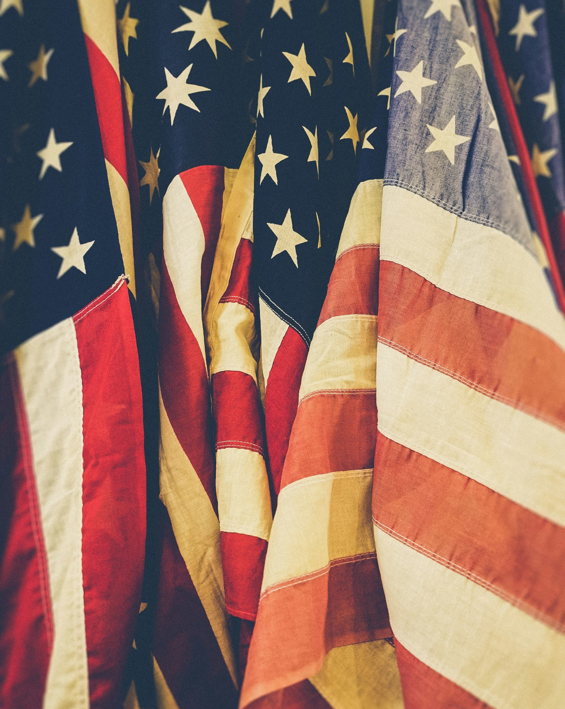

GALE IN CONTEXT:
Middle School
Government & Civics
Escape Room

Slide 2
TABLE OF CONTENTS
1 | Cover
2 | Table of Contents
3 | Escape Room Instructions and Tips
3-4 | Task Instructions and Arrangements
5 | Resource Access
6 | Printing Suggestions
7 | Group Answer Sheet
8 | Group Answer Sheet – TEACHER KEY
9-13 | Individual Task Answer Keys
14-16 | Description Cards for Stations or Folders
17 | Task 1: Constitutional Amendments
18 | Task 1: Matching Activity (ruler recommended)
19 | Task 2: The Three Branches
20 | Task 2: Sorting Graphic Organizer
21 | Task 2: Sorting Cards (cut-and-sort)
22 | Task 3: Checks and Balances
23 | Task 3: Tarsia Puzzle (cut-and-sort)
24 | Task 4: Electoral College
25 | Task 4: Election Graphic Organizer
26-27 | Task 4: Election Task Cards (cut-and-sort)
28 | Task 5: State and Local Government & Federalism
29 | Task 5: Multiple Choice Questions (cut-and-sort)
30 | Task 6: Rights and Responsibilities
31 | Task 6: Polybius Square Cipher
32 | Task 6: Polybius Square Cipher Questions
33 | Citation Information
2

Slide 3
INSTRUCTIONS
BEFORE | Print and organize all necessary materials (see Printing Suggestions). Some stations consist of cut-and-sort activities. You can choose to have students cut these as they progress and then sort, or you can have them cut and placed in envelopes or folders before they begin. Having them prepped beforehand is best practice. Tasks can be set up as stations or as completion tasks where groups remain in one location. In either setup, it is important to have materials prepared that equal the number of groups. Having a folder/envelope for each task is best practice. Gale resources should be accessed through the Gale In Context: Middle School database. (See Resource Access page).
DURING | Print Answer Key and have it on hand to answer questions and aid as needed. Walk around the room and assist groups when necessary. Each time a group finishes a task, check their code to approve them to go onto the next one.
AFTER | Review reading material with students. This activity works well as an introduction to the topic, or as a culminating activity at the end of a unit. Students can reflect about what they learned during the activity with reflection writing or use what they learned as a starting point for a deeper research project.
TASK 1:
Instructions: Students will read the assigned Gale resource and learn about the constitutional amendments. They will then match each question to the correct answer. It is recommended that students use a ruler for straight lines on the matching assignment. The letters that do not have a line through them at the end reveal the code, which is civics. Straight lines are essential. See pg. 9 for an answer key.
Arrangements: This is a single answer sheet, so one sheet per group is recommended with students working together and assigning roles. For this one, it is recommended that one student use the ruler to match correct options to ensure lines are straight.
TASK 2:
Instructions: Students will view the assigned Gale articles on the three branches of government. Students will then complete the sorting activity, sorting each responsibility card into the branch it belongs to. The number in each category after each responsibility is correctly sorted is the code. See pg. 10 for an answer key.
Arrangements: The activity for this is a cut-and-sort activity. You can have students cut them and then sort or have them precut and stored in an envelope or bag.
3

Slide 4
TASK 3:
Instructions: Students will view the assigned Gale article on checks and balances. Students will then complete the Tarsia puzzle by connecting the sides of each triangle to their corresponding question. They will end with a large hexagon shape. Their code is a quote, which will be visible once you complete the puzzle. See pg. 11 for an answer key.
Arrangements: The activity for this is a cut-and-sort activity. You can have students cut them and then sort or have them precut and stored in an envelope or bag.
TASK 4:
Instructions: Students will read the assigned Gale resource and learn about voting and the electoral college. They will then sort through different government responsibilities, assigning each responsibility to the correct branch. Their code at the and will be the number of responsibilities in each category after they are sorted correctly. See pg. 12 for an answer key.
Arrangements: This is a single answer sheet, so one sheet per group is recommended with students working together. The activity for this is a cut-and-sort activity. You can have students cut them and then sort or have them precut and stored in an envelope or bag.
TASK 5:
Instructions: Students will read the assigned Gale resource and learn about local and state government & federalism. After reading the document, students will answer the multiple-choice questions. Their code will be spelled out in the answers when they are all correct. See pg. 13 for an answer key.
Arrangements: The activity for this is a cut-and-sort activity. You can have students cut them and then sort or have them precut and stored in an envelope or bag.
TASK 6:
Instructions: Students will read the assigned Gale resource and learn about the rights and responsibilities of U.S. citizens. After reading the document, students will decode the correct answers using the Polybius cipher. Each letter is represented by a section of the cipher. The cipher can be found on pg. 31 . See pg. 13 for an answer key.
Arrangements: It is recommended that you print a cipher for each student so that all students in the group can work together to decode.
4

Slide 5
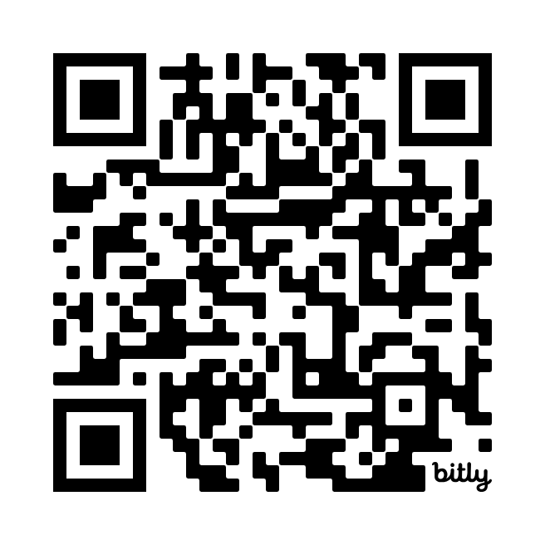


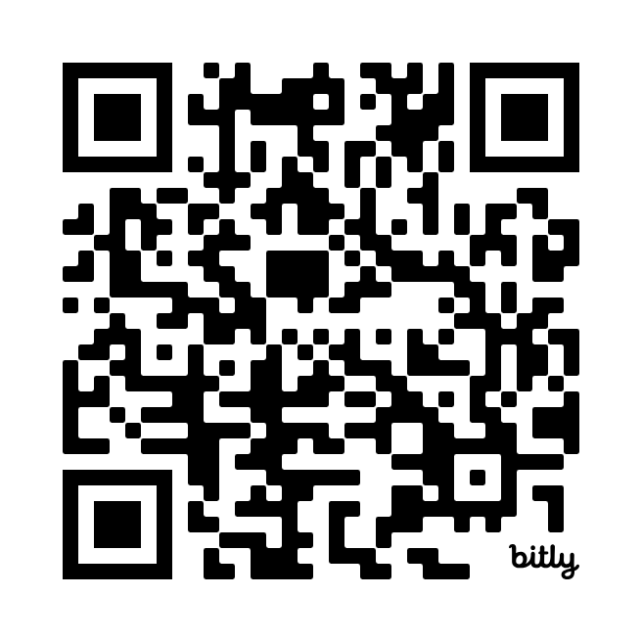

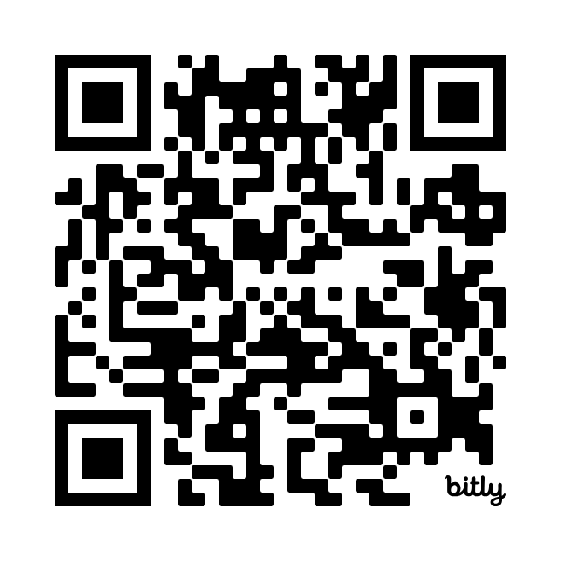


RESOURCE ACCESS
The best way to have students access task articles is to have them visit Gale In Context: Middle School and then open the links for each task using the links or QR codes below. They must open Gale In Context: Middle School prior to accessing the links below.
TASK1 | TASK 2
https://link.gale.com/apps/doc/SAEDIC771526748/MSIC | Judicial https://link.gale.com/apps/doc/DIQRYP225233181/MSIC
 | Legislative https://link.gale.com/apps/doc/RZASOF810008556/MSIC
 | Executive https://link.gale.com/apps/portal/APRQXL457930776/MSIC
TASK 3 | TASK 4 | TASK 5 |  | TASK 6
https://link.gale.com/apps/doc/XPDWUZ292213706/MSIC | https://link.gale.com/apps/doc/PXGLVM839816039/MSIC | https://link.gale.com/apps/doc/GNEHQH292781346/MSIC |  | https://link.gale.com/apps/doc/KCXRXP314796452/MSIC
5
Notes:
Students must access Gale In Context: Middle School PRIOR to opening the links or scanning QR codes.

Slide 6
PRINTING SUGGESTIONS
Pages 7 | One answer sheet per group
Pages 8-13 | Answer Keys – TEACHER USE
Pages 14-16 | Description Cards for Stations or Folders (optional)
Page 17 | Task 1 Direction Cards (2 per page)
Page 18 | Task 1 Matching Activity
Page 19 | Task 2 Directions Cards (2 per page)
Page 20 | Task 2 Sorting Organizer
Page 21 | Task 2 Sorting Cards (cut-and-sort)
Page 22 | Task 3 Direction Cards (2 per page)
Page 23 | Task 3 Tarsia Puzzle (cut-and-sort)
Page 24 | Task 4 Direction Cards (2 per page)
Page 25 | Task 4 Election Graphic Organizer
Page 26-27 | Task 4 Electoral Vote Cards (cut-and-sort)
Page 28 | Task 5 Direction Cards (2 per page)
Page 29 | Task 5 Multiple-Choice Questions (cut-and-sort)
Page 30 | Task 6 Direction Cards (2 per page)
Page 31 | Task 6 Polybius Square
Page 32 | Task 6 Polybius Cipher Questions
6

Slide 7





GROUP ANSWER SHEET
Gale In Context: Middle School
Government & Civics
Escape Room
Group Members:
TASK 1
CODE WORD:
____ ____ ____ ____ ____
TASK 3
TASK 2
CODE NUMBERS:
SECRET QUOTE: “_________________________________________________________________
________________________________________________________________.”
TASK 4
CODE NUMBER:_________________
WINNER ELECTORAL COUNT
TASK 5
CODE WORD: _________________________________
TASK 6
CODE: _________________
YOU
ESCAPED!
7

Slide 8
GROUP ANSWER KEY
Gale In Context: Middle School
Government & Civics
Escape Room
Group Members:
Group Members:
TASK 1
CODE WORD:
__C__ __I__ __V__ __I__ __C__ __S__
TASK 3
TASK 2
SECRET QUOTE: “A government of laws, and not of men” – John Adams
CODE NUMBERS:
6
7
5
TASK 4
CODE NUMBER: 271
WINNER ELECTORAL COUNT
TASK 5
CODE WORD: REPRESENTATION
TASK 6
V | O | T | I | N | G
T | R | I | A | L
J | U | R | Y
L | I | B | E | R | T | Y
E | F | F | O | R | T
CODE: OAJRT
YOU
ESCAPED!
8

Slide 9
TASK 1
ANSWER KEY
Correctly match each question with its answer by drawing a line to connect them (use the dots!). At the end, the letters with no line through them will reveal your code.
Tip – use a ruler to get extra straight lines!
Amendment 1 | • |  | • | Guarantees equal protection under the law and defines citizenship
Amendment 4 | • |  | • | Protects freedom of speech, religion, press, assembly, and petition
Amendment 5 | • |  | • | Ends slavery in the United States
Amendment 6 | • |  | • | Protects against cruel and unusual punishment
Amendment 8 | • |  | • | Grants women the right to vote
Amendment 13 | • |  | • | Ensures the right to a fair and speedy trial with a lawyer
Amendment 14 | • |  | • | Protects against self-incrimination and guarantees due process
Amendment 15 | • |  | • | Lowers the voting age to 18
Amendment 19 | • |  | • | Grants voting rights regardless of race or color
Amendment 26 | • |  | • | Protects against unreasonable searches and seizures
C
N
H
A
I
S
G
E
V
M
D
I
P
C
L
S
9

Slide 10



TASK 2
ANSWER KEY
EXECUTIVE | Signs bills into laws Vetoes bills Enforces laws Makes treaties with foreign nations Appoints federal judges Commands the military
LEGISLATIVE | Declares war Impeaches the president Collects taxes Approves presidential appointments Writes and passes laws Can override a presidential veto Confirms Supreme Court justices
JUDICIAL | Interprets laws Decides if laws are constitutional Settles disputes between states Oversees the court system Can overturn lower court decisions
6
7
5
10

Slide 11
TASK 3
ANSWER KEY
The House of _____ and the Senate make Congress.
Representatives
Aristotle
not
federal
and
of
_____ first suggested the separation of powers.
Separation of powers
unconstitutional
The president can also pardon people convicted of _____ crimes.
Congress
The history of checks and balances starts with the concept of _____.
The Supreme Court can strike down laws that it finds _____.
laws,
Madison
powerful
men.
The legislative branch includes both houses of _____.
Checks and balances keep any one branch of the government from becoming too _____.
The Supreme Court’s power of judicial review started with Marbury v. _____.
democratic
judicial
mixed
The US Constitution created a _____ government.
The judicial branch’s most important role in the system is _____ review.
of
-John Adams
A government
Aristotle thought the most successful type of government would be _____.
11

Slide 12
TASK 4
ANSWER KEY
Lucy Liberty | Jordan Justice
Winner: Lucy Liberty | Total number of electoral votes: 274
12

Slide 13
TASK 5
ANSWER KEY
1. R
2. E
3. P
4. R
5. E
6. S
7. E
8. N
9. T
10. A
11. T
12. I
13. O
14. N
Code Word: REPRESENTATION
TASK 6
ANSWER KEY
One of the most important responsibilities of American citizens is VOTING.
The right to a fair and speedy TRIAL protects citizens accused of crimes.
Citizens are expected to serve on a JURY to help decide legal cases.
The right to “life, LIBERTY, and the pursuit of happiness” is found in the Declaration of Independence.
Citizens can help their communities by volunteering their time and EFFORT.
Code: OAJRT
13

Slide 14

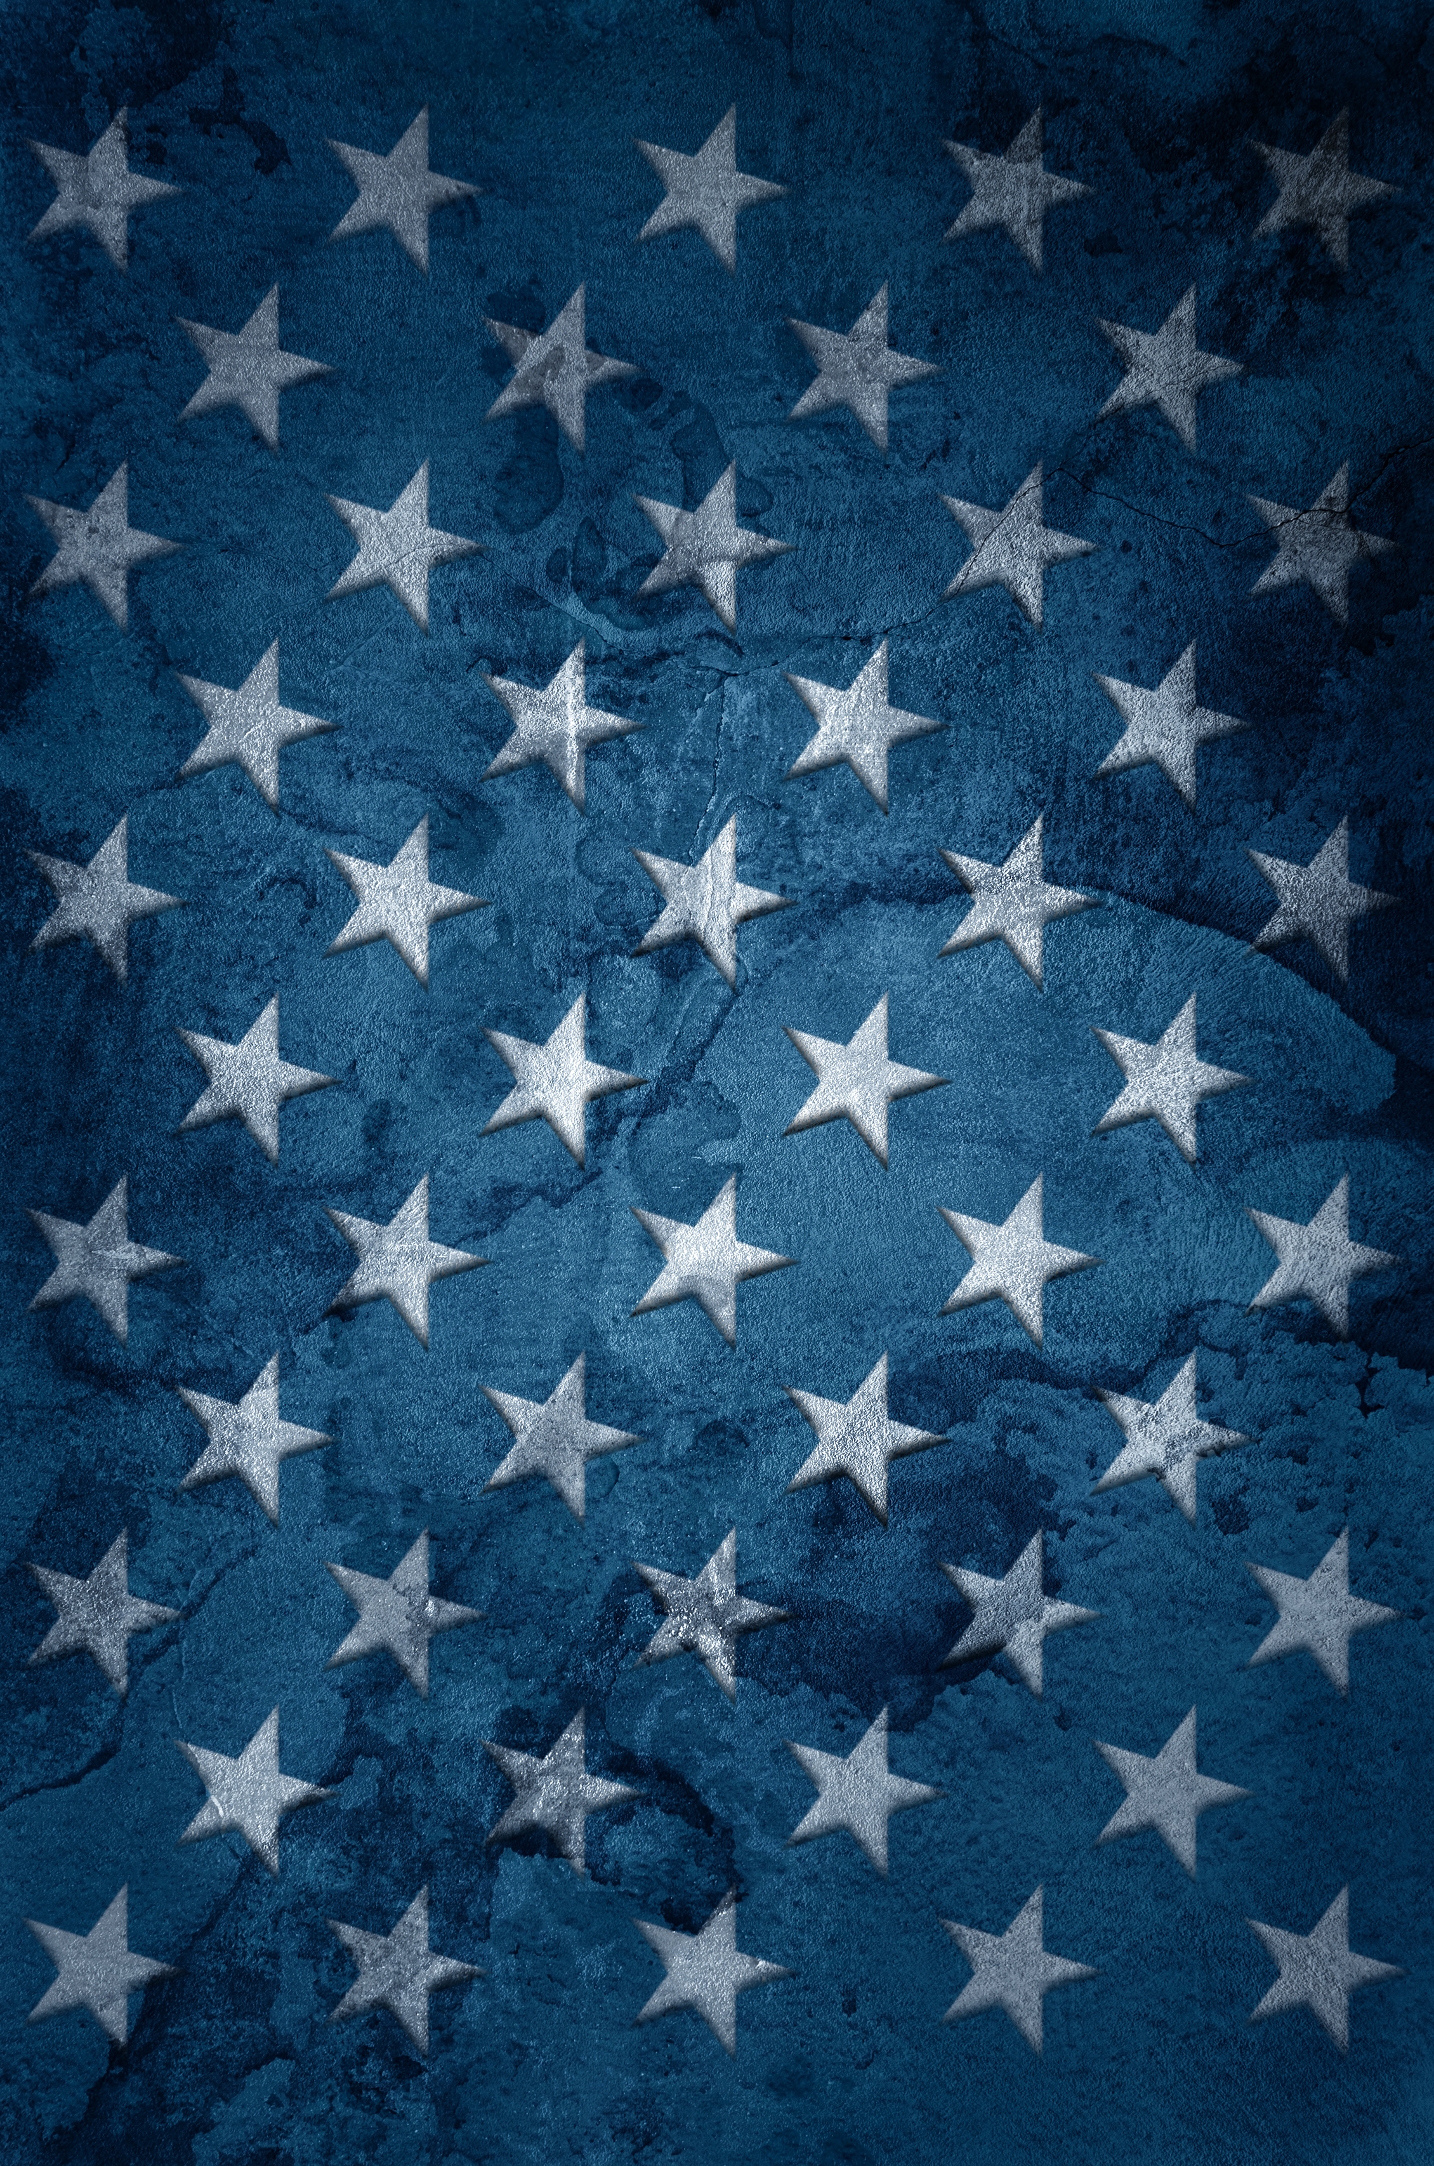


TASK 1
TASK 1
Use the Task 1 resources to complete your task and crack the code! Be sure to record answers on our group answer sheet.
Use the Task 1 resources to complete your task and crack the code! Be sure to record answers on our group answer sheet.
Constitutional Amendments
Constitutional Amendments
- - - - - - - - - - - - - - - - - - - - - - - - - - - - - - - - - - - - - - - - - - - - - - - - - - - - - - - - - - - - - - - - - - - - - - - - - -
- - - - - - - - - - - - - - - - - - - - - - - - - - - - - - - - - - - - - - - - - - - - - - - - - - - - - - -
TASK 2
TASK 2
Use the Task 2 resources to complete your task and crack the code! Be sure to record answers on our group answer sheet.
Use the Task 2 resources to complete your task and crack the code! Be sure to record answers on our group answer sheet.
The Three Branches
The Three Branches
14

Slide 15

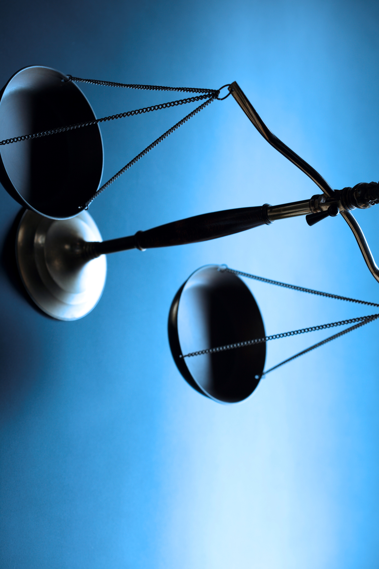


TASK 3
TASK 3
Use the Task 3 resources to complete your task and crack the code! Be sure to record answers on our group answer sheet.
Use the Task 3 resources to complete your task and crack the code! Be sure to record answers on our group answer sheet.
Checks and Balances
Checks and Balances
- - - - - - - - - - - - - - - - - - - - - - - - - - - - - - - - - - - - - - - - - - - - - - - - - - - - - - - - - - - - - - - - - - - - - - - - - -
- - - - - - - - - - - - - - - - - - - - - - - - - - - - - - - - - - - - - - - - - - - - - - - - - - - - - - -
TASK 4
TASK 4
Use the Task 4 resources to complete your task and crack the code! Be sure to record answers on our group answer sheet.
Use the Task 4 resources to complete your task and crack the code! Be sure to record answers on our group answer sheet.
Electoral
College
Electoral
College
15

Slide 16




TASK 5
TASK 5
- - - - - - - - - - - - - - - - - - - - - - - - - - - - - - - - - - - -
Use the Task 5 resources to complete your task and crack the code! Be sure to record answers on our group answer sheet.
State and Local Government & Federalism
Use the Task 5 resources to complete your task and crack the code! Be sure to record answers on our group answer sheet.
State and Local Government & Federalism
- - - - - - - - - - - - - - - - - - - - - - - - - - - - - - - - - - - - - - - - - - - - - - - - - - - - - - - - - - - - - - - - - - - - - - - - - -
- - - - - - - - - - - - - - - - - - - - - - - - - - - - - - - - - - - - - - - - - - - - - - - - - - - - - - -
TASK 6
TASK 6
Use the Task 4 resources to complete your task and crack the code! Be sure to record answers on our group answer sheet.
Use the Task 4 resources to complete your task and crack the code! Be sure to record answers on our group answer sheet.
Rights and Responsibilities
Rights and Responsibilities
16

Slide 17
TASK 1
CONSTITUTIONAL
AMENDMENTS
Amendments are changes to the Constitution of the United States. The Bill of Rights is the collection of the first ten amendments. They were added to the Constitution in 1791 at the request of people and states that wanted to ensure protection of the rights of individual citizens. Since 1791 there have been seventeen additional amendments for a total of twenty-seven, some of which have been challenged over the years.
Directions: Read the assigned text from Gale In Context: Middle School titled, “Bill of Rights and Constitutional Amendments”. Correctly match each part of the question with its answer by drawing a line to connect them. At the end, the letters with no line through them will reveal your code. Tip – use a ruler to get extra straight lines! Record the answers on your group answer key. Get approval of correct code before moving on to task 2.
- - - - - - - - - - - - - - - - - - - - - - - - - - - - - - - - - - - - - - - - - - - - - - - - - - - - - - -
TASK 1
CONSTITUTIONAL
AMENDMENTS
Amendments are changes to the Constitution of the United States. The Bill of Rights is the collection of the first ten amendments. They were added to the Constitution in 1791 at the request of people and states that wanted to ensure protection of the rights of individual citizens. Since 1791 there have been seventeen additional amendments for a total of twenty-seven, some of which have been challenged over the years.
Directions: Read the assigned text from Gale In Context: Middle School titled, “Bill of Rights and Constitutional Amendments”. Correctly match each part of the question with its answer by drawing a line to connect them. At the end, the letters with no line through them will reveal your code. Tip – use a ruler to get extra straight lines! Record the answers on your group answer key. Get approval of correct code before moving on to task 2.
17

Slide 18
TASK 1
CONSTITUTIONAL
AMENDMENTS
Correctly match each question with its answer by drawing a line to connect them (use the dots!). At the end, the letters with no line through them will reveal your code.
Tip – use a ruler to get extra straight lines!
1st Amendment | • |  | • | Guarantees equal protection under the law and defines citizenship
4th Amendment | • |  | • | Protects freedom of speech, religion, press, assembly, and petition
5th Amendment | • |  | • | Ends slavery in the United States
6th Amendment | • |  | • | Protects against cruel and unusual punishment
8th Amendment | • |  | • | Grants women the right to vote
13th Amendment | • |  | • | Ensures the right to a fair and speedy trial with a lawyer
14th Amendment | • |  | • | Protects against self-incrimination and guarantees due process
15th Amendment | • |  | • | Lowers the voting age to 18
19th Amendment | • |  | • | Grants voting rights regardless of race or color
26th Amendment | • |  | • | Protects against unreasonable searches and seizures
C
N
H
A
I
S
G
E
V
M
D
I
P
C
L
S
18

Slide 19
TASK 2
THE THREE BRANCHES
The American government is the method by which the United States operates and rules its people. The United States began in 1776 after many years under British control. In 1788, following extensive debate, American leaders crafted the Constitution, a document describing the government of the new country. The Constitution set out the rights of citizens that were to be protected. It also described the government itself as a three-branch system in which every part of the government had its own powers but was also dependent on other parts.
Directions: Read the assigned articles on the three branches of government – Executive, Legislative, and Judicial - Gale In Context: Middle School. Then complete the cut-and-sort activity, assigning each responsibility to its correct branch of government. Record total numbers for each branch on the group answer sheet and get approval before moving on to task 3.
- - - - - - - - - - - - - - - - - - - - - - - - - - - - - - - - - - - - - - - - - - - - - - - - - - - - - - -
TASK 2
THE THREE BRANCHES
The American government is the method by which the United States operates and rules its people. The United States began in 1776 after many years under British control. In 1788, following extensive debate, American leaders crafted the Constitution, a document describing the government of the new country. The Constitution set out the rights of citizens that were to be protected. It also described the government itself as a three-branch system in which every part of the government had its own powers but was also dependent on other parts.
Directions: Read the assigned articles on the three branches of government – Executive, Legislative, and Judicial - Gale In Context: Middle School. Then complete the cut-and-sort activity, assigning each responsibility to its correct branch of government. Record total numbers for each branch on the group answer sheet and get approval before moving on to task 3.
19

Slide 20
TASK 2
BRANCH SORT
Sort each responsibility card to the correct branch. The total number of each will reveal your code. Record your code on the group answer key and get approval before moving on to task 3.
EXECUTIVE
LEGISLATIVE
JUDICIAL
TOTAL:
TOTAL:
TOTAL:
20

Slide 21
TASK 2
BRANCH SORT
Appoints federal judges
Collects taxes
Interprets laws
Commands the military
Signs bills into law
Writes and passes laws
Declares war
Can overturn lower court decisions
Vetoes bills
Settles disputes
between states
Decides if laws
are constitutional
Approves presidential
appointments
Enforces laws
Confirms Supreme Court justices
Makes treaties with
foreign nations
Can override a
presidential veto
Impeaches the President
Oversees the
court system
21

Slide 22
TASK 3
CHECKS AND BALANCES
Checks and balances are the rules and regulations between the three branches of the US federal government. The US Constitution, written in 1787, created a democratic government divided into three separate parts: the legislative branch, the executive branch, and the judicial branch. Checks and balances keep any one branch of the government from becoming too powerful and ensures that the government remains balanced. They give each branch the tools to check on the other two branches. Checks and balances are an important part of American government that play a key role in protecting and promoting democracy.
Directions: Read the assigned text from Gale In Context: Middle School titled, “Checks and Balances”. Then complete the Tarsia puzzle by connecting the sides of each triangle to their corresponding question. You will end with a large hexagon shape. Your code is a quote, which will be visible around the perimeter once you complete the puzzle. Record this quote on the group answer sheet and get approval before moving on to task 4.
- - - - - - - - - - - - - - - - - - - - - - - - - - - - - - - - - - - - - - - - - - - - - - - - - - - - - - -
TASK 3
CHECKS AND BALANCES
Checks and balances are the rules and regulations between the three branches of the US federal government. The US Constitution, written in 1787, created a democratic government divided into three separate parts: the legislative branch, the executive branch, and the judicial branch. Checks and balances keep any one branch of the government from becoming too powerful and ensures that the government remains balanced. They give each branch the tools to check on the other two branches. Checks and balances are an important part of American government that play a key role in protecting and promoting democracy.
Directions: Read the assigned text from Gale In Context: Middle School titled, “Checks and Balances”. Then complete the Tarsia puzzle by connecting the sides of each triangle to their corresponding question. You will end with a large hexagon shape. Your code is a quote, which will be visible around the perimeter once you complete the puzzle. Record this quote on the group answer sheet and get approval before moving on to task 4.
22

Slide 23

men
of
The US Constitution created a _____ government.
Checks and balances keep any one branch of the government from becoming too _____.
The history of checks and balances starts with the concept of _____.
_____ first suggested the separation of powers.
-John Adams
democratic
Separation of powers
powerful
Aristotle thought the most successful type of government would be _____.
The legislative branch includes both houses of _____.
Congress
Representatives
The Supreme Court can strike down laws that it finds _____.
Madison
federal
The Supreme Court’s power of judicial review started with Marbury v. _____.
judicial
unconstitutional
The president can also pardon people convicted of _____ crimes.
and
of
laws
The House of _____ and the Senate make Congress.
mixed
The judicial branch’s most important role in the system is _____ review.
A government
Aristotle
not
23

Slide 24
TASK 4
ELECTORAL COLLEGE
Voting is an essential process in a democratic country. It allows citizens to choose their own leaders and many of their own laws. In the United States, citizens may vote for officials at the local, state, and national levels of government. Most votes are direct, meaning that the candidate with the most votes wins the office.
In the case of presidential elections, however, Americans use an electoral college system. In this system, voters actually choose state officials called electors, who in turn choose the president. The electoral college is meant to protect the country from oppressive leaders. It also protects the rights of small states. It is often criticized, though, for cases in which it awards the presidency to a candidate who did not win the most votes from citizens.
Directions: Read the assigned text from Gale In Context: Middle School titled, “Voting and Electoral College”. Sort through the election result cards and record received electoral votes (using the map at the top of the Gale document) in the proper column for each candidate. Add the electoral votes to determine the winner of the election. Record on your group answer sheet and get approval before moving on to task 5.
- - - - - - - - - - - - - - - - - - - - - - - - - - - - - - - - - - - - - - - - - - - - - - - - - - - - - - -
TASK 4
ELECTORAL COLLEGE
Voting is an essential process in a democratic country. It allows citizens to choose their own leaders and many of their own laws. In the United States, citizens may vote for officials at the local, state, and national levels of government. Most votes are direct, meaning that the candidate with the most votes wins the office.
In the case of presidential elections, however, Americans use an electoral college system. In this system, voters actually choose state officials called electors, who in turn choose the president. The electoral college is meant to protect the country from oppressive leaders. It also protects the rights of small states. It is often criticized, though, for cases in which it awards the presidency to a candidate who did not win the most votes from citizens.
Directions: Read the assigned text from Gale In Context: Middle School titled, “Voting and Electoral College”. Sort through the election result cards and record received electoral votes (using the map at the top of the Gale document) in the proper column for each candidate. Add the electoral votes to determine the winner of the election. Record on your group answer sheet and get approval before moving on to task 5.
24

Slide 25
Sort through the election result cards and record received electoral votes in the proper column for each candidate. Add the electoral votes to determine the winner of the election. Record on your group answer sheet and get approval before moving on to task 5.
What is the popular vote? ________________________________________________________________
What is the electoral vote? _______________________________________________________________
Does the person who receives the most individual votes win?____________________________
___________________________________________________________________________________________
Lucy Liberty | Jordan Justice
WINNER: ELECTORAL COUNT:
25

Slide 26
California Lucy Liberty 54 | New York Lucy Liberty 28 | Illinois Lucy Liberty 19 | Pennsylvania Jordan Justice 19 | Ohio Lucy Liberty 17
Georgia Jordan Justice 16 | Michigan Jordan Justice 15 | North Carolina Jordan Justice 16 | New Jersey Jordan Justice 14 | Virginia Lucy Liberty 13
Washington Lucy Liberty 12 | Arizona Jordan Justice 11 | Massachusetts Lucy Liberty 11 | Tennessee Jordan Justice 11 | Wisconsin Jordan Justice 10
Minnesota Jordan Justice 10 | Maryland Lucy Liberty 10 | Connecticut Lucy Liberty 7 | Oregon Jordan Justice 8 | Oklahoma Jordan Justice 7
Iowa Jordan Justice 6 | Arkansas Jordan Justice 6 | Nevada Jordan Justice 6 | Utah Jordan Justice 6 | Mississippi Jordan Justice 6
 |  |  |  | Washington D.C. Lucy Liberty 3
26

Slide 27
Rhode Island Lucy Liberty 4 | Maine Lucy Liberty 4 | Idaho Jordan Justice 4 | Montana Jordan Justice 4 | Delaware Lucy Liberty 3
Vermont Lucy Liberty 3 | Texas Lucy Liberty 40 | Florida Jordan Justice 30 | Indiana Jordan Justice 11 | Missouri Jordan Justice 10
South Carolina Lucy Liberty 9 | Alabama Jordan Justice 9 | Colorado Lucy Liberty 10 | Kentucky Jordan Justice 8 | Louisiana Jordan Justice 8
Wisconsin Jordan Justice 10 | North Dakota Lucy Liberty 3 | South Dakota Lucy Liberty 3 | Alaska Jordan Justice 3 | Wyoming Lucy Liberty 3
Nebraska Lucy Liberty 5 | New Mexico Lucy Liberty 5 | West Virginia Jordan Justice 4 | Hawaii Lucy Liberty 4 | New Hampshire Lucy Liberty 4
27

Slide 28
TASK 5
LOCAL AND STATE GOVERNMENT & FEDERALISM
State and local governments are smaller than the federal government, which oversees the entire country. State governments oversee a particular state and are structured like the federal government. Each contains three branches: the executive, judicial, and legislative branches. Additionally, each is led by a governor who is elected by the people.
Local governments vary in size and structure. Some are modeled like state governments except that they have a mayor instead of a governor, but others are run by a city council, representative council, or town meeting.
Directions: Read the assigned article “State and Local Government” in Gale In Context: Middle School. Answer the corresponding questions to reveal your code word. Get approval of correct code before moving on to task 6.
- - - - - - - - - - - - - - - - - - - - - - - - - - - - - - - - - - - - - - - - - - - - - - - - - - - - - - -
TASK 5
LOCAL AND STATE GOVERNMENT & FEDERALISM
State and local governments are smaller than the federal government, which oversees the entire country. State governments oversee a particular state and are structured like the federal government. Each contains three branches: the executive, judicial, and legislative branches. Additionally, each is led by a governor who is elected by the people.
Local governments vary in size and structure. Some are modeled like state governments except that they have a mayor instead of a governor, but others are run by a city council, representative council, or town meeting.
Directions: Read the assigned article “State and Local Government” in Gale In Context: Middle School. Answer the corresponding questions to reveal your code word. Get approval of correct code before moving on to task 6.
28

Slide 29
1. What is the main difference between the federal government and state governments?
Q. State governments are more powerful
R. Federal government oversees the entire country
S. State governments have no branches
9. What is one responsibility of state governments?
R. Running national elections
S. Managing the country’s military
T. Maintaining roads and infrastructure
2. Who leads a state government?
C. Mayor
D. President
E. Governor
10. What is the job of local courts?
Y. To handle federal crimes
Z. To make new laws
A. To handle local issues like traffic tickets
3. What are the three branches of most state governments?
O. Executive, Legislative, Military
P. Judicial, Legislative, Executive
Q. Executive, Financial, Judicial
11.What is a town meeting system?
S. A way to elect governors
T. A direct democracy where people vote on issues
U. A meeting of mayors
4. What is the role of a governor?
P. To run the federal government
Q. To lead the judicial branch
R. To lead the state’s executive branch
12. What is one advantage of local governments?
H. They have more power than the federal government
I. They are closer to the people and know their needs
J. They can ignore state laws
5. What is one way local governments differ from state governments?
C. They have no leaders
D. They are always run by a mayor
E. They may use town meetings for decisions
13. What is the higher chamber in most state legislatures?
N. House of Representatives
O. State Senate
P. City Council
6. What is federalism?
Q. A type of monarchy
R. A system where only the president makes laws
S. A government divided into levels with different responsibilities
14. What does the word representation mean in the context of local and state governments?
L. The ability to vote in national elections
M. The process of building new roads
N. Having elected officials who speak and act on behalf of the people
7. Who gives power to local governments?
C. The president
D. The federal courts
E. The state governments
8. What happens when a state law conflicts with a federal law?
M. The state law wins
N. The federal law takes precedence
O. The people vote on it
29

Slide 30
TASK 6
RIGHTS AND RESPONSIBILITIES
Citizens of the United States and other countries have rights and responsibilities. Citizens are people who are official members of a country. Citizens generally make up most of a country’s population. They are connected by the rights that they have and the responsibilities they are expected to perform. Rights are what people are allowed to do or the protections that they have. Responsibilities are what people are expected to do. In the United States, different documents, laws, and customs explain citizens’ rights and responsibilities.
Directions: Read the assigned article “Rights and Responsibilities of Citizenship” in Gale In Context: Middle School. Use the Polybius Cipher to decode the answers to the corresponding questions. Record your answers on your group answer sheet. Shaded boxes will reveal your code. Get the code correct to escape!
- - - - - - - - - - - - - - - - - - - - - - - - - - - - - - - - - - - - - - - - - - - - - - - - - - - - - - -
TASK 6
RIGHTS AND RESPONSIBILITIES
Citizens of the United States and other countries have rights and responsibilities. Citizens are people who are official members of a country. Citizens generally make up most of a country’s population. They are connected by the rights that they have and the responsibilities they are expected to perform. Rights are what people are allowed to do or the protections that they have. Responsibilities are what people are expected to do. In the United States, different documents, laws, and customs explain citizens’ rights and responsibilities.
Directions: Read the assigned article “Rights and Responsibilities of Citizenship” in Gale In Context: Middle School. Use the Polybius Cipher to decode the answers to the corresponding questions. Record your answers on your group answer sheet. Shaded boxes will reveal your code. Get the code correct to escape!
30

Slide 31




TASK 6
POLYBIUS SQUARE
1
2
3
4
5
A | B | C | D | E
F | G | H | I | J
K | L | M | N | O
P | Q | R | S | T
U | V | W | X
Y
Z
EXAMPLE:
4
5
1
= SEA
31

Slide 32
TASK 6
POLYBIUS SQUARE
QUESTIONS
Use the Polybius Cipher to decode the answers to the corresponding questions. Record your answers on your group answer sheet. Shaded boxes will reveal your code.
One of the most important responsibilities of American citizens is __________.
The right to a fair and speedy __________ protects citizens accused of crimes.
Citizens are expected to serve on a __________ to help decide legal cases.
The right to “life, ___________, and the pursuit of happiness” is found in the Declaration of Independence.
Citizens can help their communities by volunteering their time and __________.
2
5
5
4
4
2
5
3
4
1
2
5
1
3
5
2
4
2
5
3
5
5
5
1
1
5
3
5
32

Slide 33
CITATION INFORMATION
TASK 1
"Constitutional Amendments." Gale In Context Online Collection, Gale, 2019. Gale In Context: Middle School, l ink.gale.com/apps/doc/SAEDIC771526748/MSIC?u=[INSERTLOCID]
&sid=bookmark-MSIC&xid=83ee4e8b. Accessed 22 July 2025.
TASK 2
"Executive Branch." Gale Middle School Online Collection, Gale, 2022. Gale In Context: Middle School, link.gale.com/apps/doc/QPDHVS696111898/MSIC?u=[INSERTLOCID]
&sid=bookmark-MSIC&xid=33081397. Accessed 22 July 2025.
"Legislative Branch." Gale Middle School Online Collection, Gale, 2022. Gale In Context: Middle School, link.gale.com/apps/doc/RZASOF810008556/MSIC?u=[INSERTLOCID]
&sid=bookmark-MSIC&xid=ca9e49b2. Accessed 22 July 2025.
"Judicial Branch." Gale Middle School Online Collection, Gale, 2022. Gale In Context: Middle School, link.gale.com/apps/doc/DIQRYP225233181/MSIC?u=[INSERTLOCID]
&sid=bookmark-MSIC&xid=aa425f7d. Accessed 22 July 2025.
TASK 3
"Checks and Balances." Gale Middle School Online Collection, Gale, 2025. Gale In Context: Middle School, link.gale.com/apps/doc/XPDWUZ292213706/MSIC?u=[INSERTLOCID]
&sid=bookmark-MSIC&xid=5b1d894c. Accessed 22 July 2025.
TASK 4
"Voting and Electoral College." Gale Middle School Online Collection, Gale, 2022. Gale In Context: Middle School, link.gale.com/apps/doc/PXGLVM839816039/MSIC?u=[INSERTLOCID]
&sid=bookmark-MSIC&xid=8754b9ce. Accessed 22 July 2025.
TASK
5
"State and Local Government." Gale Middle School Online Collection, Gale, 2019. Gale In Context: Middle School, link.gale.com/apps/doc/GNEHQH292781346/MSIC?u=[INSERTLOCID]
&sid=bookmark-MSIC&xid=2368da1f. Accessed 22 July 2025.
TASK
6
"Rights and Responsibilities of Citizenship." Gale Middle School Online Collection, Gale, 2019. Gale In Context: Middle School, link.gale.com/apps/doc/KCXRXP314796452/MSIC?u=[INSERTLOCID]
&sid=bookmark-MSIC&xid=16c6e6a4. Accessed 22 July 2025.
EXPLORE MORE!
Find more classroom resources and support materials at:
support.gale.com
33

