Slide 1
ACCESSIBLITY TOOLS IN GALE RESOURCES

Slide 2
SUPPORT LEARNERS OF ALL ABILITIES
A
A
Leveled Content
Text Translation
Font Size Control
ReadSpeaker Technology

Slide 3
LEVELED CONTENT: DEVELOPING AND ADVANCED READERS
LOWER ELEMENTARY
Up to 500L
UPPER ELEMENTARY
501L – 850L
MIDDLE SCHOOL
851L – 1100L
HIGH SCHOOL
1101L – 1300L
UNDERGRADUATE AND UP
1301L +

Slide 4
LEVELED CONTENT: DEVELOPING AND ADVANCED READERS
LOWER ELEMENTARY
Up to 500L
UPPER ELEMENTARY
501L – 850L
MIDDLE SCHOOL
851L – 1100L
HIGH SCHOOL
1101L – 1300L
UNDERGRADUATE AND UP
1301L +

Slide 5
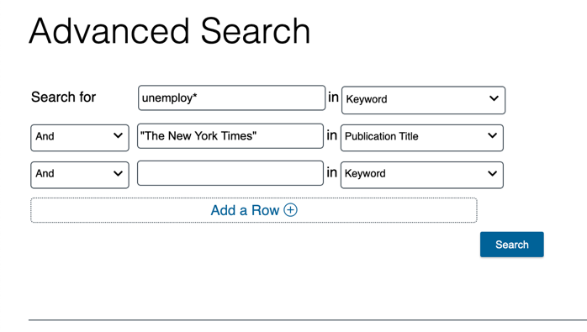
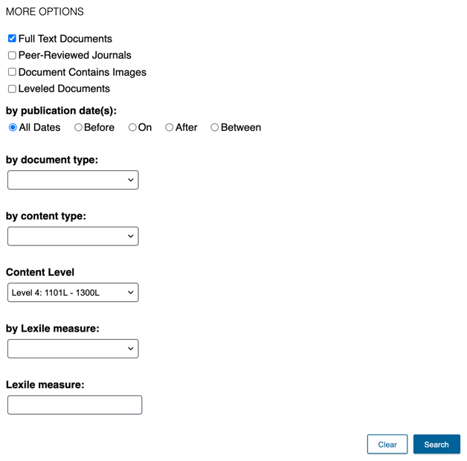
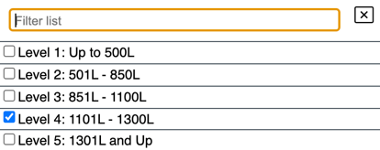
SUPPORT DEVELOPING AND ADVANCED READERS
LOWER ELEMENTARY
Up to 500L
Target content levels – Advanced Search
UPPER ELEMENTARY
501L – 850L
MIDDLE SCHOOL
851L – 1100L
HIGH SCHOOL
1101L – 1300L
UNDERGRADUATE AND UP
1301L +
Notes:
Unhide this slide if you’d like to show individuals how to use Advanced search options to uncover alternate content levels.

Slide 6
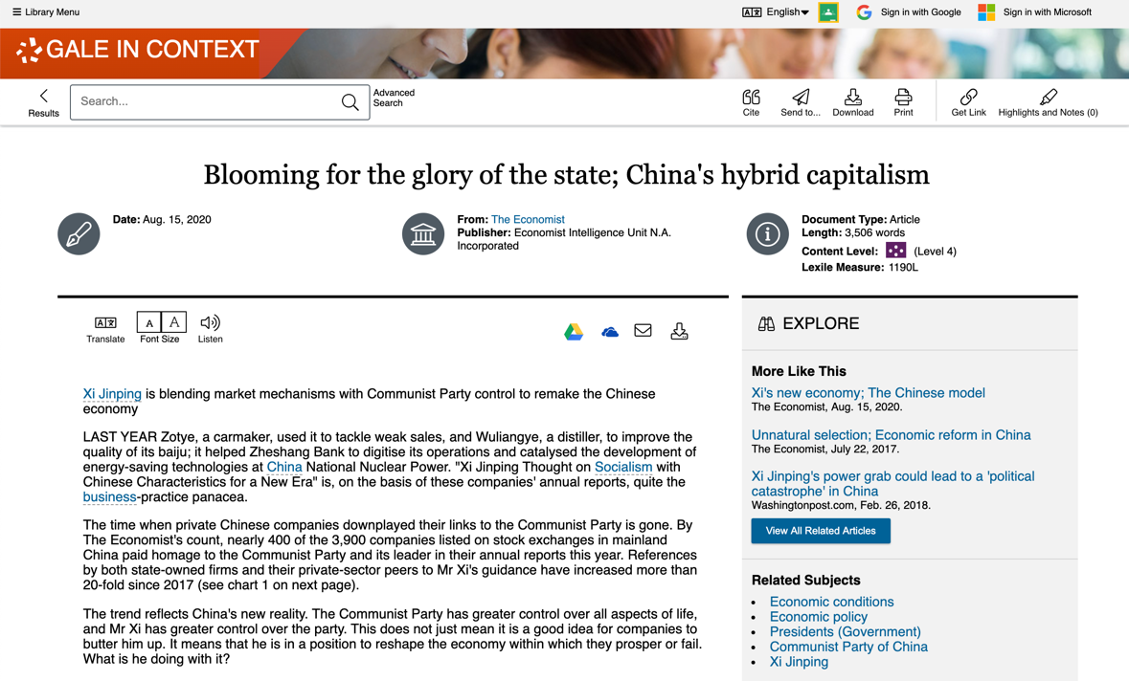
SUPPORT ACCESSIBLE LEARNING
TRANSLATE
Machine translate articles– 40+ languages
FONT SIZE
Increase or reduce as needed
LISTEN
Hear text read aloud
Download MP3
Enhance text visibility
Simply click/tap to use!
Notes:
and to listen to a machine reading of the text. Once a user clicks the listen function, the user will have the option to access additional tools, including the ability to download the MP3, and the option to access a settings menu that provides choices for reading speed, reading highlights, and even the Enhanced text visibility feature, which pops out an enlarged version of the phrase currently being read while the listen tool is reading.

Slide 7
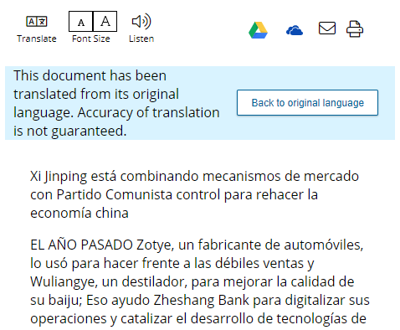
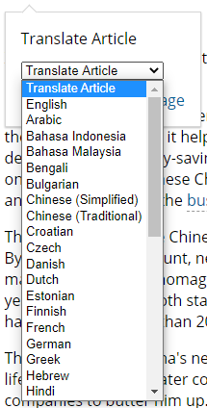
SUPPORT ACCESSIBLE LEARNING
TRANSLATE
Machine translate articles– 40+ languages
TRANSLATED DOCUMENT

Slide 8
SUPPORT ACCESSIBLE LEARNING
FONT SIZE
Increase or reduce as needed

Slide 9
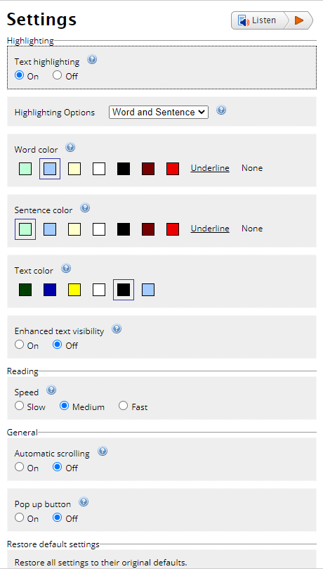
SUPPORT ACCESSIBLE LEARNING
LISTEN
Text Highlighting
Enable synchronized highlighting of the text that is currently being read
Highlighting Options
Select what parts of the text are highlighted
Enhanced Text Visibility
Display the current sentence at the bottom of the page with a larger font size and simultaneous text highlighting
Automatic Scrolling
Turn on to have the page automatically scroll to follow the highlighted text
Click Listen to have the article read aloud to you and access the ReadSpeaker settings.

Slide 10
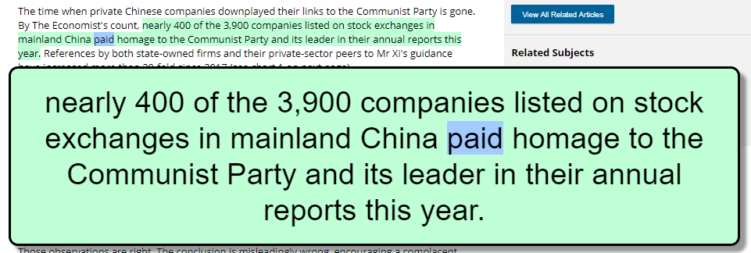
SUPPORT ACCESSIBLE LEARNING
LISTEN
Enhanced Text Visibility
Toggle Enhanced Text Visibility ‘on’ to display the current sentence at the bottom of the page with a larger font size and simultaneous text highlighting that is synchronized with the audio
Use this feature to support a wide range of reading difficulties such as low reading rate, accuracy, and comprehension. It is also beneficial for English language learners to improve their reading and comprehension skills.

