Slide 1
GALE ONEFILE PERIODICAL COLLECTIONS
Notes:
Please note that these slides may need to modified based on your institution’s Gale subscriptions.

Slide 2
GALE ONEFILE – The Big Three
Notes:
There are three major Gale OneFile collections. Gale General OneFile caters to more general interest researchers and is popular with public library patrons and high school users; Gale OneFile News has news content from local, national, and international newspapers and newswires, and Gale Academic OneFile is geared towards academic researchers, focusing on content from scholarly publications.

Slide 3
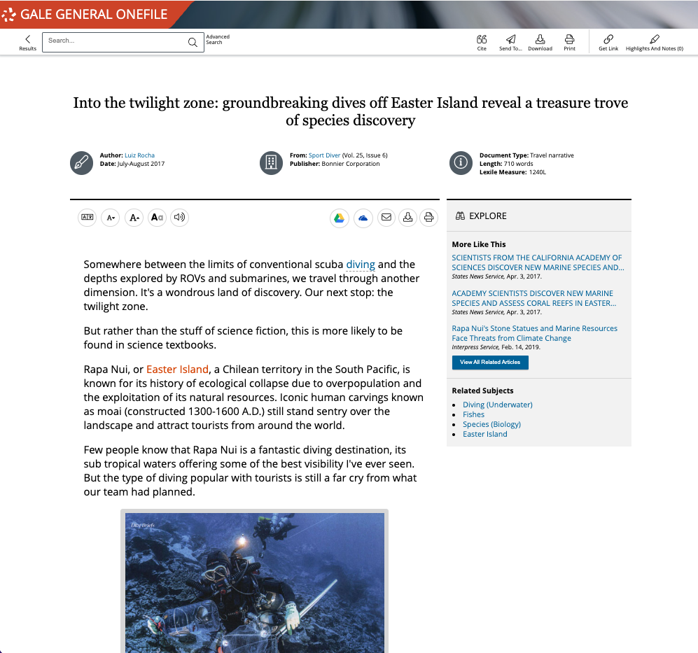
GALE GENERAL ONEFILE
GENERAL INTEREST PERIODICAL RESOURCE FOR ALL USERS
Notes:
Thousands of full-text magazines and journals recommended by Bowker's Magazines for Libraries are available also including reference, newspaper, and audio content that complements the resource's robust collection of magazines and journals. With millions of articles available, this resource serves a wide audience of readers.

Slide 4
GALE GENERAL ONEFILE: KEY SUBJECTS AND TOPICS
Notes:
In General OneFile, this Includes social studies, science & health, careers & education, and personal interest

Slide 5
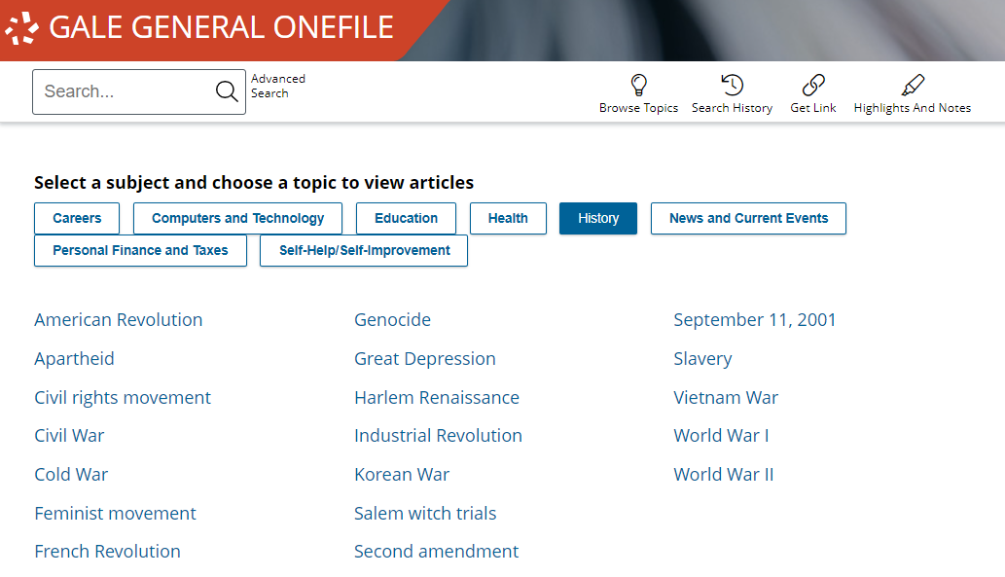
SOCIAL STUDIES
History
American Revolution, Civil War, French Revolution, Genocide, Great Depression, Harlem Renaissance, Industrial Revolution, Second Amendment, Slavery, and more.
News & Current Events
Adoption, Animal Rights, Censorship, Climate change, Discrimination, Human Trafficking, Immigration, LGBTQ issues, Police brutality, Pollution, Poverty, Terrorism, and more.
Notes:
Here are just a few of the many examples of topics covered within social studies.
Feel free to hide slides, or feature different topic page subjects depending on the audience you present to.

Slide 6
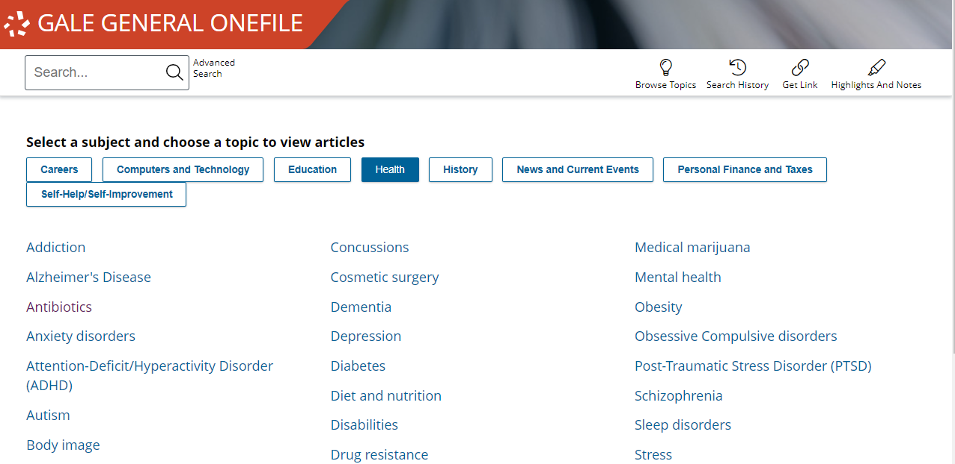
SCIENCE AND HEALTH
Computers and Technology
Artificial intelligence, Biotechnology, Cyber security, Digital divide, Electric cars, Net neutrality, Robotics, Social Media, and more.
Health
Addiction, Antibiotics, Anxiety disorders, Autism, Body image, Concussions, Depression, Diet and nutrition, Gender identity, Mental Health, Stress, and more,
Notes:
Here are just a few of the many examples of topics covered within science & health.
Feel free to hide slides, or feature different topic page subjects depending on the audience you present to.

Slide 7
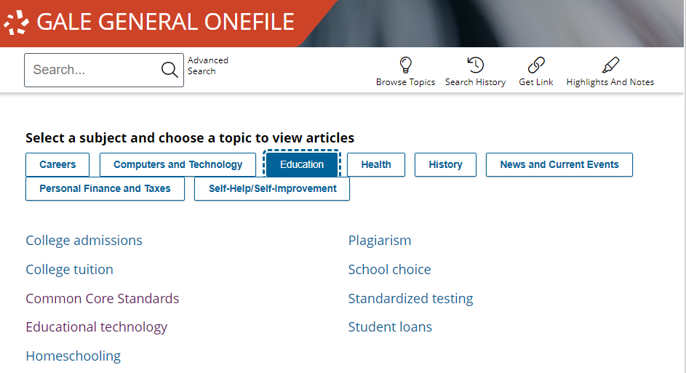
CAREERS AND EDUCATION
Careers
Accounting, Engineering, Law, Military, Nursing, Science, Teaching, and more.
Education
College tuition, Common Core Standards, Education technology, Homeschooling, and more.
Notes:
Here are just a few of the many examples of topics covered within literature and the arts.
Feel free to hide slides, or feature different topic page subjects depending on the audience you present to.

Slide 8
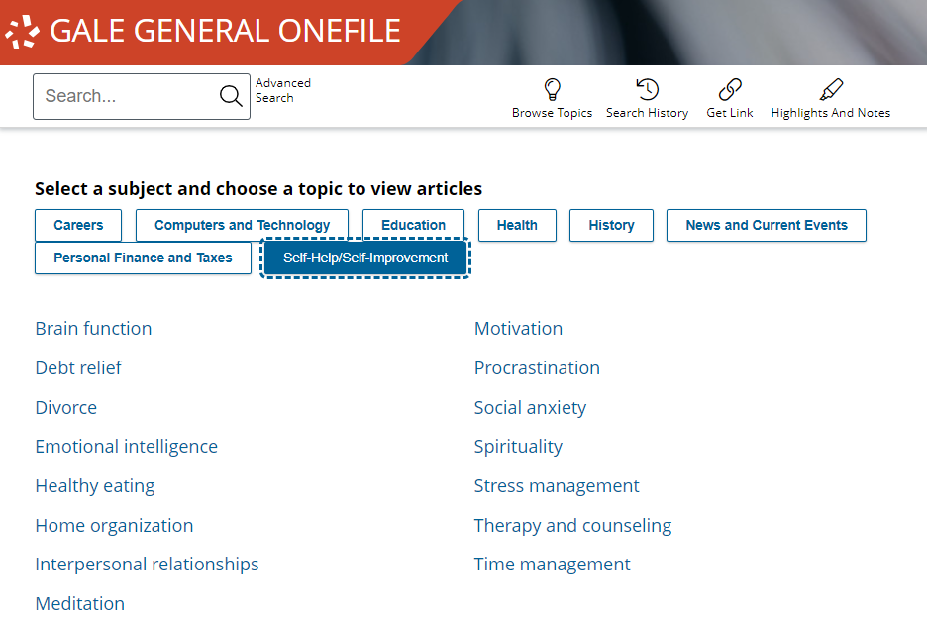
PERSONAL INTEREST
Personal Finance and Taxes
Investment research, retirement planning, Small business planning, Tax law, and more.
Self-Help/Self-Improvement
Brain function, Divorce, Emotional intelligence, Healthy eating, Home organization, Meditation, Motivation, Procrastination, Social anxiety, Spirituality, Stress management, Therapy and counseling, and more.
Notes:
Here are just a few of the many examples of topics covered within personal interest.
Feel free to hide slides, or feature different topic page subjects depending on the audience you present to.

Slide 9
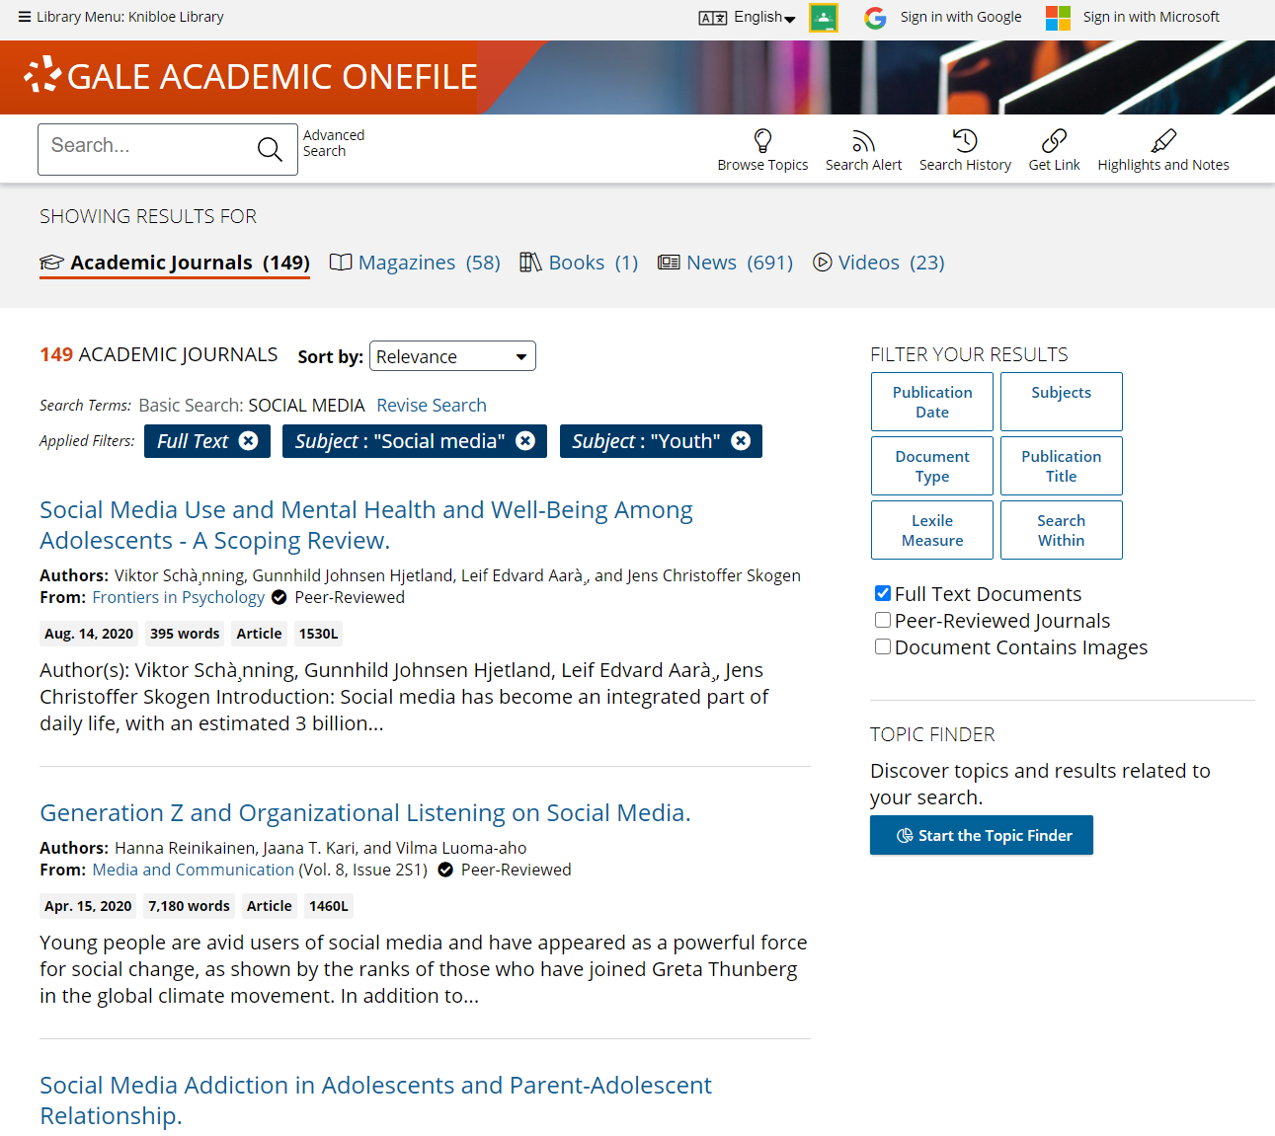
GALE ACADEMIC ONEFILE
Peer-reviewed scholarly content for educators and researchers
Notes:
Gale’s premier periodical resource, Gale Academic OneFile, provides millions of articles from over 17,000 scholarly journals and other authoritative sources—including thousands of podcasts and transcripts from NPR and CNN as well as videos from BBC Worldwide Learning.
With extensive coverage in key subject areas such as, biology, chemistry, criminal justice, economics, environmental science, history, marketing, political science, and psychology, researchers can find accurate information and articles.

Slide 10
GALE ACADEMIC ONEFILE: KEY SUBJECTS AND TOPICS
Notes:
In Gale Academic OneFile the topics cover a smaller range of subjects, focusing on the academic fields of liberal arts and science & health.

Slide 11
LIBERAL ARTS
Criminal Justice
Appeals, Arrests, Court system, Crime prevention, Due process, Evidence, Felonies and misdemeanors, Grand jury, Jury selection, Miranda rights, Prison life, Prosecution and defense attorneys, Search, seizures, & warrants, and more.
History and Political Science
African culture, history, and religion, American Reconstruction, Black history, capitalism, Globalization, Multiculturalism, Common Law, Lobbying, Political participation, Primaries, States rights, and more.
Economics
Banking industry, Capital investments, Credit cards, Demand, Economic development, Entrepreneurship, Game theory, Interest rates, Labor unions, national debt, Risk, Stocks, Taxation, Unemployment, Wage gap, and more.
Psychology
Anxiety disorders, Classical conditioning, Critical thinking, Drug use, Endocrine system and hormones, Group therapy, Long-term memory, Mood disorders, Nervous system, Psychologists, and more.
Notes:
Here are just a few of the many examples of topics covered within the liberal arts.
Feel free to hide slides, or feature different topic page subjects depending on the audience you present to.

Slide 12
SCIENCE AND HEALTH
Chemistry
Acids and Bases, Catalysis, Combustion, Covalent Bonds, Entropy, Ions, Metals, Molecules, Organic Chemistry, Proteins, Semiconductors, and more.
Environmental Science
Agriculture, Biodiversity, Climate change, Coal, Ecosystems, Floods, Global warming, Hydrologic cycle, Natural gas, Maps and mapping, Natural gas, Oceans, Solar energy, Population growth, and more.
Biology
Animal behavior, Bacteria, Brain, Cells, DNA, Ecology, Evolution, Genes, Metabolism, Mutation, Natural selection, Photosynthesis, RNA, Symbiosis, and more.
Notes:
Here are just a few of the many examples of topics covered within science & health.
Feel free to hide slides, or feature different topic page subjects depending on the audience you present to.

Slide 13
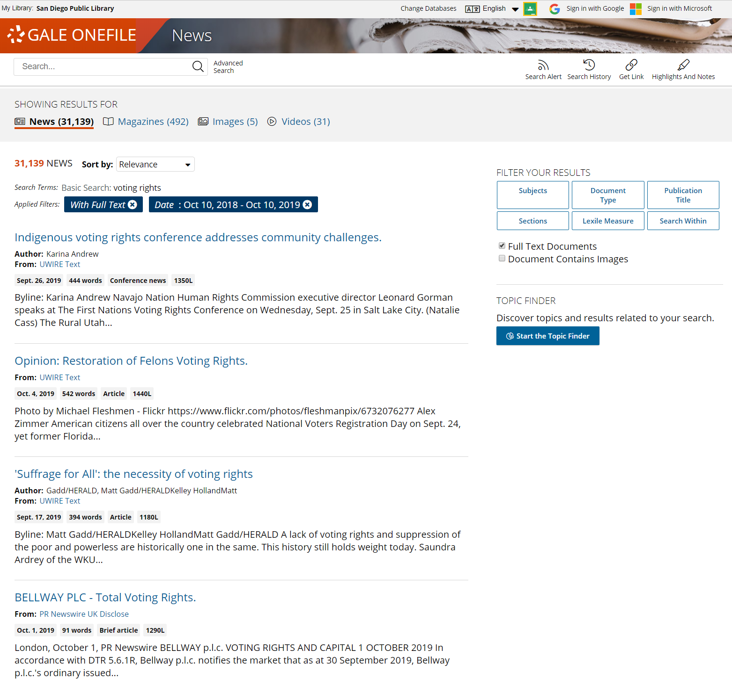
GALE ONEFILE: NEWS
U.S. and World Newspapers & Media
Notes:
Gale OneFile: News provides access to more than 2,300 major U.S. regional, national, and local newspapers, as well as leading titles from around the world. It also includes thousands of images, radio and TV broadcasts and transcripts. Users can search articles instantly by title, headline, date, author, newspaper section, or other fields.

Slide 14
GALE ONEFILE: SUBJECT COLLECTIONS
Subject-specific Content for a Variety of Interests
Content sourced from General, News, and Academic OneFile
Notes:
Gale OneFile Subject Collections pull content from General, News, and Academic sources to target special interests. In these Subject Collections, you will find content and publications relevant to your topic area. This makes it easy to search and explore content only related to your field of interest.

Slide 15
POPULAR COLLECTIONS INCLUDE

Slide 16
GALE ONEFILE: HOME IMPROVEMENT
This collection of home-improvement focused titles covers such topics as:
Architectural Techniques
Tool and Material Selection
Zoning Requirements
Design Ideas and Inspiration
And More!
Key Publications Include:
Architectural Digest
Better Homes and Gardens
Country Living
Good Housekeeping
Woodworker’s Journal
Designed to meet the needs of both hobbyists and professionals.

Slide 17
GALE ONEFILE: HEALTH AND MEDICINE
The perfect resource for up-to-date information on the complete range of health care topics including:
General Medicine
Cardiology
Oncology
Public Health
Dentistry
Pediatrics
Key Publications include:
The Lancet
The Journal of the American Medical Association
The New England Journal of Medicine
Created specifically for students, consumer health researchers, and health care professionals.

Slide 18
GALE ONEFILE: GARDENING AND HORTICULTURE
This collection focuses on key issues in gardening, landscaping, pest control, sustainable gardening practices, and other areas of horticulture.
Key Publications Include:
American Forests
Backyard and Outdoor Living
Landscape Magazine
Bloom
The Botanical Review
Applied and Environmental Soil Science
Better Homes and Gardens
This collection provides information for gardening enthusiasts and professionals alike.

Slide 19
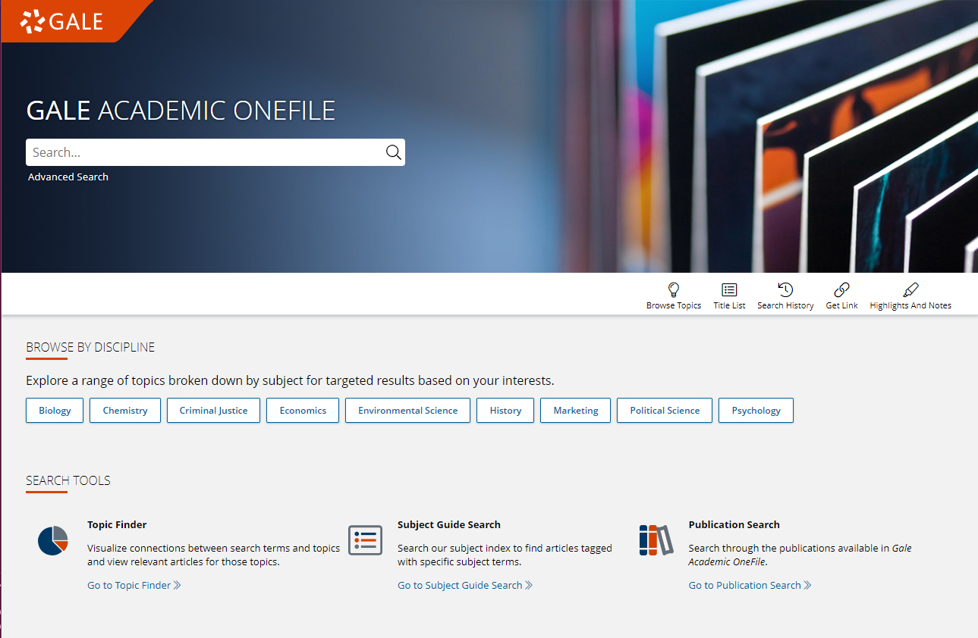
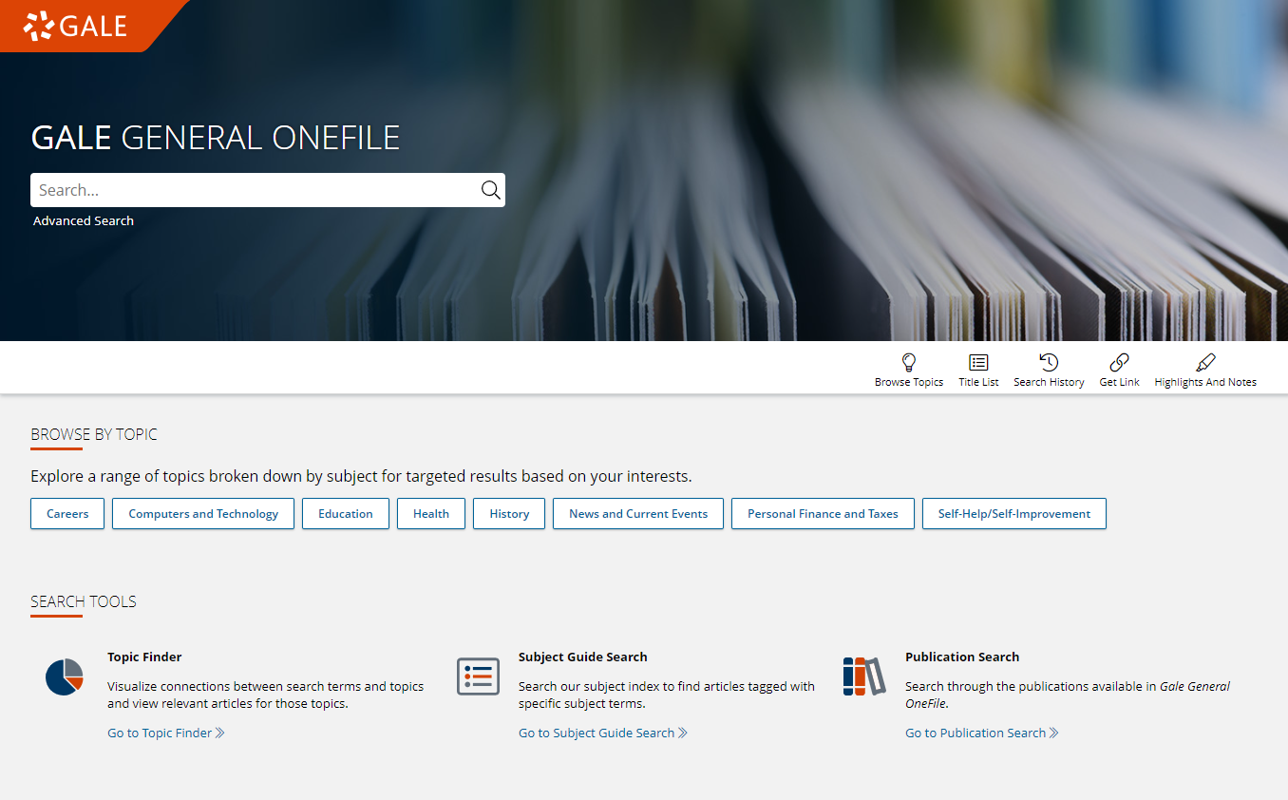
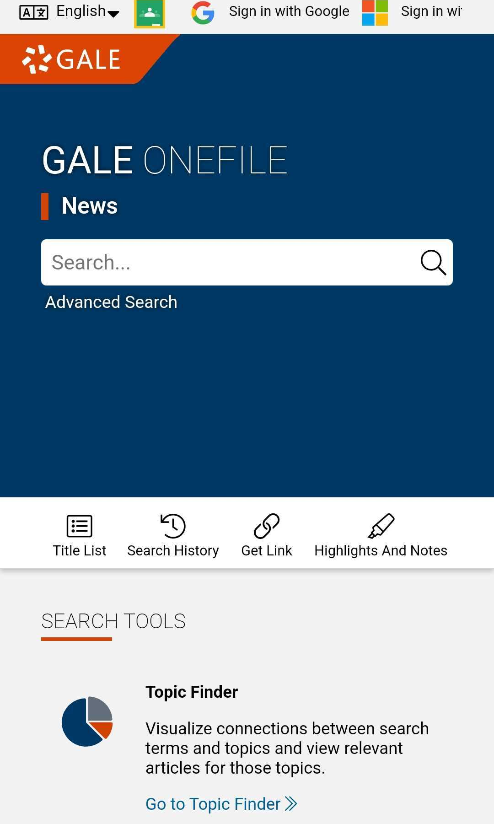
ACCESS
Anytime
Anywhere
Any Device
Without Ads or Paywalls
WWW.LIBRARYRESOURCESURL.EDU
Notes:
Customize the library access URL on this slide before presenting.
All the content in Gale OneFile can be accessed by your learners 24/7 on any device, no matter where you are. There are no limits to the amount of content you can access.
Additionally, Gale OneFile is an ad-free environment that provides full-text access without paywalls.

Slide 20
DISCOVER PREMIUM RESOURCES
Notes:
The screenshots on the following slides are shown from one Gale OneFile resource but apply to all.

Slide 21
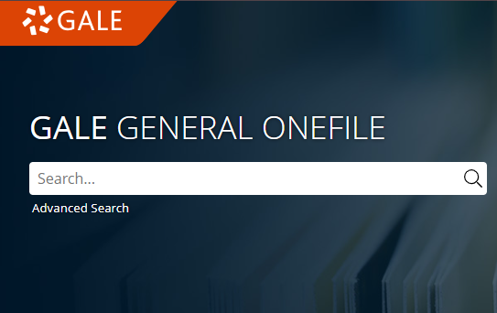
SEARCH
Enter simple search terms
Notes:
To perform a basic search, just enter key terms related to topics of interest in the search box on the homepage or at the top of every page throughout the resource.

Slide 22
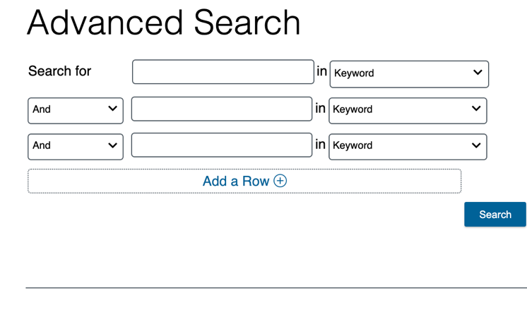
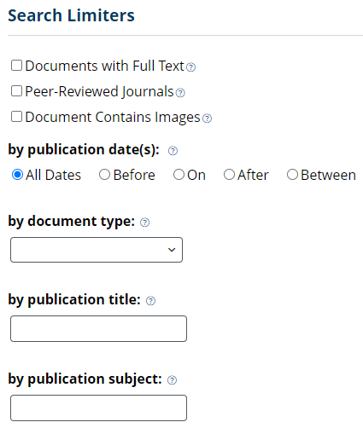
SEARCH
Enter simple search terms
Or, customize multiple fields and limiters
Notes:
You can also run a more targeted or customized search by clicking the Advanced Search option beneath or to the side of the basic search box. Advanced Search provides the option to select specific search fields (For example, Publication title if you’re looking for articles specifically from The New York Times, or content written by a particular author) and combine these fields/terms in various ways (for instance using NOT if you want articles about one subject but are NOT interested in any articles that also focus on a related subject that is not relevant to what you are teaching). If you scroll down the page, you can also include search options to limit results by document type, date, content level, and more.

Slide 23
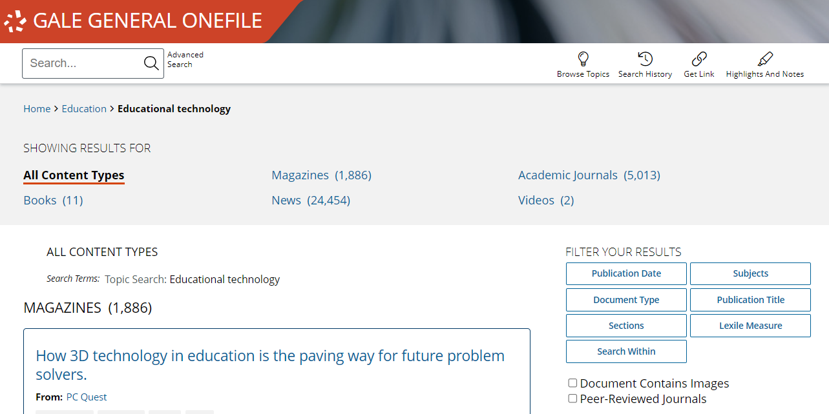
EXPLORE AND FILTER RESULTS
Examine Content Types
Click to focus on results within a format of interest
Notes:
Once you run a search or click a content type header on a topic page, you’ll find options to further pinpoint results of interest. At the top of the page, you can click to view results of specific types (videos, reference, etc.) depending on what’s available for your search.

Slide 24
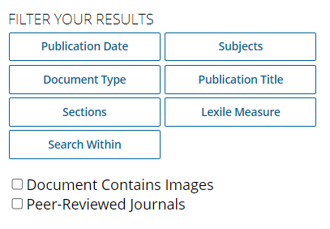
EXPLORE AND FILTER RESULTS
Examine Content Types
Click to focus on results within a format of interest
Narrow Results
Limit by Publication Date, Subjects, Document Type, etc.
Notes:
In the Filter Your Results portion on the right-hand side of the results, you’ll find options to limit your search results further based on publication date, subjects, Lexile measure, etc. Simply click one of the filtering options, check the box next to specific filters of interest, and then click to Apply the filter.
Note that these are also great options to point out to users who are in the habit of running very broad searches. Many of these options directly align to the options available in the Advanced Search, so they can begin to train students to think of more targeted search strategies.

Slide 25
EXPLORE AND FILTER RESULTS
Examine Content Types
Click to focus on results within a format of interest
Narrow Results
Limit by Publication Date, Subjects, Document Type, etc.
View Individual Sources
Access items of interest
Notes:
When you find an item that you’d like to view, simply click the title of the result to access the document, video, image, etc. From there, you’ll find an array of tools that you can use to incorporate the content into research. We’ll cover these tools and strategies a bit later.

Slide 26
AVAILABLE CONTENT TYPES
ACADEMIC
JOURNALS
MAGAZINES
NEWS
IMAGES AND VIDEOS
BOOKS
Notes:
Depending on the topic you search or browse, you will find a wide variety of content types.
Academic Journals: Peer-reviewed content for high-level researchers.
Magazines and New: Updated on a regular basis to ensure the most relevant content is available.
Images, Videos and other multimedia: Provide an additional layer of learning support for users who prefer to learn visually or aurally instead of through text.
Books and other non-periodical sources: Give background knowledge and facts on a variety of topics and subjects.

Slide 27
SUPPORT RESEARCH AND LEARNING
Notes:
Gale includes many tools and features to support organized research and learning.

Slide 28
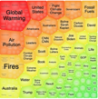
SHARE CONTENT
Get Link, Share to Classroom, Send to…
Push premium results to students and facilitate collaboration
SUPPORT ACCESSIBLE LEARNING
Translate, Text Manipulation, Listen
Provide options for learners with varied needs and preferences
ENCOURAGE ANALYSIS
Highlights and Notes
Promote deeper learning with color-coding and annotation
DEVELOP RESEARCH SKILLS
Topic Finder, Cite
Advance ability to define topics and use sources responsibly
Notes:
These tools include options to easily share or save content, features to make content accessible to learners with a variety of needs, and tools to help scaffold the research process-– from choosing and refining a topic to citing the information appropriately.
The screenshots on the following slides are shown from one Gale OneFile resource but apply to all.

Slide 29
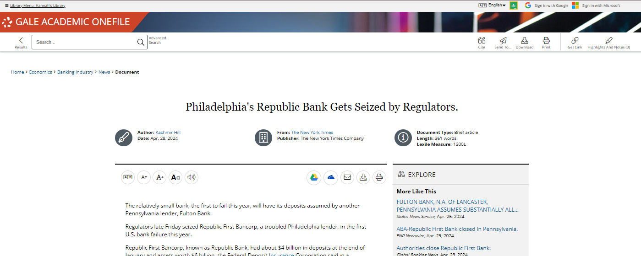
SHARE CONTENT
GET LINK
Create a Persistent URL
SEND TO…
Email, Google, or Microsoft
Notes:
As previously mentioned, all content in Gale resources are accessible 24/7 on any device in any location. Additionally, every item within the resource provides several options to export or share the content for later use. Get Link creates a persistent URL that will direct someone right back to the page you were on when you used the Get Link tool. The Send to… feature and quick links give you the ability to push content to an email address, Google Drive, or Microsoft OneDrive account for viewing at any time in the future (content does not expire from these tools until you decide to delete/remove it). There are no limits to the number of times you can use these features, and you can also download and print content.

Slide 30
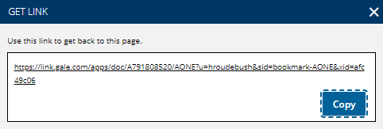
SHARE CONTENT
GET LINK
Copy and paste persistent URL to websites, LMS, assignments, etc.
Notes:
It’s easy to push content to users by clicking Get Link to create a persistent URL that you can copy and paste anywhere.

Slide 31
SHARE CONTENT
SEND TO…
Email or Export Results to Google Drive or Microsoft OneDrive
Notes:
Finally, every result can be emailed or sent to Google Drive or Microsoft OneDrive for viewing whenever/as long as you want (all documents can also be printed or downloaded if you prefer). You can click any of the shortcuts to email, Google Drive, or Microsoft OneDrive at the top of an item’s text, or use click Send to… in the upper righthand corner to start the process and follow on-screen prompts.
If you are sending to Google Drive or Microsoft OneDrive, you will be asked to log in if you are not already logged into a Google or Microsoft account within your browser. If you are already logged in, the system will automatically send it to the Google or Microsoft account active in your browser (so do note which account you’re using for the purpose of locating the content later).

Slide 32
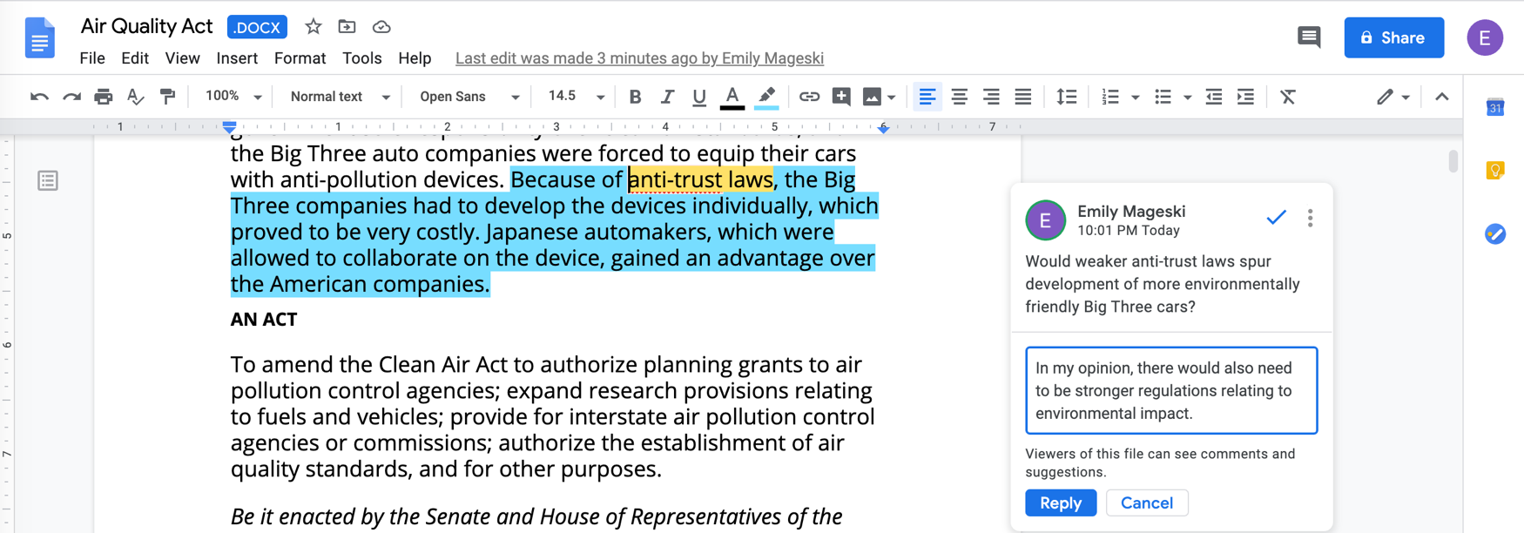
SHARE CONTENT
SEND TO…
Share document with learners or ask them to share and comment on results
Notes:
Gale content sent to Google Drive or Microsoft OneDrive can be opened as editable documents in .docx format.
These tools can help users stay organized when they perform research, and provide easy options for sharing, commenting, and collaborating with others.

Slide 33
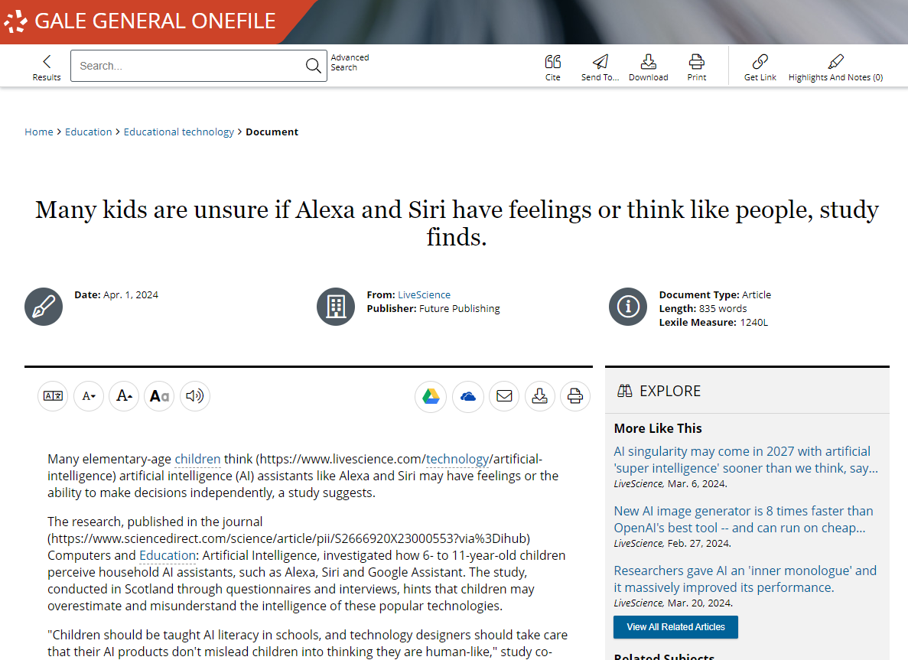
SUPPORT ACCESSIBLE LEARNING
TRANSLATE
Machine translate articles– 50+ languages
Notes:
Further, to support the varied needs of your learners, every result includes simple point (or tap) and click tools to machine translate the text (helpful for those who need to compare portions of the English language version to a different language to aide understanding) into over 40 languages,

Slide 34
SUPPORT ACCESSIBLE LEARNING
TRANSLATE
Machine translate articles– 50+ languages
FONT SIZE
Increase or reduce as needed
Notes:
to increase or decrease font size to aide readability,

Slide 35
SUPPORT ACCESSIBLE LEARNING
TRANSLATE
Machine translate articles– 50+ languages
FONT SIZE
Increase or reduce as needed
TEXT MANIPULATION
Edit the font style, color, and spacing
Notes:
Change the font, text and background color, and line, letter, and word spacing to enhance readability.

Slide 36
SUPPORT ACCESSIBLE LEARNING
TRANSLATE
Machine translate articles– 50+ languages
FONT SIZE
Increase or reduce as needed
TEXT MANIPULATION
Edit the font style, color, and spacing
LISTEN
Hear text read aloud, and download as an MP3
Notes:
Listen to the article with settings to highlight words and sentences being read, change the speed, and enhance the visibility.

Slide 37
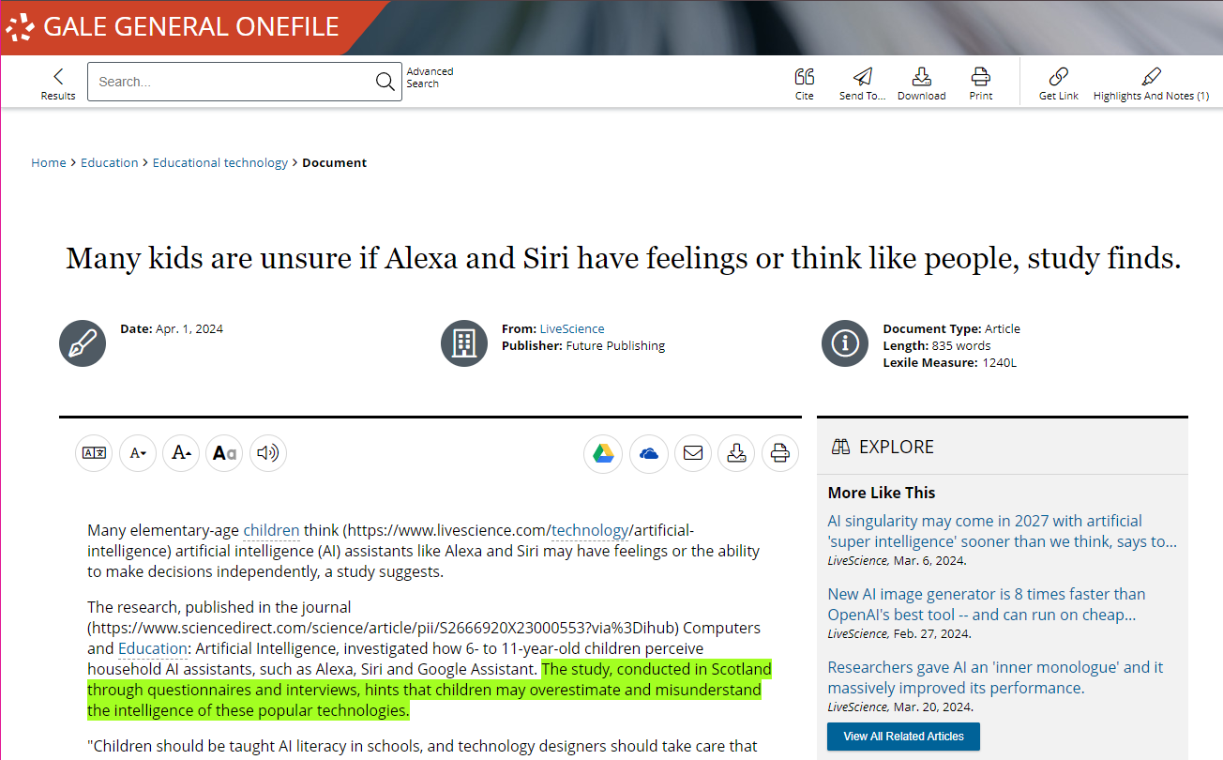
ENCOURAGE ANALYSIS
STEP 1
SELECT TEXT
Click and drag mouse on computer;
Tap on tablet or mobile device
Notes:
In addition to the sharing features we just discussed, all text results include the option to add highlights and notes. The Highlights and Notes tool allows your users to annotate while on the platform to ensure they get the most from the content.
To get started, users can simply select text within the document as you normally would to copy or paste text (click and drag on your computer or tap the first and last word on mobile devices).

Slide 38
ENCOURAGE ANALYSIS
STEP 1
SELECT TEXT
Click and drag mouse on computer;
Tap on tablet or mobile device
ADD HIGHLIGHTS AND NOTES
Choose color and type annotations in pop-up menu
STEP 2
Notes:
You’ll then see a pop-out menu that provides color options and the ability to add notes. Note that if a user selects one word within the text, the define option will allow that student to view a dictionary definition without leaving the Gale resource.
Choose the desired color for the highlight and add your thoughts or response to the notes field.

Slide 39
ENCOURAGE ANALYSIS
STEP 1
SELECT TEXT
Click and drag mouse on computer;
Tap on tablet or mobile device
ADD HIGHLIGHTS AND NOTES
Choose color and type annotations in pop-up menu
STEP 2
EXPORT
Add as many notes as desired Download, Print, or Send to… Email, Google Drive or OneDrive before closing
STEP 3
Notes:
Finally, be sure to take the highlighted item with you before you close the resource by downloading, printing, or sending the item to Google Drive or Microsoft OneDrive. This will provide a copy of the result including any highlights and notes you made within the document.
Note that you can also access the Highlights and Notes menu option in the upper right-hand corner of the resource to access all the highlights and notes you’ve made within a given session. This allows you to easily jump to articles and edit highlights and notes, or to download, print, or send a full list of all your highlights and notes to Google Drive or Microsoft OneDrive. Again, if you plan to use this tool, be sure to download, print, or Send to… before exiting the resource.

Slide 40
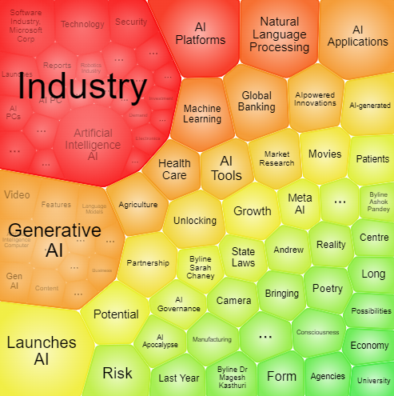
DEVELOP RESEARCH SKILLS
TOPIC FINDER
Visually Map Search Results
Interact to narrow topics
Notes:
When users have a topic in mind and begin searching the resource, Topic Finder provides a visual tool for them to better understand the divisions and connections within their larger topics to begin defining a more narrow, unique research direction.

Slide 41
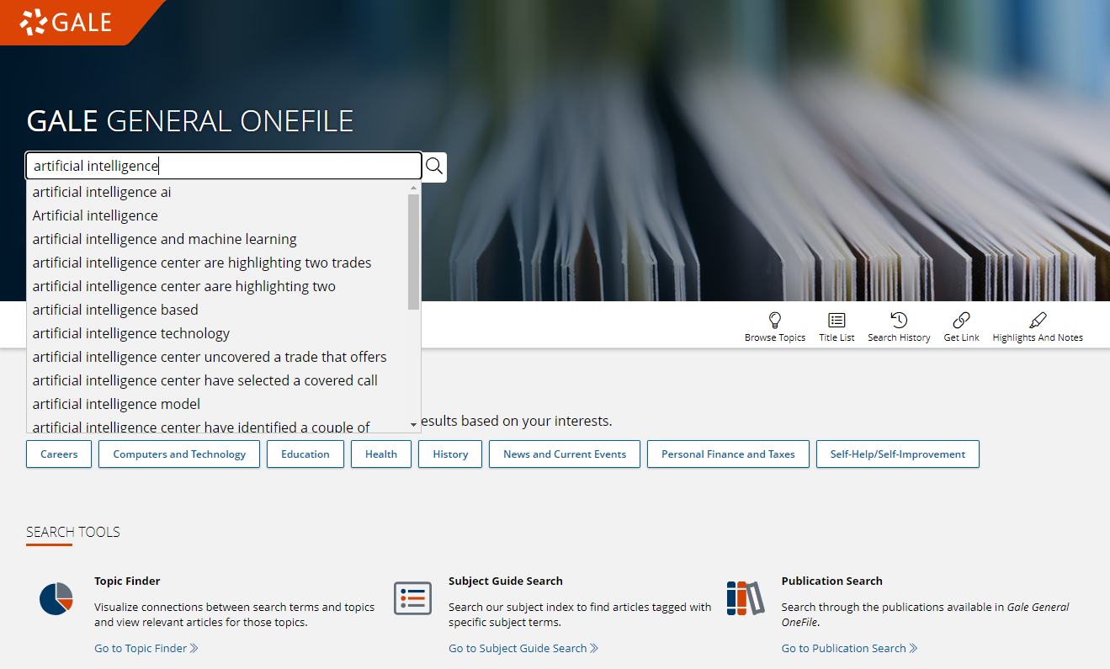
DEVELOP RESEARCH SKILLS
TOPIC FINDER
Visually Map Search Results
Interact to narrow topics
STEP ONE
Run search
Notes:
Topic Finder can be accessed after running a search within the Gale resource.

Slide 42
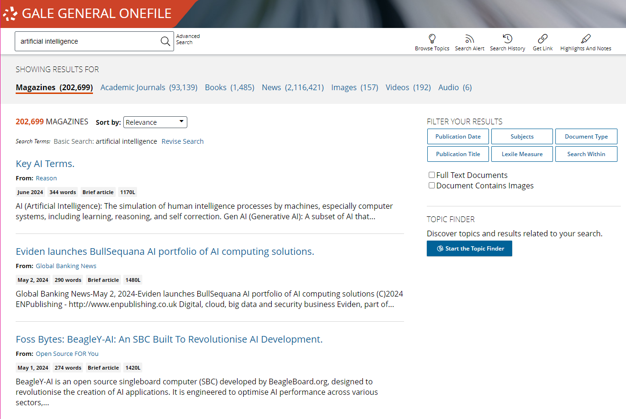
DEVELOP RESEARCH SKILLS
TOPIC FINDER
Visually Map Search Results
Interact to narrow topics
STEP ONE
Run search
STEP TWO
Start the Topic Finder
Notes:
On the right-hand side of the page, under the filters, simply click Start the Topic Finder.

Slide 43
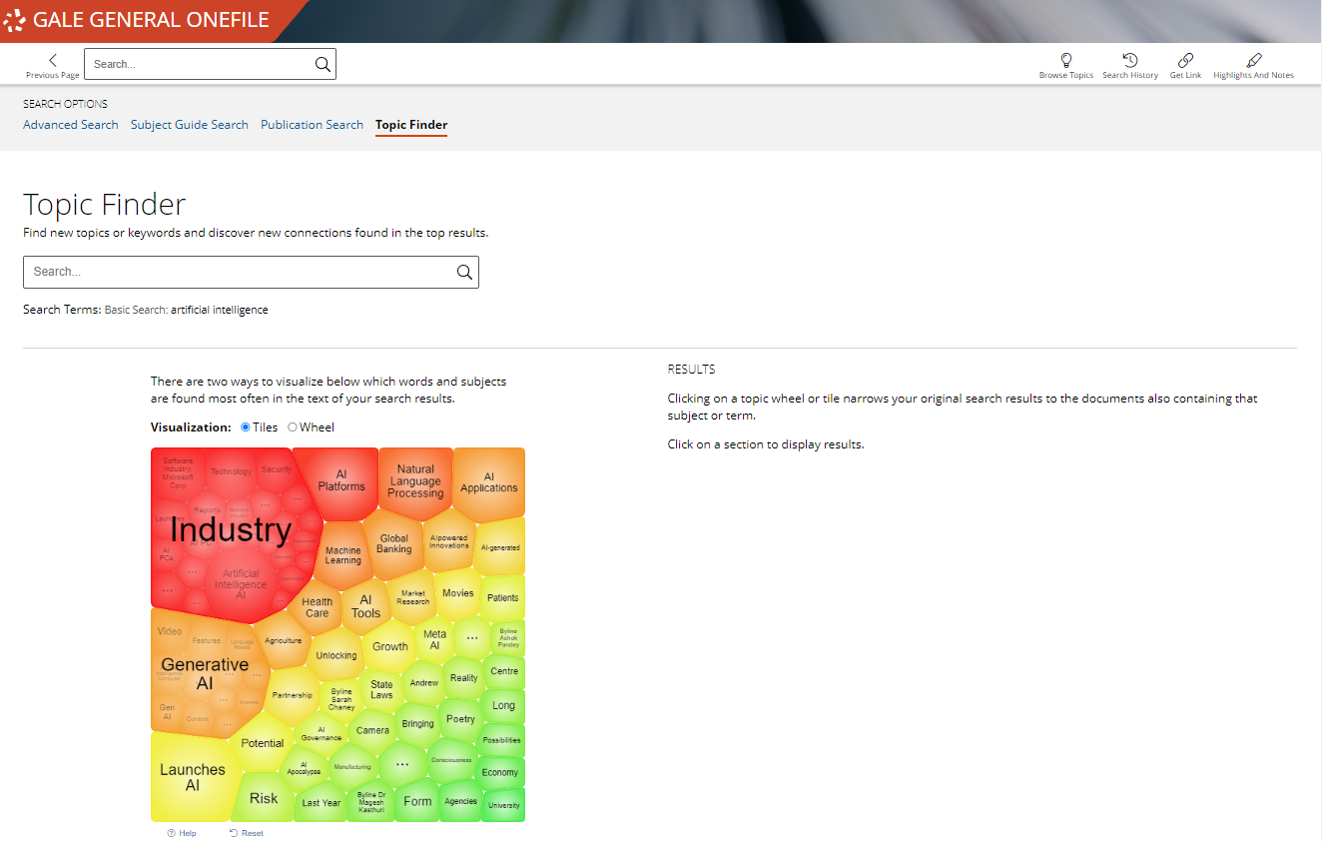
DEVELOP RESEARCH SKILLS
TOPIC FINDER
Visually Map Search Results
Interact to narrow topics
STEP ONE
Run search
STEP TWO
Start the Topic Finder
STEP THREE
Click to explore sections and link to results
Notes:
Users can then interact with either a tile (shown in this screenshot) or wheel visualization that maps out and breaks down major themes within the larger topic.

Slide 44
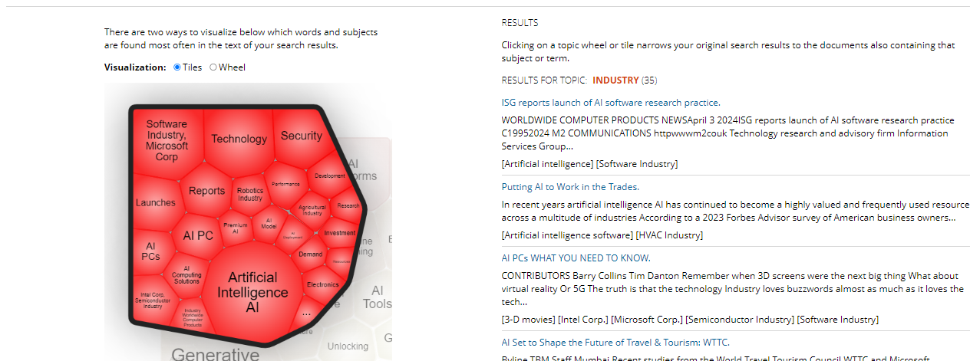
DEVELOP RESEARCH SKILLS
TOPIC FINDER
Visually Map Search Results
Interact to narrow topics
STEP ONE
Run search
STEP TWO
Start the Topic Finder
STEP THREE
Click to explore sections and link to results
Notes:
Click to see further divisions of the topic. As you do, a list of results will be presented and updated on the right-hand side of the tool so that you or your students can quickly click into relevant articles within the refined topic.

Slide 45
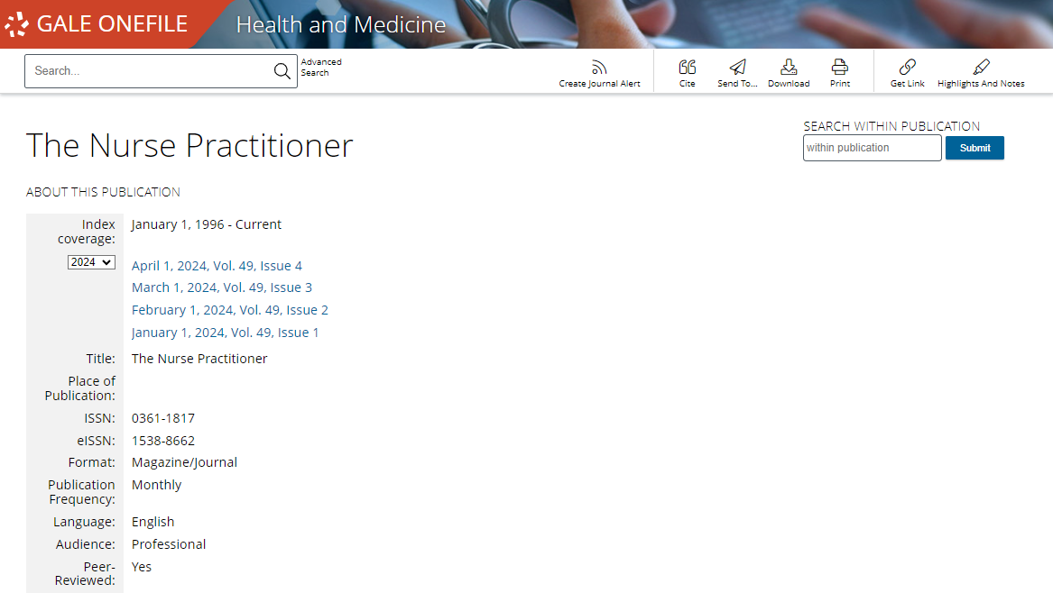
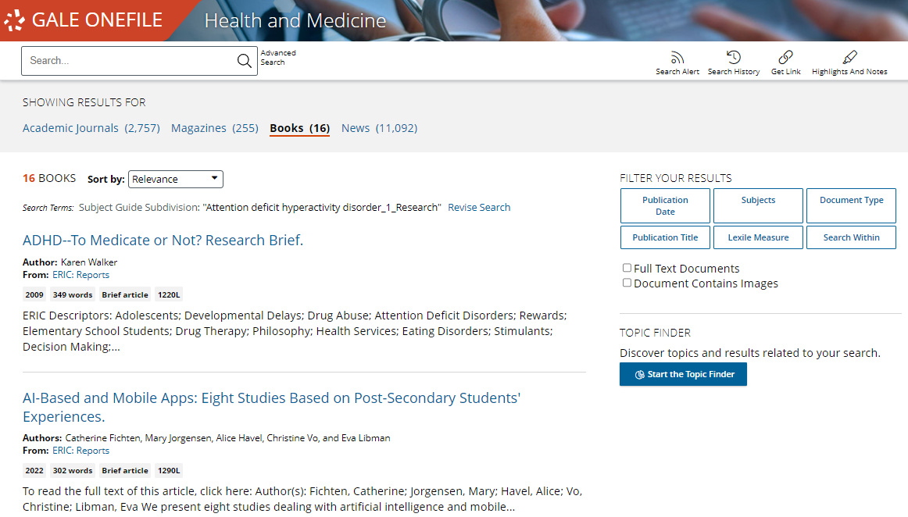
DEVELOP RESEARCH SKILLS
JOURNAL AND SEARCH ALERTS
Create email or RSS alerts when new content or journals become available
Journal Alert
Receive notifications when new issues of specific journals are published, ensuring you stay updated on the latest research in your field
Search Alert
Create personalized alerts based on your search queries, notifying you when new articles matching your criteria become available in the resource.
Notes:
Within the Gale OneFile resources, users have the ability to create Search Alerts and choose how they would like to be alerted when new results for the search become available, by Email (daily, weekly, or monthly) and the Format (Plain text or HTML) or by RSS Feed. The same alerts are available once a Journal Alert is created by selecting the publication title in search results or using Publication Search to find a journal title.

Slide 46
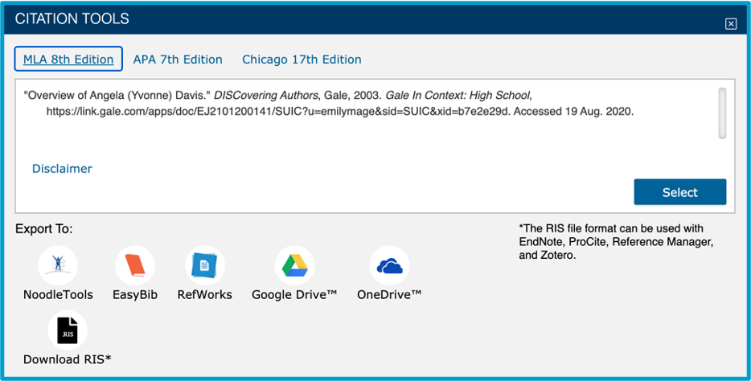
DEVELOP RESEARCH SKILLS
CITE
Click for MLA, APA, Chicago
Select, copy, and paste
Export – NoodleTools, EasyBib, and more
Notes:
Finally, a seamless Cite tool is built into every item within the Gale resource to ensure that users have support in using and citing resources responsibly.
Simply click Cite to provide machine-generated MLA, APA (7th edition is now available within the tool), and/or Chicago style citations. Use the Select button to select, then copy and paste the citation into a document, or Export the citation to services like EasyBib and NoodleTools.

Slide 47
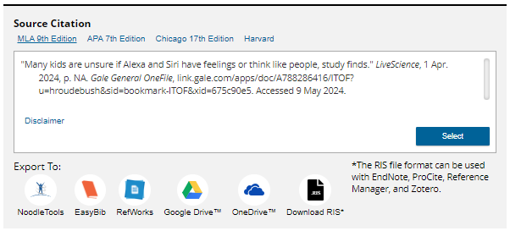
DEVELOP RESEARCH SKILLS
CITE
Click for MLA, APA, Chicago
Select, copy, and paste
Export – NoodleTools, EasyBib, and more
Or, Select Style and Export Result
Scroll to bottom and choose style
Notes:
Alternately, scroll to the bottom of the document and use the Source Citation area to select the desired citation. Whichever citation is active in this area (for example, in this screenshot, APA is the active selection)

Slide 48
?
…
Notes:
Use this slide as a visual prompt for final questions and/or discussions

Slide 49
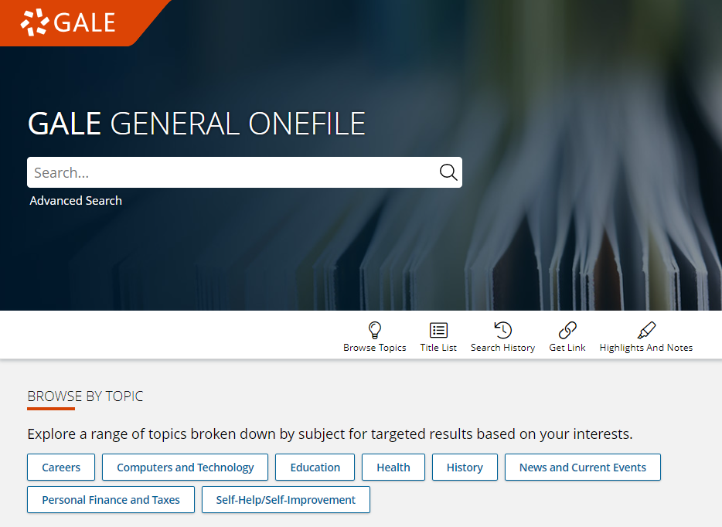
WHAT’S NEXT?
EXPLORE THE GALE ONEFILE COLLECTIONS
SHARE WITH RESEARCHERS
CONTACT THE LIBRARY!
Notes:
Wrap up– ask teachers to visit the resource, share articles with students, and contact the library for support

Slide 50
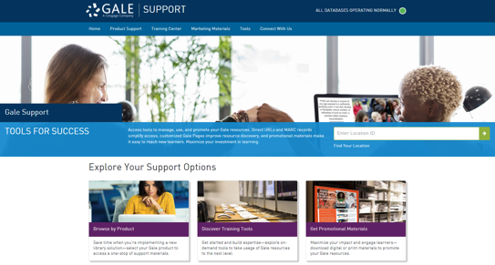
CONNECT FOR MORE IDEAS
ENTER LIBRARIAN NAME
emailaddress@school.edu
LIBRARY WEBSITE
www.librarysite.edu
SUPPORT.GALE.COM/TRAINING
Lesson plans, tutorials, scavenger hunts, and more
Notes:
Customize this concluding slide with your contact and site/access information.

