Slide 1
GALE IN CONTEXT: ENVIRONMENTAL STUDIES
Notes:
Use this slide to introduce yourself and the presentation.
Notes throughout this presentation provide instruction around areas to customize for your specific audience, as well as speaker notes to make the process of presenting easier. Feel free to hide slides and select what content to feature if you are given shorter speaking times, or if you’re able to take attendees live into Gale In Context: Environmental Studies.

Slide 2
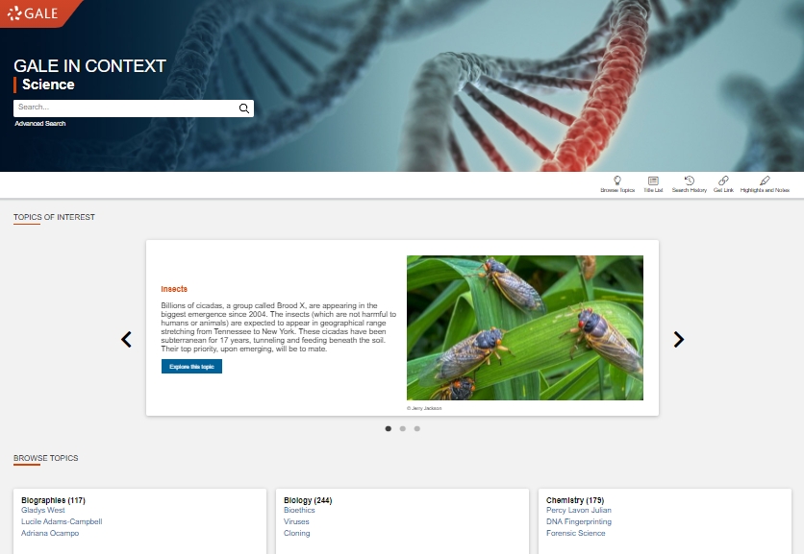
GALE IN CONTEXT: ENVIRONMENTAL STUDIES
Discover Premium Resources
Trusted reference, top periodicals, videos, images, audio, case studies, conference papers, and statistics
Support Curriculum Standards
Focuses on the study of sustainability and the environment. Topics include ecosystems, global warming, food safety, and introductions to environmental disasters.
Enhance Teaching and Learning
Google/Microsoft integration, unlimited print/download/email, highlights and notes, and more
Notes:
Gale In Context: Environmental Studies focuses on the study of sustainability and the environment. It provides hundreds of topic, event, and state portals to bring together content from articles, case studies, statistics, images, and more. Users can search the information to learn about diverse subjects such as climate change, food security, soil ecology, and tourism.
Users will find a vast array of resources for papers, projects, and presentations that bolster the development of critical thinking, problem solving, and effective communication skills including related topics, case studies, statistics, journal articles, and more.

Slide 3
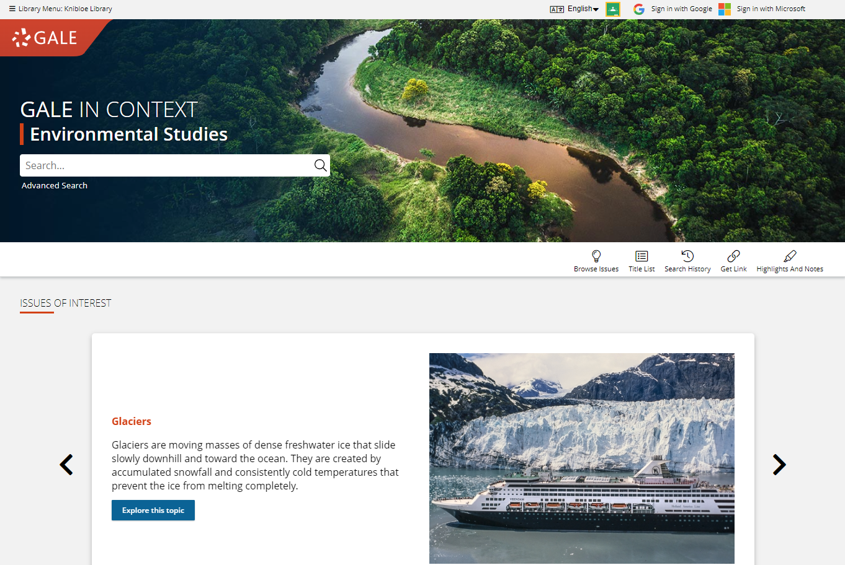
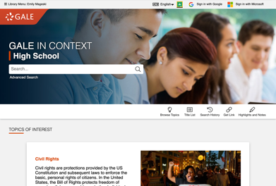
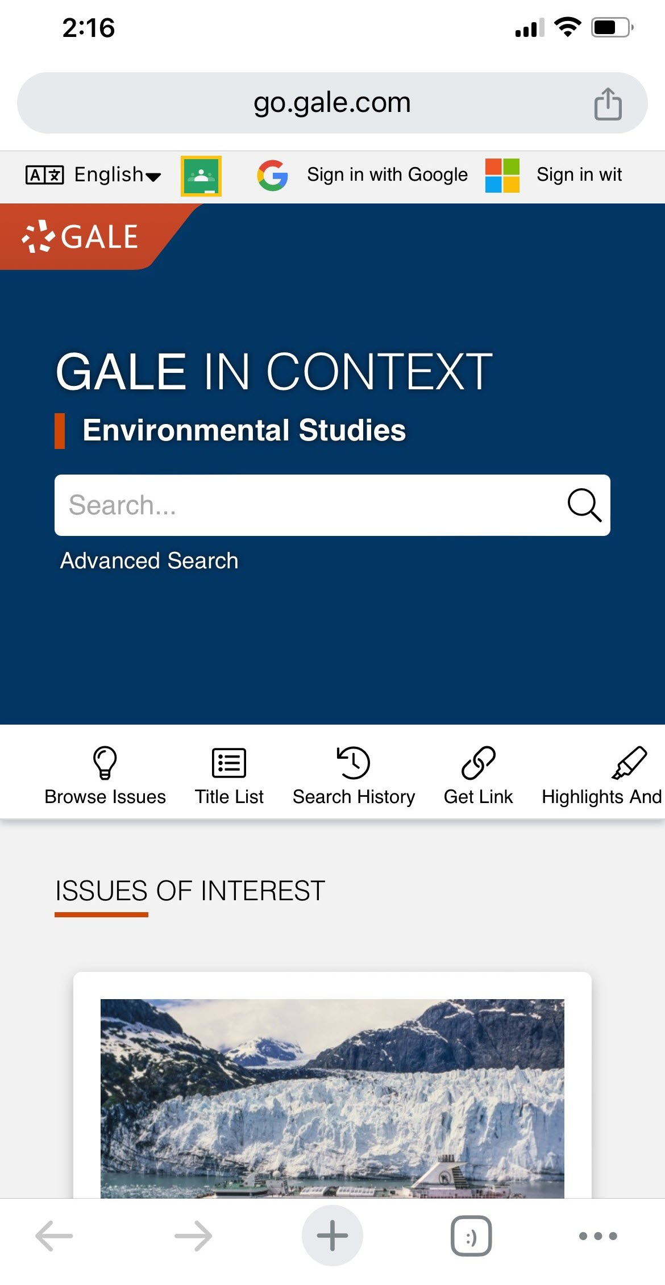
ACCESS
Anytime
Anywhere
Any Device
Without Ads or Paywalls
WWW.LIBRARYRESOURCESURL.EDU
Notes:
Customize the library access URL on this slide before presenting.
All of the content in Gale In Context: Environmental Studies can be accessed by you and your learners 24/7 on any device, no matter where you are. Your entire class can look at the same article at once without problems, and there are no limits to the amount of content you can access.
Additionally, Gale In Context: Environmental Studies is an ad-free environment that provides full-text access without paywalls.

Slide 4
DISCOVER PREMIUM RESOURCES

Slide 5
SEARCH OR BROWSE
EXPLORE CONTENT
VIEW AND SHARE RESULTS
Notes:
It’s easy to access all the premium resources within Gale In Context: Environmental Studies by browsing or searching for topics of interest, exploring content organized by type, and then clicking individual result titles to view and use videos, documents, and more.

Slide 6
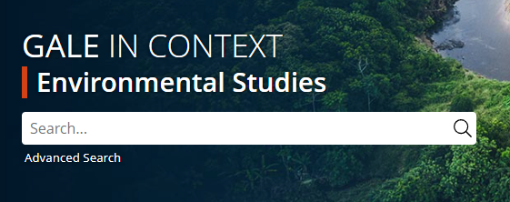
SEARCH
Enter simple search terms
Notes:
To perform a basic search, just enter key terms related to topics of interest in the search box on the homepage or at the top of every page throughout Gale In Context: Environmental Studies.

Slide 7
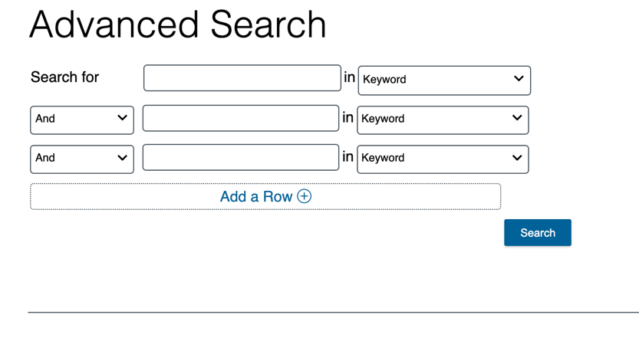
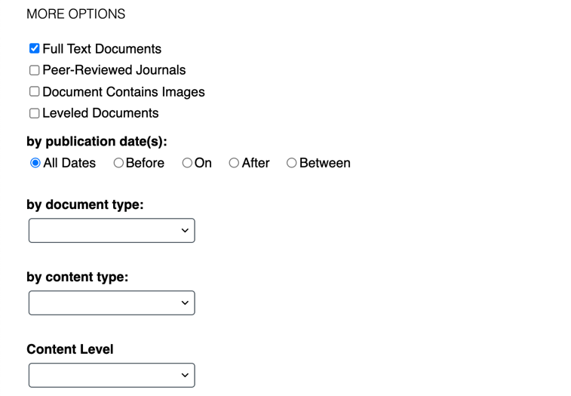
SEARCH
Enter simple search terms
Or, customize multiple fields and limiters
Notes:
You can also run a more targeted or customized search by clicking the Advanced Search option beneath or to the side of the basic search box. Advanced Search provides the option to select specific search fields (For example, Publication title if you’re looking for articles specifically from The New York Times, or content written by a particular author) and combine these fields/terms in various ways (for instance using NOT if you want articles about one subject, but are NOT interested in any articles that also focus on a related subject that is not relevant to what you are teaching). If you scroll down the page, you can also include search options to limit results by document type, date, content level, and more.

Slide 8
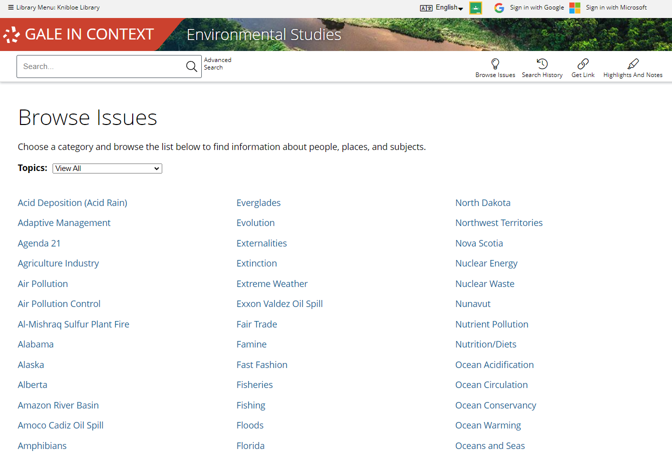
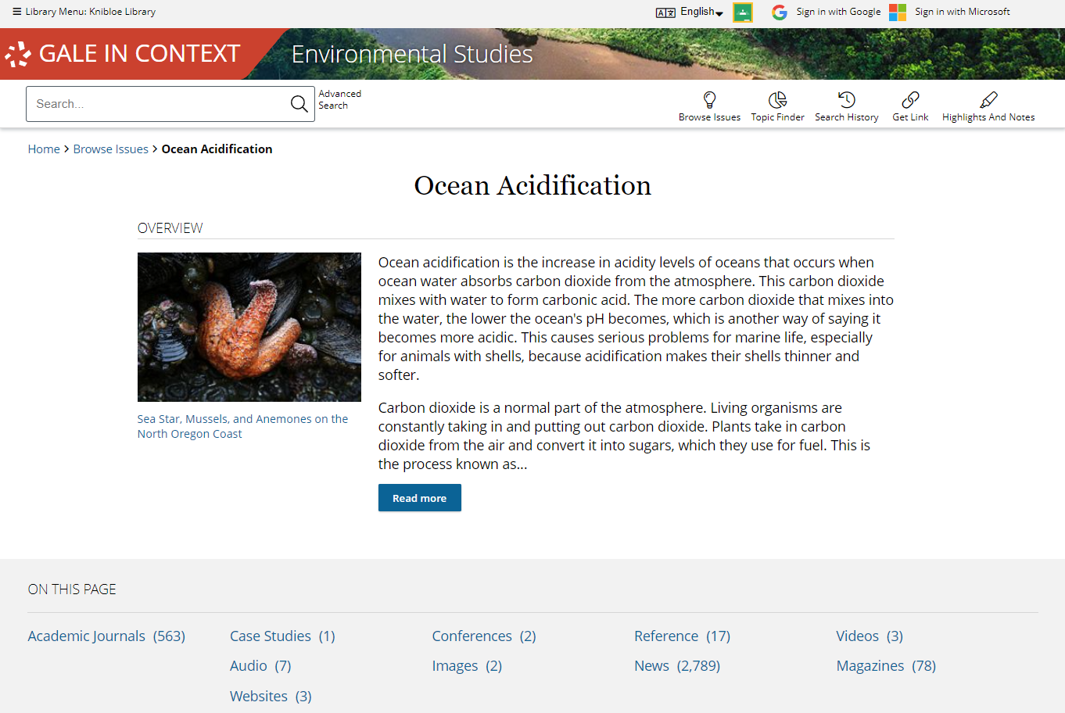
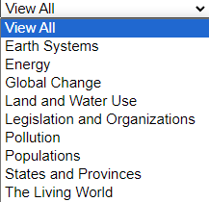
BROWSE
BROWSE TOPICS by subject or view all
Connect to curated overviews and results
Notes:
In addition to searching, Gale In Context: Environmental Studies is designed to make it easy for you and your students to browse for topics of interest. Simply click the Browse Topics option in the upper right corner of the homepage and on many other pages throughout Gale In Context: Environmental Studies to access a list of all topics for which there are curated pages. If desired, you can use the drop-down menu at the top of this page to view pages based on categories of interest.
When you click the title of one of the topics, you’ll be able to access a curated hub of information that contains an overview and image related to the topic, and that then organizes and provides access to content of various types on the topic (for instance, reference materials, magazine articles, videos, etc.). Simply click the header for a content type to view all results of that format, and click the title of an individual result to view that specific article, video, etc.
Note that if you do not see a topic page related to something of interest, that just means that you can run a basic or advanced search within Gale In Context: Environmental Studies to view any available results (it doesn’t mean content on that topic is unavailable).

Slide 9
EXPLORE AND FILTER RESULTS
Examine Content Types
Click to focus on results within a format of interest
Notes:
You may want to place the next slides (Explore and Filter Results) after the Support Developing and Advanced Readers slides, and before the next segment of the slide deck (Support Curriculum).
Once you run a search, or click a content type header on a topic page, you’ll find options to further pinpoint results of interest. At the top of the page, you can click to view results of specific types (videos, reference, etc.) depending on what’s available for your search.

Slide 10
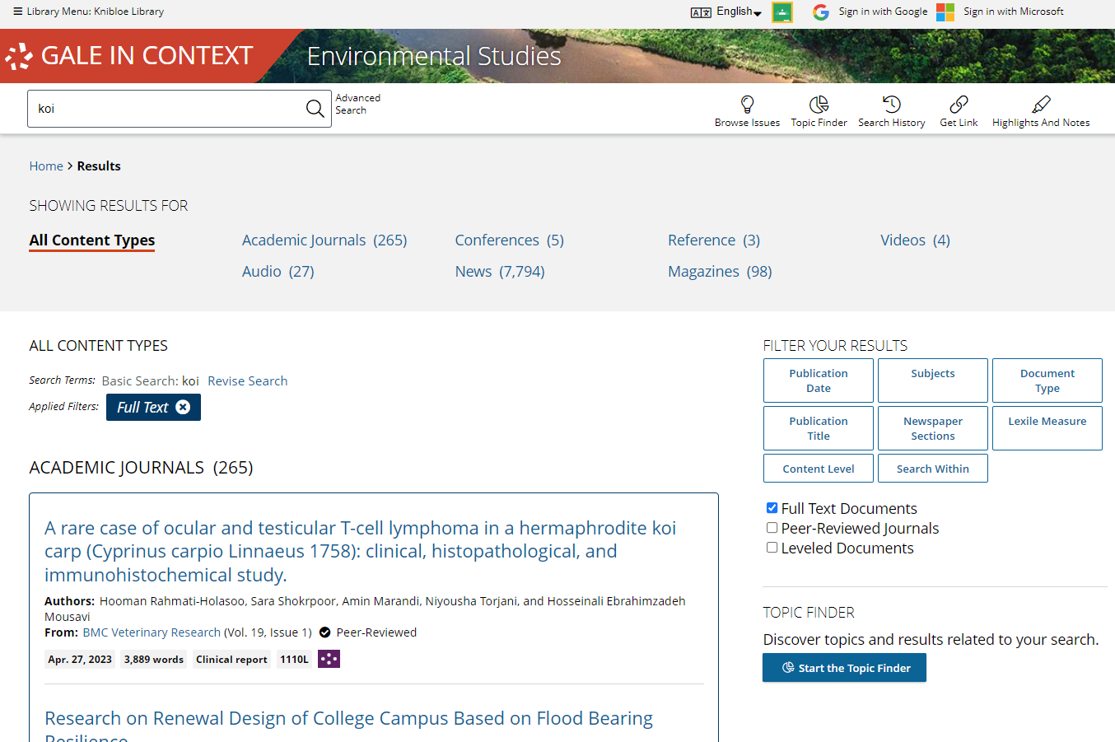
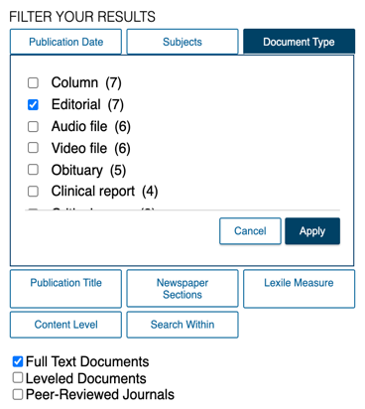
EXPLORE AND FILTER RESULTS
Examine Content Types
Click to focus on results within a format of interest
Narrow Results
Limit by Publication Date, Subjects, Document Type, etc.
Notes:
In the Filter Your Results portion on the right-hand side of the results, you’ll find options to limit your search results further based on publication date, subjects, content level, etc. Simply click one of the filtering options, check the box next to specific filters of interest, and then click to Apply the filter.
Note that these are also great options to point out to students who are in the habit of running very broad searches. Many of these options directly align to the options available in the Advanced Search, so they can begin to train students to think of more targeted search strategies.

Slide 11
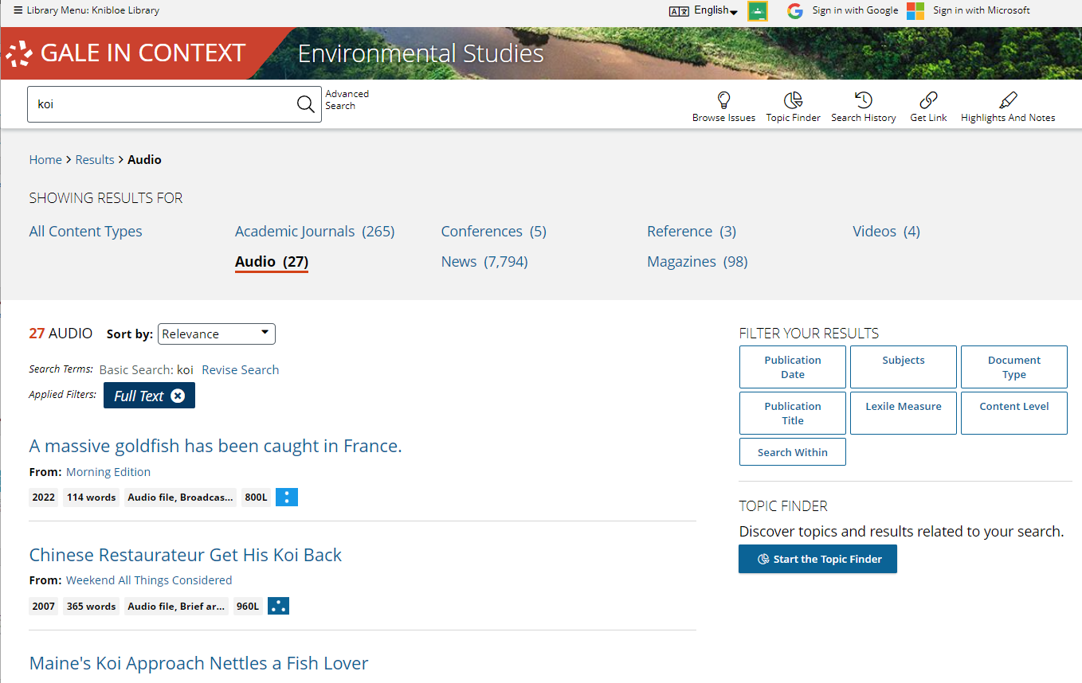
EXPLORE AND FILTER RESULTS
Examine Content Types
Click to focus on results within a format of interest
Narrow Results
Limit by Publication Date, Subjects, Document Type, etc.
View Individual Sources
Access items of interest
Notes:
When you find an item that you’d like to view, simply click the title of the result to access the document, video, image, etc. From there, you’ll find an array of tools that you can use to incorporate the content into your lessons and assignments. We’ll cover these tools and strategies a bit later.

Slide 12
EXPLORE CONTENT
REFERENCE
NEWSPAPERS MAGAZINES JOURNALS
VIDEOS AUDIO IMAGES
CASE STUDIES, CONFERENCES, STATISTICS AND MORE
Notes:
Depending on the topic you search or browse, you will find a wide variety of content types.

Slide 13
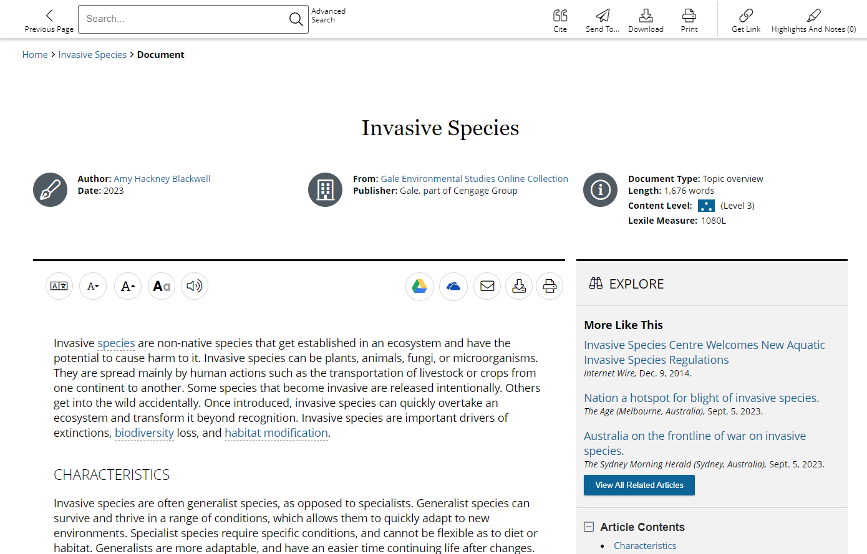
May provide alternate levels or critical thinking questions
REFERENCE
Introduce new or complicated subjects
Develop background knowledge
Assist in research topic selection
Notes:
Reference documents are great place to start research, introduce a topic, and find main ideas, key terms, and related topics.

Slide 14
NEWSPAPERS, MAGAZINES, AND JOURNALS
Provide recent coverage, in-depth analysis, and academic perspectives
NEW ARTICLES ADDED EACH DAY!
The New York Times
The Washington Post
Ecology, Environment & Conservation
American Journal of Sports Medicine
Life Science Weekly
Biodiversity Data Journal
Soil Research
BBC Wildlife Magazine
Mother Earth News
Notes:
Periodical feeds within Gale resources update multiple times per day, so you can be sure you’ll find recent coverage of trending topics from authoritative sources. These sources make great prompts, and also add a level of currency to student research projects.

Slide 15
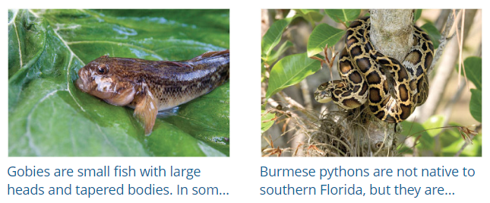
VIDEO
Engage learners and spark discussion
IMAGES
Inspire thinking and enhance projects
AUDIO
Vary teaching and learning format
Notes:
Additionally, multimedia content within Gale In Context resources support learner preferences and can be used to enhance projects or break up instruction.

Slide 16
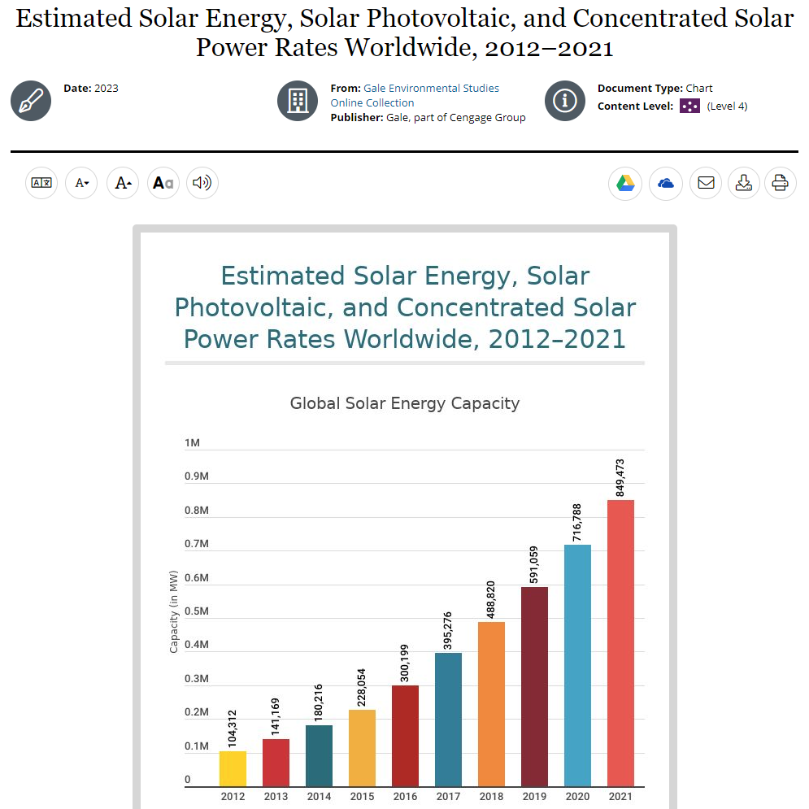
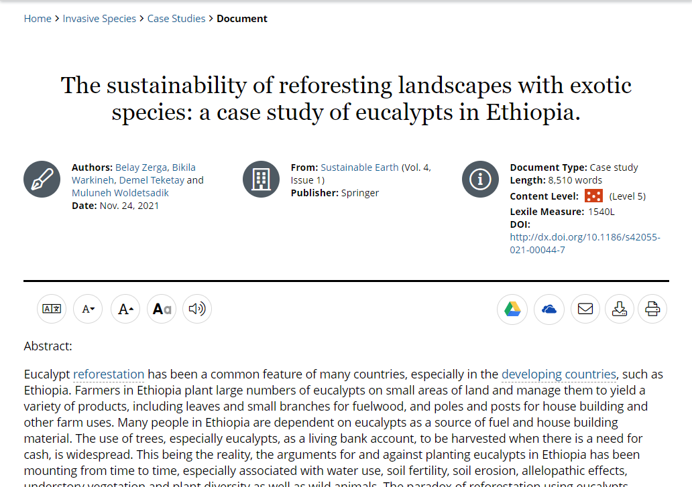
AND MORE!
EXPERIMENTS
Encourage critical thinking and research
CASE STUDIES
Notes:
Additional sources may include Case Studies for deep-dive analysis and Statistics provide specific numbers to support research, often with visual representation of data.

Slide 17
SUPPORT DEVELOPING AND ADVANCED READERS
LOWER ELEMENTARY
Up to 500L
UPPER ELEMENTARY
501L – 850L
MIDDLE SCHOOL
851L – 1100L
HIGH SCHOOL
1101L – 1300L
UNDERGRADUATE AND UP
1301L +
Notes:
Plus, the content is assigned a reading level, so if you support developing readers, or advanced students, you can find content targeted to their needs! These content levels can be viewed on search and browse results pages,

Slide 18
SUPPORT DEVELOPING AND ADVANCED READERS
LOWER ELEMENTARY
Up to 500L
UPPER ELEMENTARY
501L – 850L
MIDDLE SCHOOL
851L – 1100L
HIGH SCHOOL
1101L – 1300L
UNDERGRADUATE AND UP
1301L +
Notes:
And can also be used to sort or filter search and browse results so that you can pinpoint results that are well suited for your learners.

Slide 19
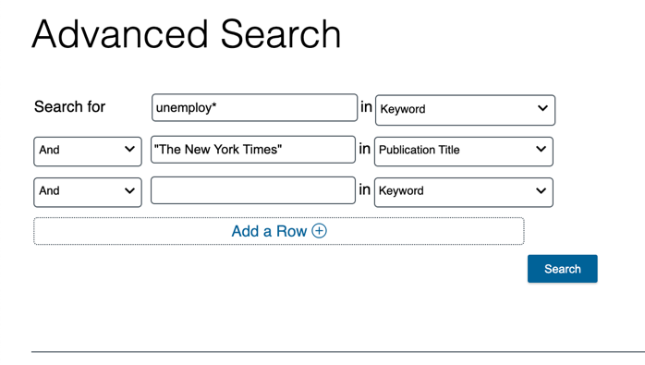
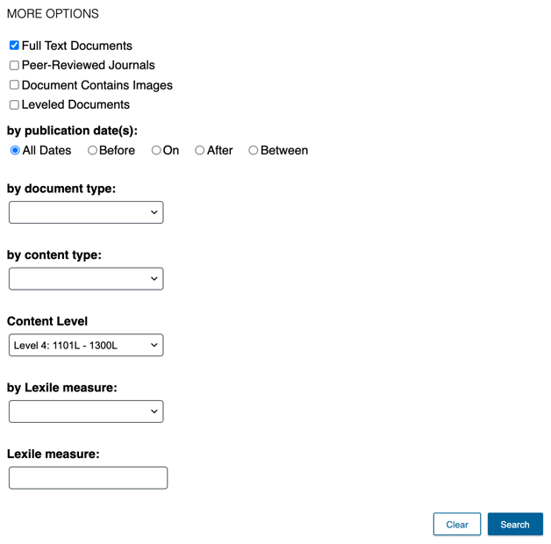
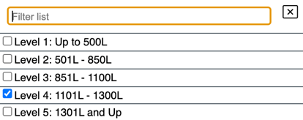
SUPPORT DEVELOPING AND ADVANCED READERS
LOWER ELEMENTARY
Up to 500L
Target content levels – Advanced Search
UPPER ELEMENTARY
501L – 850L
MIDDLE SCHOOL
851L – 1100L
HIGH SCHOOL
1101L – 1300L
UNDERGRADUATE AND UP
1301L +
Notes:
Unhide this slide if you’d like to show individuals how to use Advanced search options to uncover alternate content levels.

Slide 20
SUPPORT CURRICULUM
Notes:
Gale In Context: Environmental Studies supports topics across the high school curriculum

Slide 21
COVER KEY TOPICS ACROSS SUBJECTS
ENVIRONMENTAL SCIENCE
HUMAN-ENVIRONMENT INTERACTIONS
EARTH SYSTEMS
Biomes
Cells
Evolution
Forces
Electricity
Astronomy
Acids and Bases
Atoms
States of Matter

Slide 22
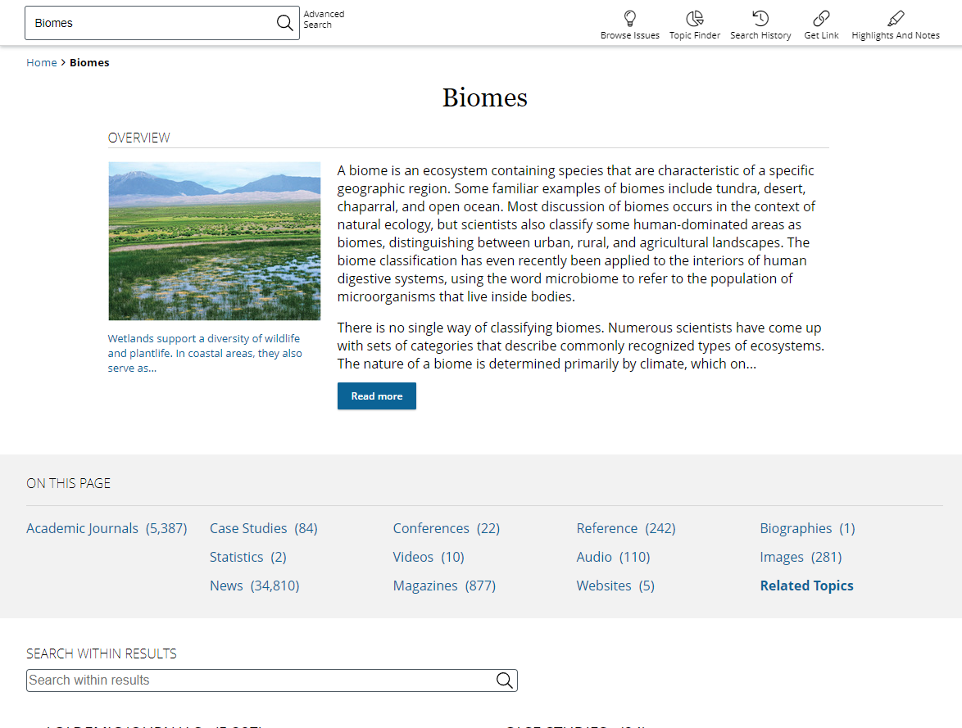
ENVIRONMENTAL SCIENCE
The Living World
Ecosystems, Biomes, Biodiversity, Carbon, Nitrogen, Phosphorus, and Water Cycles
Global Change
Global Temperature Changes, Emissions, Climate Justice, Greenhouse Gases, Ocean Warming and Acidification, Ozone Depletion
Energy
Energy Source, Fuel Types, Energy Consumption, Energy Conservation
Notes:
Here are just a few of the many examples of topics covered within environmental science.
Feel free to hide slides, or feature different topic page subjects depending on the audience you present to.

Slide 23
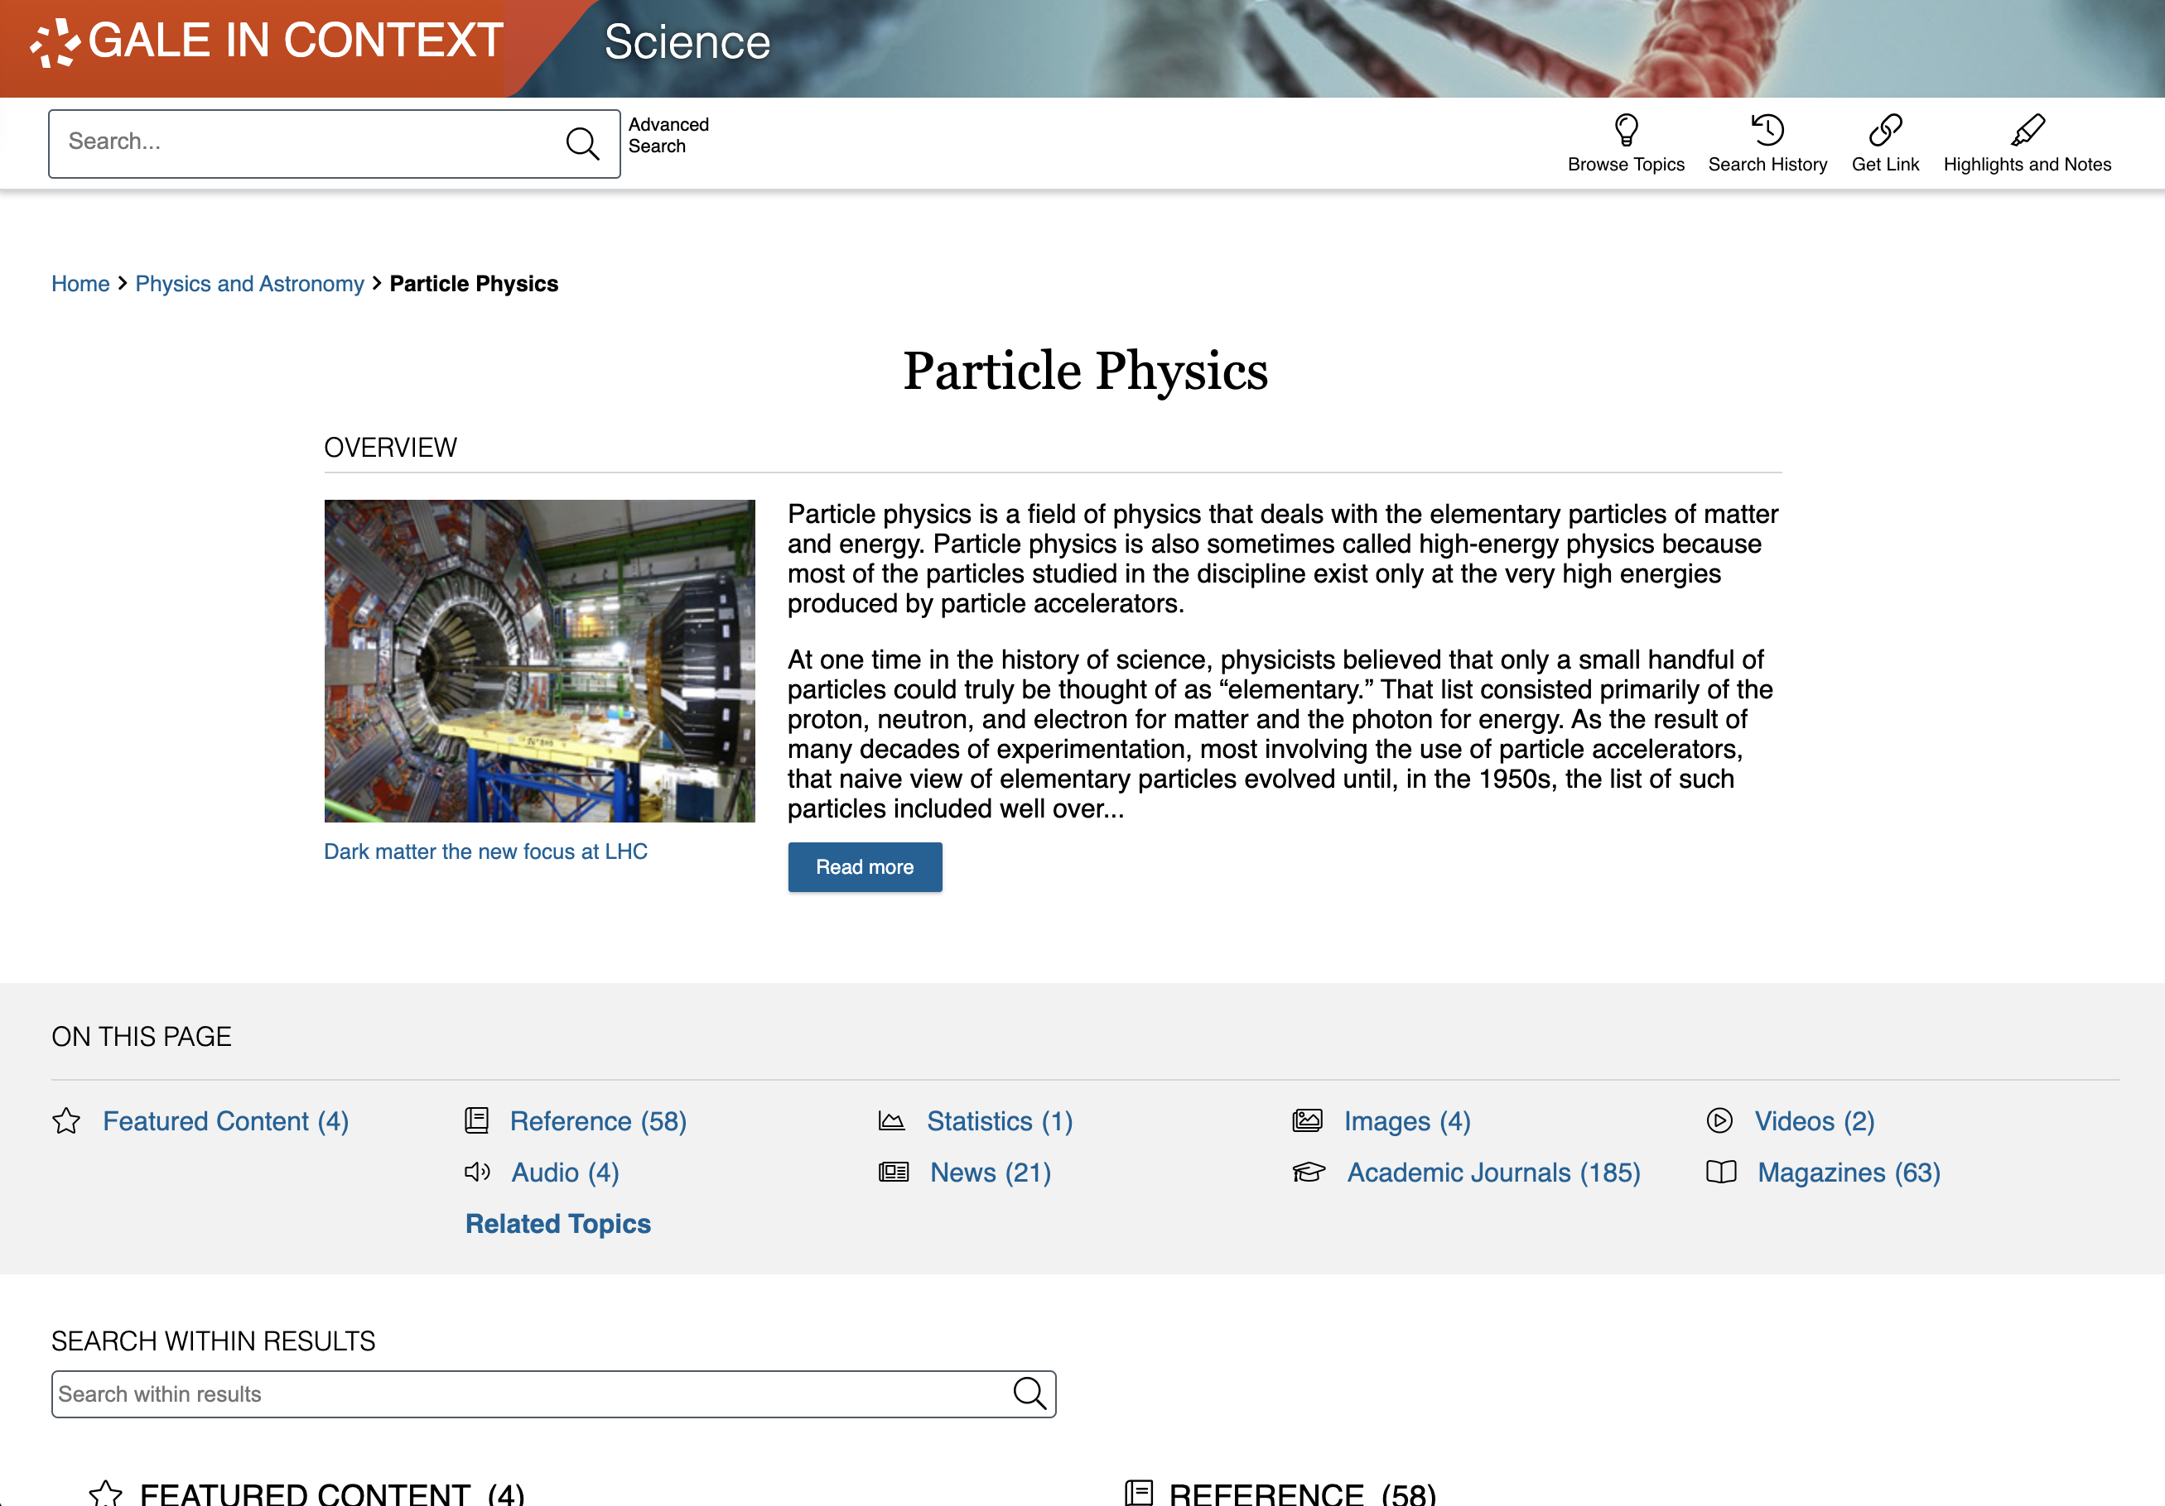
HUMAN-ENVIRONMENT INTERACTIONS
Populations
Endangered Species, Population Growth, Population Dynamics, Population Biology
Sustainability
Conservation, Green Technology, Green Jobs, Sustainable Agriculture, Sustainable Development, Energy Alternatives
Pollution
Sources of Pollution, Light Pollution, Plastic Pollution, Emissions, Heavy Metals, Pollution Controls
Notes:
Here are just a few of the many examples of topics covered within Human-Environment Interactions.
Feel free to hide slides, or feature different topic page subjects depending on the audience you present to.

Slide 24
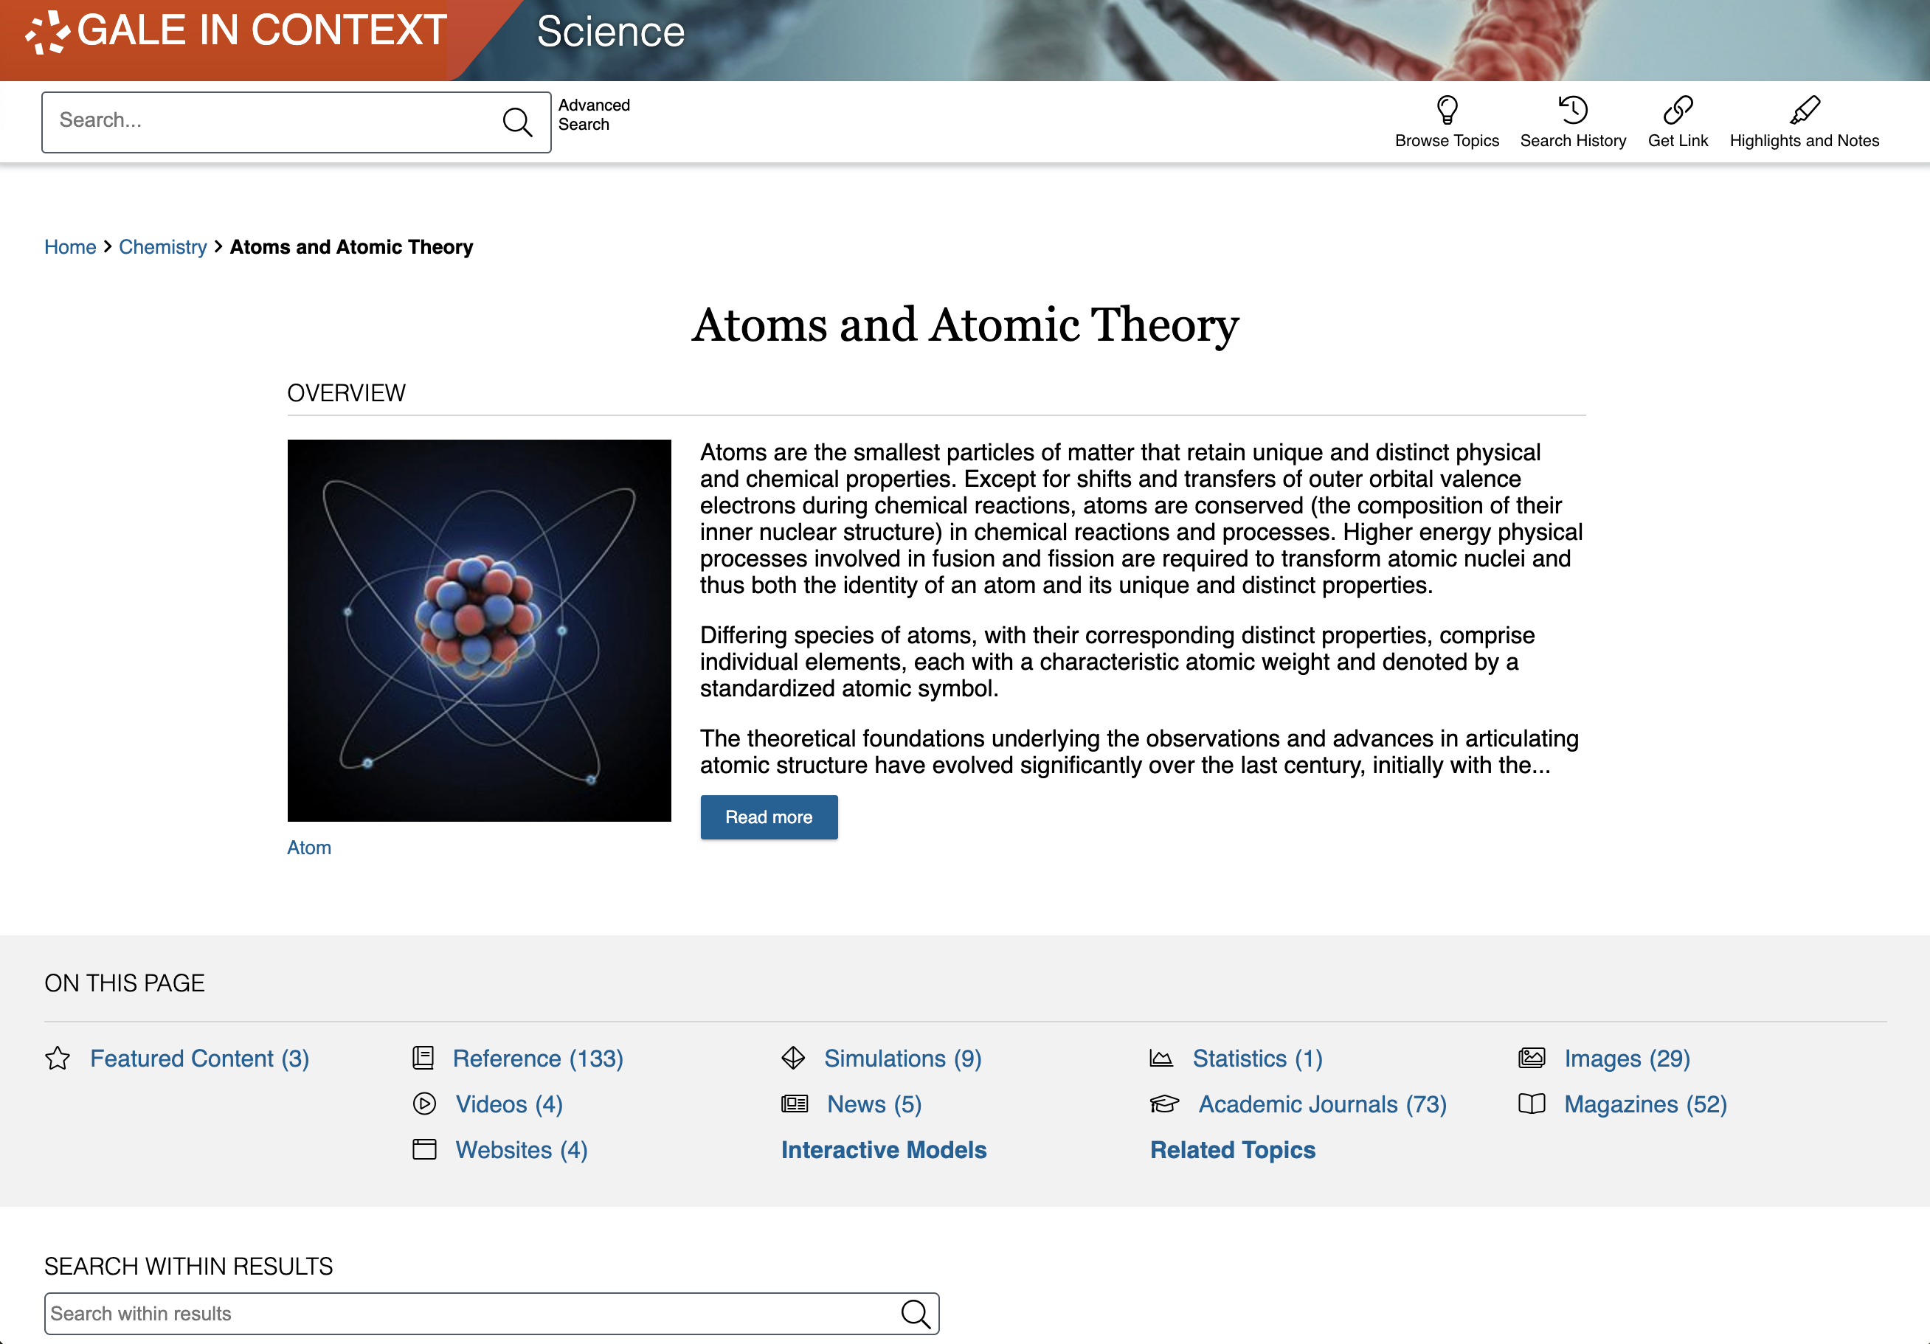
EARTH SYSTEMS
Earth Systems and Resources
Soil Ecology, Earth’s Atmosphere, Heavy Metals, Weather Events, Seasons, Geologic Time, Erosion, Aquifers
Land and Water Use
Landfills, Adaptive Management, Mining, Urban Development, Vegetarianism, Indigenous Environmentalism, Irrigation
Notes:
Here are just a few of the many examples of topics covered within earth systems.
Feel free to hide slides, or feature different topic page subjects depending on the audience you present to.

Slide 25
ENHANCE LEARNING
Notes:
All of the content within Gale In Context: Environmental Studies can not only be accessed anywhere 24/7 on any device with an internet connection with no limits to the number of students who can view the same article at the same time, but also provides helpful tools to transform the premium content found within into resources to support learning and the development of research skills.

Slide 26
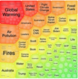
SHARE CONTENT
Get Link, Share to Classroom, Send to…
Push premium results to students and facilitate collaboration
SUPPORT ACCESSIBLE LEARNING
Translate, Font Size, Listen
Provide options for learners with varied needs and preferences
ENCOURAGE ANALYSIS
Highlights and Notes
Promote deeper learning with color-coding and annotation
DEVELOP RESEARCH SKILLS
Topic Pages, Topic Finder, Cite
Advance ability to define topics and use sources responsibly
Notes:
These tools include options to easily push content to students, or have students share with you/with each other, features to make content accessible to learners with a variety of needs, the highlights and notes tool that can be used in many different ways to record student analysis of sources for assignments or research, and tools to help scaffold the research process-– from choosing and refining a topic to citing the information appropriately.

Slide 27
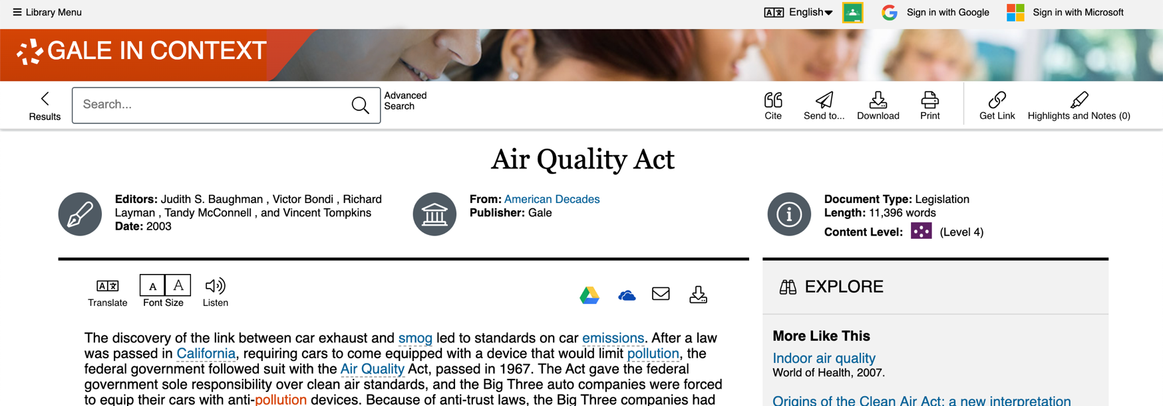
SHARE CONTENT
GET LINK
Create a Persistent URL
SHARE TO CLASSROOM
Push to Google Classroom
SEND TO…
Email, Google, or Microsoft
Notes:
As previously mentioned, all of the content in the Gale resource is accessible 24/7 on any device in any location. Additionally, every item within the resource provides a number of options to export or share the content for later use. Get Link creates a persistent URL that will direct someone right back to the page you were on when you used the Get Link tool. Share to Classroom allows you to pull content into Google Classroom courses as assignments, announcements, and more. And, the Send to… feature and quick links give you the ability to push content to an email address, Google Drive, or Microsoft OneDrive account for viewing at any time in the future (content does not expire from these tools until you decide to delete/remove it). There are no limits to the number of times you can use these features, and you can also download and print content.

Slide 28
SHARE CONTENT
GET LINK
Copy and paste persistent URL to websites, LMS, assignments, etc.
Notes:
It’s easy to push content to students by clicking Get Link to create a persistent URL that you can copy and paste anywhere

Slide 29
SHARE CONTENT
GET LINK
Drive learners to trusted sources
Notes:
When students click the link, they will go directly to whatever page you were on when you generated the persistent URL.

Slide 30
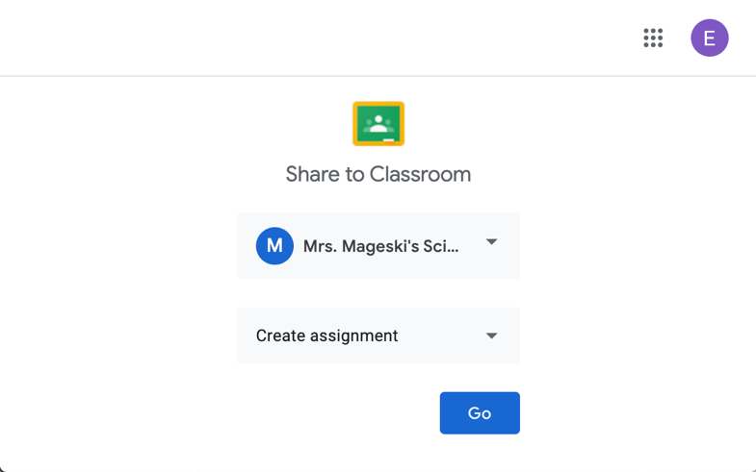
SHARE CONTENT
SHARE TO CLASSROOM
Follow Google Classroom prompts to create assignments, announcements, and more
Notes:
You also have the option to Share results to Google Classroom as assignments, announcements, etc.
Simply click the Share to Classroom button in the upper right portion of the screen. If you’re not already signed in to your Google Classroom account, you will be asked to do so.
From there, follow the Google prompts in the pop-up screen to decide which course you’d like to share the content to, and how.

Slide 31
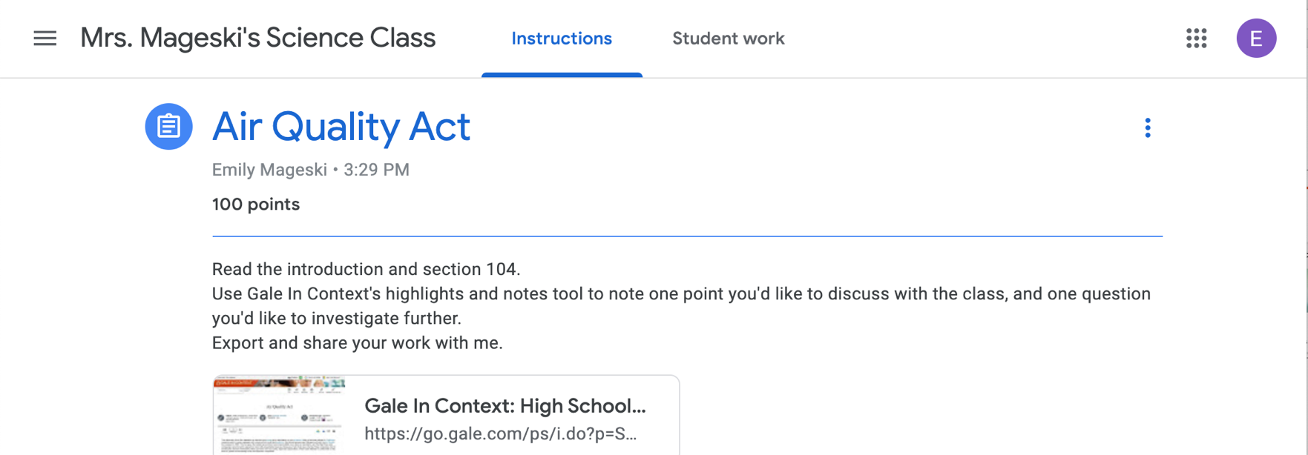
SHARE CONTENT
SHARE TO CLASSROOM
Follow Google Classroom prompts to create assignments, announcements, and more
Notes:
Depending on the selections you make, you’ll see something like this. Students will be able to click right from the assignment, announcement, etc. to the specific Gale content you share.

Slide 32
SHARE CONTENT
Get Link and Share to Classroom on Topic Pages and Search Results
Create Units of Learning
Share topic pages to introduce then delve into themes
Notes:
Both Get Link and Share to Classroom are also available on Gale In Context: Environmental Studies topic pages. So, you could essentially share those topic pages as a full set of content supporting a specific topic you’re covering in class. Or, for example, ask students to read one reference article and one newspaper editorial on a topic page of choice so that they not only have background information to understand a topic, but can use that background knowledge to critique the validity of arguments made within their chosen editorial.

Slide 33
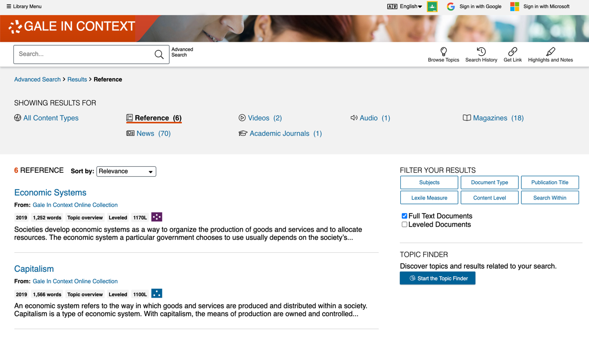
SHARE CONTENT
Get Link and Share to Classroom on Topic Pages and Search Results
Create Units of Learning
Share topic pages to introduce then delve into themes
Provide Learning Choices
Ask students to select 1-2 readings from list of options
Notes:
Get Link and Share to Classroom are available on search results, too. This gives you the option to craft a specific search, share it with students, and ask them to choose which resources to explore. It also gives you the ability to ask them to compare and contrast, or combine takeaways from multiple results that they select, providing a supported step into researching topics and synthesizing multiple sources. The highlights and notes tool that we’ll look at later can also help facilitate this skill.

Slide 34
SHARE CONTENT
SEND TO…
Email or Export Results to Google Drive or Microsoft OneDrive
Notes:
Finally, every result can be emailed or sent to Google Drive or Microsoft OneDrive for viewing whenever/as long as you want (all documents can also be printed or downloaded if you prefer). You can click any of the shortcuts to email, Google Drive, or Microsoft OneDrive at the top of an item’s text, or use click Send to… in the upper righthand corner to start the process and follow on-screen prompts.
If you are sending to Google Drive or Microsoft OneDrive, you will be asked to log in if you are not already logged into a Google or Microsoft account within your browser. If you are already logged in, the system will automatically send it to the Google or Microsoft account active in your browser (so do note which account you’re using for the purpose of locating the content later).

Slide 35
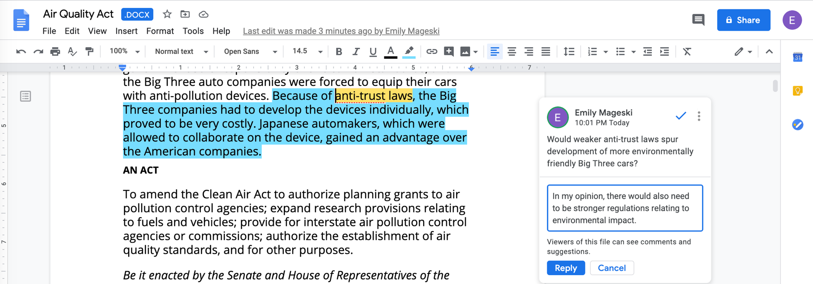
SHARE CONTENT
SEND TO…
Share document with students or ask students to share and comment on results
Notes:
Use this slide if your school/institution uses Google—
Gale content sent to Google Drive can be opened as a Google Doc. Content brought into Microsoft OneDrive can be opened as a Microsoft Word Online document.
These tools can help students stay organized when they perform research, and also provide easy options for sharing with other students, commenting, and collaborating when working on group projects or virtual discussions.

Slide 36
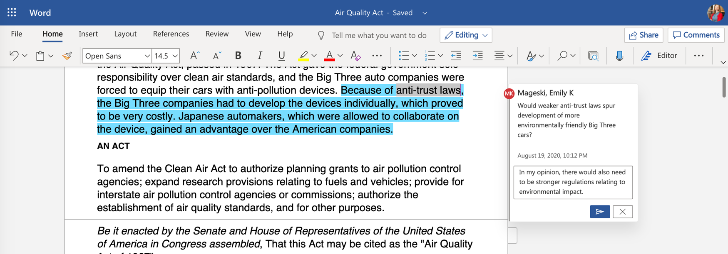
SHARE CONTENT
SEND TO…
Share document with students or ask students to share and comment on results
Notes:
Use this slide if your school/institution uses Microsoft OneDrive—
Gale content sent to Google Drive can be opened as a Google Doc. Content brought into Microsoft OneDrive can be opened as a Microsoft Word Online document.
These tools can help students stay organized when they perform research, and also provide easy options for sharing with other students, commenting, and collaborating when working on group projects or virtual discussions.

Slide 37
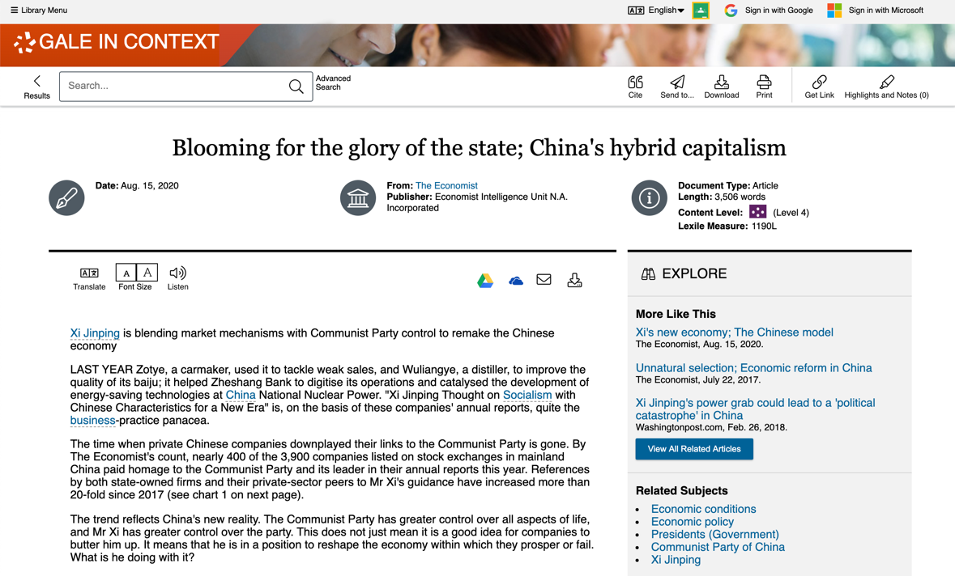
SUPPORT ACCESSIBLE LEARNING
TRANSLATE
Machine translate articles– 40+ languages
Notes:
Further, to support the varied needs of your learners, every result includes simple point (or tap) and click tools to machine translate the text (helpful for those who need to compare portions of the English language version to a different language in order to aide understanding) into over 40 languages,

Slide 38
SUPPORT ACCESSIBLE LEARNING
TRANSLATE
Machine translate articles– 40+ languages
FONT SIZE
Increase or reduce as needed
Notes:
to increase or decrease font size to aide readability,

Slide 39
SUPPORT ACCESSIBLE LEARNING
TRANSLATE
Machine translate articles– 40+ languages
FONT SIZE
Increase or reduce as needed
LISTEN
Hear text read aloud
Download MP3
Enhance text visibility
Simply click/tap to use!
Notes:
and to listen to a machine reading of the text. Once a user clicks the listen function, the user will have the option to access additional tools, including the ability to download the MP3, and the option to access a settings menu that provides choices for reading speed, reading highlights, and even the Enhanced text visibility feature, which pops out an enlarged version of the phrase currently being read while the listen tool is reading.

Slide 40
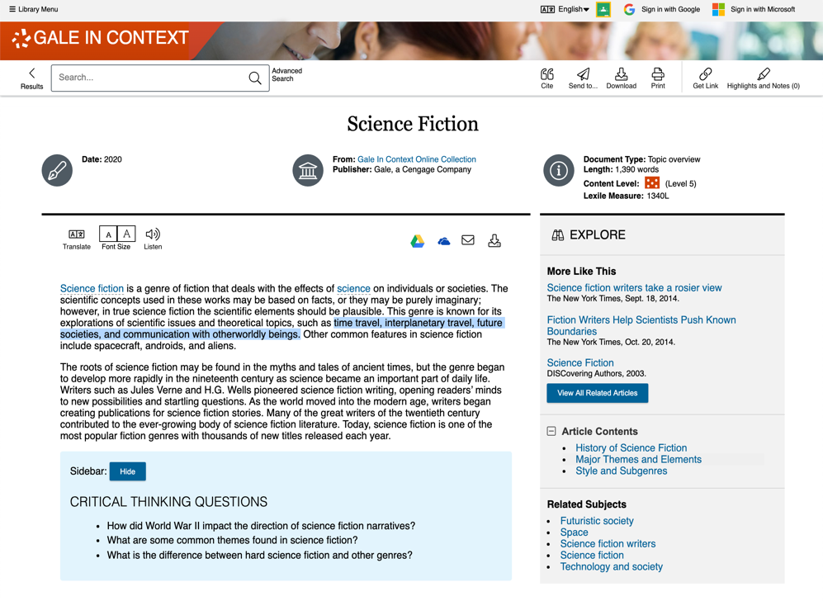
ENCOURAGE ANALYSIS
SELECT TEXT
Click and drag mouse on computer;
Tap on tablet or mobile device
STEP 1
Notes:
In addition to the sharing features we just discussed, all text results include the option to add highlights and notes. You can use these features to call out specific portions of text or to note questions for students; or you can ask students to color code specific items (pro or con arguments, first read/second passes in close reading assignments, strong points made within and questions about a text. Etc.), add their thoughts, send the document to Google Drive or OneDrive (or download it), and then share the Google Doc, Microsoft Word Online doc, or PDF with you for further commentary.
To get started, you or your students can simply select text within the document as you normally would to copy or paste text (click and drag on your computer, or tap the first and last word on mobile devices).

Slide 41
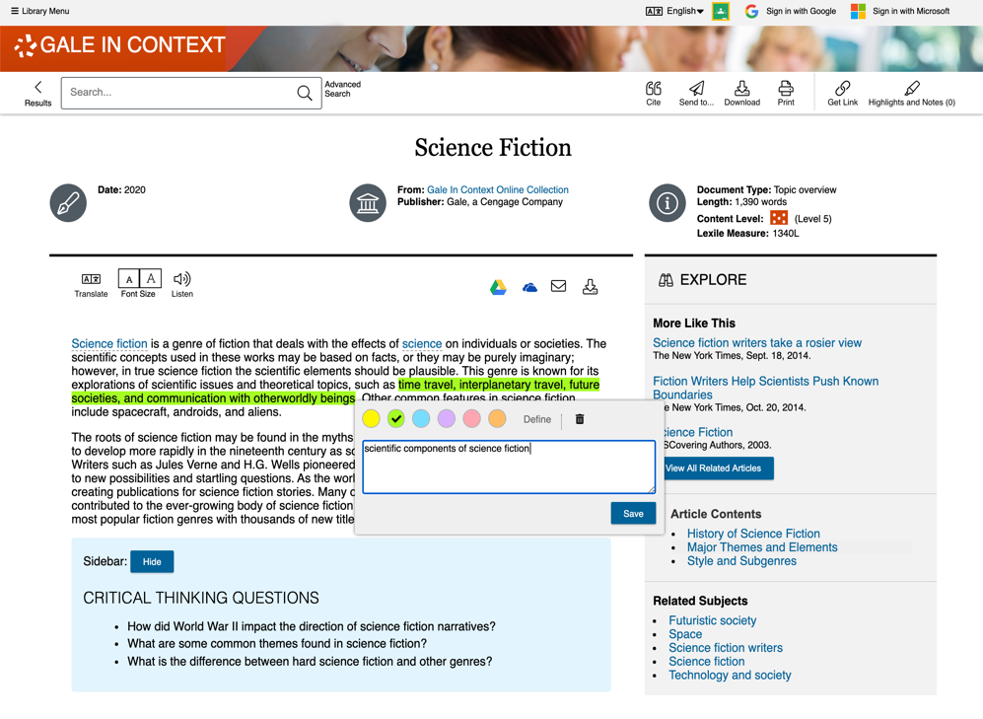
ENCOURAGE ANALYSIS
SELECT TEXT
Click and drag mouse on computer;
Tap on tablet or mobile device
STEP 1
ADD HIGHLIGHTS AND NOTES
Choose color and type annotations in pop-up menu
STEP 2
Notes:
You’ll then see a pop-out menu that provides color options and the ability to add notes. Note that if a student selects one word within the text, the define option will allow that student to view a dictionary definition without leaving the Gale resource.
Choose the desired color for the highlight and add your thoughts or response to the notes field.

Slide 42
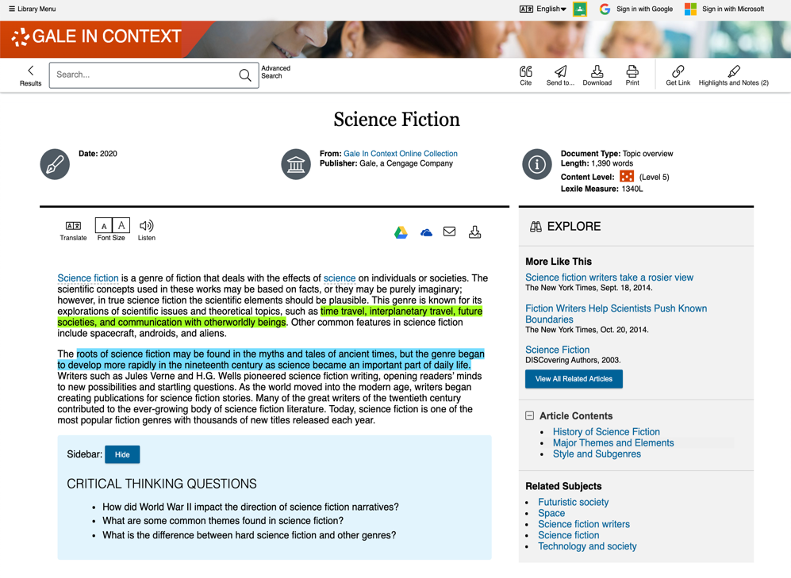
ENCOURAGE ANALYSIS
SELECT TEXT
Click and drag mouse on computer;
Tap on tablet or mobile device
STEP 1
ADD HIGHLIGHTS AND NOTES
Choose color and type annotations in pop-up menu
STEP 2
EXPORT
Add as many notes as desired Download, Print, or Send to… Email, Google Drive or OneDrive before closing
STEP 3
Notes:
Finally, be sure to take the highlighted item with you before you close the resource by downloading, printing, or sending the item to Google Drive or Microsoft OneDrive. This will provide a copy of the result including any highlights and notes you made within the document.
Note that you can also access the Highlights and Notes menu option in the upper right-hand corner of the resource to access all the highlights and notes you’ve made within a given session. This allows you to easily jump to articles and edit highlights and notes, or to download, print, or send a full list of all your highlights and notes to Google Drive or Microsoft OneDrive. Again, if you plan to use this tool, be sure to download, print, or Send to… before exiting the resource.

Slide 43
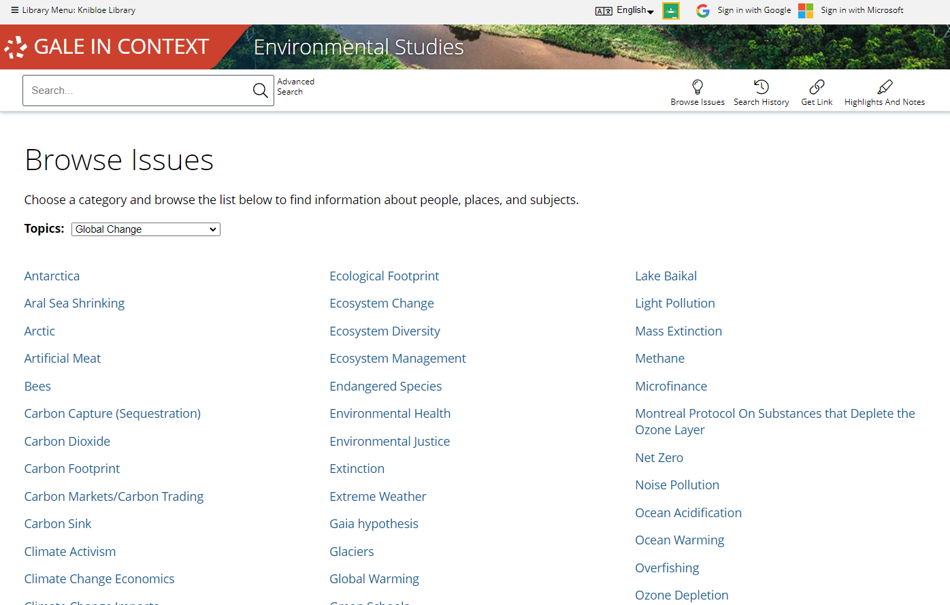
DEVELOP RESEARCH SKILLS
TOPIC PAGES
Highlight Potential Projects
Browse Topics to see frequently investigated topics
Notes:
Finally, Gale resources are designed to help develop your students’ research skills, whether you are assigning a full research project, or just asking them to prepare for an in-class discussion.
At a basic level, topic pages within Gale In Context (available via the Browse Topics menu option or from the homepage) highlight potential topics for students who are having trouble picking a subject of interest. These students can even use the Topics dropdown on the Browse Topics page to focus on topics within larger areas of interest (for example, social issues).

Slide 44
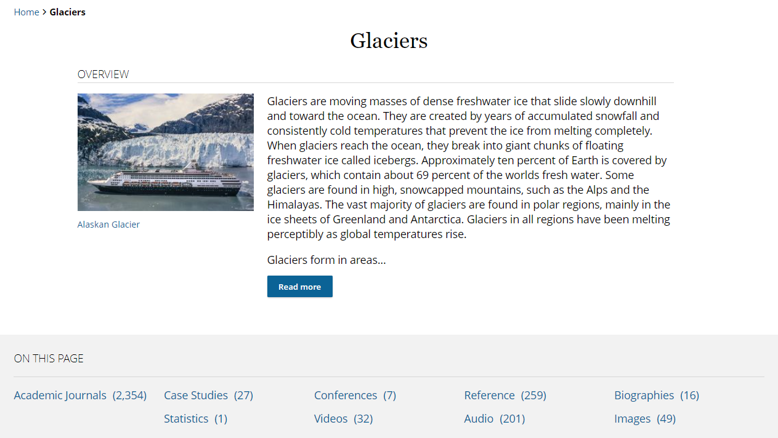
DEVELOP RESEARCH SKILLS
TOPIC PAGES
Highlight Potential Projects
Browse Topics to see frequently investigated topics
Curate Variety of Premium Sources
Scaffold the research process
Introduce new source types
Notes:
Topic pages bring together a curated set of content on a topic. This means students have a supportive jumping off point to dive into a variety of resources, making research a little more accessible for those students who aren’t quite ready to create complex search strategies. Further, these pages offer a wide array of different content types, including things that students may not have thought to look for on their own, but will have experience using for future research or projects.

Slide 45
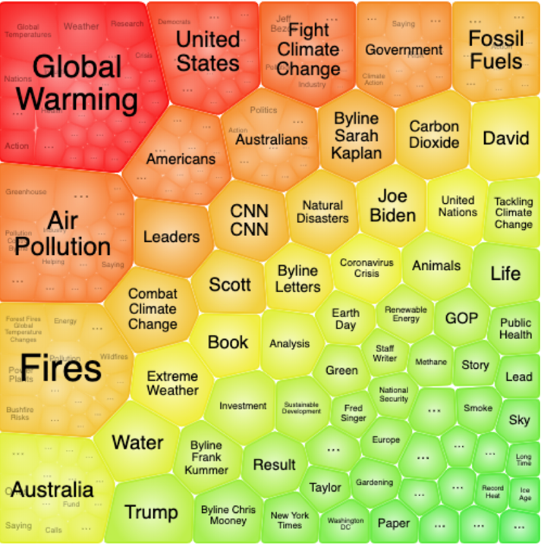
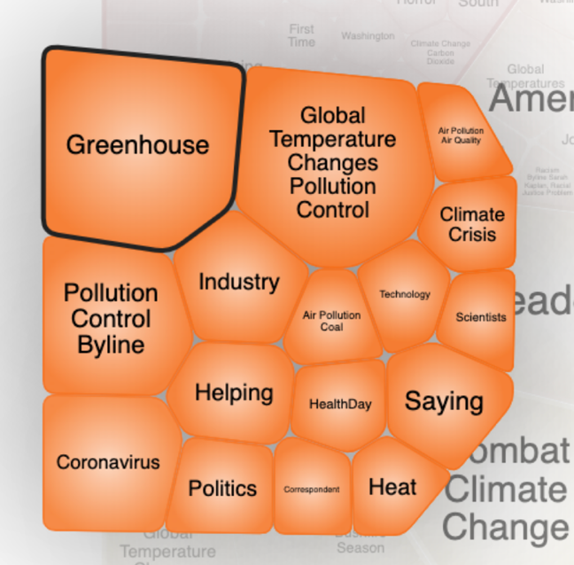
DEVELOP RESEARCH SKILLS
TOPIC FINDER
Visually Map Search Results
Interact to narrow topics
Notes:
When students have a topic in mind and begin searching the resource, topic finder provides a visual tool for them to better understand the divisions and connections within their larger topics in order to begin defining a more narrow, unique research direction.

Slide 46
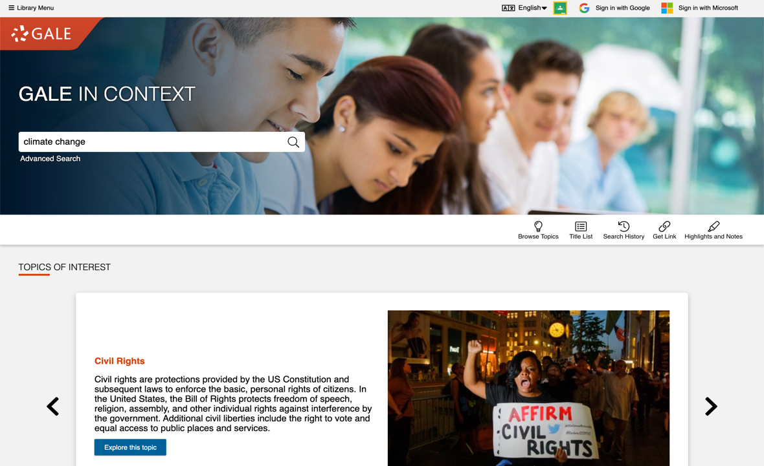
DEVELOP RESEARCH SKILLS
TOPIC FINDER
Visually Map Search Results
Interact to narrow topics
STEP ONE
Run search
Notes:
Topic finder can be accessed after running a search within the Gale resource.

Slide 47
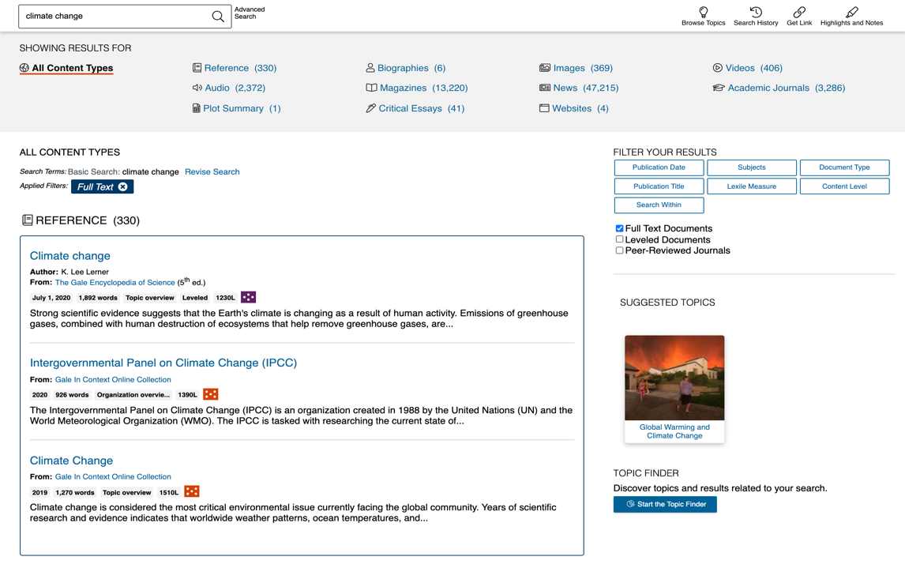
DEVELOP RESEARCH SKILLS
TOPIC FINDER
Visually Map Search Results
Interact to narrow topics
STEP ONE
Run search
STEP TWO
Start the Topic Finder
Notes:
On the right-hand side of the page, under the filters, simply click Start the Topic Finder.

Slide 48
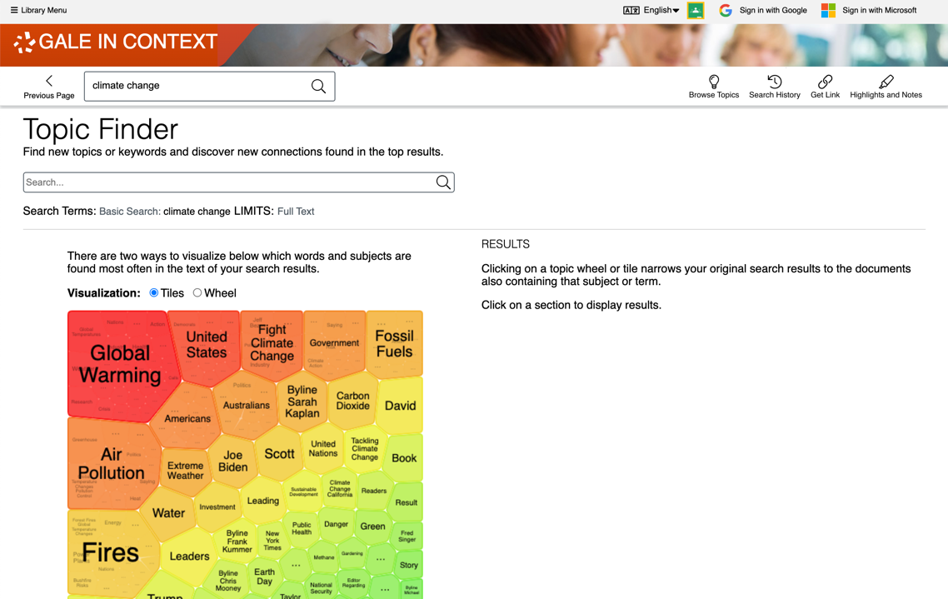
DEVELOP RESEARCH SKILLS
TOPIC FINDER
Visually Map Search Results
Interact to narrow topics
STEP ONE
Run search
STEP TWO
Start the Topic Finder
STEP THREE
Click to explore sections and link to results
Notes:
You or your students can then interact with either a tile (shown in this screenshot) or wheel visualization that maps out and breaks down major themes within the larger topic. Click to interact with the tiles or wheels

Slide 49
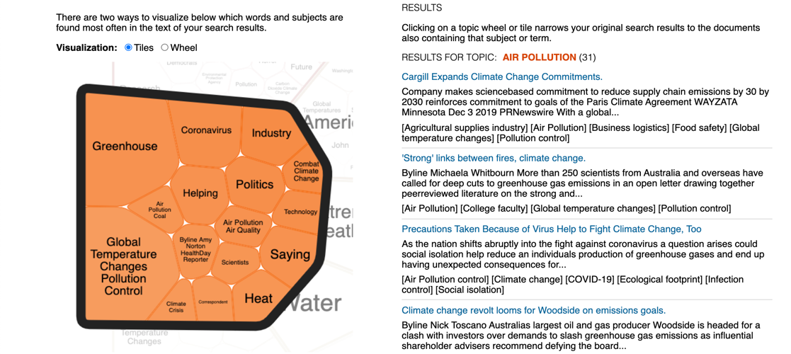
DEVELOP RESEARCH SKILLS
TOPIC FINDER
Visually Map Search Results
Interact to narrow topics
STEP ONE
Run search
STEP TWO
Start the Topic Finder
STEP THREE
Click to explore sections and link to results
Notes:
to see further divisions of the topic. As you do, a list of results will be presented and updated on the right-hand side of the tool so that you or your students can quickly click into relevant articles within the refined topic.

Slide 50
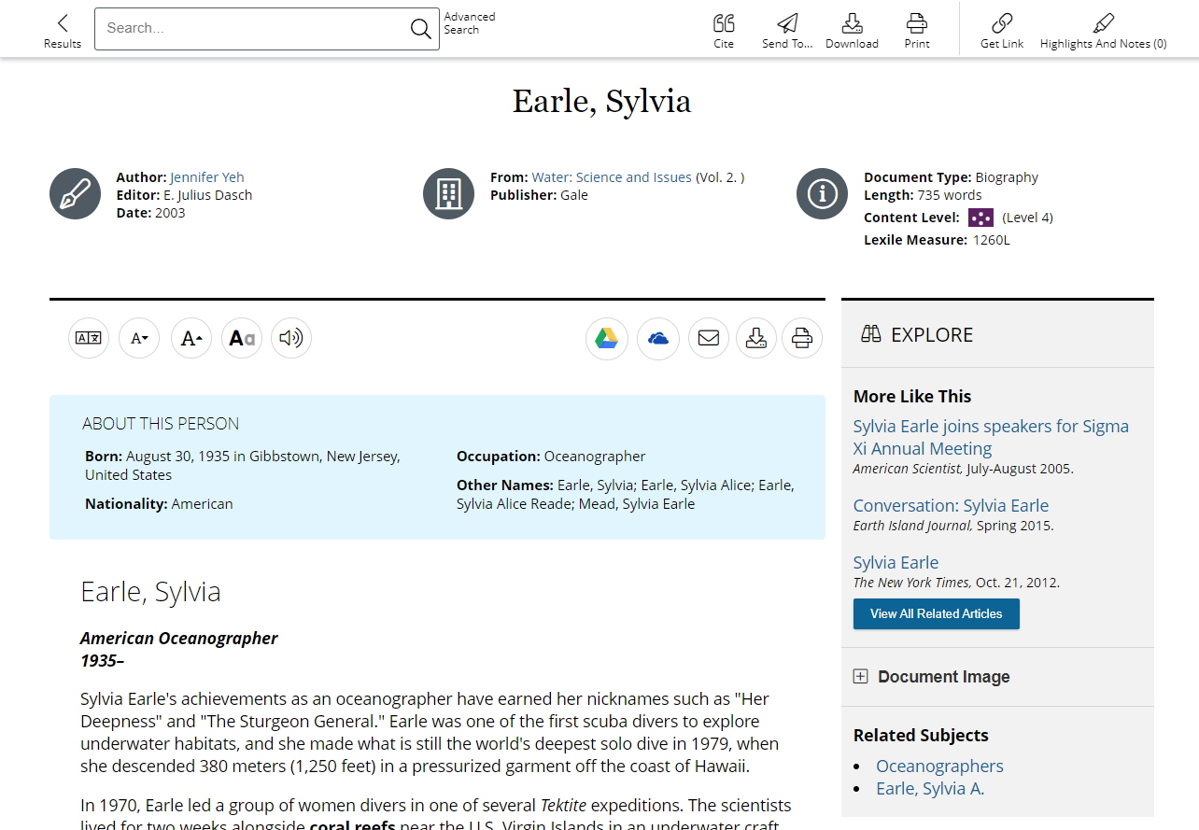
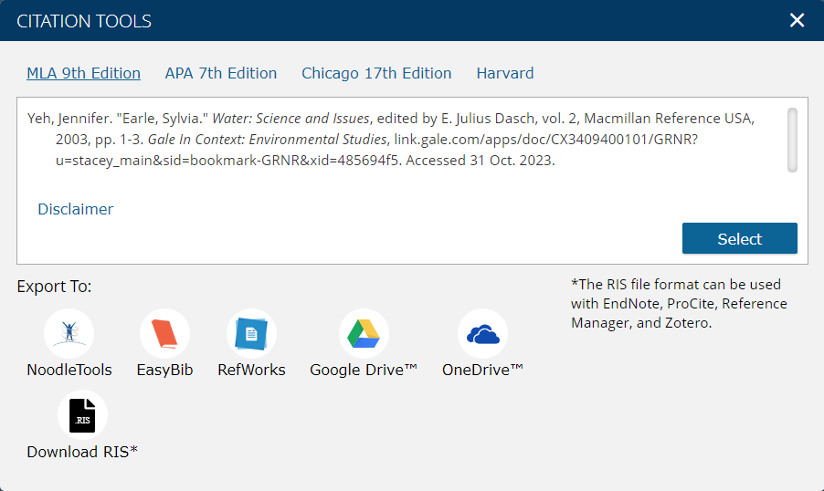
DEVELOP RESEARCH SKILLS
CITE
Click for MLA, APA, Chicago
Select, copy, and paste
Export – NoodleTools, EasyBib, and more
Notes:
Finally, a seamless Cite tool is built into every item within the Gale resource to ensure that students have support in using and citing resources responsibly.
Simply click Cite to provide machine-generated MLA, APA (7th edition is now available within the tool), and/or Chicago style citations. Use the Select button to select, then copy and paste the citation into a document, or Export the citation to services like EasyBib and NoodleTools.

Slide 51
DEVELOP RESEARCH SKILLS
CITE
Click for MLA, APA, Chicago
Select, copy, and paste
Export – NoodleTools, EasyBib, and more
Or, Select Style and Export Result
Scroll to bottom and choose style
Notes:
Alternately, scroll to the bottom of the document and use the Source Citation area to select the desired citation. Whichever citation is active in this area (for example, in this screenshot, APA is the active selection)

Slide 52
DEVELOP RESEARCH SKILLS
CITE
Click for MLA, APA, Chicago
Select, copy, and paste
Export – NoodleTools, EasyBib, and more
Or, Select Style and Export Result
Scroll to bottom and choose style
Export Document
Notes:
Will be exported with the document when it is downloaded, printed, emailed, or sent to Google Drive or Microsoft OneDrive.

Slide 53
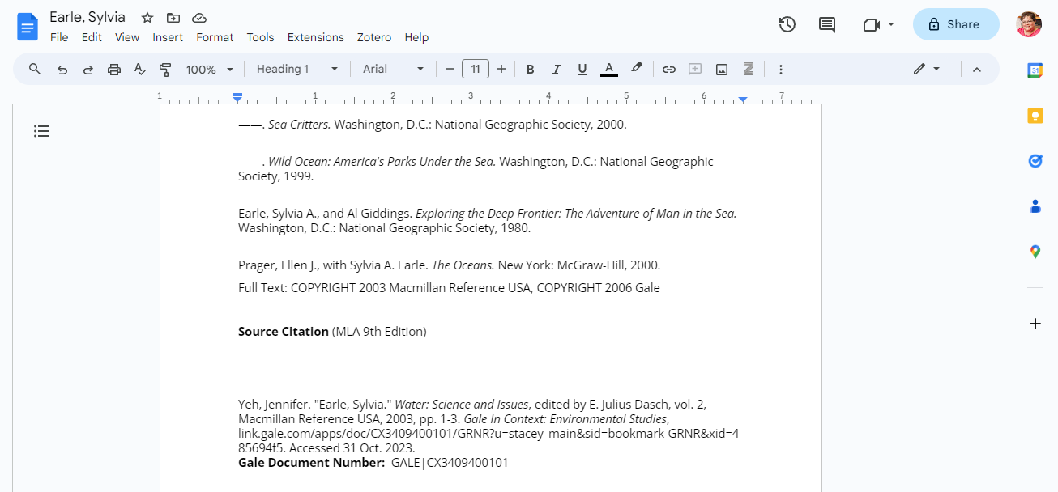
DEVELOP RESEARCH SKILLS
CITE
Click for MLA, APA, Chicago
Select, copy, and paste
Export – NoodleTools, EasyBib, and more
Or, Select Style and Export Result
Scroll to bottom and choose style
Export document
View document text, highlights and notes, and selected citation
Notes:
And will appear at the bottom of the exported document.

Slide 54
?
…
Notes:
Use this slide as a visual prompt for final questions and/or discussions

Slide 55
WHAT’S NEXT?
EXPLORE GALE IN CONTEXT: ENVIRONMENTAL STUDIES
SHARE WITH STUDENTS
CONTACT THE LIBRARY!
Notes:
Wrap up– ask teachers to visit the resource, share articles with students, and contact the library for support

Slide 56
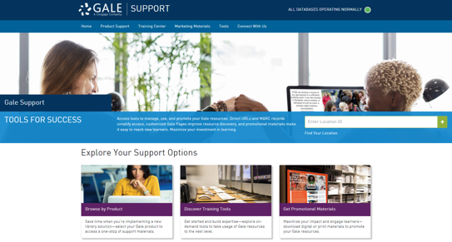
Connect FOR MORE IDEAS
ENTER LIBRARIAN NAME
emailaddress@school.edu
LIBRARY WEBSITE
www.librarysite.edu
SUPPORT.GALE.COM/TRAINING
Lesson plans, tutorials, scavenger hunts, and more
Notes:
Customize this concluding slide with your contact and site/access information.

Slide 57
INTEGRATE INTO YOUR LMS
Notes:
The next few slides cover discovery within Schoology and Canvas. If you are utilizing one of these LMS unhide these slides, if not you can keep them hidden during your presentation. Remember: integrating into your LMS means your users will automatically authenticate into Gale In Context: Environmental Studies when selected.

Slide 58
SCHOOLOGY
ACCESS THROUGH COURSE HOME
Your integrated Gale resources will appear in the tool bar on the left.
Notes:
To select a resource added to a course users will need to select the course and choose the correct resource from those added to the left side tool bar.

Slide 59
SCHOOLOGY
ACCESS THROUGH COURSE HOME
Your integrated Gale resources will appear in the tool bar on the left.
Selecting a resource will open it within the Schoology interface.
Notes:
To select a resource added to a course users will need to select the course and choose the correct resource from those added to the left side tool bar.
Selecting the Gale In Context: Environmental Studies option will launch them straight into the resource, while keeping them in the Schoology interface.

Slide 60
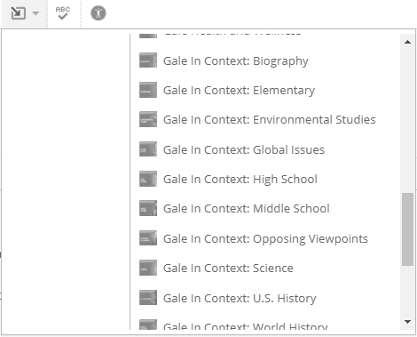
SCHOOLOGY
ACCESS THROUGH MATERIALS
When creating or editing a material, select the Insert Content drop down in the Description section and choose your resource.
Notes:
To access resources while creating or editing a material (like an assignment or discussion post) teachers will select the Insert Content option at the top of the description dialogue box. The drop down will have Gale In Context: Environmental Studies listed.

Slide 61
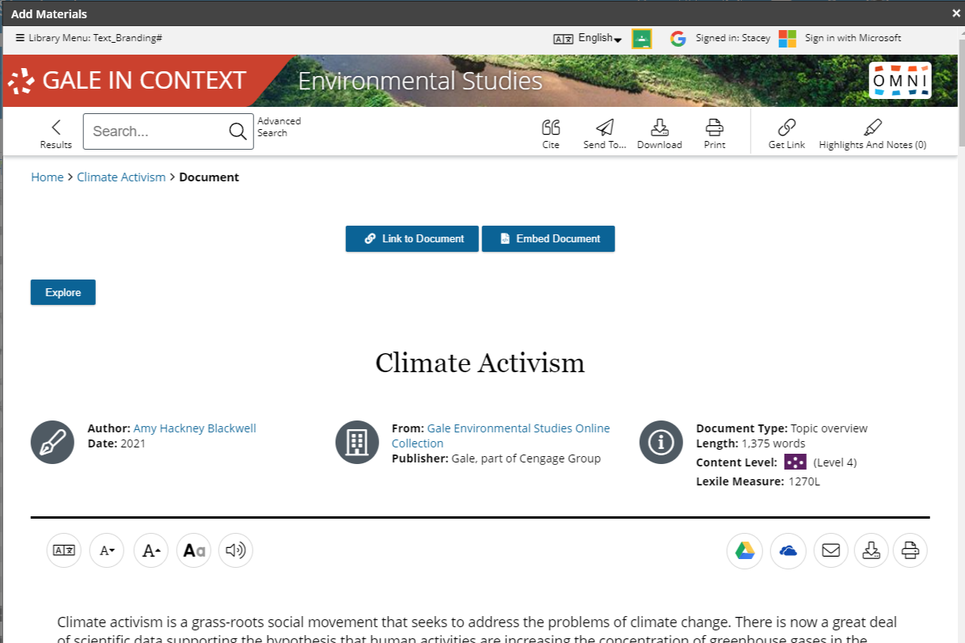
SCHOOLOGY
ACCESS THROUGH MATERIALS
When creating or editing a material, select the Insert Content drop down in the Description section and choose your resource.
The resource will open within Schoology. Utilize the Link to Document or Embed Document buttons to add content to your material.
Notes:
Selecting the Insert Content option pulls forward the Gale In Context: Environmental Studies interface while continuing to keep the user within Schoology.
While in Gale In Context: Environmental Studies users can choose either Link to Document or Embed Document. Selecting Link to Document will enter a URL into the material that others will be able to select. Embed Document creates an iframe in which the native Gale In Context: Environmental Studies platform is available.

Slide 62
CANVAS
ACCESS THROUGH COURSE HOME
Your integrated Gale resources will appear in the tool bar on the left.
Notes:
To select a resource added to a course users will need to select the course and choose the correct resource from those added to the left side tool bar.

Slide 63
CANVAS
ACCESS THROUGH COURSE HOME
Your integrated Gale resources will appear in the tool bar on the left.
Selecting a resource will open it within the Canvas interface.
Notes:
To select a resource added to a course users will need to select the course and choose the correct resource from those added to the left side tool bar.
Selecting the Gale In Context: Environmental Studies option will launch them straight into the resource, while keeping them in the Canvas interface.

Slide 64
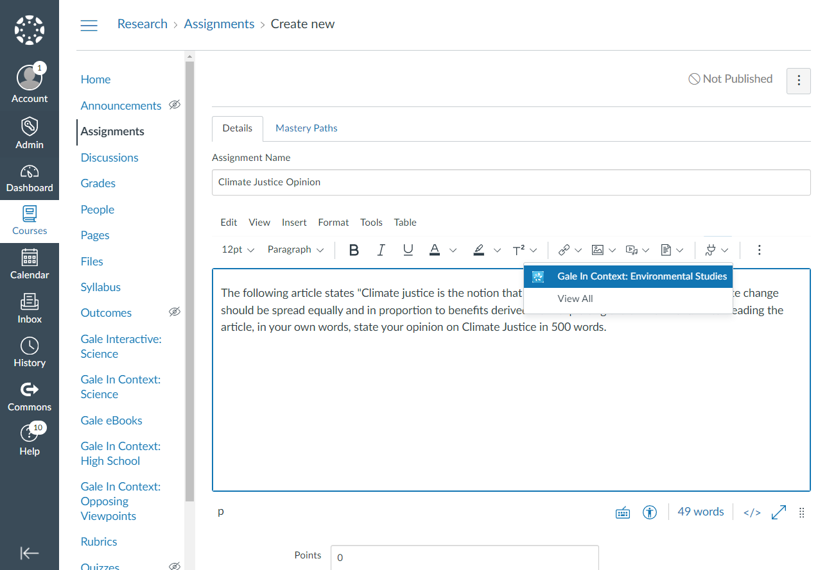
CANVAS
ACCESS THROUGH MATERIALS
When creating or editing a material, select the Apps drop down in the Details section and choose your resource.
Notes:
To access resources while creating or editing a material (like an assignment or discussion post) teachers will select the Apps option at the top of the Details dialogue box. The drop down will have Gale In Context: Environmental Studies listed.

Slide 65
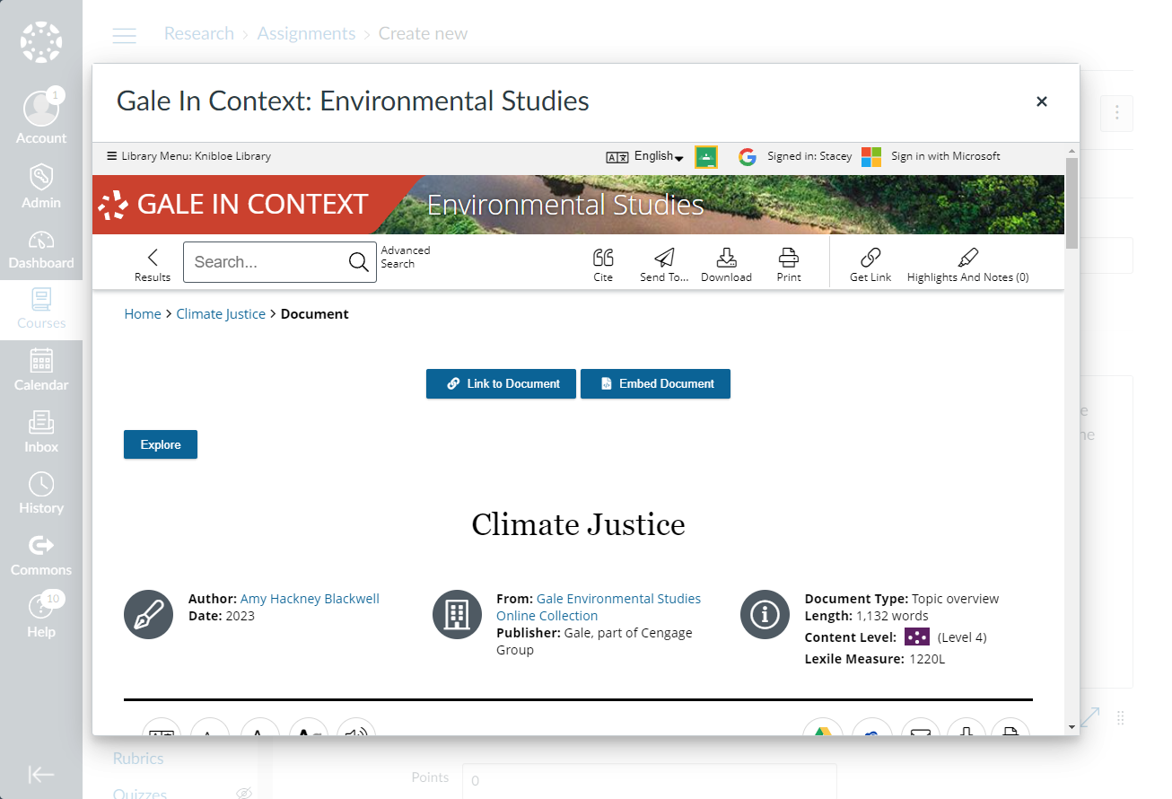
CANVAS
ACCESS THROUGH MATERIALS
When creating or editing a material, select the Apps drop down in the Details section and choose your resource.
The resource will open within Canvas. Utilize the Link to Document or Embed Document buttons to add content to your material.
Notes:
To access resources while creating or editing a material (like an assignment or discussion post) teachers will select the Apps option at the top of the Details dialogue box. The drop down will have Gale In Context: Environmental Studies listed.

