Slide 1
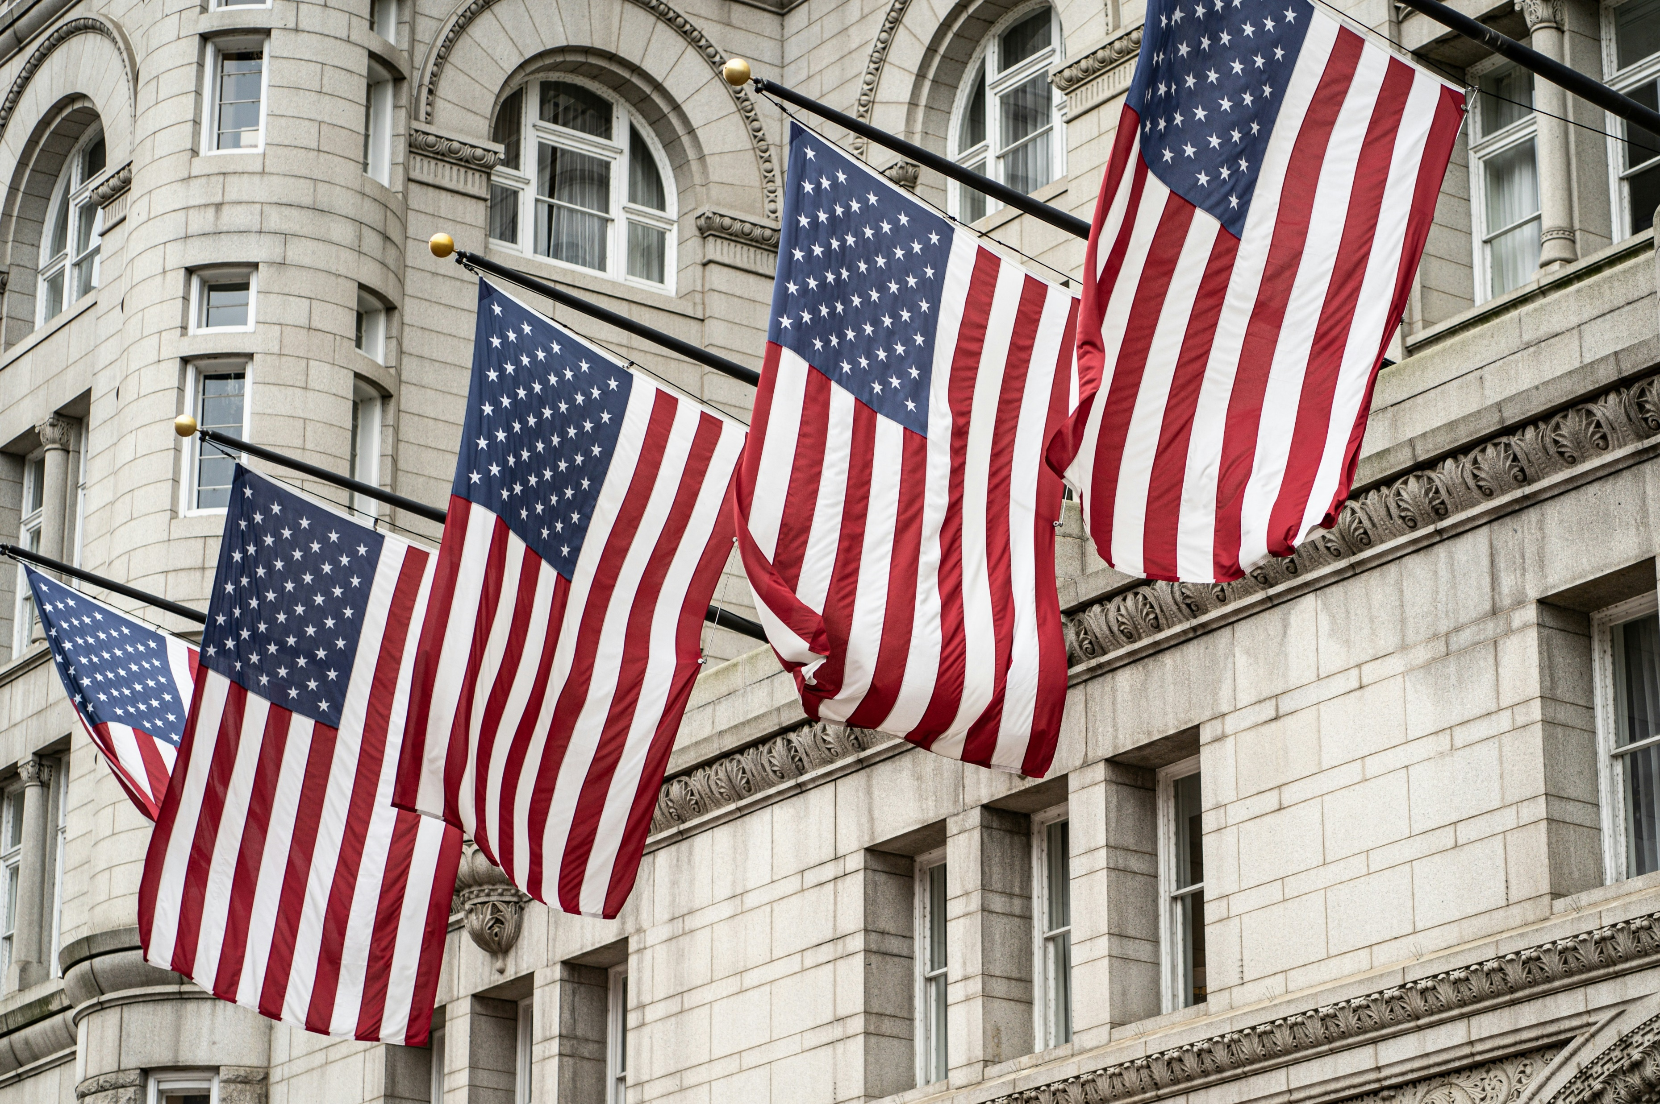
250 Years of
Compromise and Endurance
Choice Board
Over the past 250 years, the United States has faced countless challenges - conflicts over rights, power, identity, and justice. In response, the government has often relied on two key strategies: compromise, the art of finding middle ground between opposing views, and endurance, the ability to uphold principles or adapt policies over time. Through congressional acts, executive orders, and Supreme Court rulings, these strategies have shaped the nation’s laws and values.
DIRECTIONS: In this activity, you’ll explore how each branch of government has contributed to America’s ongoing story of compromise and endurance by analyzing historical documents in Gale In Context: High School. You will choose one congressional act, executive order, and Supreme Court ruling for each of the following themes:
Civil Rights & Liberties
Economic Policy
War & National Security
Federal vs. State Power
As you examine each source, consider the context, the conflict, and the lasting impact of the decision. Use the corresponding Gale document to answer the accompanying questions.

Slide 2
CIVIL RIGHTS & LIBERTIES
Select one of each (congressional act, executive order, and supreme court ruling) from below to learn more about. Then click on the box to open the corresponding Gale document. Use the document to answer the assigned questions for each.
CONGRESSIONAL
ACTS
EXECUTIVE
ORDERS
SUPREME COURT
RULINGS
Civil Rights Act of 1964
Outlawed discrimination in public places and employment.
EO 9981
Desegregated the armed forces.
Brown v. Board of Education (1954)
Declared racial segregation in schools unconstitutional.
Voting Rights Act of 1965
Prohibited discrimination based on disability.
EO 11246
Required affirmative action in hiring by federal contractors.
Shelby County v. Holder (2013)
Weakened federal oversight of voting laws.
Americans with Disabilities Act (1990)
Prohibited discrimination based on disability.
EO 2000
Improved access to services for people with limited English proficiency.
Tinker v. Des Moines (1969)
Affirmed students’ rights to free speech in schools.

Slide 3
CIVIL RIGHTS & LIBERTIES – Congressional Act
Chosen Congressional Act:
1. What was the historical context in which this legislation was passed? What national or social issues was Congress responding to?
2. What conflict or debate surrounded the creation of this law?
3. What compromises (if any) were made to pass the legislation?
4. What was the immediate effect of this law on federal, state, or public institutions?
5. How has this law endured or evolved over time? Has it been amended, repealed, or challenged?

Slide 4
CIVIL RIGHTS & LIBERTIES – Executive Order
Chosen Executive Order:
1. What was the historical and political context in which this executive order was issued? What crisis, issue, or goal prompted presidential action?
2. What conflict or challenge did the executive order attempt to address? Was it responding to resistance, urgency, or a gap in legislation?
3. How did the order assert federal authority or interact with state powers? What compromises (if any) were made to pass the legislation?
4. What was the immediate impact of the order on policy, people, or institutions?
5. Did the order lead to lasting change, legal challenges, or further government action?

Slide 5
CIVIL RIGHTS & LIBERTIES – Supreme Court Ruling
Chosen Supreme Court Ruling:
1. What was the historical and legal context surrounding this case? What events or issues led to the case being heard by the Supreme Court?
2. What was the central conflict or constitutional question in the case? What opposing viewpoints or legal interpretations were involved?
3. How did the Court resolve the conflict, and what reasoning did it use?
4. What was the immediate impact of the ruling on federal and state power or individual rights?
5. How has this decision endured or influenced later laws, cases, or public policy?

Slide 6
ECONOMIC POLICY
Select one of each (congressional act, executive order, and supreme court ruling) from below to learn more about. Then click on the box to open the corresponding Gale document. Use the document to answer the assigned questions for each.
CONGRESSIONAL
ACTS
EXECUTIVE
ORDERS
SUPREME COURT
RULINGS
Social Security Act (1935)
Established retirement and unemployment benefits..
EO 6102 (1933)
Prohibited hoarding of gold to stabilize the economy.
West Coast Hotel v. Parrish (1937)
Upheld minimum wage laws.
Fair Labor Standards Act (1938)
Set minimum wage and banned child labor.
EO 10988 (1962)
Recognized federal employee unions.
NLRB v. Jones & Laughlin Steel Corp. (1937)
Supported federal regulation of labor.
Emergency Economic Stabilization Act (2008)
Authorized financial bailout during financial crisis.
EO 12564 (1986)
Established drug-free federal workplace.
Gibbons v. Ogden (1824) Regulated interstate commerce.

Slide 7
ECONOMIC POLICY – Congressional Act
Chosen Congressional Act:
1. What was the historical context in which this legislation was passed? What national or social issues was Congress responding to?
2. What conflict or debate surrounded the creation of this law?
3. What compromises (if any) were made to pass the legislation?
4. What was the immediate effect of this law on federal, state, or public institutions?
5. How has this law endured or evolved over time? Has it been amended, repealed, or challenged?

Slide 8
ECONOMIC POLICY – Executive Order
Chosen Executive Order:
1. What was the historical and political context in which this executive order was issued? What crisis, issue, or goal prompted presidential action?
2. What conflict or challenge did the executive order attempt to address? Was it responding to resistance, urgency, or a gap in legislation?
3. How did the order assert federal authority or interact with state powers? What compromises (if any) were made to pass the legislation?
4. What was the immediate impact of the order on policy, people, or institutions?
5. Did the order lead to lasting change, legal challenges, or further government action?

Slide 9
ECONOMIC POLICY – Supreme Court Ruling
Chosen Supreme Court Ruling:
1. What was the historical and legal context surrounding this case? What events or issues led to the case being heard by the Supreme Court?
2. What was the central conflict or constitutional question in the case? What opposing viewpoints or legal interpretations were involved?
3. How did the Court resolve the conflict, and what reasoning did it use?
4. What was the immediate impact of the ruling on federal and state power or individual rights?
5. How has this decision endured or influenced later laws, cases, or public policy?

Slide 10
WAR & NATIONAL SECURITY
Select one of each (congressional act, executive order, and supreme court ruling) from below to learn more about. Then click on the box to open the corresponding Gale document. Use the document to answer the assigned questions for each.
CONGRESSIONAL
ACTS
EXECUTIVE
ORDERS
SUPREME COURT
RULINGS
War Powers Resolution (1973)
Limited presidential war-making powers.
EO 9066 (1942)
Authorized internment of Japanese Americans.
Korematsu v. United States (1944)
Upheld internment during WWII.
USA PATRIOT Act (2001) Expanded surveillance and security powers post-9/11.
EO 9835 (1947)
Establishing the Federal Employee Loyalty Program
Youngstown Sheet & Tube Co. v. Sawyer (1952)
Limited presidential power during wartime.
Espionage Act (1917) Prevented interference with military operations.
EO 13228 (2001)
Establishing the Office of Homeland Security
Hamdi v. Rumsfeld (2004)
Affirmed due process rights for U.S. citizens labeled enemy combatants.

Slide 11
WAR & NATIONAL SECURITY – Congressional Act
Chosen Congressional Act:
1. What was the historical context in which this legislation was passed? What national or social issues was Congress responding to?
2. What conflict or debate surrounded the creation of this law?
3. What compromises (if any) were made to pass the legislation?
4. What was the immediate effect of this law on federal, state, or public institutions?
5. How has this law endured or evolved over time? Has it been amended, repealed, or challenged?

Slide 12
WAR & NATIONAL SECURITY – Executive Order
Chosen Executive Order:
1. What was the historical and political context in which this executive order was issued? What crisis, issue, or goal prompted presidential action?
2. What conflict or challenge did the executive order attempt to address? Was it responding to resistance, urgency, or a gap in legislation?
3. How did the order assert federal authority or interact with state powers? What compromises (if any) were made to pass the legislation?
4. What was the immediate impact of the order on policy, people, or institutions?
5. Did the order lead to lasting change, legal challenges, or further government action?

Slide 13
WAR & NATIONAL SECURITY – Supreme Court Ruling
Chosen Supreme Court Ruling:
1. What was the historical and legal context surrounding this case? What events or issues led to the case being heard by the Supreme Court?
2. What was the central conflict or constitutional question in the case? What opposing viewpoints or legal interpretations were involved?
3. How did the Court resolve the conflict, and what reasoning did it use?
4. What was the immediate impact of the ruling on federal and state power or individual rights?
5. How has this decision endured or influenced later laws, cases, or public policy?

Slide 14
FEDERAL VS. STATE POWER
Select one of each (congressional act, executive order, and supreme court ruling) from below to learn more about. Then click on the box to open the corresponding Gale document. Use the document to answer the assigned questions for each.
CONGRESSIONAL
ACTS
EXECUTIVE
ORDERS
SUPREME COURT
RULINGS
No Child Left Behind Act (2001)
Increased federal role in education.
EO 12291 (1981)
Required cost-benefit analysis of federal regulations.
McCulloch v. Maryland (1819) Affirmed federal supremacy over state laws.
Clean Air Act (1970)
Allowed federal regulation of air pollution, affecting state industries.
EO 10730 (1957)
Desegregation of Central High School in Little Rock, Arkansas.
Worcester v. Georgia (1832) State laws vs. federal treaties with Native American tribes.
Clean Water Act (1972)
Gave the federal government authority to regulate water pollution.
EO 10340 (1952)
Seizure of Steel Mills During the Korean War.
Printz v. United States (1997) Limited federal power to compel state officials.

Slide 15
FEDERAL VS. STATE POWER – Congressional Act
Chosen Congressional Act:
1. What was the historical context in which this legislation was passed? What national or social issues was Congress responding to?
2. What conflict or debate surrounded the creation of this law?
3. What compromises (if any) were made to pass the legislation?
4. What was the immediate effect of this law on federal, state, or public institutions?
5. How has this law endured or evolved over time? Has it been amended, repealed, or challenged?

Slide 16
FEDERAL VS. STATE POWER – Executive Order
Chosen Executive Order:
1. What was the historical and political context in which this executive order was issued? What crisis, issue, or goal prompted presidential action?
2. What conflict or challenge did the executive order attempt to address? Was it responding to resistance, urgency, or a gap in legislation?
3. How did the order assert federal authority or interact with state powers? What compromises (if any) were made to pass the legislation?
4. What was the immediate impact of the order on policy, people, or institutions?
5. Did the order lead to lasting change, legal challenges, or further government action?

Slide 17
FEDERAL VS. STATE POWER – Supreme Court Ruling
Chosen Supreme Court Ruling:
1. What was the historical and legal context surrounding this case? What events or issues led to the case being heard by the Supreme Court?
2. What was the central conflict or constitutional question in the case? What opposing viewpoints or legal interpretations were involved?
3. How did the Court resolve the conflict, and what reasoning did it use?
4. What was the immediate impact of the ruling on federal and state power or individual rights?
5. How has this decision endured or influenced later laws, cases, or public policy?

