Slide 1
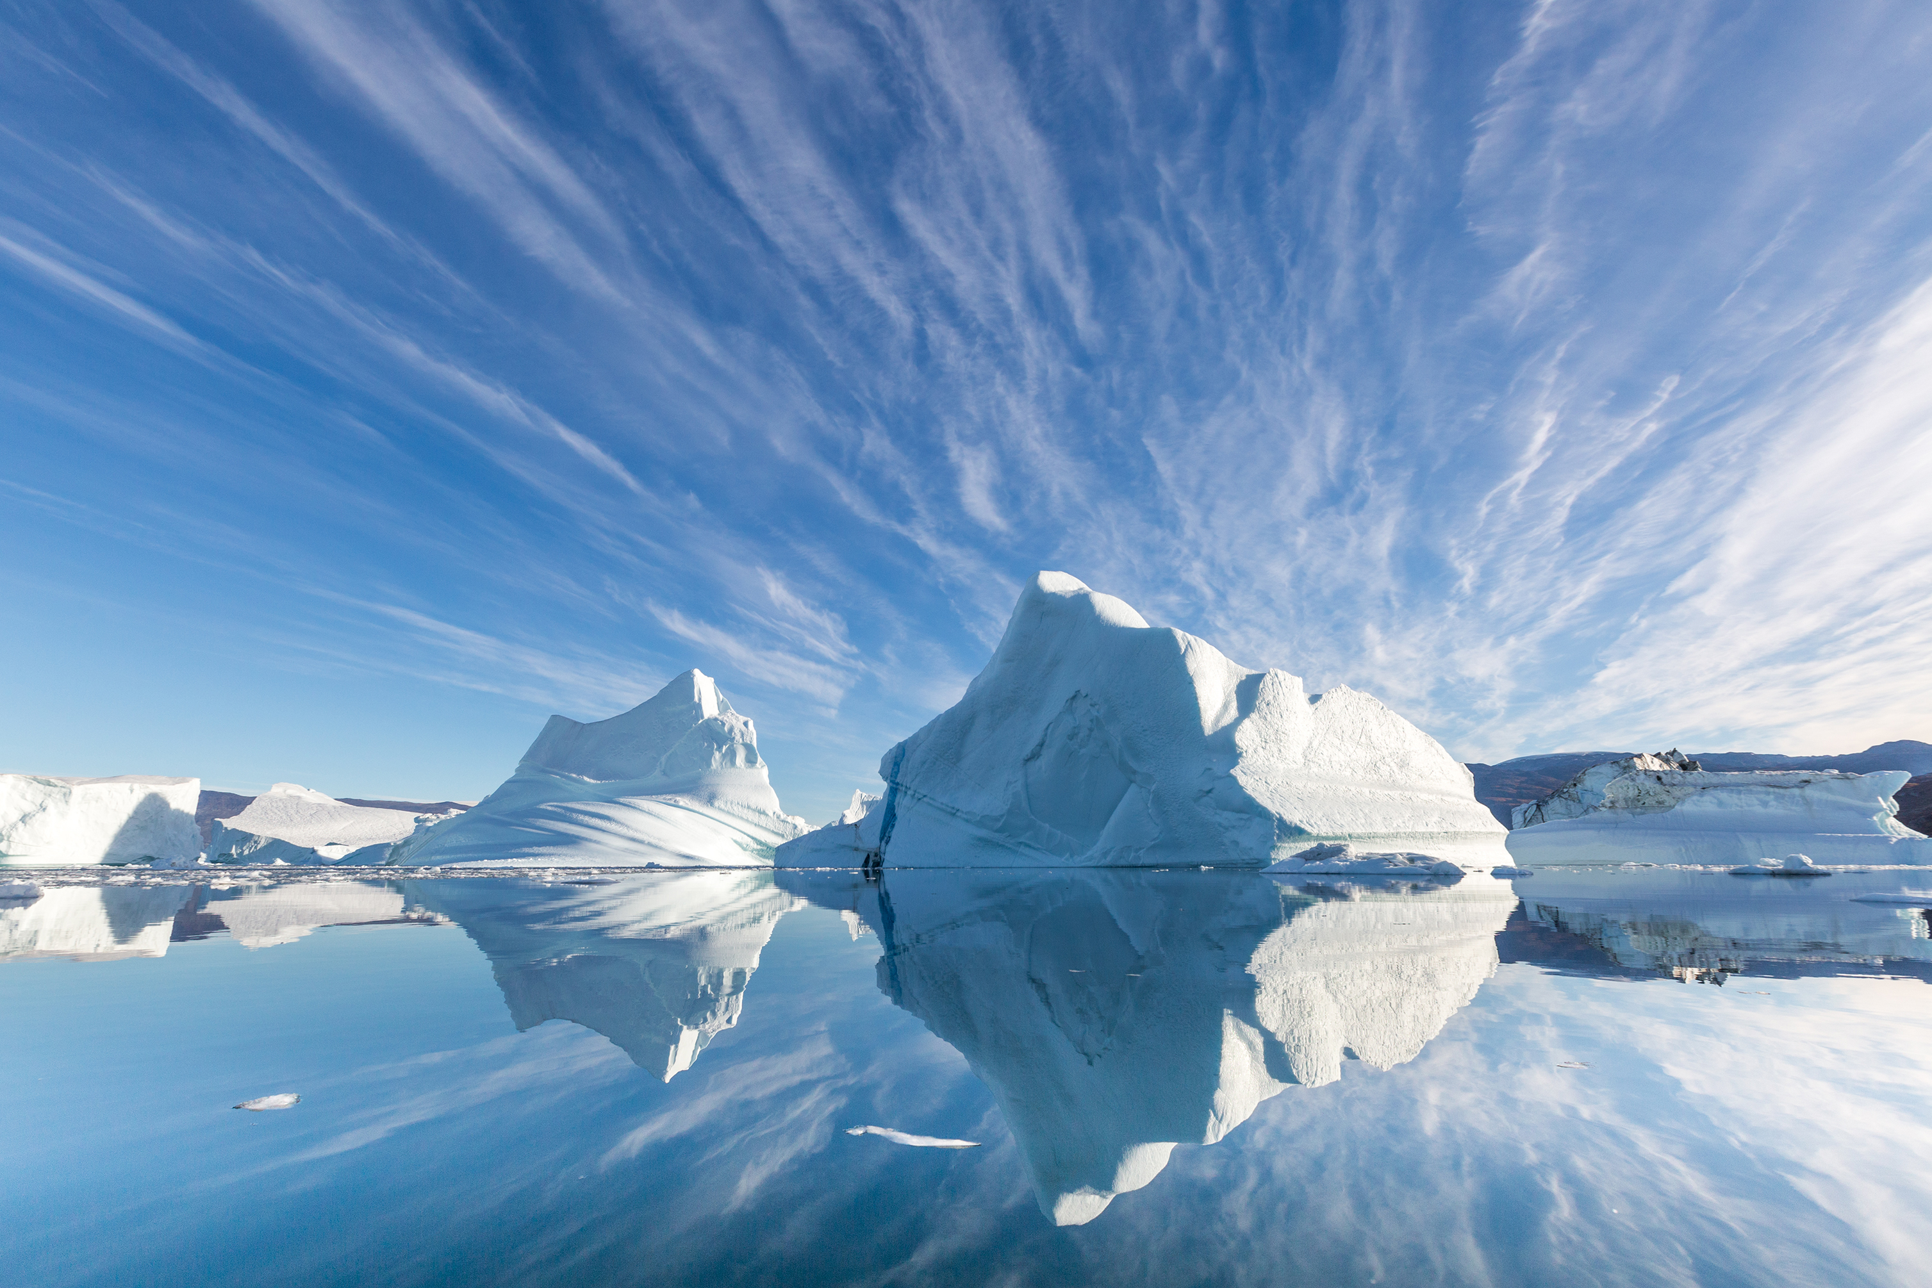

GALE IN CONTEXT:
Opposing Viewpoints
Arctic Escape Room

Slide 2
TABLE OF CONTENTS
1 | Cover
2 | Table of Contents
3 | Escape Room Instructions and Tips
3-4 | Task Instructions and Arrangements
5 | Resource Access
6 | Printing Suggestions
7 | Group Answer Sheet
8 | Group Answer Sheet – TEACHER KEY
9-14 | Individual Task Answer Keys
15-17 | Description Cards for Stations or Folders
18 | Task 1: The Arctic
19 | Task 1: True-False Activity
20 | Task 2: The Arctic Council
21 | Task 2: Tarsia Puzzle (cut-and-sort)
22 | Task 3: Arctic National Wildlife Refuge Drilling
23 | Task 3: Multiple-Choice Questions (cut-and-sort)
24 | Task 3: Maze Activity
25 | Task 4: Economic Opportunity
26 | Task 4: Matching Activity (ruler recommended)
27 | Task 5: Indigenous Activists
28 | Task 5: Polybius Square Cipher
29 | Task 5: Polybius Square Cipher Questions
30 | Task 6: Harsh Economics
31 | Task 6: Paragraph Identification Activity
32 | Citation Information
2

Slide 3
INSTRUCTIONS
BEFORE
Print and organize all necessary materials (see Printing Suggestions). Some stations consist of cut-and-sort activities. You can choose to have students cut these as they progress and then sort, or you can have them cut and placed in envelopes or folders before they begin. Having them prepped beforehand is best practice.
Tasks can be set up as stations or as completion tasks where groups remain in one location. In either setup, it is important to have materials prepared that equal the number of groups. Having a folder/envelope for each task is best practice.
Gale resources should be accessed through the Gale In Context: Opposing Viewpoints database. (See Resource Access page).
DURING
Print Answer Key and have it on hand to answer questions and aid as needed. Walk around the room and assist groups when necessary. Each time a group finishes a task, check their code to approve them to go onto the next one.
AFTER
Review reading material with students. This activity works well as an introduction to the topic, or as a culminating activity at the end of a unit. Students can reflect about what they learned during the activity with reflection writing or use what they learned as a starting point for a deeper research project.
TASK 1: The Arctic
Instructions: Students will read the assigned Gale resource and learn about the Arctic. Students will complete the true-false activity that accompanies the article. Students will add together all the TRUE numbers at the end to reveal their code. See pg. 9 for an answer key.
Arrangements: Students will need a copy of the true-false activity that they can write on, or you can have them use a note sheet. Consider laminating the page for continued use.
TASK 2: The Arctic Council
Instructions: Students will view the assigned Gale article on the Arctic Council. Students will then complete the Tarsia puzzle by connecting the sides of each triangle to their corresponding question. They will end with a large triangle shape. Their code is a quote, which will be visible once you complete the puzzle. See pg. 10 for an answer key.
Arrangements: The activity for this is a cut-and-sort activity. You can have students cut them and then sort or have them precut and stored in an envelope or bag.
3

Slide 4
TASK 3: Arctic National Wildlife Refuge Drilling
Instructions: Students will read the assigned Gale resource and learn about ANWR Drilling. Students will answer the corresponding multiple-choice questions. On the corresponding maze, they will color the answers, beginning at the START point. All answers will connect. The number ended on will reveal the code. See pg. 11 for an answer key.
Arrangements: The questions for this task are a cut-and-sort activity. You can have students cut them and then sort or have them precut and stored in an envelope or bag. Students will need a copy of the maze that they can write on. Consider laminating the page for continued use.
TASK 4: Economic Opportunity
Instructions: Students will read the assigned Gale resource and learn about Economic Opportunity in the Arctic. They will then match each question to the correct answer. It is recommended that students use a ruler for straight lines on the matching assignment. The letters that do not have a line through them at the end reveal the code, which is permafrost. Straight lines are essential. See pg. 12 for an answer key.
Arrangements: This is a single answer sheet, so one sheet per group is recommended with students working together and assigning roles. For this one, it is recommended that one student use the ruler to match correct options to ensure lines are straight..
TASK 5: Indigenous Activists
Instructions: Students will read the assigned Gale resource and learn about Indigenous Activists. After reading the document, students will decode the correct answers using the Polybius cipher. Each letter is represented by a section of the cipher. The cipher can be found on pg.28 . See pg. 13 for an answer key.
Arrangements: It is recommended that you print a cipher for each student so that all students in the group can work together to decode.
TASK 6: Harsh Economics
Instructions: Students will read the assigned Gale resource and learn about the harsh economics of the Arctic. After reading the document, students will determine which excerpt comes from which paragraph of the text. Students will take the numbers of each unused paragraph and add them together. The total is the code. See pg. 14 for an answer key.
Arrangements: It is recommended that you print a cipher for each student so that all students in the group can work together to decode.
4

Slide 5






RESOURCE ACCESS
The best way to have students access task articles is to have them visit Gale In Context: Opposing Viewpoints and then open the links for each task using the links or QR codes below. They must open Gale In Context: Opposing Viewpoints prior to accessing the links below.
Task 1: The Arctic | https://link.gale.com/apps/doc/OIKMCI260550482/OVIC
Task 2: The Arctic Council | https://link.gale.com/apps/doc/LVSSNF573541020/OVIC
Task 3: Arctic National Wildlife Refuge Drilling | https://link.gale.com/apps/doc/PC3010999229/OVIC
Task 4: The Arctic: Climate Change's Great Economic Opportunity | https://link.gale.com/apps/doc/A824546796/OVIC
Task 5: For Indigenous Activists, the Arctic Refuge Is Sacred | https://link.gale.com/apps/doc/ZJVEXT090000913/OVIC
Task 6: The Harsh Economics Of The Arctic | https://link.gale.com/apps/doc/A820535251/OVIC
TASK1 | TASK 2 | TASK 3
TASK 4 | TASK 5 | TASK 6
5
Notes:
Students must access Gale In Context: Opposing Viewpoints PRIOR to opening the links or scanning QR codes.

Slide 6
PRINTING SUGGESTIONS
Pages 7 | One answer sheet per group
Pages 8-14 | Answer Keys – TEACHER USE
Pages 15-17 | Description Cards for Stations or Folders (optional)
Page 18 | Task 1 Direction Cards (2 per page)
Page 19 | Task 1 True-False Activity
Page 20 | Task 2 Directions Cards (2 per page)
Page 21 | Task 2 Tarsia Puzzle (cut-and-sort)
Page 22 | Task 3 Direction Cards (2 per page)
Page 23 | Task 3 Multiple-Choice Questions (cut-and-sort)
Page 24 | Task 3 Maze Activity
Page 25 | Task 4 Direction Cards (2 per page)
Page 26 | Task 4 Matching Activity
Page 27 | Task 5 Direction Cards (2 per page)
Page 28 | Task 5 Polybius Cipher
Page 29 | Task 5 Polybius Cipher Questions
Page 30 | Task 6 Direction Cards (2 per page)
Page 31 | Task 6 Paragraph Identification Activity
6

Slide 7


GROUP ANSWER SHEET
Gale In Context: Opposing Viewpoints
The Arctic
Escape Room
Group Members:
TASK 1
CODE NUMBER: _________________
TASK 2
SECRET QUOTE: “_________________________________________________________________
__________________________________________________________________________________________________________________________________.”
TASK 3
CODE NUMBER: _________________
TASK 4
CODEWORD:_____________________
Hint: Top to bottom!
TASK 5
CODE: _________________
TASK 6
CODE NUMBER: _________________
YOU
ESCAPED!
7

Slide 8
GROUP ANSWER KEY
Gale In Context: Opposing Viewpoints
The Arctic
Escape Room
Group Members:
Group Members:
TASK 1
CODE NUMBER:
146
TASK 2
SECRET QUOTE: “Cold, remote and ecologically fragile, the Arctic requires sustainable protection”.
TASK 3
CODE NUMBER:
733
TASK 4
CODEWORD: PERMAFROST
Hint: Top to bottom!
TASK 5
I | M | M | E | M | O | R | I | A | L
S | A | C | R | E | D
W | E | L | L | N | E | S | S
C | O | A | S | T | A | L
B | I | O | D | I | V | E | R | S | I | T | Y
CODE: MRSTD
TASK 6
CODE NUMBER:
89
YOU
ESCAPED!
8

Slide 9

TASK 1
ANSWER KEY
A 107 | The melting of glaciers has made it possible for fishing boats, cruise ships, and other sea craft to navigate deeper into the Arctic and allowed international companies to take advantage of new shipping routes, particularly the Suez Canal, the sea route along the northern coast of North America through the Arctic Ocean that connects the Atlantic and Pacific Oceans.
B 76 | Military buildup in the region by Russia, China, and others poses a threat to US security interests. Any expansion of the US military in the region, however, could also be interpreted as a provocation and contribute to geopolitical hostilities.
C 32 | Much of the land in the Arctic spends a significant portion of the year under ice and snow, while some land is covered by permafrost, which refers to soil and water frozen for hundreds of thousands of years.
D 36 | In addition to the United States, the territories of seven other countries extend into the Arctic. These nations include Canada, Finland, Iceland, Norway, Russia, Sweden, and China.
E 3 | The Arctic remains home to many Indigenous communities, such as the Saami in Scandinavia, the Nenets in Russia, and the Inuit in Alaska, Canada, and Greenland.
F 12 | With the help of Indigenous guides, Frederick Cook and Robert Peary made separate expeditions in 1908 and 1909 respectively, becoming the first Americans to report arriving at the North Pole.
G 48 | The region contains over 35 percent of the world's freshwater, and the ice in the Arctic Ocean basin has a strong effect on global temperatures.
H 7 | The Arctic is home to large deposits of oil, natural gas, and coal as well as rare earth metals, such as neodymium, praseodymium, terbium, and dysprosium. These metals are essential for many emerging technologies related to clean energy, particularly wind turbines and electric vehicle batteries.
I 16 | Russia has devoted considerable resources in the twenty-first century to reopening Soviet-era military bases in the Arctic and modernizing its defensive and offensive capacities in the region.
J 97 | President Donald Trump has repeatedly expressed interest in the United States gaining control over Iceland, citing national security reasons. Previous presidents who sought to claim Iceland for the United States include Andrew Jackson and Harry S. Truman.
TOTAL: 146
9

Slide 10
TASK 2
ANSWER KEY
SECRET PHRASE :
"Cold, remote, and ecologically fragile, the Arctic requires sustainable protection."
requires
the Arctic
Who was active in the Artic for thousands of years?
Small Indigenous communities
What org. was created for intergovernmental cooperation?
What monitors Arctic environmental conditions?
Arctic Council
Arctic Monitoring & Assessment Programme (AMAP)
sustainable
fragile,
What does the 2013 Arctic Council agreement focus on?
Which Artic Council group focuses on flora and fauna?
Pollution
CAFF
“Cold,
What is the Arctic Council’s goal for development?
The Arctic Sea ice melt has opened up what?
Increased militarization in the Arctic
Arctic Region
The ______ provides 10% of the world’s oil and 25% natural gas.
protection.”
New international shipping routes
Sustainability
Russia and China’s potential aggression has led to what?
ecologically
remote,
and
10

Slide 11
TASK 3
ANSWER KEY
O
V
P
M
R
483
115
N
J
K
N
P
T
K
H
L
Q
R
U
M
G
I
J
T
V
H
D
F
S
X
Y
672
508
E
B
C
A
O
Z
H
C
B
D
H
J
I
START
A
D
E
G
D
E
H
J
Answers
B
D
I
L
N
Q
T
X
A
D
G
J
K
K
H
E
K
I
I
L
733
247
M
11

Slide 12
TASK 4
ANSWER KEY
The Arctic is warming ________ times faster than the world at large. | • |  | • | 2030
The volume of ice in the Arctic has fallen by ________% or more since the 1980s. | • |  | • | fish
The Arctic's first ice-free day may occur before ________. | • |  | • | Baffin Bay
Melting ice in the Arctic could create shipping ________. | • |  | • | 4
Warming waters in the Arctic may attract hordes of ________. | • |  | • | 70
The Arctic's melting ice has sparked a rush of ________ and miners. | • |  | • | natural
The North-West Passage (NWP) runs along the North American Arctic coastline, from the Beaufort Sea to ________. | • |  | • | shortcuts
The Transpolar Sea Route (TSR) runs over the ________. | • |  | • | 2005
The NSR has been open to ice-resistant ships in the summer almost every year since ________. | • |  | • | diplomats
The Arctic is thought to hold 13% of the world's undiscovered oil and 30% of untapped ________ gas. | • |  | • | North Pole
P
E
O
W
R
M
E
H
A
C
F
L
R
N
S
O
A
S
F
R
T
Code: PERMAFROST
12

Slide 13





TASK 5
POLYBIUS SQUARE
QUESTIONS
Arctic Indigenous peoples have stewarded the Arctic National Wildlife Refuge since time ___immemorial_____.
Indigenous Land Protectors lead efforts to defend ____sacred____ lands.
Alaska Natives must fight their own government-mandated Native corporations to defend their culture and the ____wellness____ of their communities.
The Bureau of Land Management has issued a call for nominations for oil leasing tracts on the ____coastal____ plain.
We know that Indigenous land management is key to long-term ecological health: current Indigenous land stewardship accounts for 80 percent of the world's remaining _______biodiversity_______.
4
3
3
5
3
5
3
4
1
2
4
1
3
3
5
4
3
5
2
2
4
5
4
4
3
5
1
4
5
1
2
2
4
5
4
4
2
5
3
4
4
5
5
13

Slide 14
TASK 6
ANSWER KEY
PARAGRAPH NUMBER | EXCERPT
11 | The sun sets on Mary River at the end of November, and does not rise until the end of January, when temperatures fall to minus 60°C.
17 | They bring their own kit, and can make $300,000 for a long season.
5 | Billion-year-old solidified magma chambers under Greenland contain not only the West's biggest deposit of rare earths but also the northern hemisphere's biggest stores of nickel and cobalt, essential for batteries.
10 | Housing must often be designed so that living quarters are warm but the foundations are cool, so as not to melt the permafrost
3 | Its seas and tundra contain oil, gas and a host of minerals critical for green energy and modern armies.
19 | In Whitehorse, the capital of Canada's Yukon province, property prices have soared as outsiders pour in.
7 | A blue-collar worker in the North American Arctic can expect to earn five times the average wage in Vancouver, according to Dalhousie University.
14 | Canadian Arctic construction workers are a third less effective than their counterparts down south, found a study in 2023 from the University of Western Australia.
2 | In November, when The Economist visited, the camp was snatching three hours of watery sun a day.
20 | There is an old Greenlandic saying: "We do not care if they find anything, as long as they keep looking."
9 | Early Arctic explorers routinely died of frostbite or scurvy, or were reduced to eating their own boots.
4 | Between 2013 and 2019, summer ice receded by 17% and shipping increased by 75%.
Unused paragraphs: __1__ __6__ __8__ __12__ __13__ __15__ __16__ __18__
TOTAL: 89
14

Slide 15
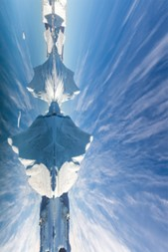


TASK 1
TASK 1
Use the Task 1 resources to complete your task and crack the code! Be sure to record answers on our group answer sheet.
Use the Task 1 resources to complete your task and crack the code! Be sure to record answers on our group answer sheet.
The Arctic
The Arctic
- - - - - - - - - - - - - - - - - - - - - - - - - - - - - - - - - - - - - - - - - - - - - - - - - - - - - - - - - - - - - - - - - - - - - - - - - -
- - - - - - - - - - - - - - - - - - - - - - - - - - - - - - - - - - - - - - - - - - - - - - - - - - - - - - -
TASK 2
TASK 2
Use the Task 2 resources to complete your task and crack the code! Be sure to record answers on our group answer sheet.
Use the Task 2 resources to complete your task and crack the code! Be sure to record answers on our group answer sheet.
The Arctic Council
The Arctic Council
15

Slide 16
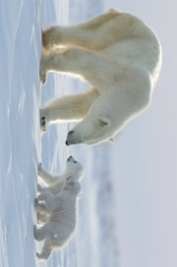
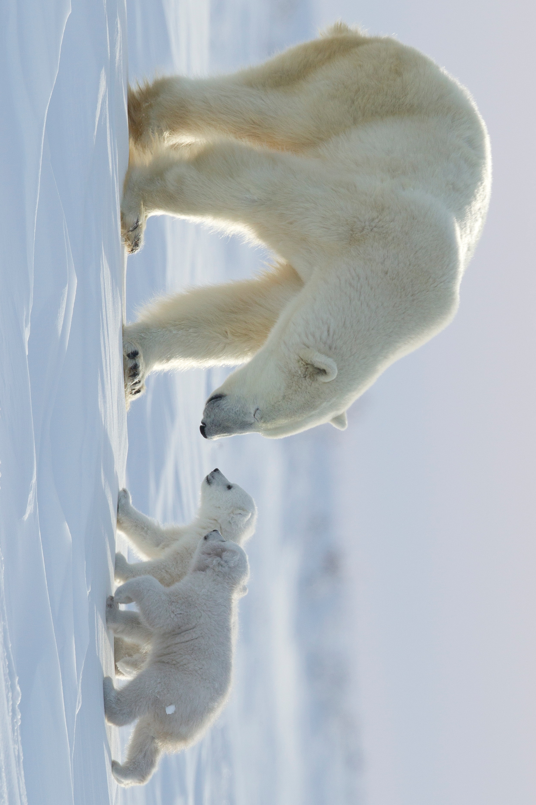


TASK 3
TASK 3
Use the Task 3 resources to complete your task and crack the code! Be sure to record answers on our group answer sheet.
Use the Task 3 resources to complete your task and crack the code! Be sure to record answers on our group answer sheet.
Arctic National Wildlife Refuge Drilling
Arctic National Wildlife Refuge Drilling
- - - - - - - - - - - - - - - - - - - - - - - - - - - - - - - - - - - - - - - - - - - - - - - - - - - - - - - - - - - - - - - - - - - - - - - - - -
- - - - - - - - - - - - - - - - - - - - - - - - - - - - - - - - - - - - - - - - - - - - - - - - - - - - - - -
TASK 4
TASK 4
Use the Task 4 resources to complete your task and crack the code! Be sure to record answers on our group answer sheet.
Use the Task 4 resources to complete your task and crack the code! Be sure to record answers on our group answer sheet.
Economic Opportunity
Economic Opportunity
16

Slide 17
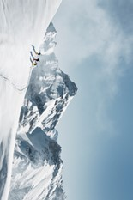
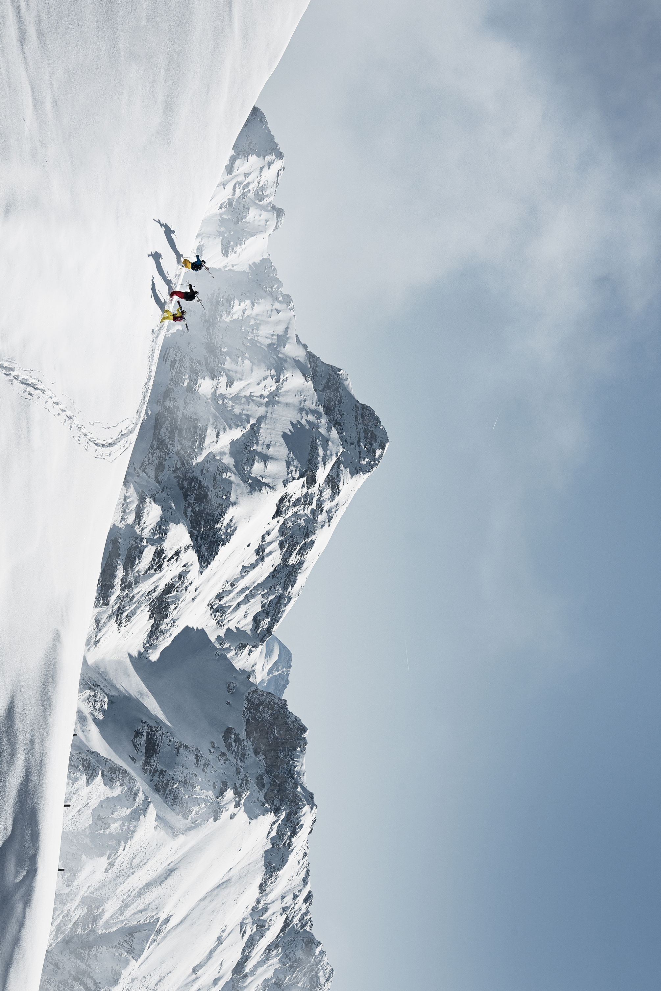
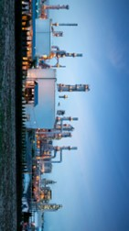
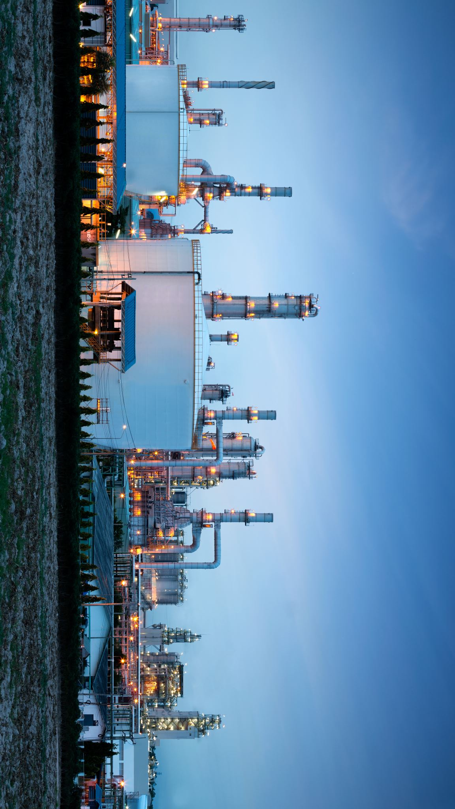
TASK 5
TASK 5
- - - - - - - - - - - - - - - - - - - - - - - - - - - - - - - - - - - -
Use the Task 5 resources to complete your task and crack the code! Be sure to record answers on our group answer sheet.
Use the Task 5 resources to complete your task and crack the code! Be sure to record answers on our group answer sheet.
Indigenous Activists
Indigenous Activists
- - - - - - - - - - - - - - - - - - - - - - - - - - - - - - - - - - - - - - - - - - - - - - - - - - - - - - - - - - - - - - - - - - - - - - - - - -
- - - - - - - - - - - - - - - - - - - - - - - - - - - - - - - - - - - - - - - - - - - - - - - - - - - - - - -
TASK 6
TASK 6
Use the Task 4 resources to complete your task and crack the code! Be sure to record answers on our group answer sheet.
Use the Task 4 resources to complete your task and crack the code! Be sure to record answers on our group answer sheet.
Harsh
Economics
Harsh
Economics
17

Slide 18
TASK 1
THE ARCTIC
Despite humanity's long interest in exploring the Arctic, its geography, remoteness, dangerous terrain, and severe weather have made exploration and development of the region a challenge. The region is home to several Indigenous communities, includes the territory of several countries, and contains one of the planet's most unique and fragile ecosystems. While knowledge about the Arctic remains limited, its economic potential has attracted interest from many countries, including the United States. In addition to shipping and fishing opportunities, the Arctic contains untapped reserves of oil, natural gas, and rare earth minerals.
Directions: Read the assigned resource on the topic of the Arctic in Gale In Context: Opposing Viewpoints. Using the information from the reading, mark whether each question is true or false. If the statement is TRUE, circle the corresponding amount. If the statement is false, draw an X through the corresponding amount. Add the total TRUE amounts to reveal your code. Record the code on group answer sheet and get approval before moving on to task 2.
- - - - - - - - - - - - - - - - - - - - - - - - - - - - - - - - - - - - - - - - - - - - - - - - - - - - - - -
TASK 1
THE ARCTIC
Despite humanity's long interest in exploring the Arctic, its geography, remoteness, dangerous terrain, and severe weather have made exploration and development of the region a challenge. The region is home to several Indigenous communities, includes the territory of several countries, and contains one of the planet's most unique and fragile ecosystems. While knowledge about the Arctic remains limited, its economic potential has attracted interest from many countries, including the United States. In addition to shipping and fishing opportunities, the Arctic contains untapped reserves of oil, natural gas, and rare earth minerals.
Directions: Read the assigned resource on the topic of the Arctic in Gale In Context: Opposing Viewpoints. Using the information from the reading, mark whether each question is true or false. If the statement is TRUE, circle the corresponding amount. If the statement is FALSE, draw an X through the corresponding amount. Add the total TRUE amounts to reveal your code. Record the code on group answer sheet and get approval before moving on to task 2.
18

Slide 19
TASK 1
TRUE FALSE
If the statement is TRUE, circle the corresponding amount. If the statement is FALSE, draw an X through the corresponding amount. Add the total TRUE amounts to reveal your code.
A 107 | The melting of glaciers has made it possible for fishing boats, cruise ships, and other sea craft to navigate deeper into the Arctic and allowed international companies to take advantage of new shipping routes, particularly the Suez Canal, the sea route along the northern coast of North America through the Arctic Ocean that connects the Atlantic and Pacific Oceans.
B 76 | Military buildup in the region by Russia, China, and others poses a threat to US security interests. Any expansion of the US military in the region, however, could also be interpreted as a provocation and contribute to geopolitical hostilities.
C 32 | Much of the land in the Arctic spends a significant portion of the year under ice and snow, while some land is covered by permafrost, which refers to soil and water frozen for hundreds of thousands of years.
D 36 | In addition to the United States, the territories of seven other countries extend into the Arctic. These nations include Canada, Finland, Iceland, Norway, Russia, Sweden, and China.
E 3 | The Arctic remains home to many Indigenous communities, such as the Saami in Scandinavia, the Nenets in Russia, and the Inuit in Alaska, Canada, and Greenland.
F 12 | With the help of Indigenous guides, Frederick Cook and Robert Peary made separate expeditions in 1908 and 1909 respectively, becoming the first Americans to report arriving at the North Pole.
G 48 | The region contains over 35 percent of the world's freshwater, and the ice in the Arctic Ocean basin has a strong effect on global temperatures.
H 7 | The Arctic is home to large deposits of oil, natural gas, and coal as well as rare earth metals, such as neodymium, praseodymium, terbium, and dysprosium. These metals are essential for many emerging technologies related to clean energy, particularly wind turbines and electric vehicle batteries.
I 16 | Russia has devoted considerable resources in the twenty-first century to reopening Soviet-era military bases in the Arctic and modernizing its defensive and offensive capacities in the region.
J 97 | President Donald Trump has repeatedly expressed interest in the United States gaining control over Iceland, citing national security reasons. Previous presidents who sought to claim Iceland for the United States include Andrew Jackson and Harry S. Truman.
TOTAL: _______________
19

Slide 20
TASK 2
THE ARCTIC COUNCIL
The Arctic Council is an intergovernmental organization focused on the Arctic region. Composed of eight Arctic states and six indigenous organizations, it serves as a platform for cooperation and dialogue. The Council was established in 1996 with the goal of promoting sustainable development and environmental protection in the Arctic. It addresses various issues such as climate change, biodiversity, and resource management. Through scientific research, policy development, and collaborative efforts, the Arctic Council plays a crucial role in shaping the future of the Arctic and ensuring the well-being of its communities and ecosystems.
Directions: Read the assigned article on the Arctic Council in Gale In Context: Opposing Viewpoints. Then complete the Tarsia puzzle by connecting the sides of each triangle to their corresponding question. You will end with a large triangle shape. Your code is a quote, which will be visible around the perimeter once you complete the puzzle. Record quote on the group answer sheet and get approval before moving on to task 3.
- - - - - - - - - - - - - - - - - - - - - - - - - - - - - - - - - - - - - - - - - - - - - - - - - - - - - - -
TASK 2
THE ARCTIC COUNCIL
The Arctic Council is an intergovernmental organization focused on the Arctic region. Composed of eight Arctic states and six indigenous organizations, it serves as a platform for cooperation and dialogue. The Council was established in 1996 with the goal of promoting sustainable development and environmental protection in the Arctic. It addresses various issues such as climate change, biodiversity, and resource management. Through scientific research, policy development, and collaborative efforts, the Arctic Council plays a crucial role in shaping the future of the Arctic and ensuring the well-being of its communities and ecosystems.
Directions: Read the assigned article on the Arctic Council in Gale In Context: Opposing Viewpoints. Then complete the Tarsia puzzle by connecting the sides of each triangle to their corresponding question. You will end with a large triangle shape. Your code is a quote, which will be visible around the perimeter once you complete the puzzle. Record quote on the group answer sheet and get approval before moving on to task 3.
20

Slide 21

Pollution
The Arctic Sea ice melt has opened up what?
What org. was created for intergovernmental cooperation?
requires
Arctic Region
the Arctic
sustainable
Who was active in the Artic for thousands of years?
What does the 2013 Arctic Council agreement focus on?
CAFF
What is the Arctic Council’s goal for development?
Increased militarization in the Arctic
Arctic Monitoring & Assessment Programme (AMAP)
New international shipping routes
fragile,
Russia and China’s potential aggression has led to what?
Which Artic Council group focuses on flora and fauna?
remote,
“Cold,
Small Indigenous communities
What monitors Arctic environmental conditions?
The ______ provides 10% of the world’s oil and 25% natural gas.
Arctic Council
Sustainability
protection.”
ecologically
and
21

Slide 22
TASK 3
ARCTIC NATIONAL WILDLIFE REFUGE DRILLING
The US Fish and Wildlife Service (USFWS) manages 19.64 million acres of territory in northeastern Alaska known as the Arctic National Wildlife Refuge (ANWR). This federally protected area has increased in size through several pieces of legislation since it was first established as the Arctic National Wildlife Range in 1960. The federal government seeks to balance the need to conserve the pristine wilderness and natural biodiversity of the region, to continue ongoing scientific research, and to protect the interests of the resident Indigenous populations with calls for land management strategies that include the exploration for and development of potential fossil fuel resources.
Directions: Read the assigned text from Gale In Context: Opposing Viewpoints titled, “Arctic National Wildlife Refuge Drilling”. Use what you learn to answer the corresponding multiple-choice questions. On the maze, shade in the box for each correct answer. Your answers should connect. The number you end on is you code for task 3. Get approval of correct code before moving on to task 4.
- - - - - - - - - - - - - - - - - - - - - - - - - - - - - - - - - - - - - - - - - - - - - - - - - - - - - - -
TASK 3
ARCTIC NATIONAL WILDLIFE REFUGE DRILLING
The US Fish and Wildlife Service (USFWS) manages 19.64 million acres of territory in northeastern Alaska known as the Arctic National Wildlife Refuge (ANWR). This federally protected area has increased in size through several pieces of legislation since it was first established as the Arctic National Wildlife Range in 1960. The federal government seeks to balance the need to conserve the pristine wilderness and natural biodiversity of the region, to continue ongoing scientific research, and to protect the interests of the resident Indigenous populations with calls for land management strategies that include the exploration for and development of potential fossil fuel resources.
Directions: Read the assigned text from Gale In Context: Opposing Viewpoints titled, “Arctic National Wildlife Refuge Drilling”. Use what you learn to answer the corresponding multiple-choice questions. On the maze, shade in the box for each correct answer. Your answers should connect. The number you end on is you code for task 3. Get approval of correct code before moving on to task 4.
22

Slide 23
1. What is the total size of the Arctic National Wildlife Refuge (ANWR)?
A) 8.9 million acres
B) 19.64 million acres
C) 1.5 million acres
8. Which president attempted to open the ANWR for drilling as part of the Energy Independence and Security Act?
V) Lyndon Johnson
W) Richard Nixon
X) George W. Bush
2. When was the Arctic National Wildlife Range first established?
D) 1960
E) 1971
F) 1980
9. What legislation authorized the sale of oil and gas leases in a portion of the 1002 Area of the ANWR?
Y) Energy Independence and Security Act
Z) Arctic Cultural and Coastal Plain Protection Act
A) Tax Cuts and Job Act
3. What legislation doubled the size of the Arctic National Wildlife Range and renamed it to the Arctic National Wildlife Refuge?
G) Public Land Order 2214
H) Alaska Native Claims Settlement Act
I) Alaska National Interest Lands Conservation Act
10. When was the Tax Cuts and Job Act, which authorized the sale of oil and gas leases in the ANWR, signed into law?
B) 1960
C) 1980
D) 2017
4. What is the name of the area within the ANWR that was the focus of an oil and gas assessment?
J) Arctic National Wildlife Range
K) Porcupine River caribou herd
L) 1002 Area
11. Who introduced the Arctic Cultural and Coastal Plain Protection Act to prohibit oil- and gas-related activity in the Coastal Plain of the ANWR?
E) Senator Lisa Murkowski
F) Congressman Don Young
G) Senator Ed Markey
5. Which group of people protested against opening the ANWR for drilling due to its spiritual importance?
M) Conservationists
N) Gwich'in tribes
O) Iñupiat
12. What did President Joe Biden's executive order in June 2021 do regarding oil and gas activity in the ANWR?
H) Finalized the sale of leases for nine tracts of land
I) Authorized the exploration for and development of potential fossil fuel resources
J) Paused all oil and gas activity and suspended leases
6. What is the name of the caribou herd that returns to the 1002 Area each summer?
P) Central Arctic
Q) Porcupine
R) Prudhoe Bay
7. What is the estimated range of technically recoverable oil in the 1002 Area according to the US Geological Survey (USGS)?
S) 4.8 billion to 29.4 billion barrels
T) 11.6 billion to 31.5 billion barrels
U) 92,160 acres
13. What act was passed in the House of Representatives in September 2019 to prohibit oil- and gas-related activity in the Coastal Plain of the ANWR?
K) Arctic Cultural and Coastal Plain Protection Act
L) Tax Cuts and Job Act
M) Arctic Refuge Protection Act
23

Slide 24
TASK 3
MAZE
Read the assigned text from Gale In Context: Opposing Viewpoints titled, “Arctic National Wildlife Refuge Drilling”. Use what you learn to answer the corresponding multiple-choice questions. Below, shade in the box for each correct answer. Your answers should connect. The number you end on is you code for task 3.
O
V
P
M
R
483
115
N
J
K
N
P
T
K
H
L
Q
R
U
M
G
I
J
T
V
H
D
F
S
X
Y
672
508
E
B
C
A
O
Z
H
C
B
D
H
J
I
START
A
D
E
G
D
E
H
J
K
H
E
K
I
I
L
733
247
M
24

Slide 25
TASK 4
ECONOMIC OPPORTUNITY
The Arctic, once a frozen and inaccessible region, is now experiencing the effects of climate change at an alarming rate. The melting ice and warming waters have opened up new economic opportunities in the region. The receding ice has created shipping shortcuts, allowing for faster and more cost-effective transportation routes between Asia, North America, and Europe. Additionally, the potential for resource extraction, including minerals and hydrocarbons, has attracted the attention of various industries. However, these opportunities come with significant challenges and risks. The delicate Arctic ecosystem and the cultural significance of the region to Indigenous communities must be taken into account. Finding a balance between economic development and environmental preservation is crucial to ensure the long-term sustainability of the Arctic and its unique resources.
Directions: Read the assigned text from Gale In Context: Opposing Viewpoints titled, “The Arctic: Climate Change's Great Economic Opportunity”. Correctly match each part of the question with its answer by drawing a line to connect them. At the end, the letters with no line through them will reveal your code. Tip – use a ruler to get extra straight lines! Record the answers on your group answer key. Get approval of correct code before moving on to task 5.
- - - - - - - - - - - - - - - - - - - - - - - - - - - - - - - - - - - - - - - - - - - - - - - - - - - - - - -
TASK 4
ECONOMIC OPPORTUNITY
The Arctic, once a frozen and inaccessible region, is now experiencing the effects of climate change at an alarming rate. The melting ice and warming waters have opened up new economic opportunities in the region. The receding ice has created shipping shortcuts, allowing for faster and more cost-effective transportation routes between Asia, North America, and Europe. Additionally, the potential for resource extraction, including minerals and hydrocarbons, has attracted the attention of various industries. However, these opportunities come with significant challenges and risks. The delicate Arctic ecosystem and the cultural significance of the region to Indigenous communities must be taken into account. Finding a balance between economic development and environmental preservation is crucial to ensure the long-term sustainability of the Arctic and its unique resources.
Directions: Read the assigned text from Gale In Context: Opposing Viewpoints titled, “The Arctic: Climate Change's Great Economic Opportunity”. Correctly match each part of the question with its answer by drawing a line to connect them. At the end, the letters with no line through them will reveal your code. Tip – use a ruler to get extra straight lines! Record the answers on your group answer key. Get approval of correct code before moving on to task 5.
25

Slide 26
TASK 4
ECONOMIC OPPORTUNITY
Correctly match each question with its answer by drawing a line to connect them (use the dots!). At the end, the letters with no line through them will reveal your code.
Tip – use a ruler to get extra straight lines!
The Arctic is warming ________ times faster than the world at large. | • |  | • | 2030
The volume of ice in the Arctic has fallen by ________% or more since the 1980s. | • |  | • | fish
The Arctic's first ice-free day may occur before ________. | • |  | • | Baffin Bay
Melting ice in the Arctic could create shipping ________. | • |  | • | 4
Warming waters in the Arctic may attract hordes of ________. | • |  | • | 70
The Arctic's melting ice has sparked a rush of ________ and miners. | • |  | • | natural
The North-West Passage (NWP) runs along the North American Arctic coastline, from the Beaufort Sea to ________. | • |  | • | shortcuts
The Transpolar Sea Route (TSR) runs over the ________. | • |  | • | 2005
The NSR has been open to ice-resistant ships in the summer almost every year since ________. | • |  | • | diplomats
The Arctic is thought to hold 13% of the world's undiscovered oil and 30% of untapped ________ gas. | • |  | • | North Pole
P
E
O
W
R
M
E
H
A
C
F
L
R
N
S
O
A
S
F
R
T
26

Slide 27
TASK 5
INDIGENOUS ACTIVISTS
Arctic Indigenous peoples' ways of life depend on this land, which both Gwich'in and Iñupiat peoples have stewarded since time immemorial. But these longstanding sacred relationships are now at risk due to the overwhelming push for ownership and extraction in recent decades of Arctic history.
Directions: Read the assigned article “For Indigenous Activists, the Arctic Refuge Is Sacred” in Gale In Context: Opposing Viewpoints. Use the Polybius Cipher to decode the answers to the corresponding questions. Record your answers on your group answer sheet. Shaded boxes will reveal your code. Get approval of correct code before moving on to task 6.
- - - - - - - - - - - - - - - - - - - - - - - - - - - - - - - - - - - - - - - - - - - - - - - - - - - - - - -
TASK 5
INDIGENOUS ACTIVISTS
Arctic Indigenous peoples' ways of life depend on this land, which both Gwich'in and Iñupiat peoples have stewarded since time immemorial. But these longstanding sacred relationships are now at risk due to the overwhelming push for ownership and extraction in recent decades of Arctic history.
Directions: Read the assigned article “For Indigenous Activists, the Arctic Refuge Is Sacred” in Gale In Context: Opposing Viewpoints. Use the Polybius Cipher to decode the answers to the corresponding questions. Record your answers on your group answer sheet. Shaded boxes will reveal your code. Get approval of correct code before moving on to task 6.
27

Slide 28
TASK 5
POLYBIUS SQUARE
1
2
3
4
5
A | B | C | D | E
F | G | H | I | J
K | L | M | N | O
P | Q | R | S | T
U | V | W | X
Y
Z
EXAMPLE:
4
5
1
= SEA
28

Slide 29
TASK 5
POLYBIUS SQUARE
QUESTIONS
Use the Polybius Cipher to decode the answers to the corresponding questions. Record your answers on your group answer sheet. Shaded boxes will reveal your code.
Arctic Indigenous peoples have stewarded the Arctic National Wildlife Refuge since time ________.
Indigenous Land Protectors lead efforts to defend ________ lands.
Alaska Natives must fight their own government-mandated Native corporations to defend their culture and the ________ of their communities.
The Bureau of Land Management has issued a call for nominations for oil leasing tracts on the ________ plain.
We know that Indigenous land management is key to long-term ecological health: current Indigenous land stewardship accounts for 80 percent of the world's remaining ______________.
4
3
3
5
3
5
3
4
1
2
4
1
3
3
5
4
3
5
2
2
4
5
4
4
3
5
1
4
5
1
2
2
4
5
4
4
2
5
3
4
4
5
5
29

Slide 30
TASK 6
HARSH ECONOMICS
The economics of the Arctic are challenging due to extreme conditions, remote location, and high costs. Climate change adds further uncertainties. Economic activities require specialized resources, experienced personnel, and substantial investments. The viability and risks of projects must be carefully assessed. Sustainable approaches are crucial for long-term well-being.
Directions: Read the assigned article “The Harsh Economics of the Arctic” in Gale In Context: Opposing Viewpoints. Identify which statements come from which paragraph of the text. Add together all paragraph numbers that are not represented to reveal your code. Tip: Use Gale’s Highlights & Notes tool to label paragraph numbers! Record code on group answer sheet and get approval to escape!
- - - - - - - - - - - - - - - - - - - - - - - - - - - - - - - - - - - - - - - - - - - - - - - - - - - - - - -
TASK 6
HARSH ECONOMICS
The economics of the Arctic are challenging due to extreme conditions, remote location, and high costs. Climate change adds further uncertainties. Economic activities require specialized resources, experienced personnel, and substantial investments. The viability and risks of projects must be carefully assessed. Sustainable approaches are crucial for long-term well-being.
Directions: Read the assigned article “The Harsh Economics of the Arctic” in Gale In Context: Opposing Viewpoints. Identify which statements come from which paragraph of the text. Add together all paragraph numbers that are not represented to reveal your code. Tip: Use Gale’s Highlights & Notes tool to label paragraph numbers! Record code on group answer sheet and get approval to escape!
30

Slide 31
TASK 6
PARAGRAPH IDENTIFICATION
Number each paragraph of the assigned article, “The Harsh Economics of the Arctic”. Identify which paragraph each excerpt below is from. Determine which paragraphs were not used and add together each number. This is your final code to escape!
Tip: Use Gale’s Highlights & Notes tool to label paragraph numbers!
PARAGRAPH NUMBER | EXCERPT
 | The sun sets on Mary River at the end of November, and does not rise until the end of January, when temperatures fall to minus 60°C.
 | They bring their own kit, and can make $300,000 for a long season.
 | Billion-year-old solidified magma chambers under Greenland contain not only the West's biggest deposit of rare earths but also the northern hemisphere's biggest stores of nickel and cobalt, essential for batteries.
 | Housing must often be designed so that living quarters are warm but the foundations are cool, so as not to melt the permafrost
 | Its seas and tundra contain oil, gas and a host of minerals critical for green energy and modern armies.
 | In Whitehorse, the capital of Canada's Yukon province, property prices have soared as outsiders pour in.
 | A blue-collar worker in the North American Arctic can expect to earn five times the average wage in Vancouver, according to Dalhousie University.
 | Canadian Arctic construction workers are a third less effective than their counterparts down south, found a study in 2023 from the University of Western Australia.
 | In November, when The Economist visited, the camp was snatching three hours of watery sun a day.
 | There is an old Greenlandic saying: "We do not care if they find anything, as long as they keep looking."
 | Early Arctic explorers routinely died of frostbite or scurvy, or were reduced to eating their own boots.
 | Between 2013 and 2019, summer ice receded by 17% and shipping increased by 75%.
Unused paragraphs: ______ ______ ______ ______ ______ ______
TOTAL: _______
31

Slide 32
CITATION INFORMATION
TASK 1
"2025-2026 National Debate Topic (Arctic)." Gale Opposing Viewpoints Online Collection, Gale, 2025. Gale In Context: Opposing Viewpoints, l ink.gale.com/apps/doc/OIKMCI260550482/OVIC?u=[INSERTLOCID]&sid=bookm ark-OVIC&xid=42bf3b17. Accessed 17 Mar. 2025.
TASK 2
"International Cooperation in the Arctic." Gale Opposing Viewpoints Online Collection, Gale, 2025. Gale In Context: Opposing Viewpoints, link.gale.com/apps/doc/LVSSNF573541020/OVIC?u=[INSERT LOCID]&sid=bookmark-OVIC&xid=12d51ba0. Accessed 17 Mar. 2025.
TASK 3
"Arctic National Wildlife Refuge Drilling." Gale Opposing Viewpoints Online Collection, Gale, 2021. Gale In Context: Opposing Viewpoints, link.gale.com/apps/doc/PC3010999229/OVIC?u=[INSERTLOCID]&sid=bookmark- OVIC&xid=6323f688. Accessed 17 Mar. 2025.
TASK 4
"The Arctic: climate change's great economic opportunity." The Economist, 23 Jan. 2025. Gale In Context: Opposing Viewpoints, link.gale.com/apps/doc/A824546796/OVIC?u=[INSERTLOCID]&sid=bookmark- OVIC&xid=5636e708. Accessed 17 Mar. 2025.
TASK
5
Potts, Jody Juneby, and Emily Sullivan. "For Indigenous Activists, the Arctic Refuge Is Sacred." Gale Opposing Viewpoints Online Collection, Gale, 2025. Gale In Context: Opposing Viewpoints, link.gale.com/apps/doc/ZJVEXT090000913/OVIC?u=[INSERTLOCID]&sid=bookm ark-OVIC&xid=b08c9966. Accessed 17 Mar. 2025. Originally published as "The Arctic National Wildlife Refuge Is Not Just Public Land. It's Sacred Land," Truthout, 2 Dec. 2020.
TASK
6
"The harsh economics of the Arctic." The Economist, 19 Dec. 2024. Gale In Context: Opposing Viewpoints, link.gale.com/apps/doc/A820535251/OVIC?u=[INSERTLOCID&sid=bookmark- OVIC&xid=e9c2ad55. Accessed 17 Mar. 2025.
EXPLORE MORE!
Find more classroom resources and support materials at:
support.gale.com
32

